Slide 1

Phan Kinh Primary School
08-11
2023
Welcome to our English lesson
Teacher: Dương Thị Hoa Class: 3C

Slide 2
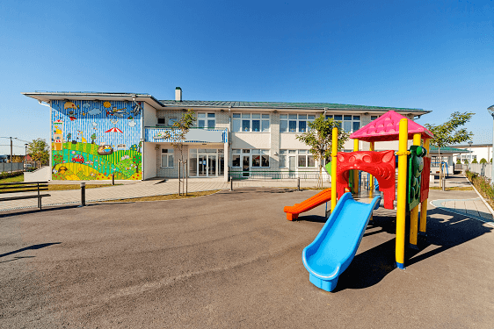
1
2
3
4
5
6
7
8
9
playground
Notes:
Click on a numbered square to make the square disappear.
Click on the image to reveal it. All the squares will disappear.

Slide 3
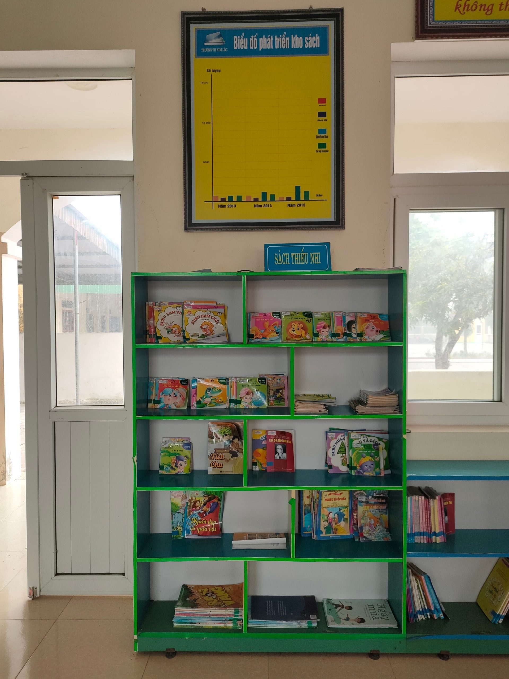
1
2
3
4
5
6
7
8
9
library

Slide 4
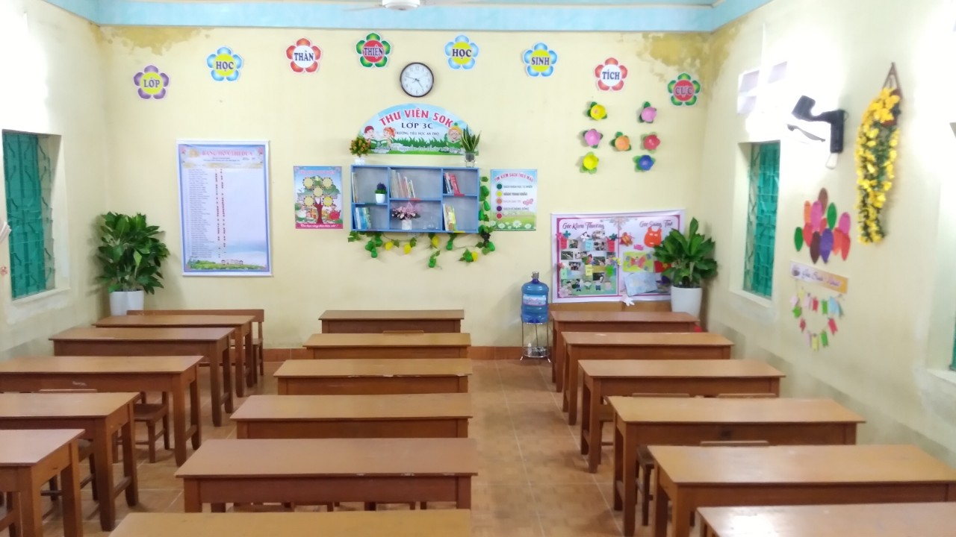
1
2
3
4
5
6
7
8
9
classroom

Slide 5
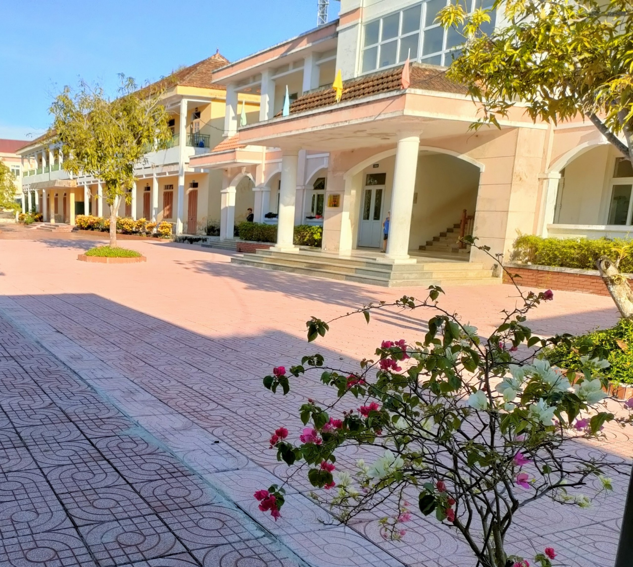
1
2
3
4
5
6
school
7
8
9

Slide 6




6
Our school
LESSON 2: 1, 2, 3.

Slide 7
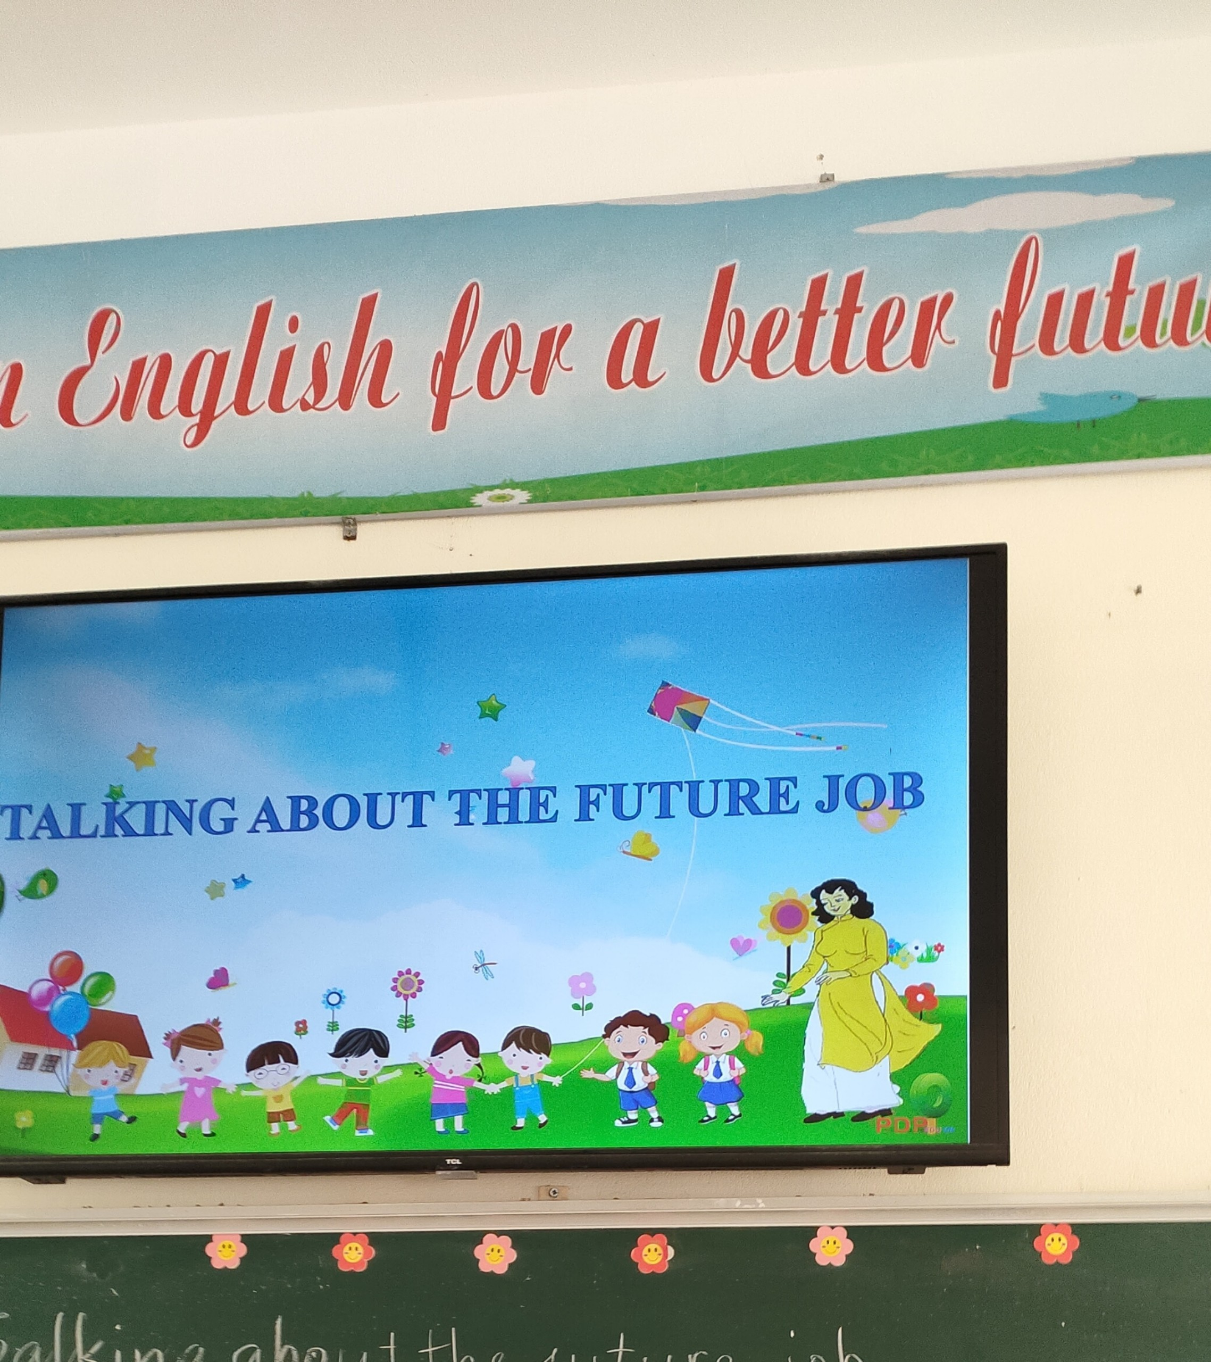

Slide 9
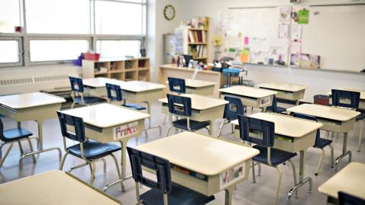


Let’s go to our classroom.
Ok, let’s go.

Slide 10

Let’s go to the library.
Ok, let’s go.

Slide 11
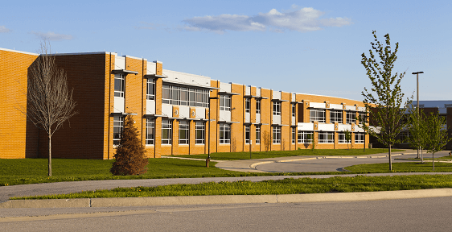
Let’s go to school.
Ok, let’s go.

Slide 12
Let’s go to the playground.
Ok, let’s go.

Slide 13

computer room

Slide 14
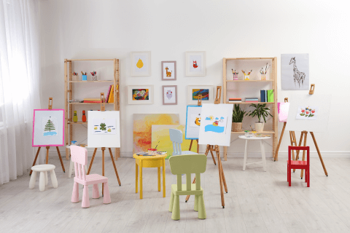
art room

Slide 15
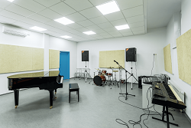
music room

Slide 16

gym

Slide 17
Look and guess.

Slide 18

1
2
3
4
5
6
7
8
9
music room
Notes:
Click on a numbered square to make the square disappear.
Click on the image to reveal it. All the squares will disappear.

Slide 19

1
2
3
4
5
computer room
6
Notes:
Click on a numbered square to make the square disappear.
Click on the image to reveal it. All the squares will disappear.

Slide 20

1
2
3
4
5
6
7
8
9
gym
Notes:
Click on a numbered square to make the square disappear.
Click on the image to reveal it. All the squares will disappear.

Slide 21

Listen, point and say.

Slide 22

Work in pairs. Practise.

Slide 23

Let’s talk.

Slide 25

Fun corner

Slide 26



Game time
1
2
3
4
5
6
7
8
Notes:
Divide the class into 2 teams.
The teams take turns to choose a lucky number, say the word and make a sentence with that word, using the sentence model.
Give points to the teams.

Slide 27

Let’s …………………
Ok, let’s go.

Slide 28

Let’s …………………
Ok, let’s go.

Slide 29

Let’s …………………
Ok, let’s go.

Slide 30

Let’s …………………
Ok, let’s go.

Slide 31


Let’s …………………
Ok, let’s go.

Slide 32
Let’s …………………
Ok, let’s go.

Slide 33


Let’s …………………
Ok, let’s go.

Slide 34


Let’s …………………
Ok, let’s go.

