Slide 1
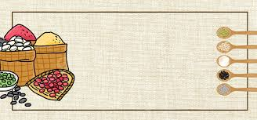

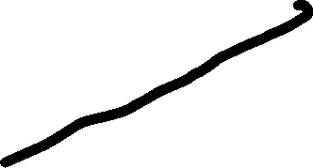
HELLO EVERYONE
Topic: Food and drink

Slide 2
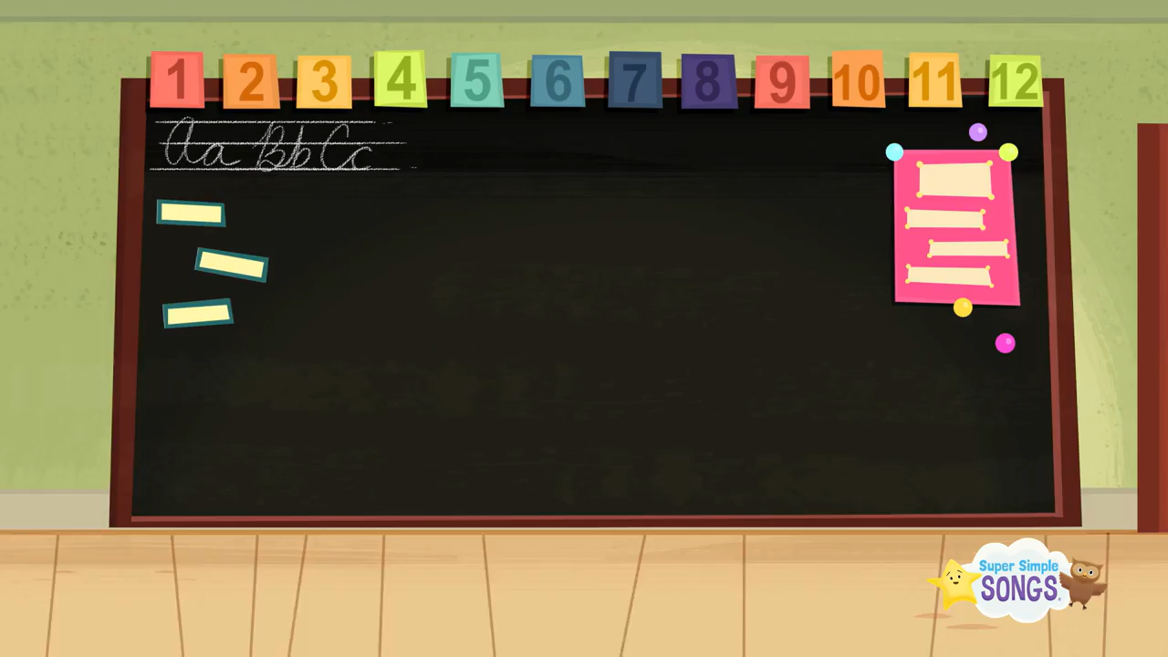

Slide 3

Classroom rules
Raise Your Hand
Be on time
Listen to your teacher
Come prepared new lesson
Work hard

Slide 4

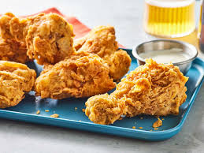
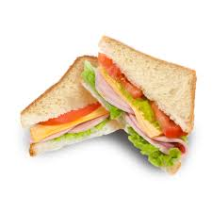
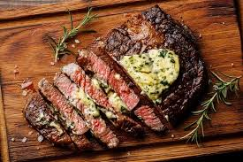
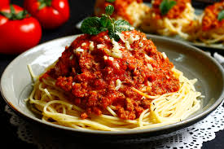
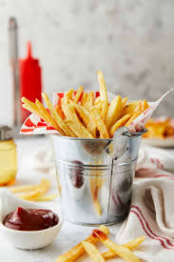
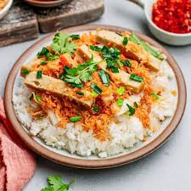
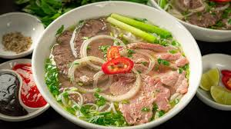
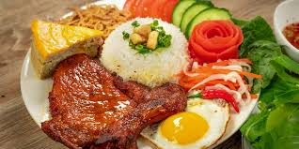
VOCABULARY about Food
Chicken
Sandwich
Beefsteak
Spaghetti
French fries
Sticky rice
Vietnamese noodle soup
Broken rice

Slide 5
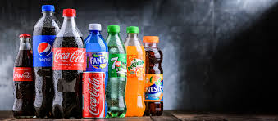
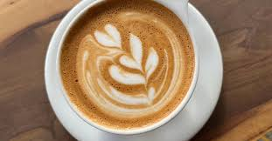
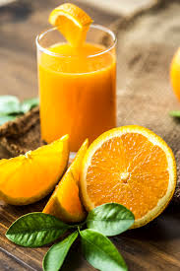
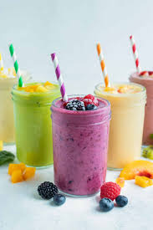
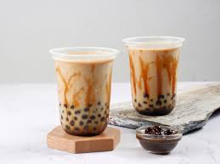
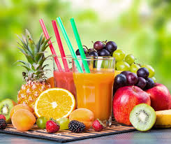
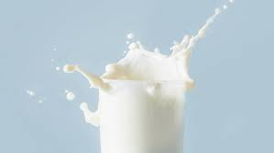
VOCABULARY about Drink
Soft drink
Coffee
Orange juice
Smoothie
Milk tea
Fruit juice
Milk

Slide 6
HOW TO ANSWER THESE QUESTION
What’s your favourite food?
My favorite food is + món ăn (Món ăn yêu thích của tôi là…)
Ví dụ: My favorite food is chicken. (Món ăn yêu thích của tôi là đùi gà rán.)
I love + món ăn. (Tôi thích món…)
Ví dụ: I love mac and cheese. (Tôi thích nui phô mai đút lò.)
I’m a big fan of + món ăn. (Tôi là một fan lớn của/Tôi mê mẩn món…)
Ví dụ: I’m a big fan of Spaghetti . (Tôi mê mẩn món thịt đùi lợn muối kiểu Tây Ban Nha.)

Slide 7
2. What would you like to eat?
I'd like + noun, please: Vui lòng cho tôi …
Ví dụ: I'd like an spaghetti, please. (Vui lòng cho tôi món mì Ý.)

Slide 8
Exercise 1. rearrange the sentences to make sense
1. your /favourite/ What /is / food/?
………………………………………………………………………
2. big / a / I’m / Spaghetti / of/ fan /.
……………………………………………………………………
3. like / I’d / spaghetti / a /,please/.
……………………………………………………………………
4. cheese / burger / love /and / I /.
……………………………………………………………………
5. food / chicken / My / is/ favorite /.
……………………………………………………………………

Slide 9
Exercise 2. Read and complete.
Dining drinks like some rice
Nam and his family are at the (1) ……………… table. There’s a lot of food and (2) …………. on the table. His father and mother would (3) ………….some rice, beans and some water. His sister would like (4) ………… bread, meat and some milk. Nam would like some (5) ………….., fish and some juice.

Slide 10
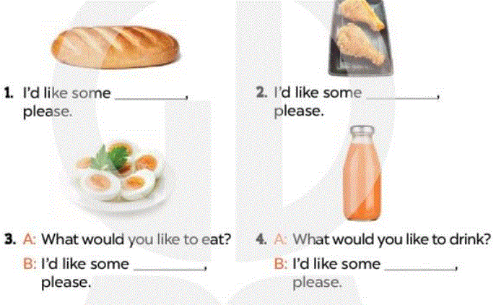
Exercise 3. Look and write

Slide 11

GOODBYE SONG
See you later, alligator
In the while, crocodile
Give a hug, ladybug
Blow a kiss, jellyfish.
See you soon, big baboon
Out the door, dinosaur
Take care, polar bear
Wave goodbye, butterfly.

Slide 12

HOMEWORK
Make a video of your favorite food

Slide 13
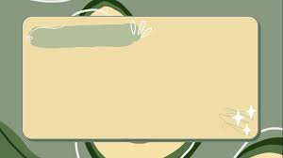


GOODBYE CLASS

