Slide 1


Slide 2
Extension
activities

Slide 3
I. OBJECTIVES.
By the end of the lesson, pupils will be able to:
1. Language.
- identify five different countries together with their flags and land shapes
- identify the different times in different countries
- identify some countries are near or far from Viet Nam
2. Core competencies.
- Communication and collaboration
3. General competencies.
- Listening: listen and number
- Critical thinking: read and match
- Oral communication: let’s play
- Self-control & independent learning: perform listening tasks
- Communication and collaboration: work in pairs or groups
- Sociability: talk to each other, say good words to others.
4. Attributes.
- Kindness: help partners to complete learning tasks
- Diligence: complete learning tasks
- Honesty: tell the truth about feelings and emotions

Slide 4
Warm-up

Slide 5
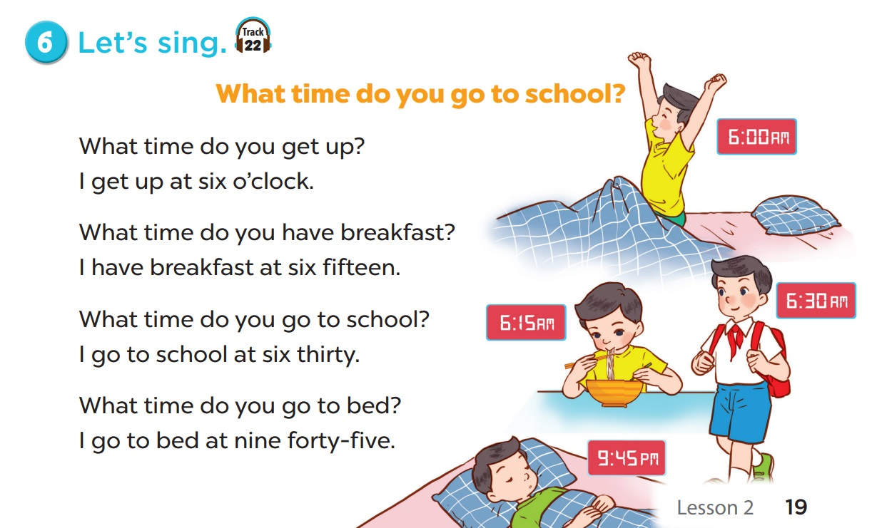

Notes:
Teacher may let pupils watch the animation video of the song and have them sing along.
https://www.youtube.com/watch?v=-GAWoPPtI8c&list=PL8_ETpRL2xNay3h-a-vBjWhplE1wXFpSJ&index=

Slide 6
1. Look and write.

Slide 7
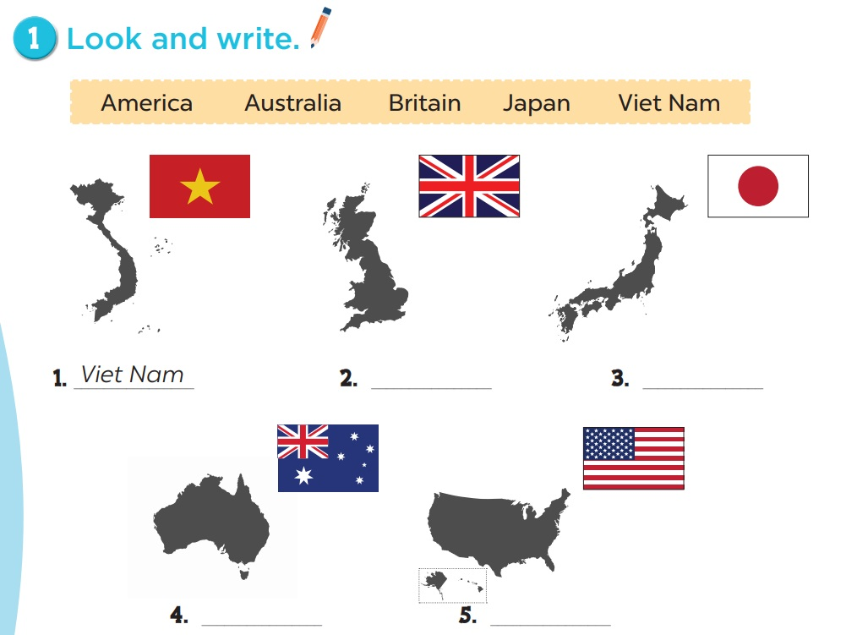
2. Britain
3. Japan
4. Australia
5. America

Slide 8
2. Look and write.

Slide 9
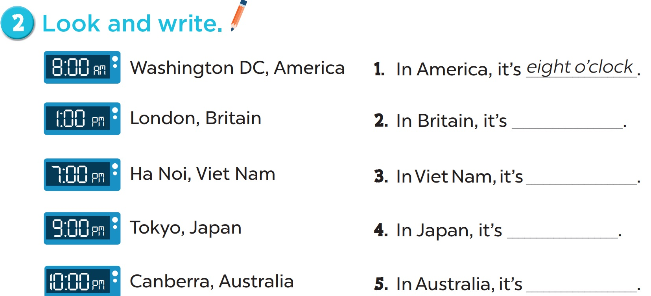
one o’clock
seven o’clock
nine o’clock
ten o’clock

Slide 10
3. Read the questions.
Then tick the answers.

Slide 11
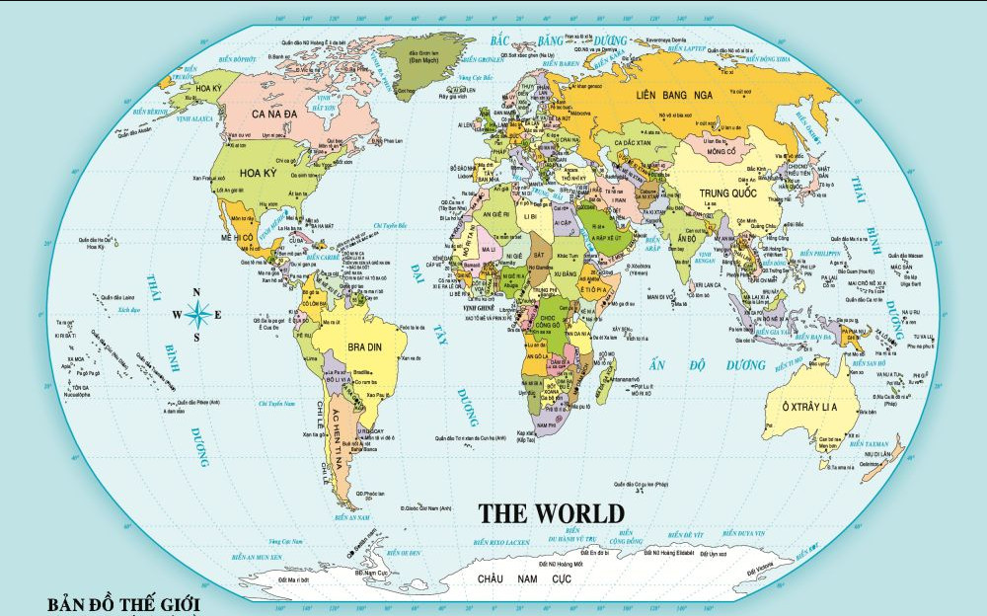
Where is Viet Nam?
Where is Viet Nam?
Where is USA?
Notes:
Ask pupils to look at the map and find the countries. Draw lines from countries to Viet Nam.

Slide 12
Where is Viet Nam?
Where is Russia?
Where is Viet Nam?
Notes:
Ask pupils to look at the map and find the countries. Draw lines from countries to Viet Nam.

Slide 13
Where is Viet Nam?
Where is Thailand?
Where is Viet Nam?
Notes:
Ask pupils to look at the map and find the countries. Draw lines from countries to Viet Nam.

Slide 14
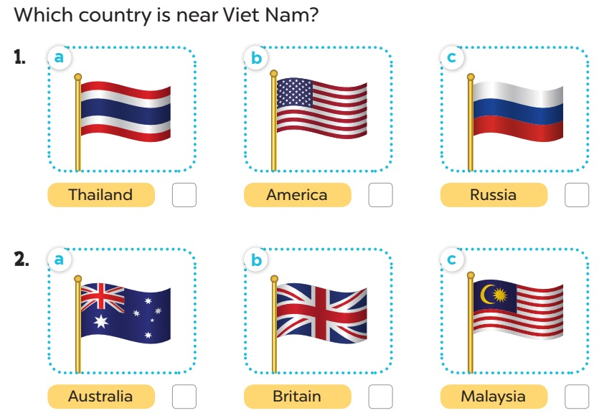


Slide 15
Where is Viet Nam?
Where is Australia?
Where is Viet Nam?
Notes:
Ask pupils to look at the map and find the countries. Draw lines from countries to Viet Nam.

Slide 16
Where is Viet Nam?
Where is Britain?
Where is Viet Nam?
Notes:
Ask pupils to look at the map and find the countries. Draw lines from countries to Viet Nam.

Slide 17
Where is Viet Nam?
Where is Malaysia?
Where is Viet Nam?
Notes:
Ask pupils to look at the map and find the countries. Draw lines from countries to Viet Nam.

Slide 18
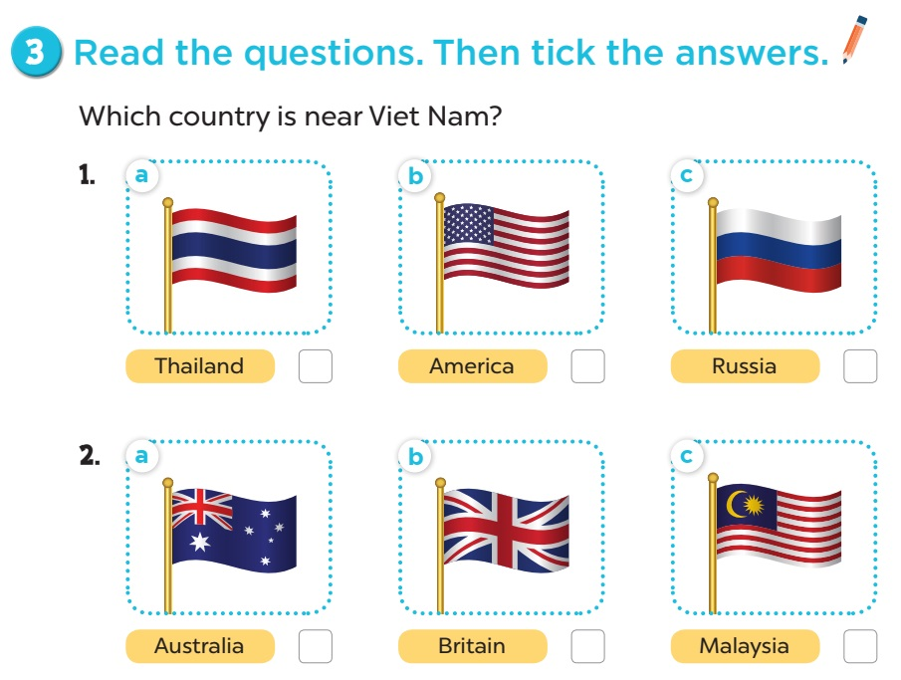

Slide 19
Where is Viet Nam?
Where is Canada?
Where is Viet Nam?
Notes:
Ask pupils to look at the map and find the countries. Draw lines from countries to Viet Nam.

Slide 20
Where is Viet Nam?
Where is Thailand?
Where is Viet Nam?
Notes:
Ask pupils to look at the map and find the countries. Draw lines from countries to Viet Nam.

Slide 21
Where is Viet Nam?
Where is Viet Nam?
Where is Singapore?
Notes:
Ask pupils to look at the map and find the countries. Draw lines from countries to Viet Nam.

Slide 22
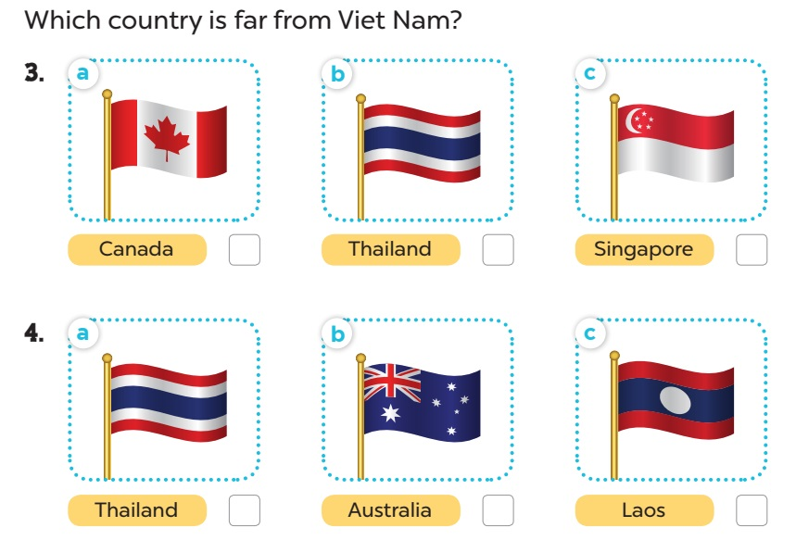

Slide 23
Where is Viet Nam?
Where is Viet Nam?
Where is Thailand?
Notes:
Ask pupils to look at the map and find the countries. Draw lines from countries to Viet Nam.

Slide 24
Where is Viet Nam?
Where is Australia?
Where is Viet Nam?
Notes:
Ask pupils to look at the map and find the countries. Draw lines from countries to Viet Nam.

Slide 25
Where is Viet Nam?
Where is Viet Nam?
Where is Laos?
Notes:
Ask pupils to look at the map and find the countries. Draw lines from countries to Viet Nam.

Slide 27
Game

Slide 28

Singapore

Slide 29

Thailand

Slide 30

Japan

Slide 31

Malaysia

Slide 32

Viet Nam

Slide 33

America

Slide 34

Britain

Slide 35

Australia

Slide 36




Look and guess.
Singapore
S_ _ _ _ _ _ _ _

Slide 37

Look and guess.
Thailand
T_ _ _ _ _ _ _

Slide 38

Look and guess.
A_s_ _ _l_ _
Australia

Slide 39

Look and guess.
C_n_d_
Canada

Slide 40

Look and guess.
Japan
J_ _ _ _

Slide 41

Look and guess.
_a_a_ _ _a
Malaysia

