Slide 1



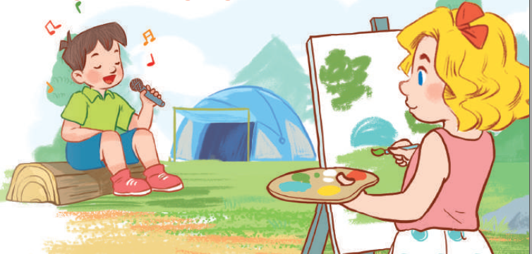
19
Outdoor activities
LESSON 3 – PERIOD 6

Slide 2
Warm up
& Review
Read
and answer
Let’s write
Project
Fun corner
& wrap up

Slide 3

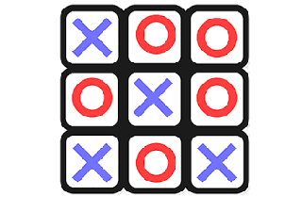

TIC TAC TOE

Slide 4

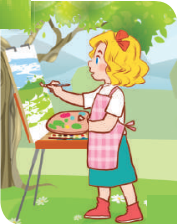
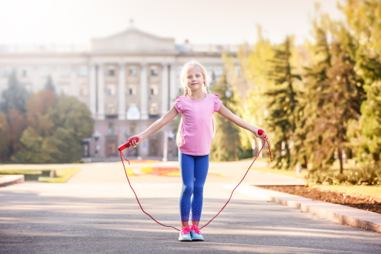
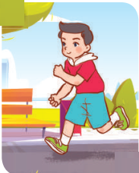


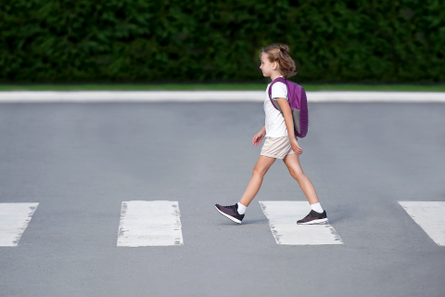
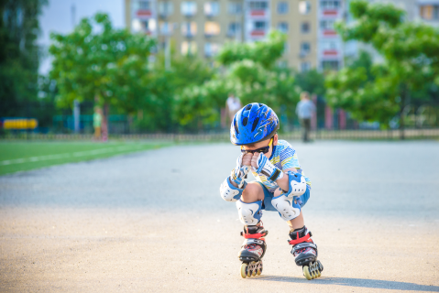
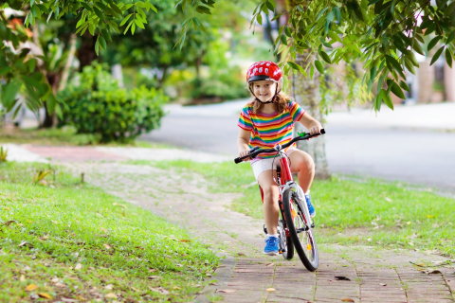
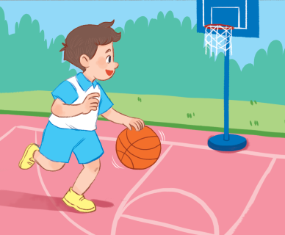
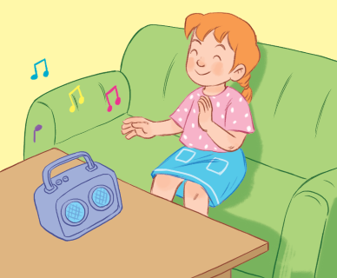
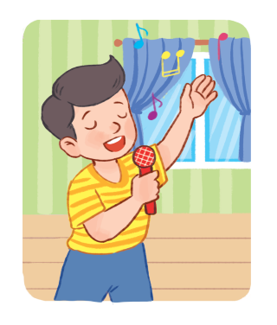
Choose and say!
What’s he/she doing?
A
B
C
1
2
3

Slide 5


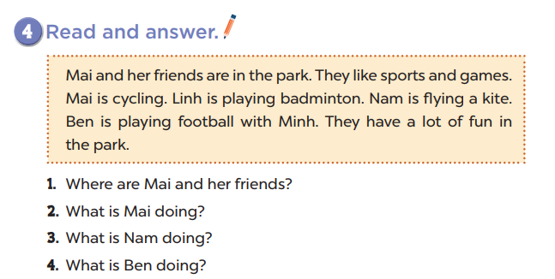
They’re in the park.
She’s cycling.
He’s flying a kite.
He’s playing football.

Slide 6
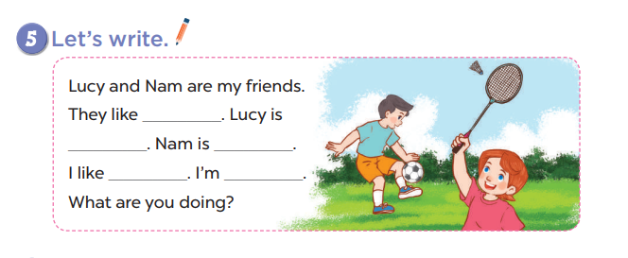

Slide 7
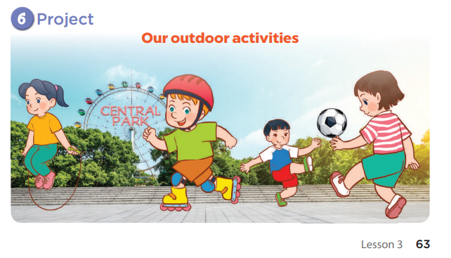

Slide 8

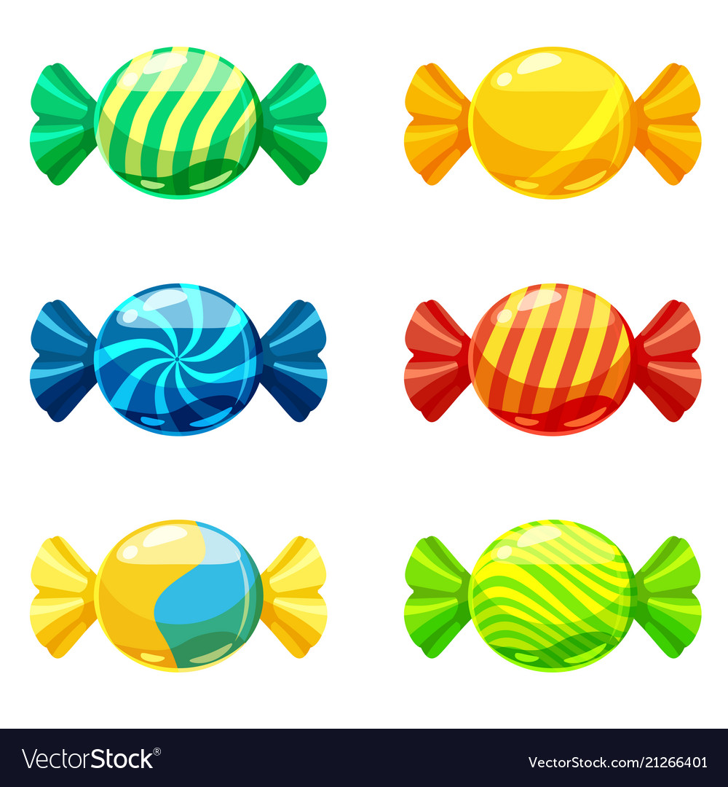
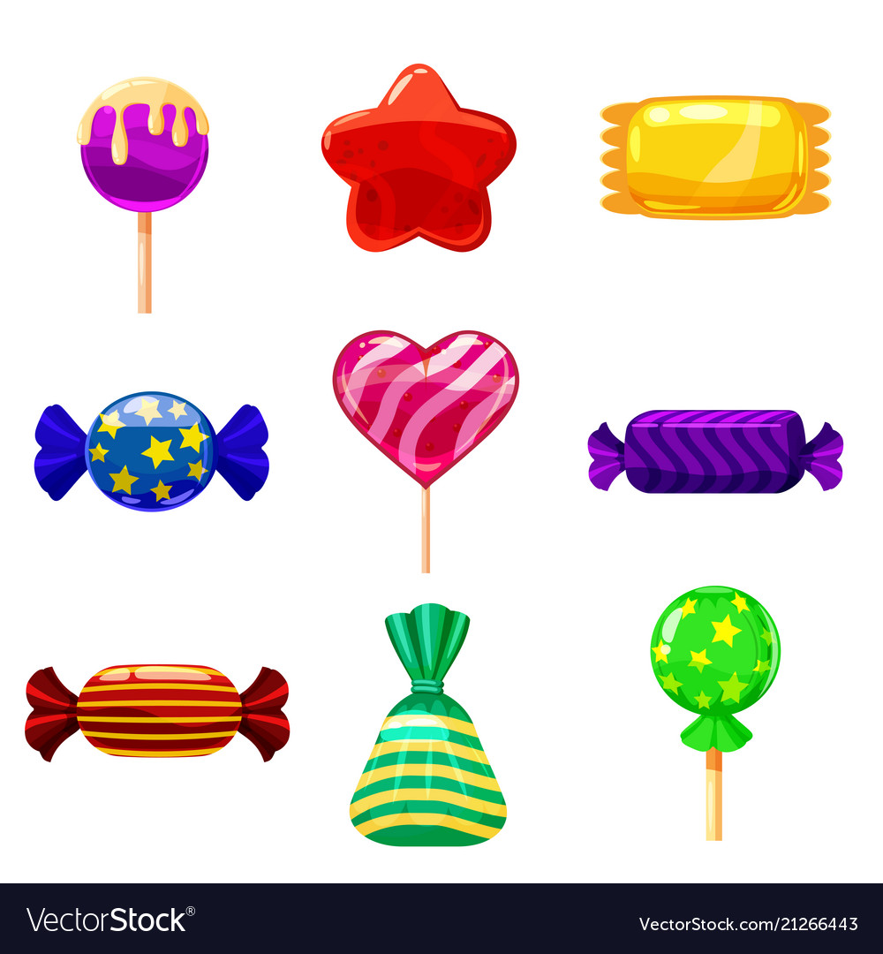
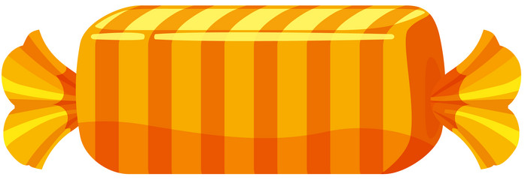
TEAM A
TEAM B
0
1
2
3
4
5
6
7
8
9
0
1
2
3
4
5
6
7
8
9
0
1
2
3
4
5
6
7
8
0
9
1
2
3
4
5
6
7
8
9
0
1
2
3
4
5
6
7
8
9
0
1
2
3
4
5
6
7
8
9
CANDY OR LIGHTENING

Slide 9
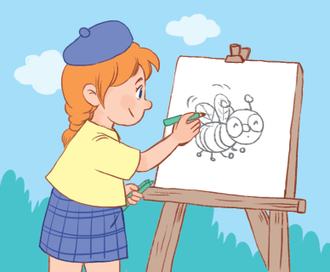




What are you doing?
30
READING
AM
20
IS
WRITING
ARE
PAINTING
“I ____ __________
a bee.”
am
painting

Slide 10
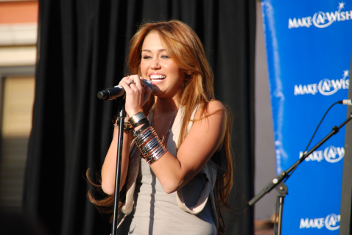
What’s she doing?
AM
20
DANCING
40
IS
SINGING
ARE
WATCHING T.V
She ____ __________
at the party.
is
singing

Slide 11
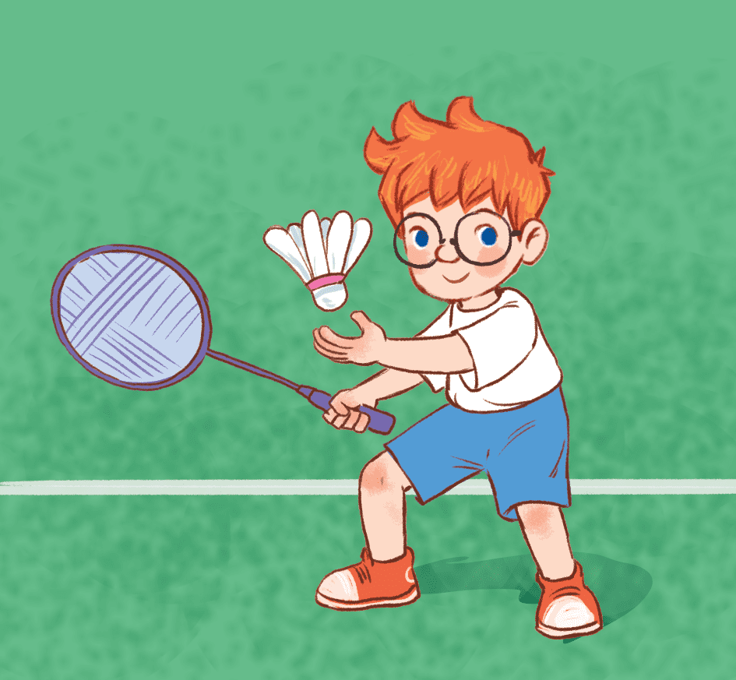
What’s he doing?
AM
10
30
playing football
IS
playing badminton
ARE
playing games
He ____ __________
in the park.
is
playing badminton

Slide 12
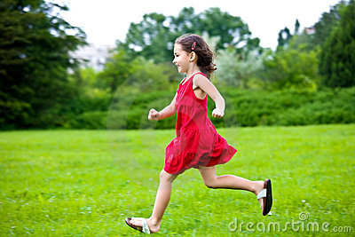
What’s she doing?
AM
50
RUNNING
10
IS
WALKING
ARE
SKIPPING
She ____ __________
in the garden.
is
running

Slide 13
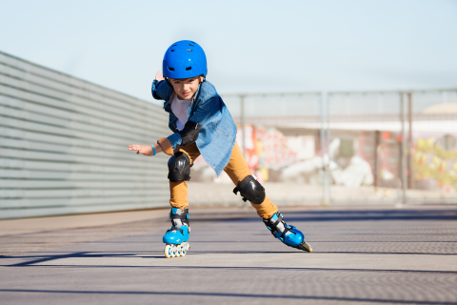
What are you doing?
20
Listening to music
AM
30
Flying a kite
IS
skating
ARE
“I ____ __________
in the rink.”
am
skating

Slide 14
What’s she doing?
AM
20
RUNNING
40
IS
SKIPPING
ARE
CYCLING
She ____ __________
in the playground.
is
cycling

Slide 15
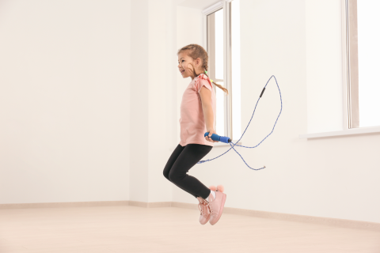
What are you doing?
10
AM
50
SKIPPING
IS
CYCLING
ARE
SINGING
“I ____ __________
with my sister.”
am
skipping

Slide 16
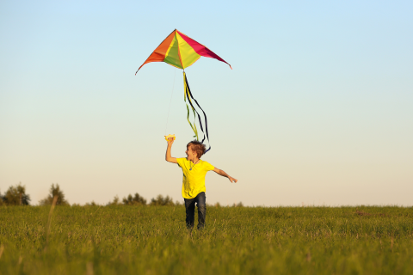
What’s he doing?
AM
40
20
WATCHING T.V
IS
WALKING
ARE
FLYING A KITE
He ____ __________
in the field.
is
Flying a kite

