Slide 1

TO CLASS 3

Slide 2
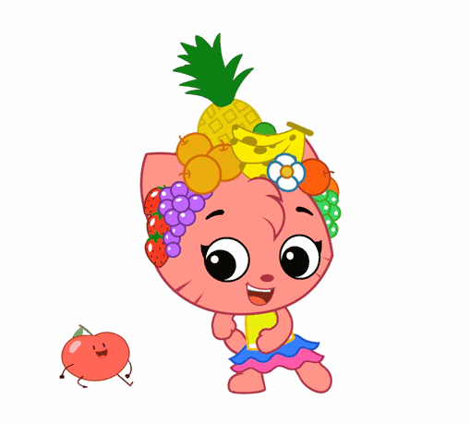
Warm - up

Slide 3


Slide 4
PLAY A GAME
GUESSING

Slide 5
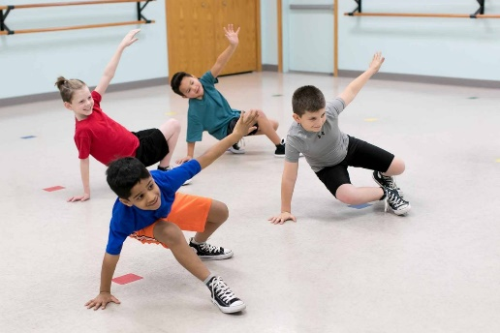

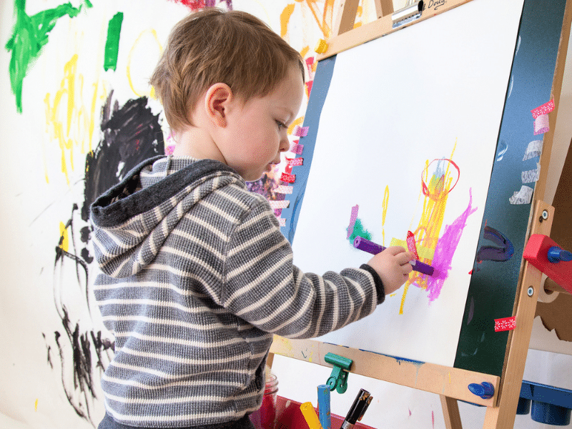
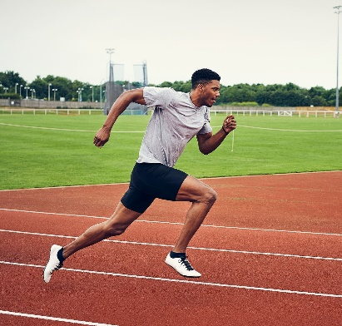



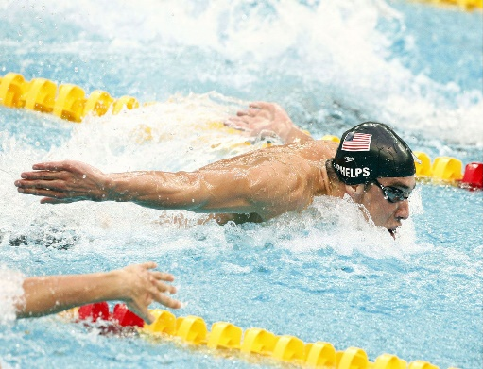
PLAY A GAME

Slide 6



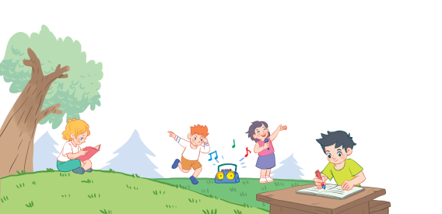
18
Part 1,2,3

Slide 7
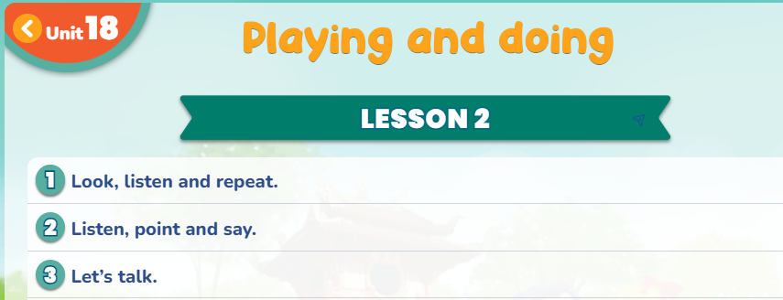

Slide 8
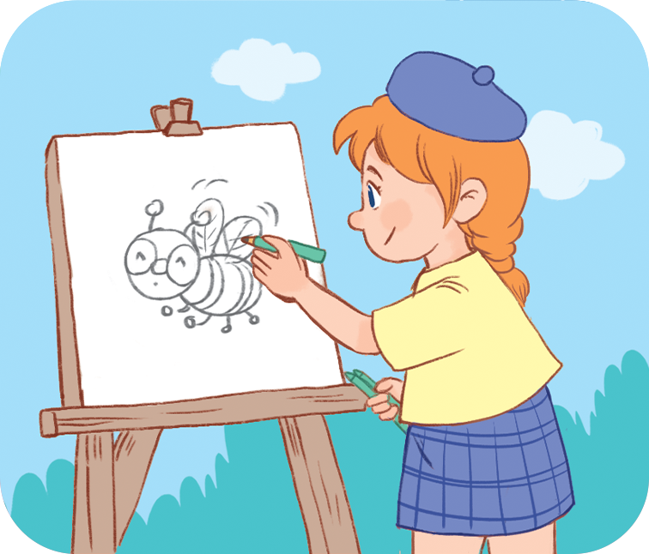
Vocabulary
drawing a picture
Vẽ tranh

Slide 9
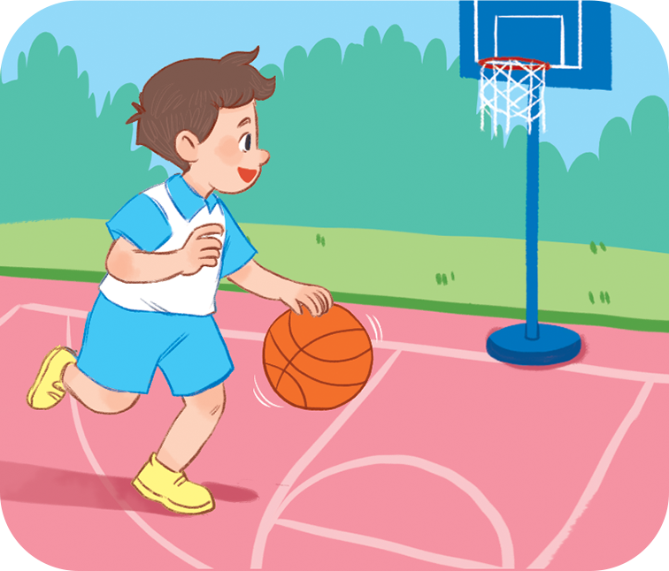
Vocabulary
playing basketball
Chơi bóng rổ

Slide 10
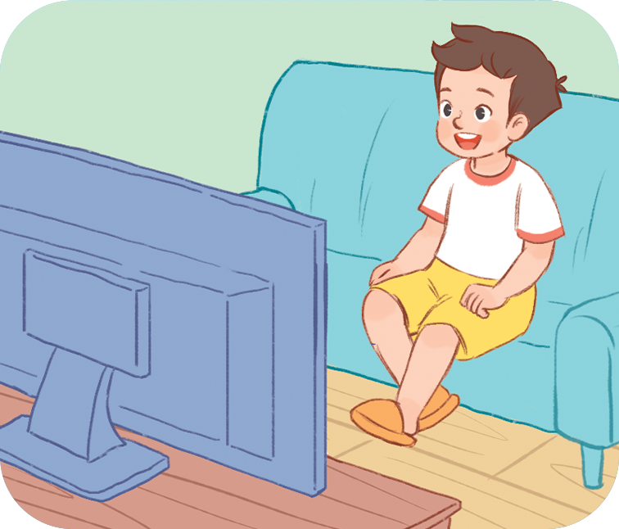
Vocabulary
watching TV
Xem tivi

Slide 11
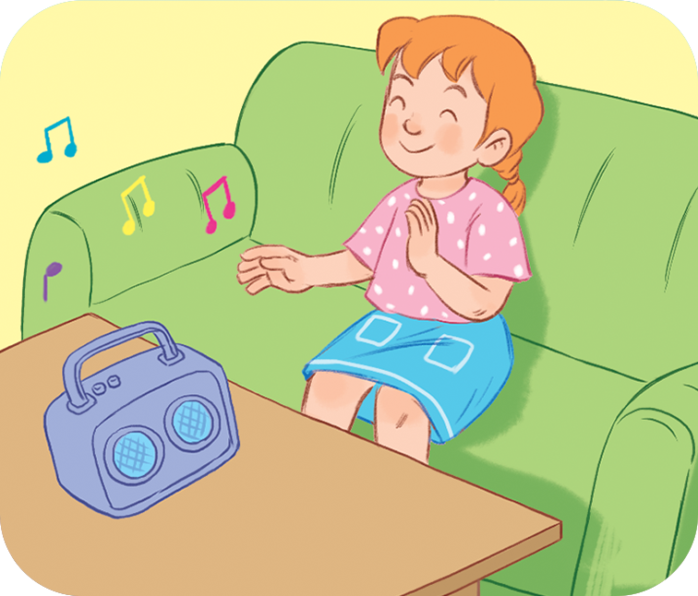
Vocabulary
listening to music
Nghe nhạc

Slide 12
Vocabulary
playing basketball
: Chơi bóng rổ
drawing a picture
: Vẽ tranh
watching TV
: Xem TV
listening to music
: Nghe nhạc

Slide 13
GAME: TPR

Slide 14

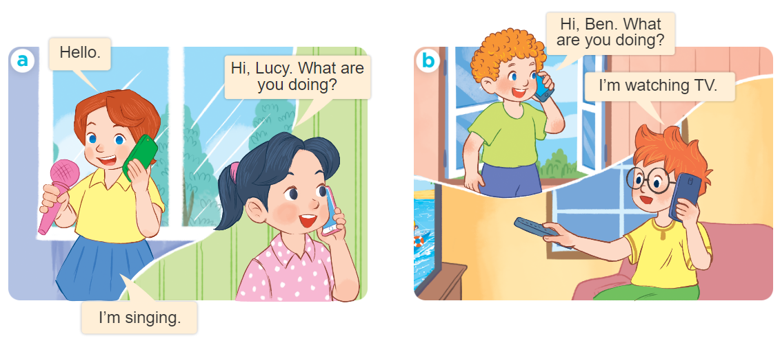
1
Look, listen and repeat.

Slide 16
Structures
Hỏi và trả lời bạn đang làm gì:
What are you doing?
(Bạn đang làm gì vậy?)
I’m _________.
(Tớ đang __________.)

Slide 17



EXAMPLE
What are you doing?
drawing a picture
I’m _________________.

Slide 18
2
Listen, point and say.
What are you doing?
I’m _________________.
playing
basketball
drawing
a picture
listening
to music.
watching TV

Slide 19

3
Let’s talk.
GAME: PASS THE BALL

Slide 20
GAME: PHYSICAL LINE UP

Slide 21




Thank you!

