Slide 1



............PRIMARY SCHOOL
WELCOME TEACHERS TO OUR CLASS 3
TEACHER: .....

Slide 2




Warm-up and review

Slide 3
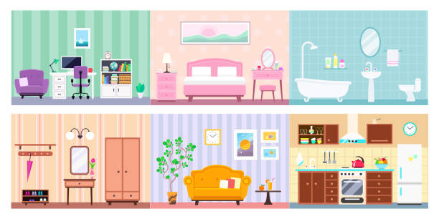
Game: What room is this?
Look and guess
Notes:
Open the coloured squares and guess the room behind.

Slide 4

1
2
living room
3
4
SHOW

Slide 5

1
2
bathroom
3
4
SHOW

Slide 6
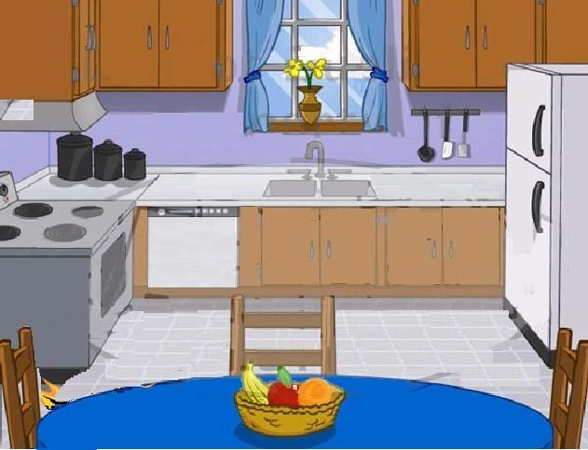
1
2
kitchen
3
4
SHOW

Slide 7

1
2
bedroom
3
4
SHOW

Slide 8



Saturday, February 25th , 2023
14
My bedroom
Lesson 1 – Period 1

Slide 9
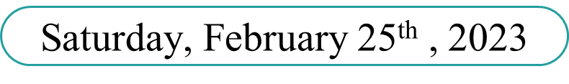
UNIT 14: MY BEDROOM
LESSON 1- PERIOD 1
A. VOCABULARY

Slide 10

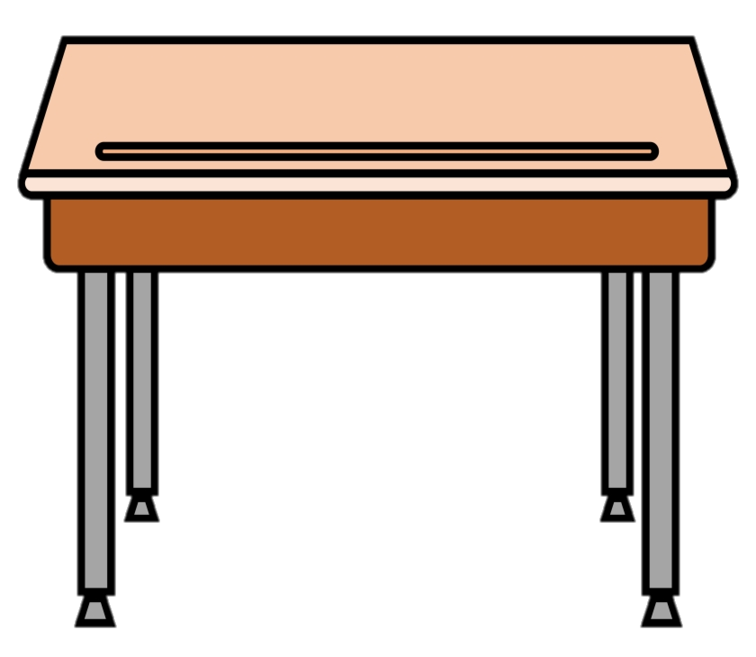
a desk
desks

Slide 11
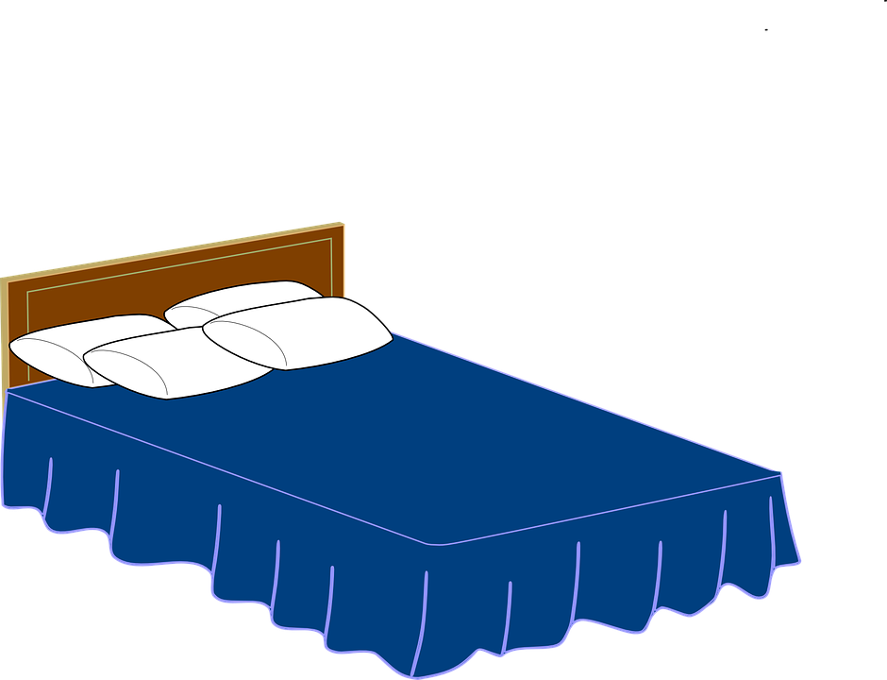
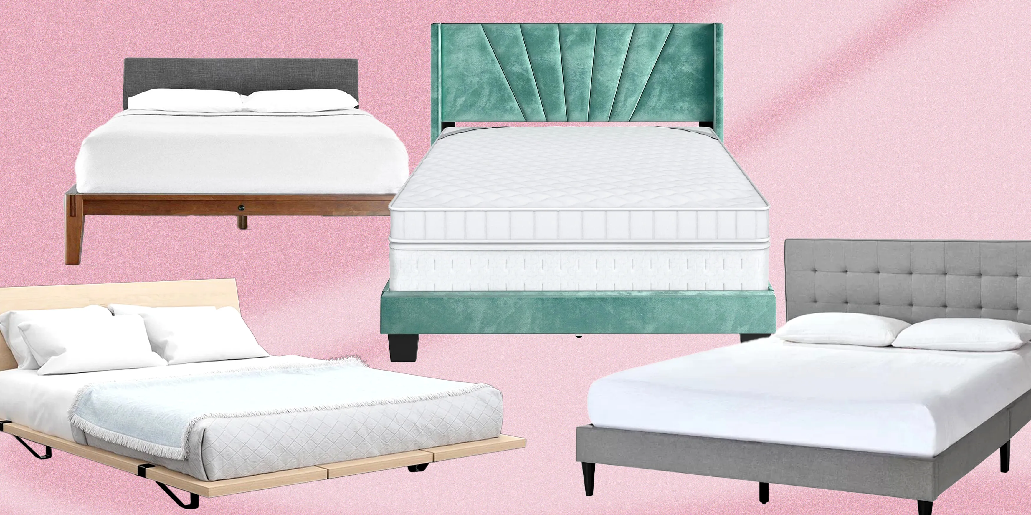
a bed
beds

Slide 12


a door
doors

Slide 13
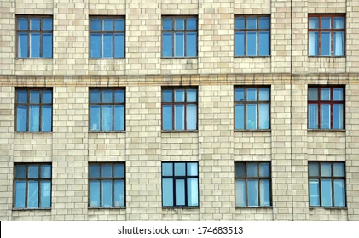
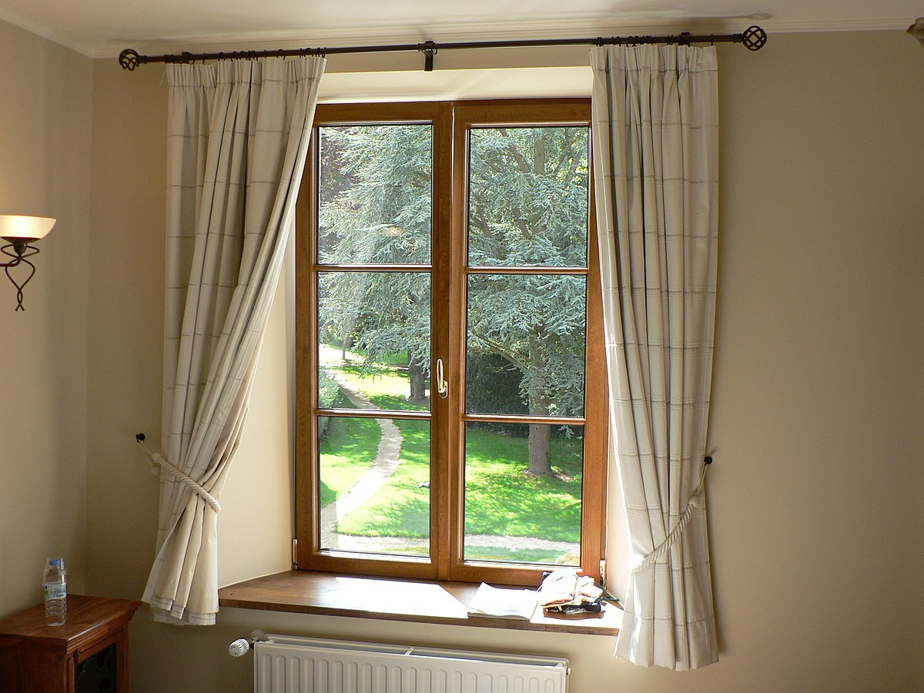
a window
windows

Slide 14
UNIT 14: MY BEDROOM
LESSON 1- PERIOD 1
A. VOCABULARY
1. DESK:
BÀN HỌC SINH
2. BED:
CÁI GIƯỜNG
3. DOOR:
CỬA RA VÀO
4.WINDOW:
CỬA SỔ

Slide 15

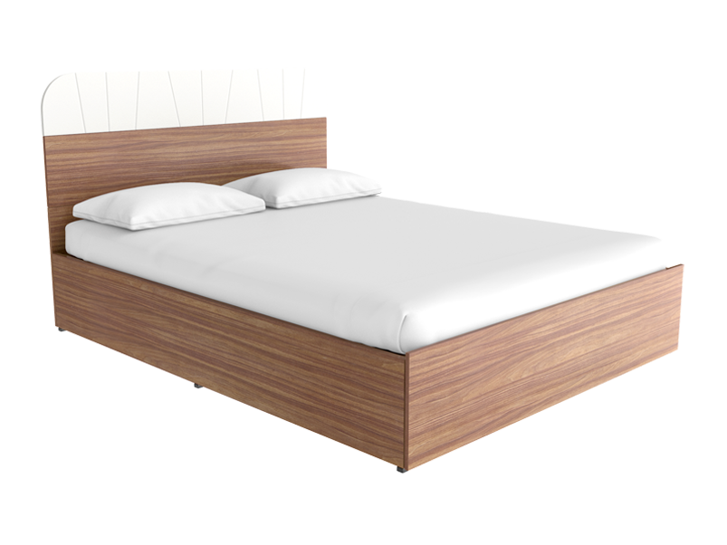
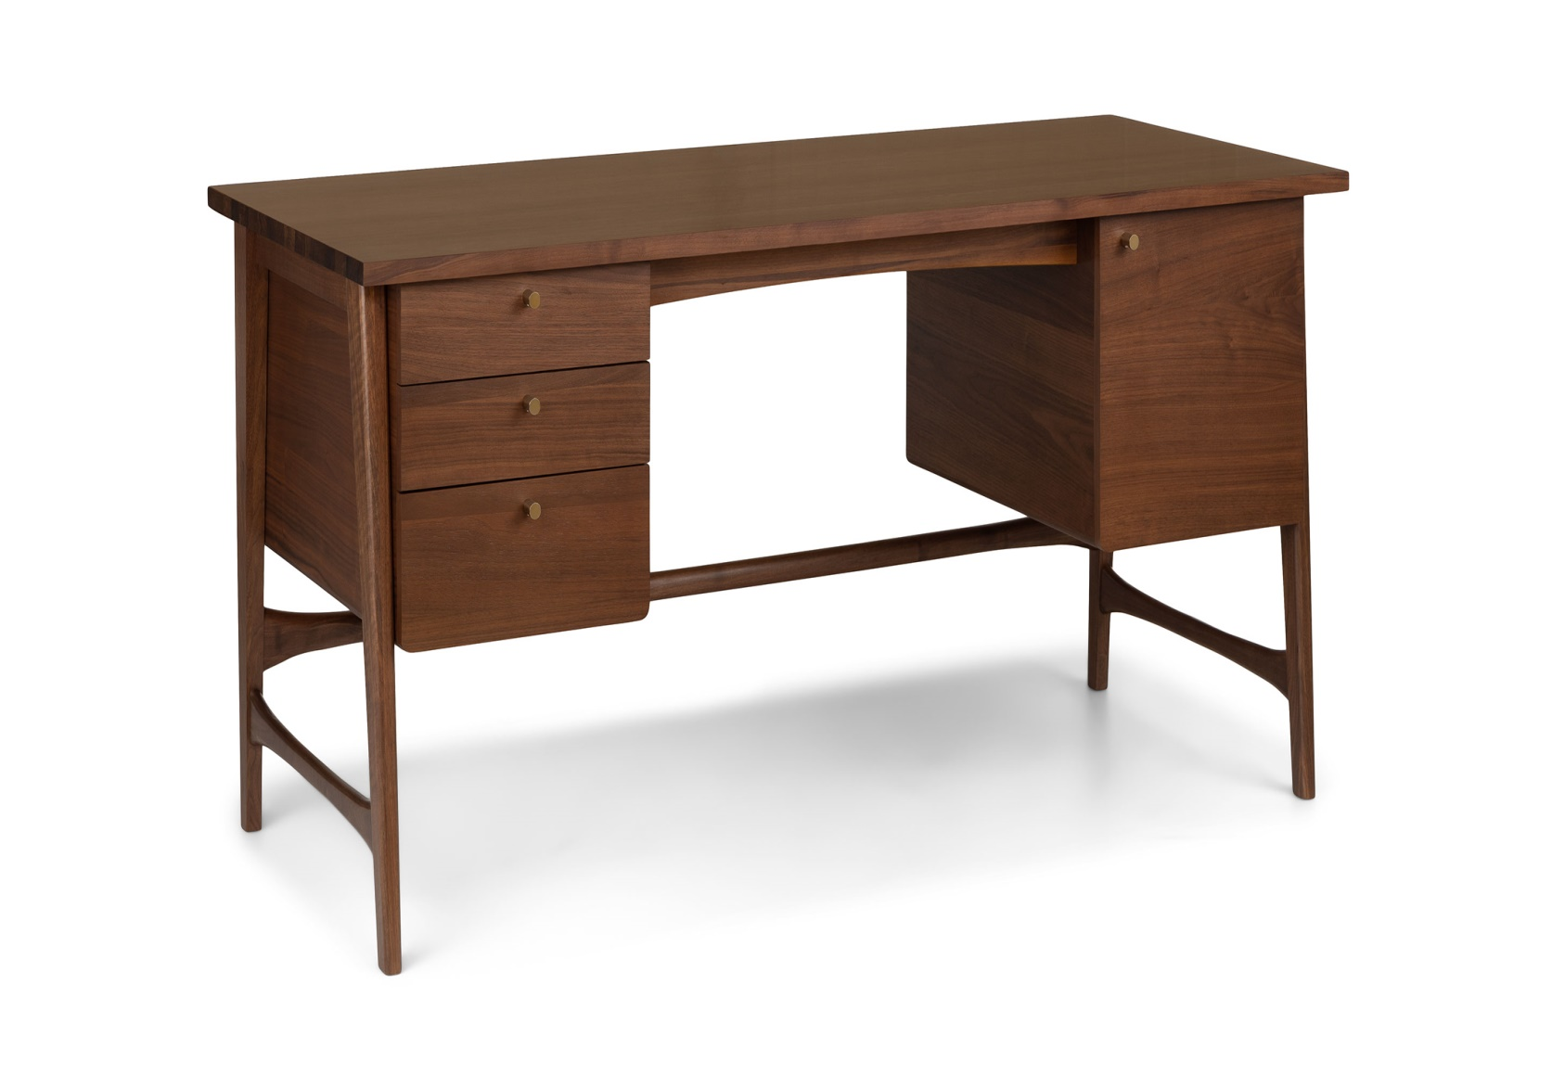

PLAY GAME: PASS THE BALL
WHAT IS THIS?

Slide 16
Unit 14
Lesson 1
Period 1
1
Look, listen and repeat.

Slide 17
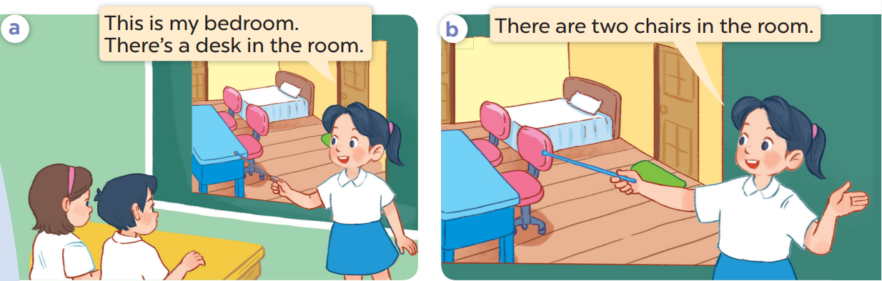
UNIT 14: MY BEDROOM
LESSON 1- PERIOD 1

Slide 18
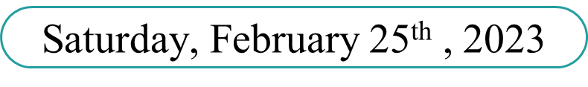
UNIT 14: MY BEDROOM
LESSON 1- PERIOD 1

Slide 19
UNIT 14: MY BEDROOM
LESSON 1- PERIOD 1
B. STRUCTURE
*NÓI VỀ ĐỒ VẬT ( SỐ ÍT VÀ SỐ NHIỀU)
SỐ ÍT ( 1 ĐỒ VẬT)
- There is a/ an … = có một …
SỐ NHIỀU ( TỪ 2 ĐỒ VẬT TRỞ LÊN)
- There are … = có …

Slide 20

Lesson 1
Period 1
Unit 14
Lesson 1
Period 1
2
Listen, point and say.

Slide 21

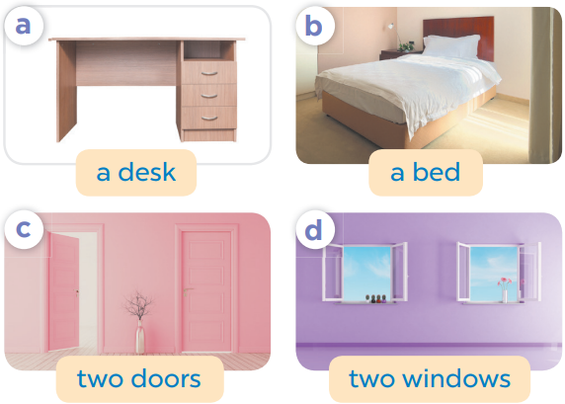
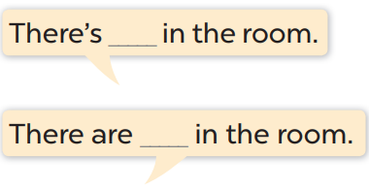
UNIT 14: MY BEDROOM
LESSON 1- PERIOD 1

Slide 22
Unit 14
Lesson 1
Period 1
3
Let’s talk.

Slide 23
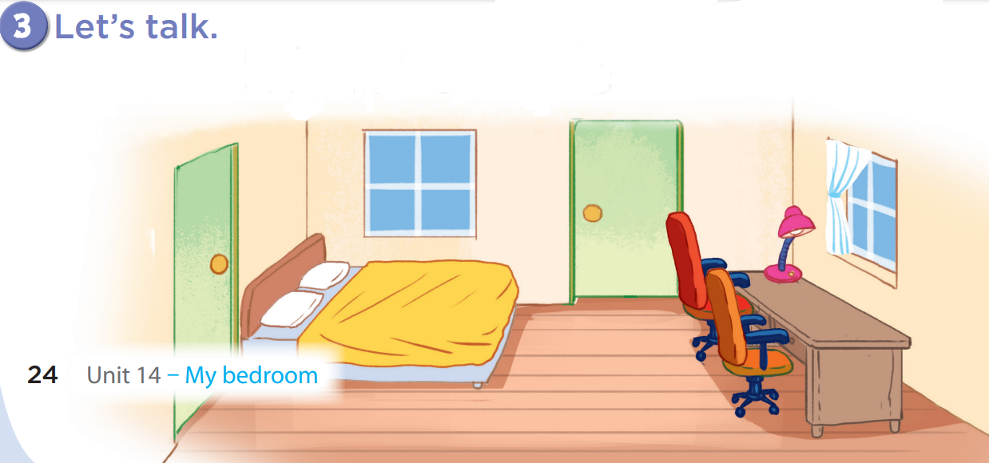
UNIT 14: MY BEDROOM
LESSON 1- PERIOD 1
There are two windows.
There is a bed.

Slide 24
UNIT 14: MY BEDROOM
LESSON 1- PERIOD 1
There is a desk.
There are two doors.

Slide 25
UNIT 14: MY BEDROOM
LESSON 1- PERIOD 1
There is a lamp.
There are two chairs.

Slide 26
Game: who’s the faster?
Notes:
Game: Look and say
- Divide the class into 2-4 teams.
- Have the pupils look at the arrows and say the sentences.

Slide 27
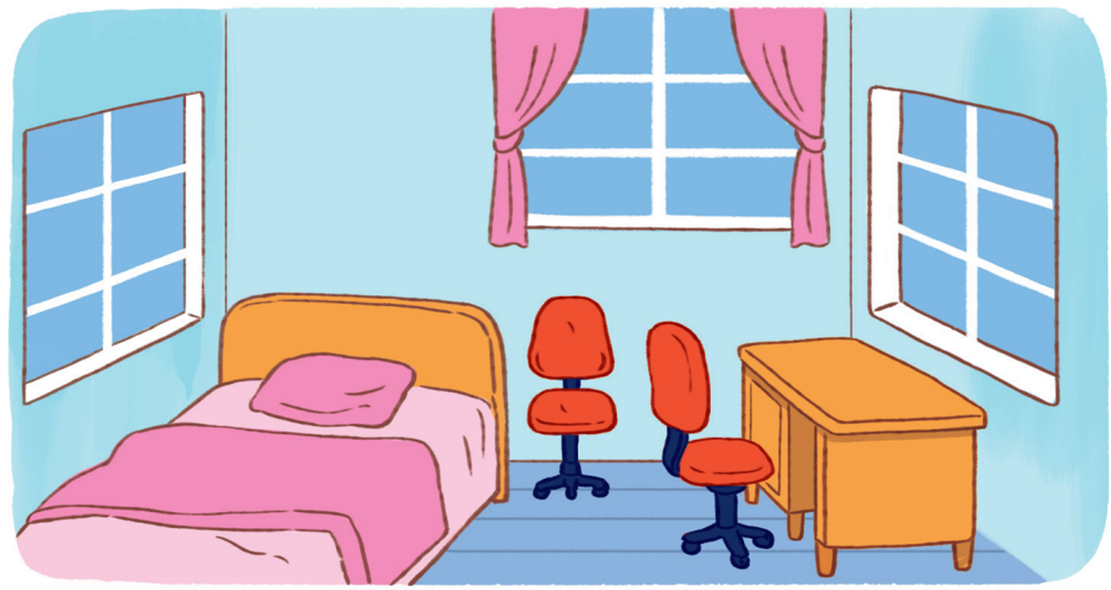
What can you see in the bedroom?

Slide 28
Thank you so much

