Slide 1



Jobs
Lesson 4

Slide 2






01
VOCABULARY
Let’s learn something new!

Slide 3


cook (N)
Đầu bếp

Slide 4

doctor (N)
Bác sĩ

Slide 5
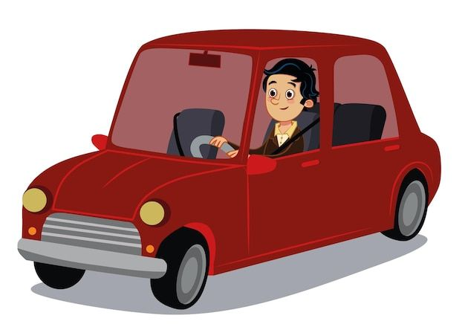
driver (N)
Tài xế

Slide 6

farmer (N)
Nông dân

Slide 7

singer (N)
Ca sĩ

Slide 8
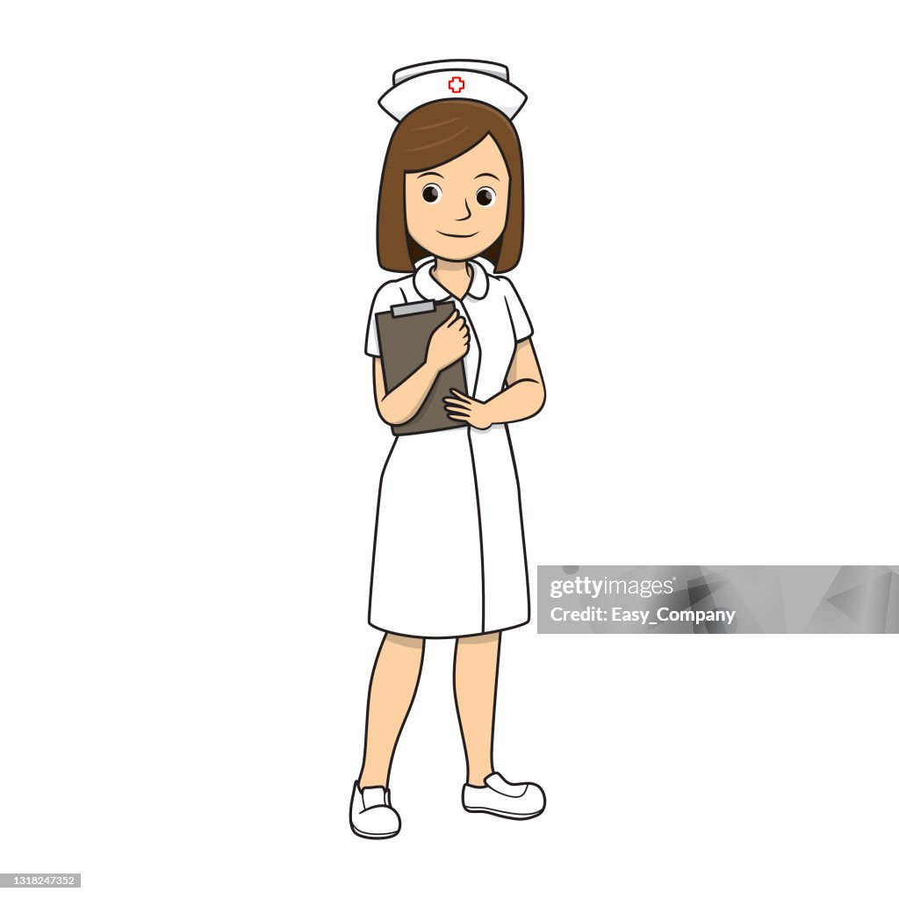
Nurse (N)
Y tá

Slide 9

teacher (N)
Giáo viên

Slide 10


Slide 11
Check-up
Let’s write

Slide 12
driver (N)
Tài xế

Slide 13
cook (N)
Đầu bếp

Slide 14
doctor (N)
Bác sĩ

Slide 15
farmer (N)
Nông dân

Slide 16
Nurse (N)
Y tá

Slide 17
teacher (N)
Giáo viên

Slide 18
singer (N)
Ca sĩ

Slide 19

Cái ghế
Chair

Slide 20
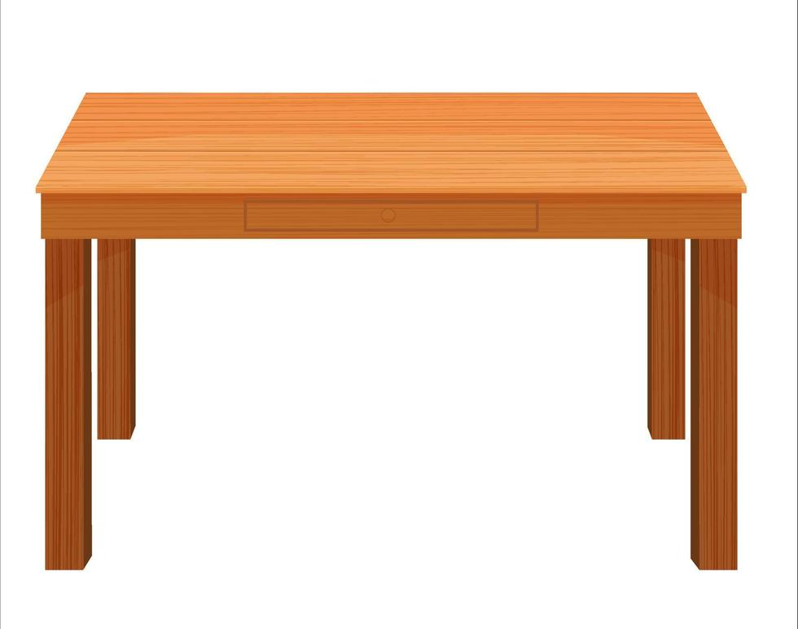
table
Cái bàn

Slide 21

lamp
Cái đèn

Slide 22

Phòng khách
Living room

Slide 23
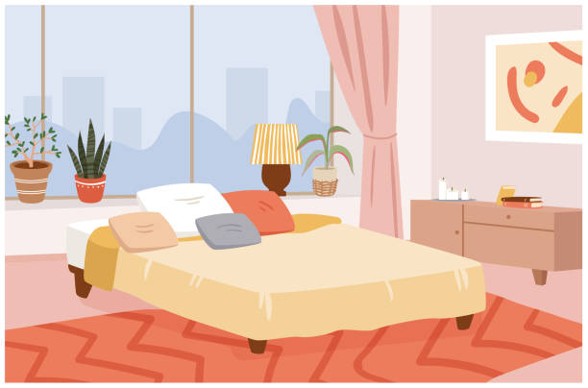
Phòng ngủ
bedroom

Slide 24

Phòng bếp
kitchen

Slide 25
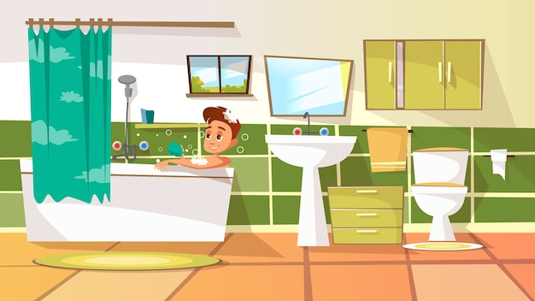
Phòng tắm
bathroom

Slide 26
02
Grammar
Let’s learn something new!

Slide 27
What’s his job?
He’s a doctor.

Slide 28
He’s a driver.

Slide 29
He’s a singer.

Slide 30
He’s a famer.

Slide 31
What’s her job?
She’s a singer.

Slide 32
She’s a cook.

Slide 33
She’s a nurse.

Slide 34
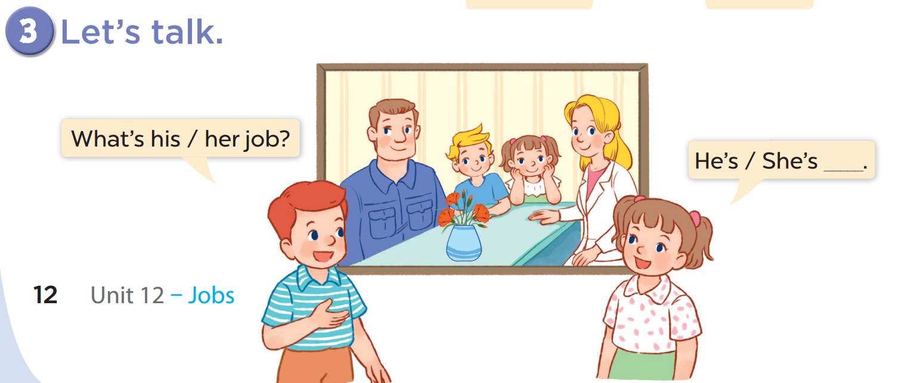

Slide 35
Game
LOOK AND SAY

Slide 36




What’s her job?
She’s a doctor.

Slide 37

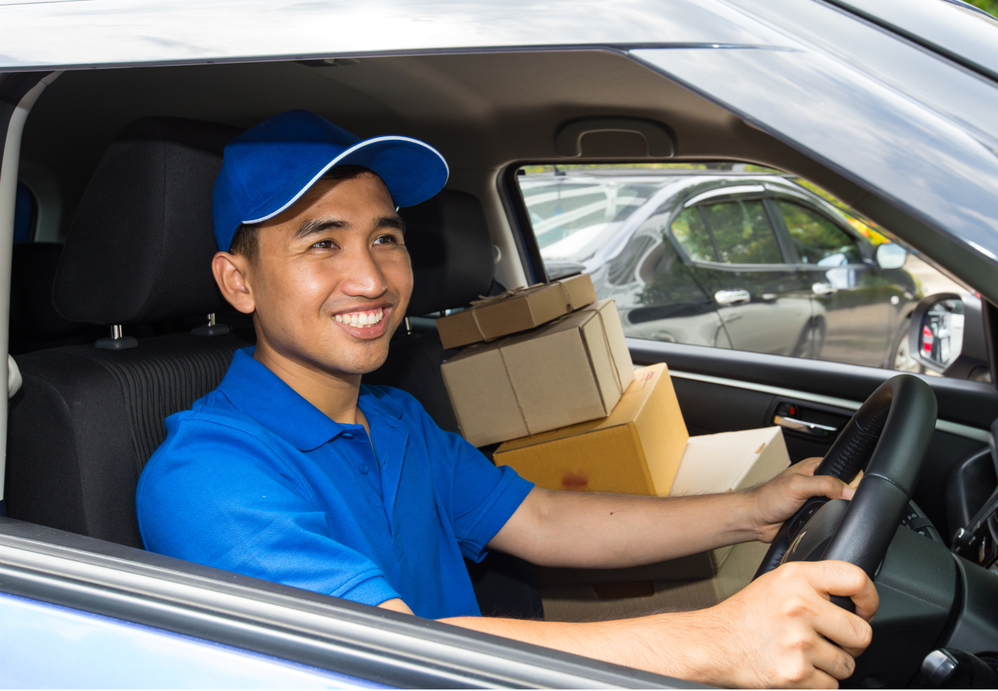
What’s his job?
He’s a driver.

Slide 38


What’s her job?
She’s a teacher.

Slide 39
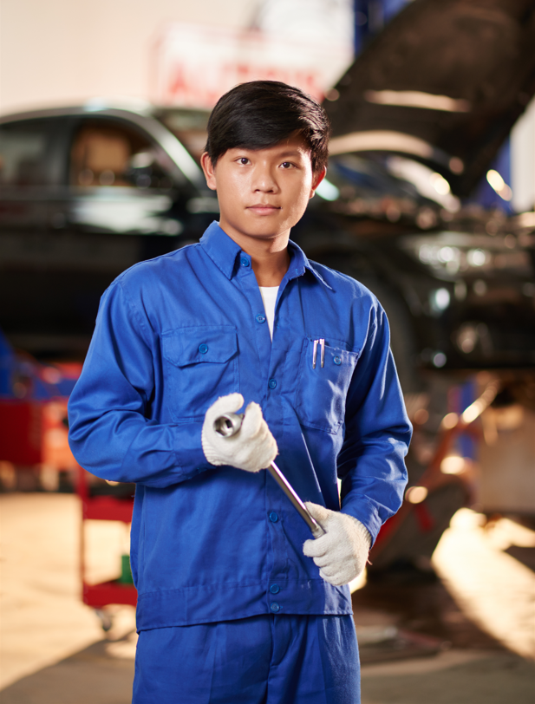
What’s his job?
He’s a worker.

Slide 40

What’s his job?
He’s a teacher.

Slide 41

What’s her job?
She’s a doctor.

Slide 42
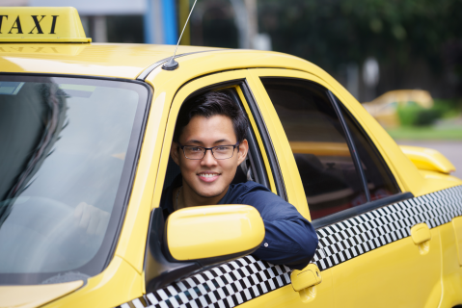
What’s his job?
He’s a driver.

Slide 43

What’s his job?
He’s a worker.

Slide 44
Check-up
LISTEN AND WRITE

Slide 45
Is she a teacher?
(+) Yes, she is.
(-) No, she isn’t.

Slide 46
Is she a famer?
(+) Yes, she is.
(-) No, she isn’t.

Slide 47
Is he a doctor?
(+) Yes, he is.
(-) No, he isn’t.

Slide 48
Is he a driver?
(+) Yes, he is.
(-) No, he isn’t.

Slide 49
Check-up
Let’s play

Slide 50
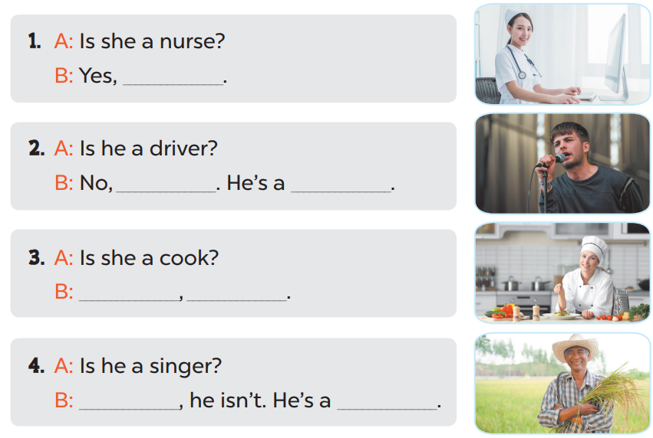

Slide 51
she is
he isn’t
a singer
Yes
she is
No
farmer

Slide 52
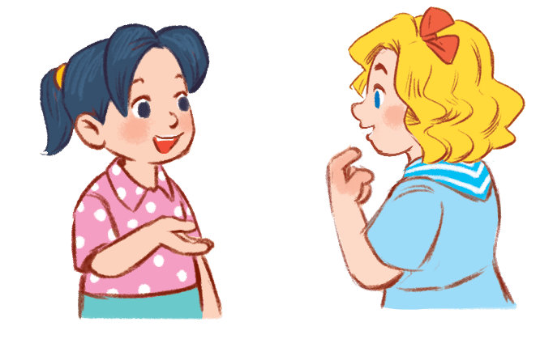
Game time!!!
Choose a number!
1
2
3
4
5
6
7
8
9
10
Next activity
Notes:
Step 1: Divide the class into 2 teams.
Step 2: Invite each pupil from each team to go to the board and practice “Is she/ he a _____? – yes, she/ he is. No, she/ he is.”
Step 3: Encourage pupils to practice speaking.
Step 4: Give points for pupils.

Slide 53
- Is she a farmer?
- No, she isn’t.
+10

Slide 54
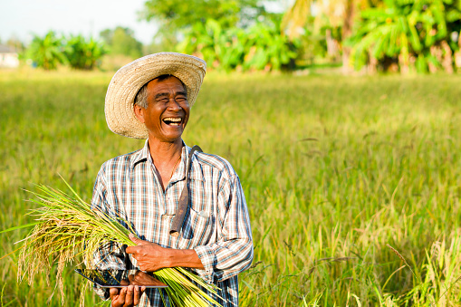
- Is he a farmer?
- Yes, he is.
+5

Slide 55
- Is he a cook?
- No, he isn’t.
+5

Slide 56
- Is he a teacher?
- Yes, he is.
+5

Slide 57

- Is she a doctor?
- Yes, she is.
+10

Slide 58
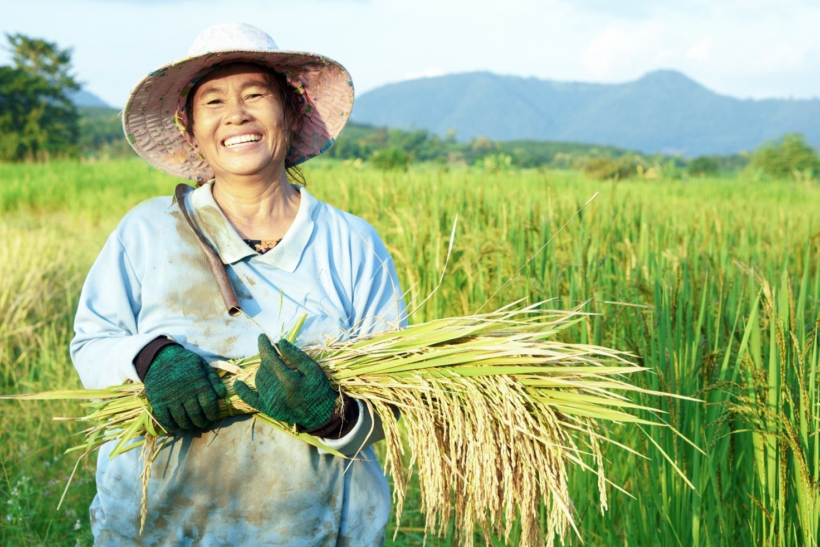
- Is she a driver?
- No, she isn’t.
+15

Slide 59

- Is she a singer?
- No, she isn’t.
+5

Slide 60
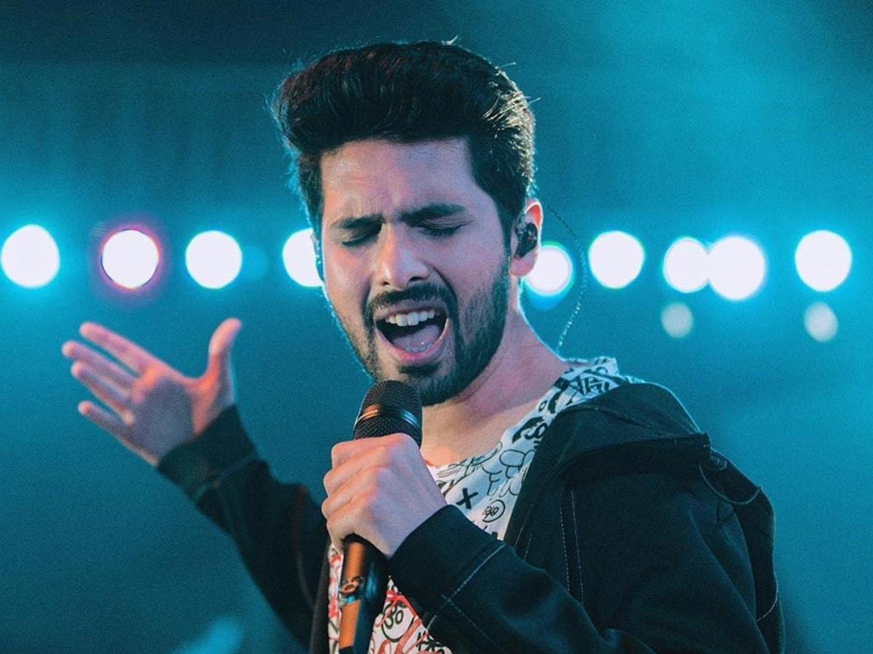
- Is he a singer?
- Yes, he is.
+5

Slide 61
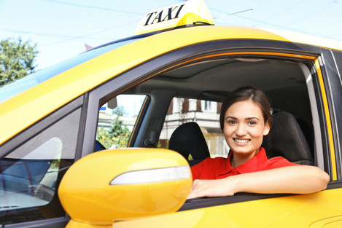
- Is she a driver?
- Yes, she is.
+10

Slide 62
- Is he a driver?
- No, he isn’t.
+5

Slide 63

Thank you
Good bye

