Slide 1



Slide 2







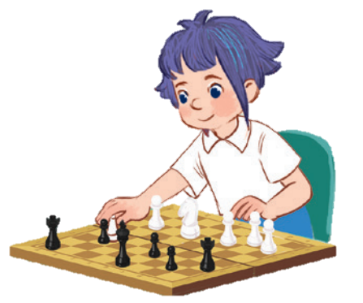
10

Slide 3
I. OBJECTIVES.
By the end of the lesson, pupils will be able to:
1. Language.
- Understand and correctly repeat the sentences in two communicative contexts about school break time activities.
- Correctly say the words and use I ______ at break time. to identify school break time activities.
- Enhance the correct use of I ______ at break time. to identify school break time activities.
- Listen to and understand two communicative contexts in which pupils talk about what they do at break time.
2. Core competencies.
teamwork, motivation, communication, planning and organization
3. General Competencies.
- Listening: look, listen and repeat
- Critical Thinking: listen, point and say
- Oral Communication: let’s talk
- Written Communication: complete the sentence
- Communication and collaboration: work in pairs or groups
4. Attributes.
- Kindness: help partners to complete learning tasks
- Diligence: complete learning tasks
- Honesty: tell the truth about activities at break time

Slide 4
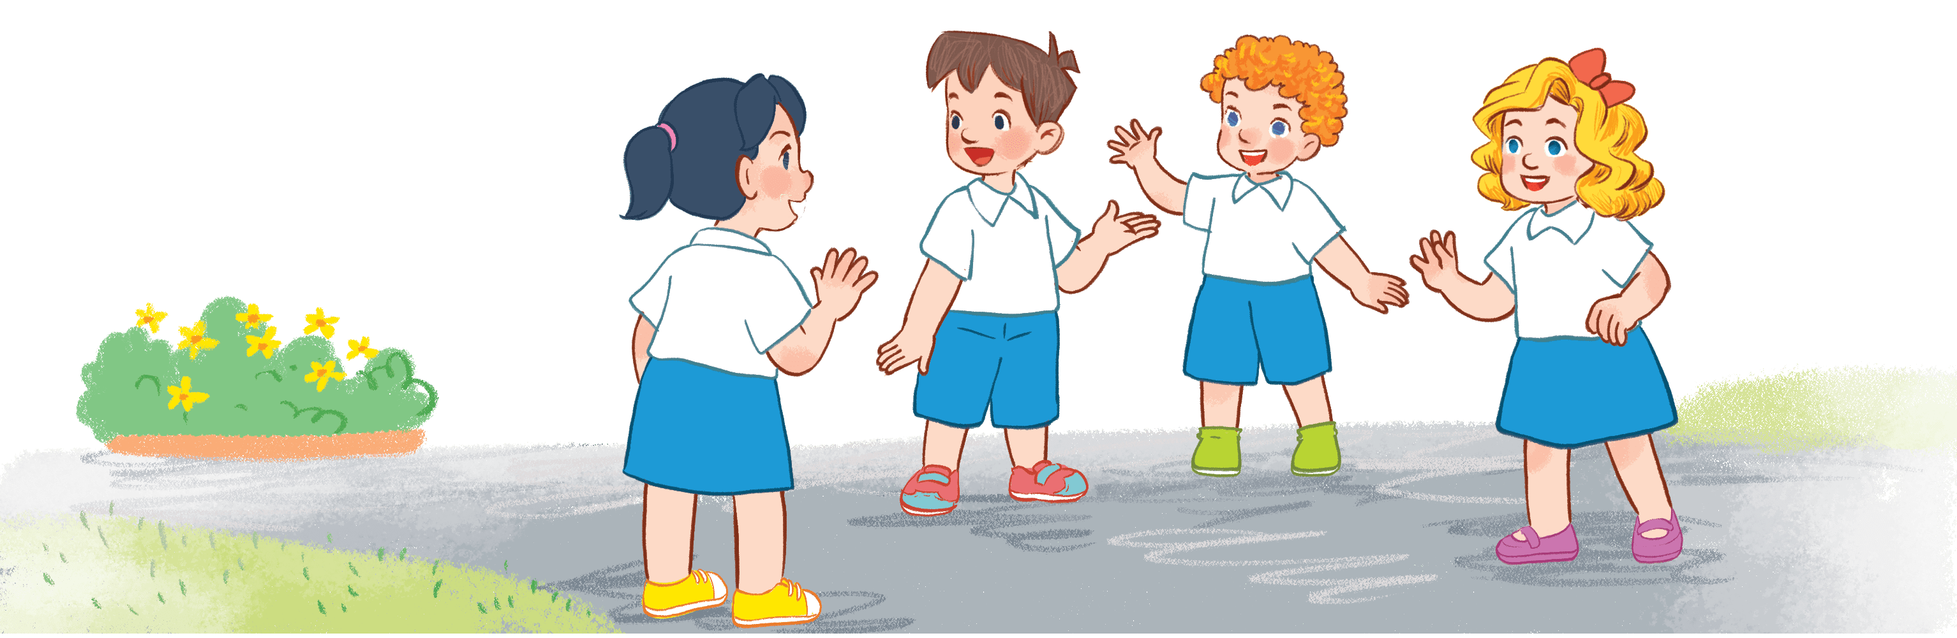
Warm-up AND REVIEW
Notes:
Game: Look and Guess
- Teacher shows 4 pictures numbered 1 to 4 on the board.
- Teacher lets the pupils choose 1 square on the screen and open it.
- Teacher lets the pupils guess the corresponding number of the picture.

Slide 5
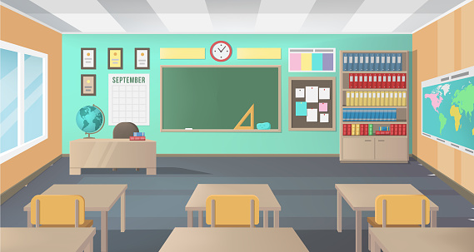

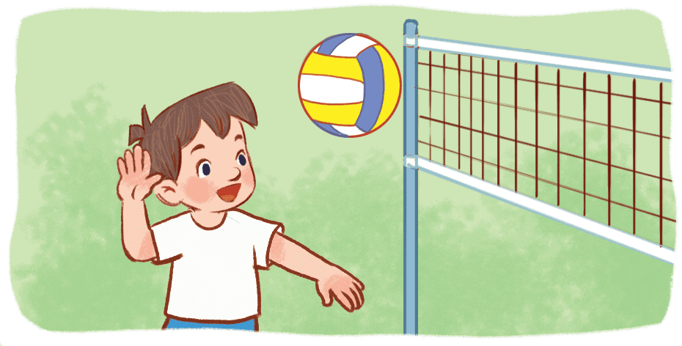
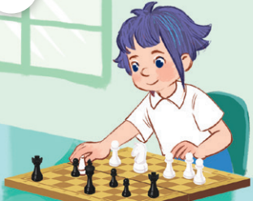
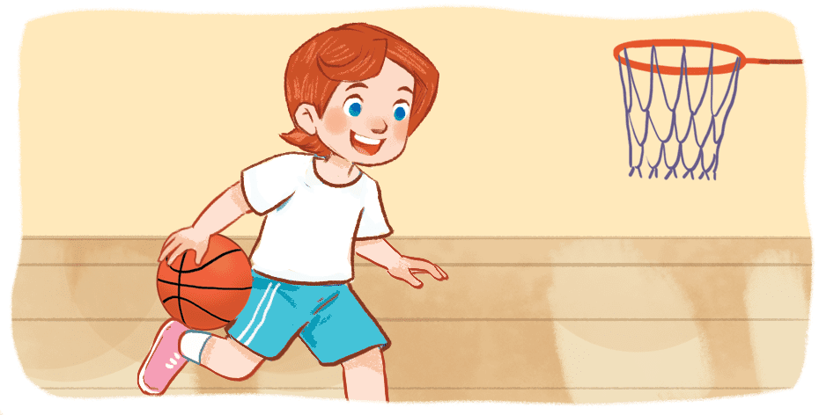

(1)
(3)
(2)
(4)
Notes:
Game: Look and Guess
- Teacher shows 4 pictures on the board with numbers.
- Teacher lets the pupils choose 1 square on the screen and open it.
- Teacher lets the pupils guess the number of the pictures.

Slide 6
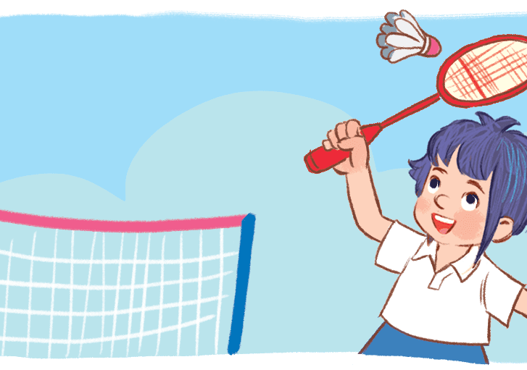
Notes:
Picture 4

Slide 7
Notes:
Picture 1

Slide 8
Notes:
Picture 2

Slide 9
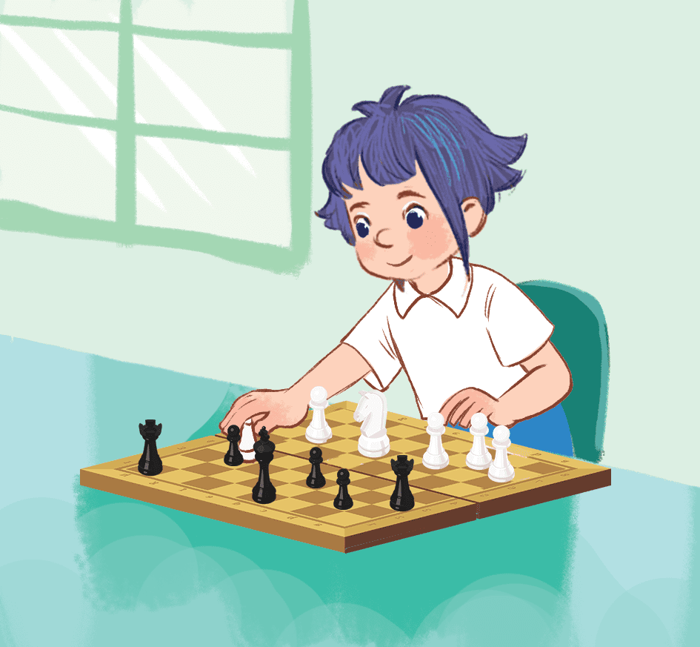
Notes:
Picture 3

Slide 10
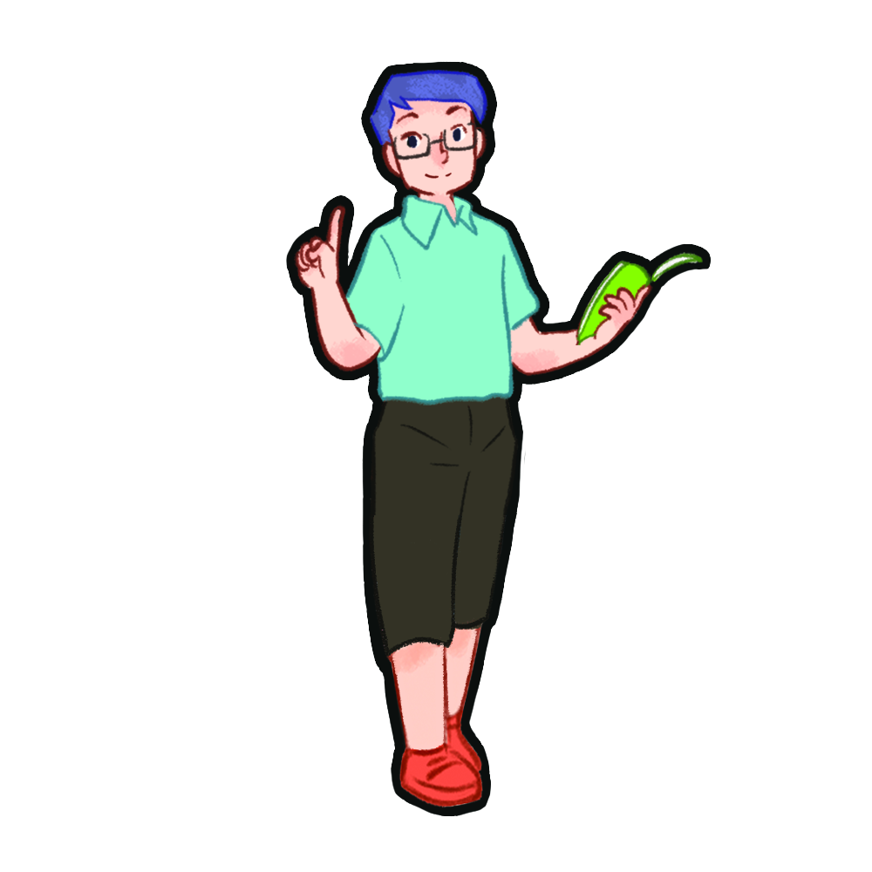
1. Look, listen and repeat.

Slide 11

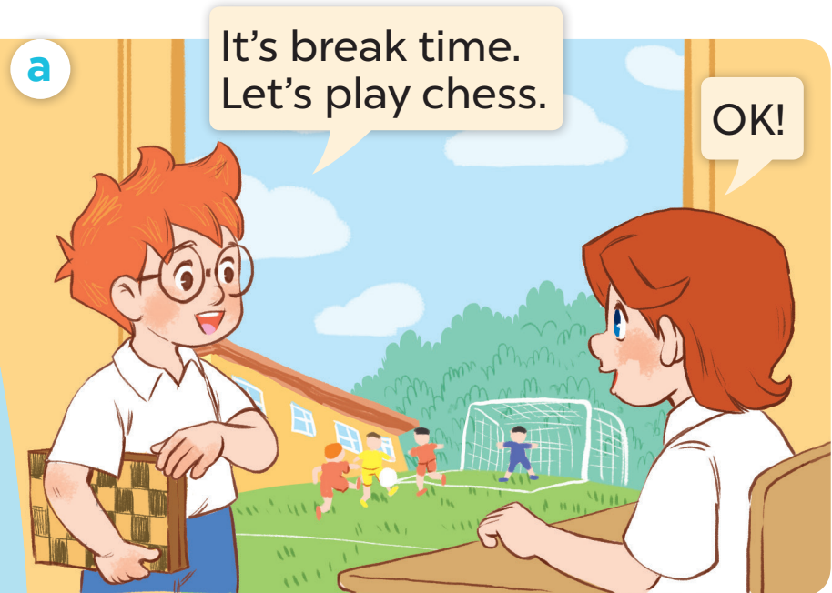
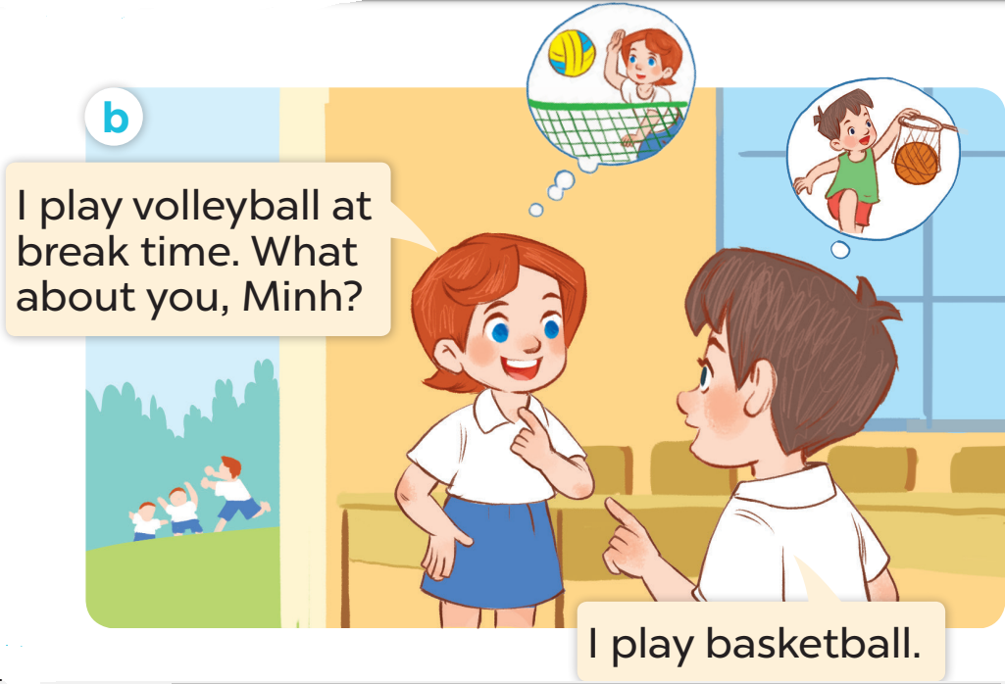

Slide 12
2. Listen, point and say.

Slide 13

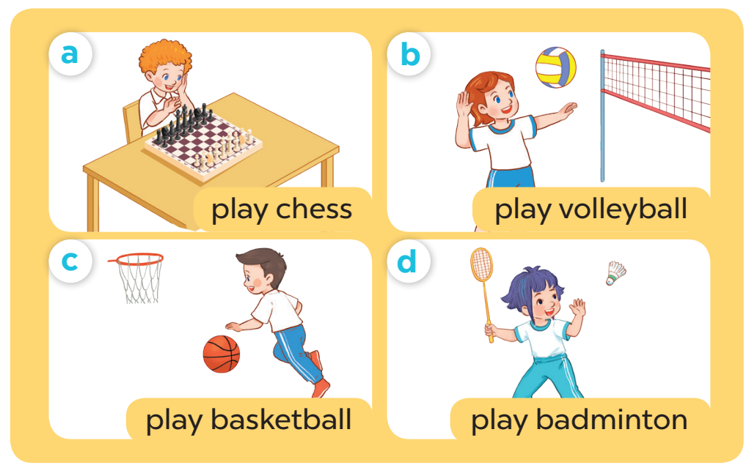

Slide 14
4. Listen and tick.

Slide 15
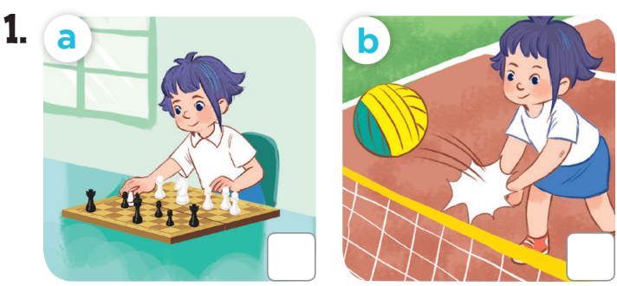

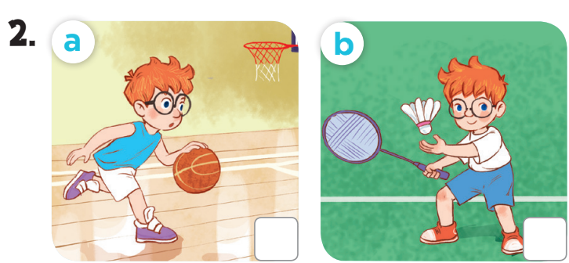


Slide 16
Game time
Notes:
Game: Whisper
- Teacher divides the class into groups of 4.
- Teachers asks 2 groups to get in 2 lines and stand back to the board.
- Teacher asks the first pupil of each line to look at one picture and whisper to the next pupil.
- The last one of each line comes to the board and choose the picture and stick it on the board.
- Change the position of the first pupil and repeat the activities.

Slide 17
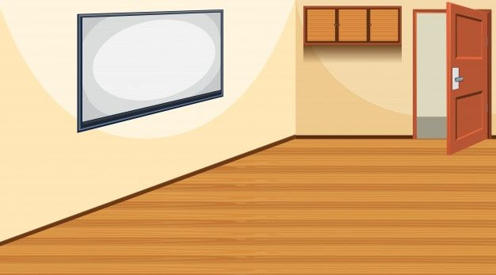





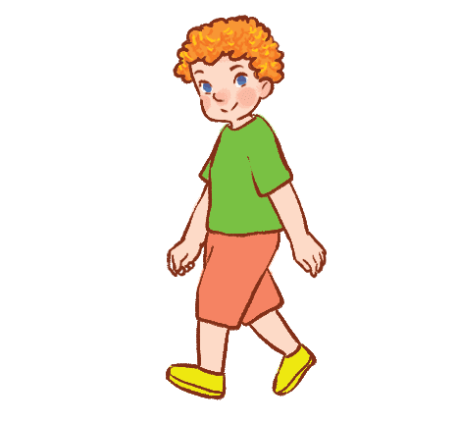



TEAM B
TEAM A

Slide 18
TEAM B
TEAM A

Slide 19



TEAM B
TEAM A

