Slide 1
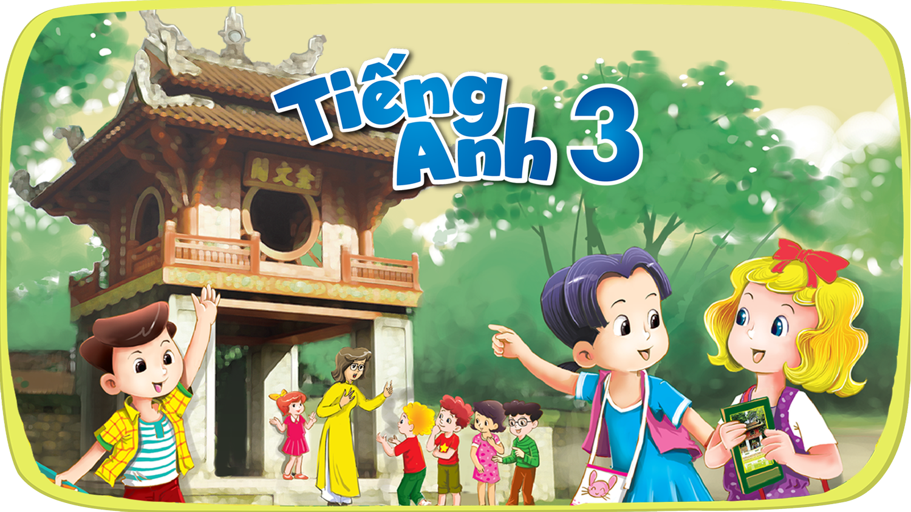


Slide 2







9
Colours
LESSON 3 + LESSON 3

Slide 3
I. OBJECTIVES.
By the end of the lesson, pupils will be able to:
1. Language.
- To pronounce the sounds of the consonant clusters bl and br in isolation, say the words blue and brown, and -- Read the sentences My school bag is blue. and The pencil cases are brown.
- To listen to two sentences and circle the correct options to complete the gaps in two gapped sentences.
- Use the words blue, brown, red, yellow, orange, green, white and black related to the topic “colours”;
2. Core competencies.
- Teamwork, motivation, communication, planning and organization.
3. General competencies.
- Listening: listen and repeat
- Critical Thinking: listen and circle.
- Oral Communication: let’s chant (practice speakin).
- Communication and collaboration: work in pairs or groups.
4. Attributes.
- Responsibility: appreciate kindness.
- Diligence: complete learning tasks.
- Honesty: tell the truth about feelings and emotions.

Slide 4
Warm-up and review

Slide 5
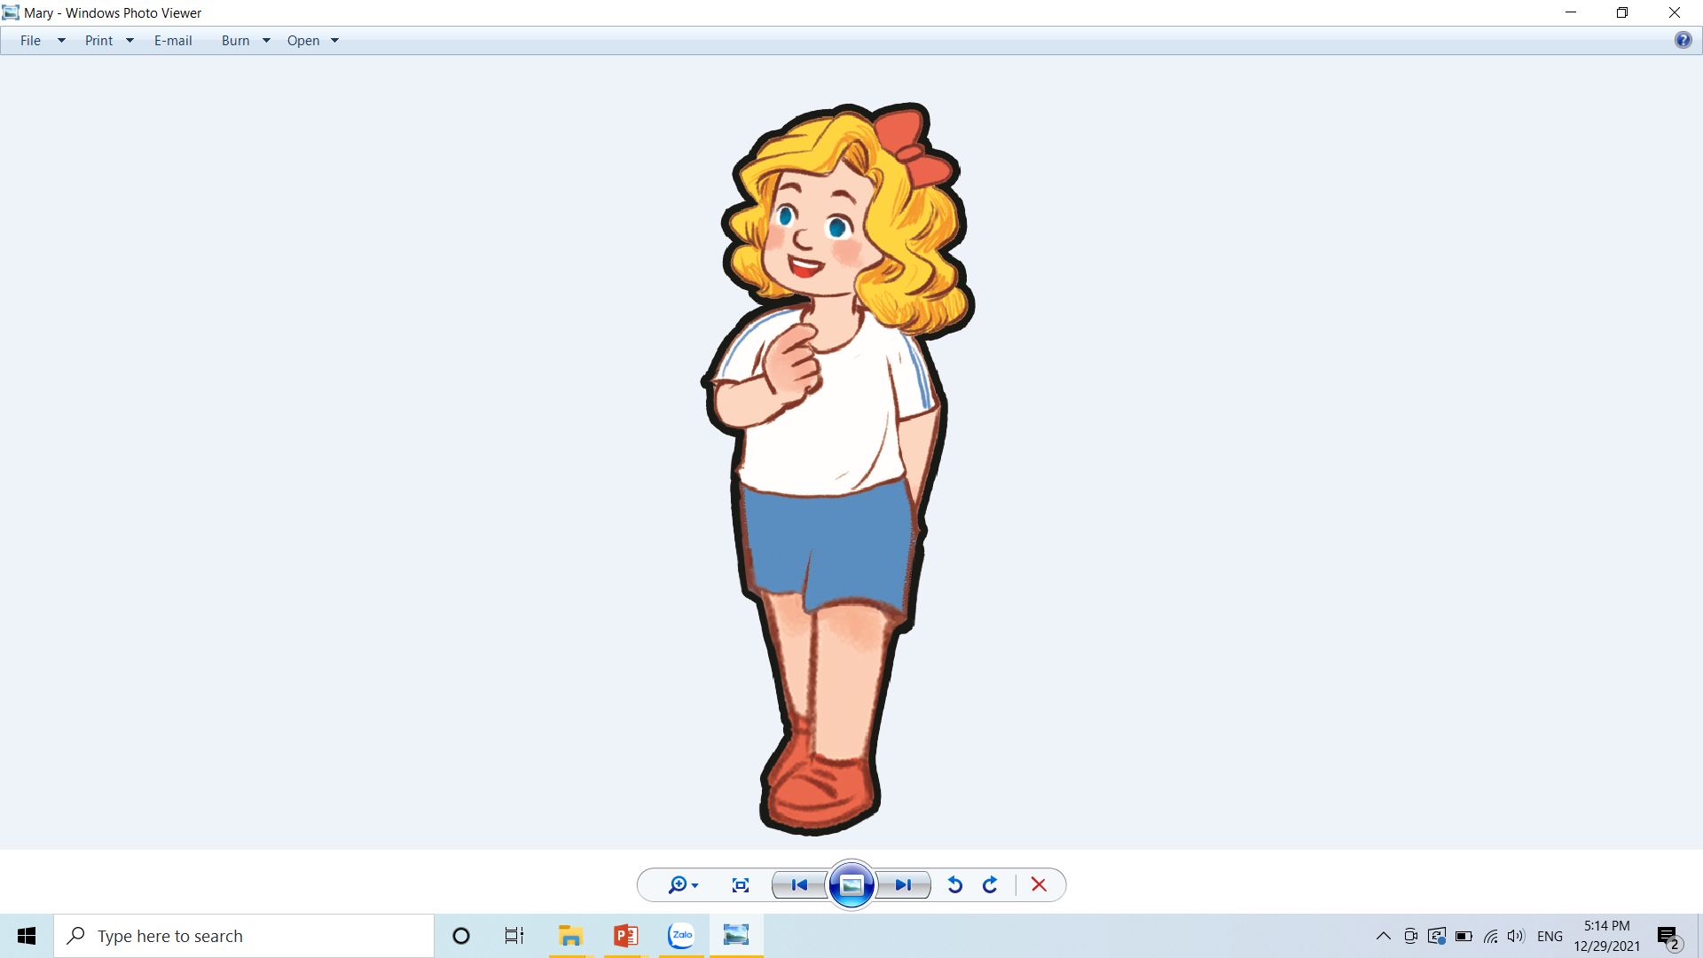

That door could be really fun. Let’s play a game to find out. Are you ready?
Hello, everyone, this is me Mary. Do you like my Anywhere Door?

Slide 6









TEAM 1
0
TEAM 2
0
Notes:
Divide the class into 2 teams.
Each team takes turns choosing from door 1 to 8. Then answer the questions.
Then students can choose to keep or give the points they get to the other team. (Students cannot choose to keep or give twice in a row)

Slide 7
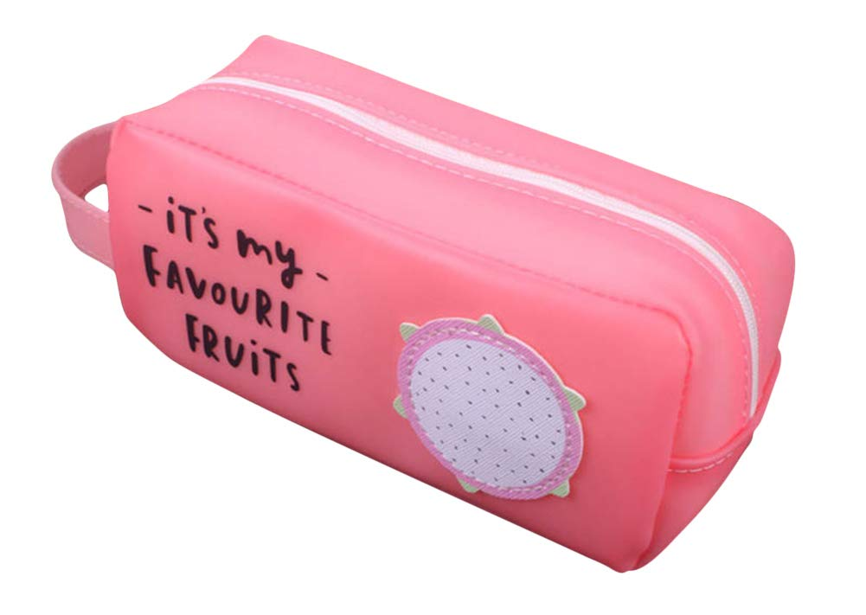
What is it?
What colour is it?
It’s a pencil case.
It’s pink.

Slide 8
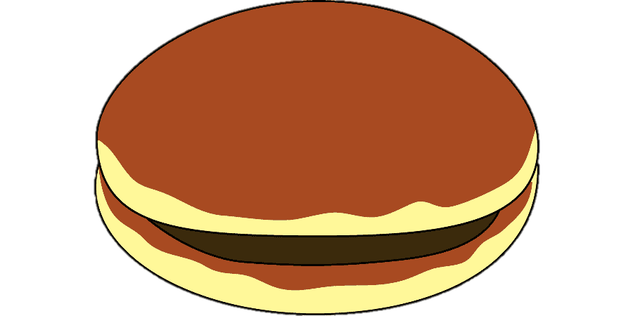
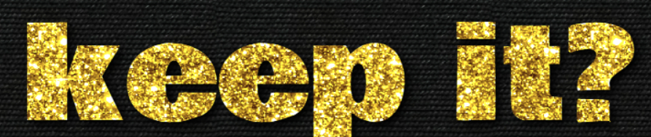
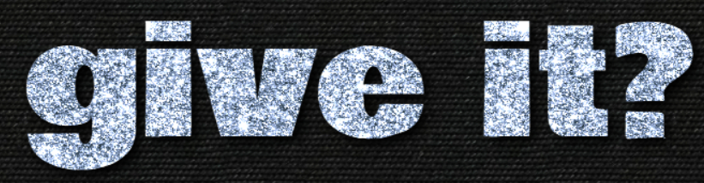
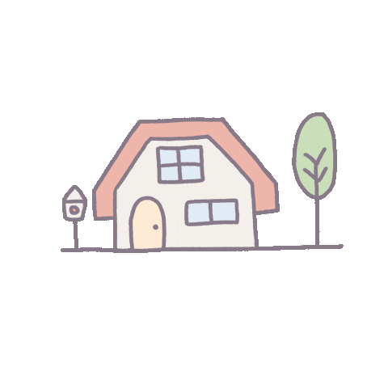
4 points
or
Notes:
Click the home to go back.

Slide 9

What colour are they?
What are they?
They’re notebooks.
They’re orange.

Slide 10
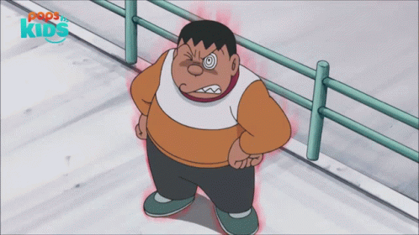

1 point
or
Notes:
Click the home to go back.

Slide 11
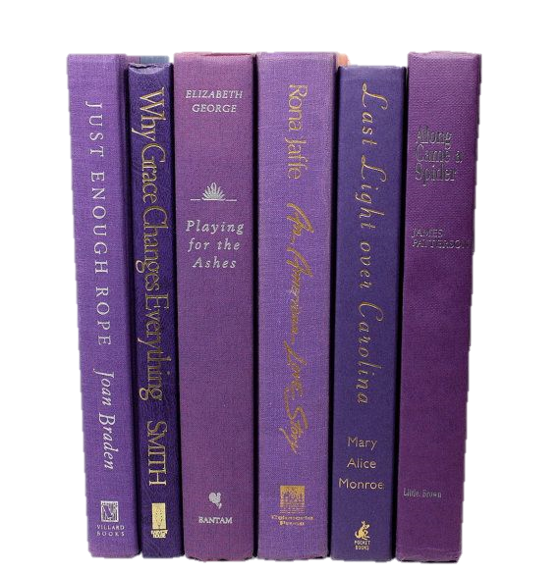
What are they?
What colour are they?
They’re books.
They’re purple.

Slide 12
3 points
or
Notes:
Click the home to go back.

Slide 13
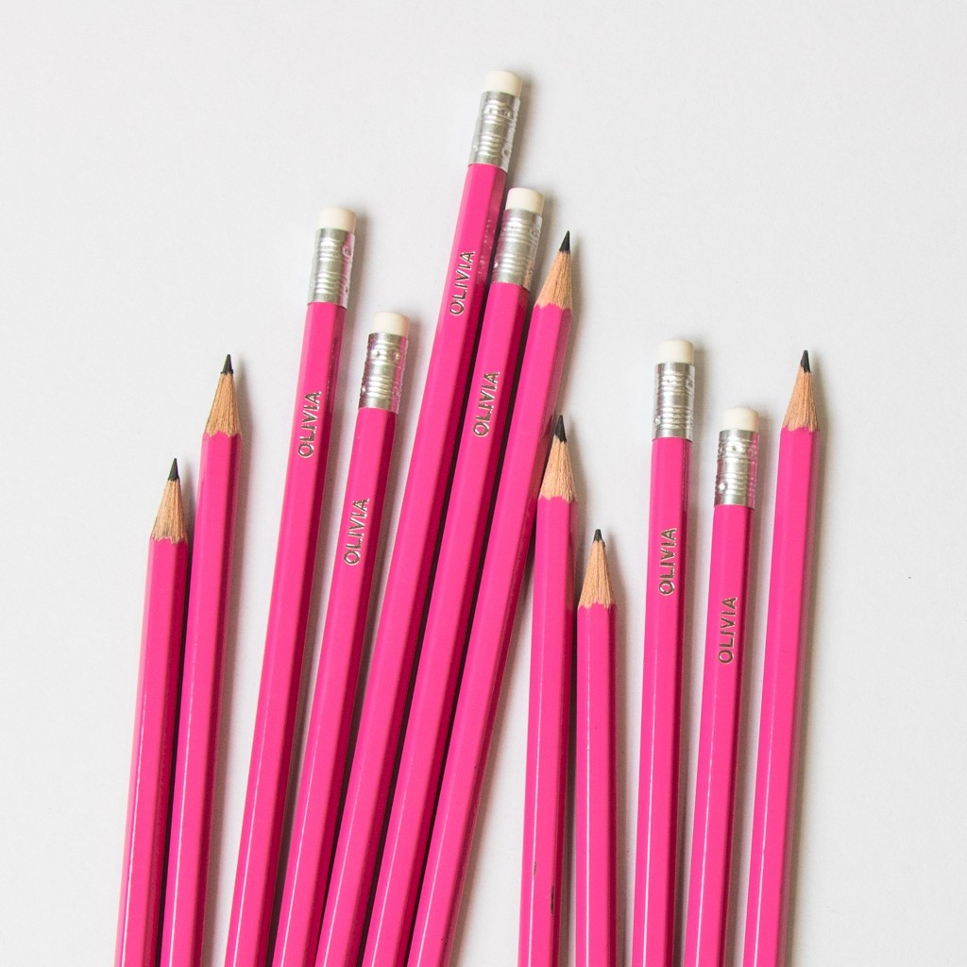
What are they?
What colour are they?
They’re pink.
They’re pencils.

Slide 14
2 points
or
Notes:
Click the home to go back.

Slide 15
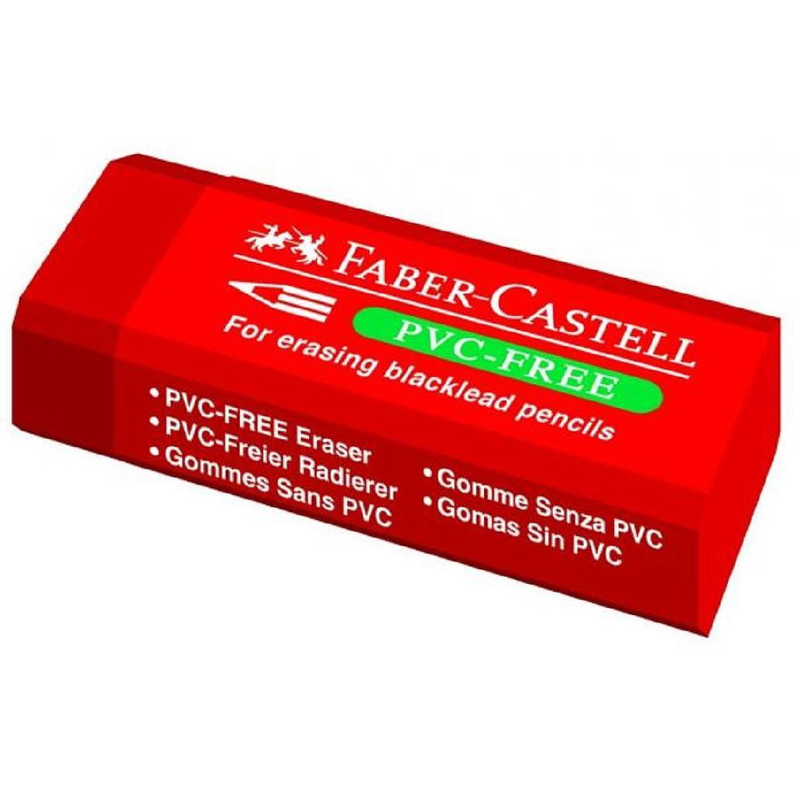
What colour is it?
What is it?
It’s an eraser.
It’s red.

Slide 16
2 points
or
Notes:
Click the home to go back.

Slide 17
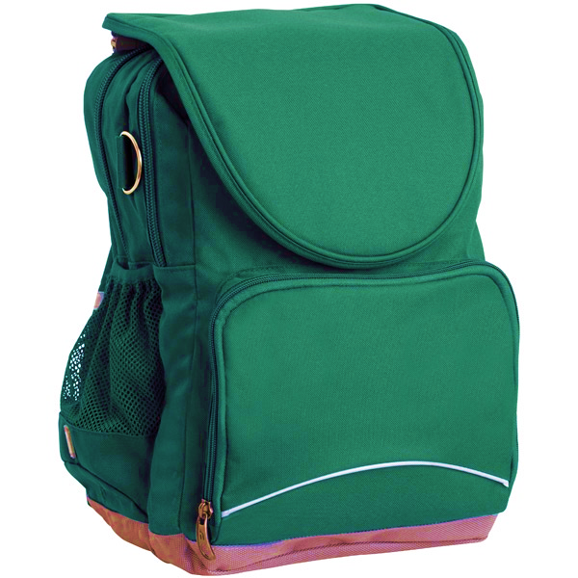
What colour is it?
What is it?
It’s a school bag.
It’s green.

Slide 18
3 points
or
Notes:
Click the home to go back.

Slide 19
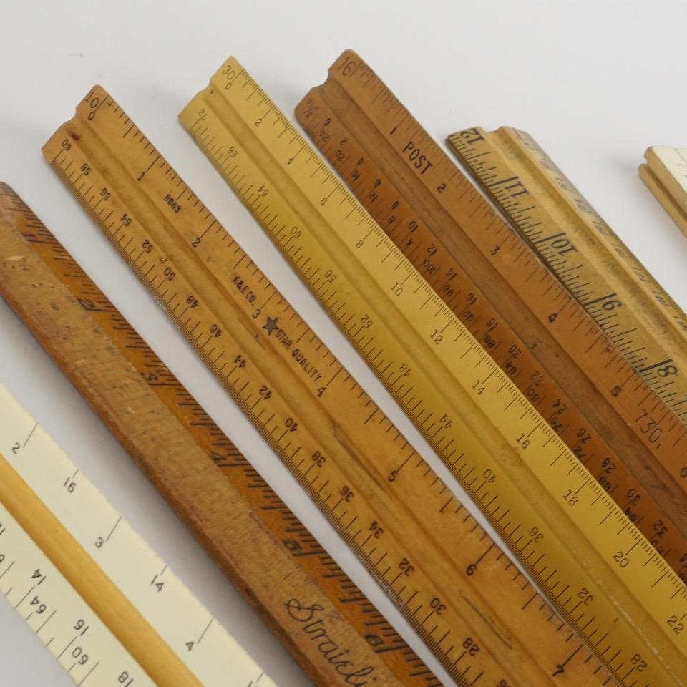
What colour are they?
What are they?
They’re rulers.
They’re brown.

Slide 20
0 point
or
Notes:
Click the home to go back.

Slide 21
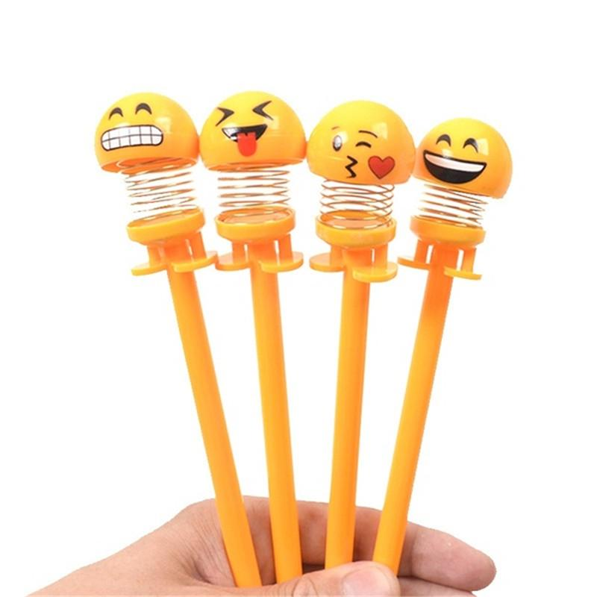
What colour are they?
What are they?
They’re yellow.
They’re pens.

Slide 22
6 points
or
Notes:
Click the home to go back.

Slide 23
1.Listen and repeat.

Slide 24
Well done, boys and girls. Now let’s learn some sounds. Listen and repeat.

Slide 25

bl
ack

Slide 26
bl
ue

Slide 27
br
own

Slide 28
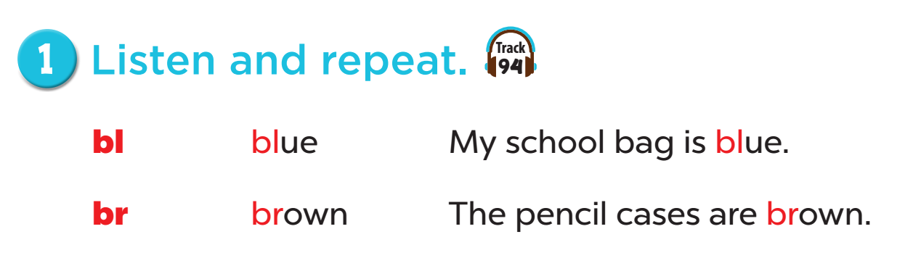

Slide 29
2. Listen and circle.

Slide 30


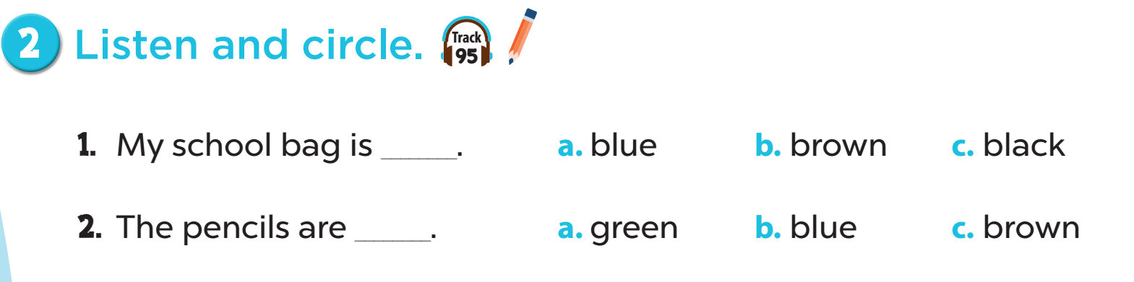


Slide 31
4. Read and tick.

Slide 32
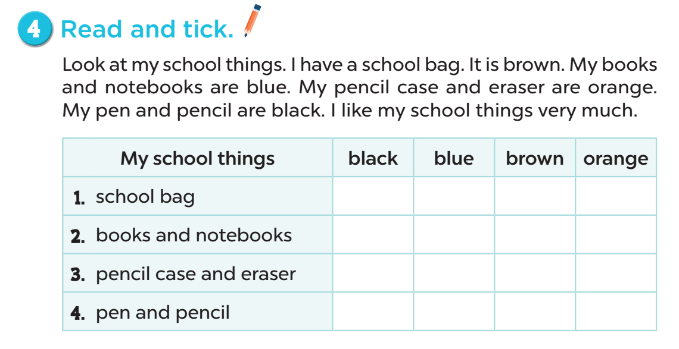
4
1
3
2

Slide 33


Slide 34
Fun corner and wrap-up

Slide 35
bl
ack
Notes:
Slap the board game. (choose the sounds and phonics words)
- Divide the class into groups or play individually.
- Teacher writes some words on the board then plays the sounds.

Slide 36
bl
ue

Slide 37
br
own

