Slide 1

TO CLASS 3H

Slide 2
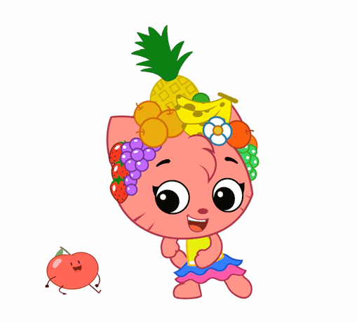
Warm - up

Slide 4
PLAY A GAME
SECRET BOX

Slide 6





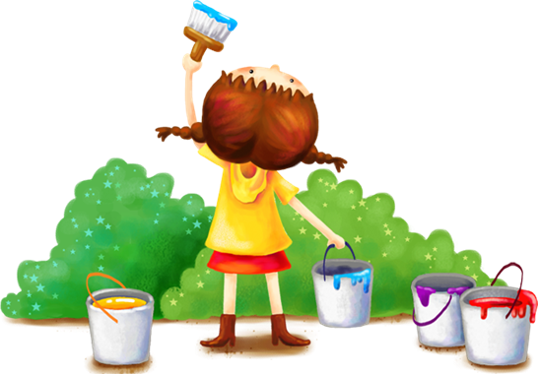

Unit 9
Colours
Lesson 1 (1,2,3)

Slide 7
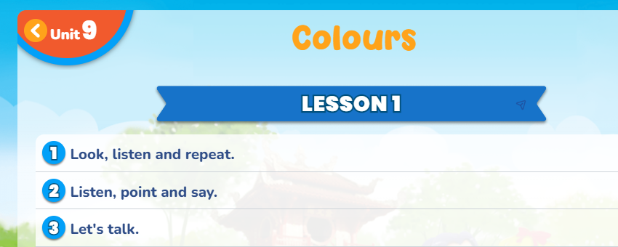

Slide 8




Vocabulary
blue
: màu xanh dương
brown
: màu nâu
red
: màu đỏ
yellow
: màu vàng

Slide 9
GAME:
WHAT’S MISSING?

Slide 10


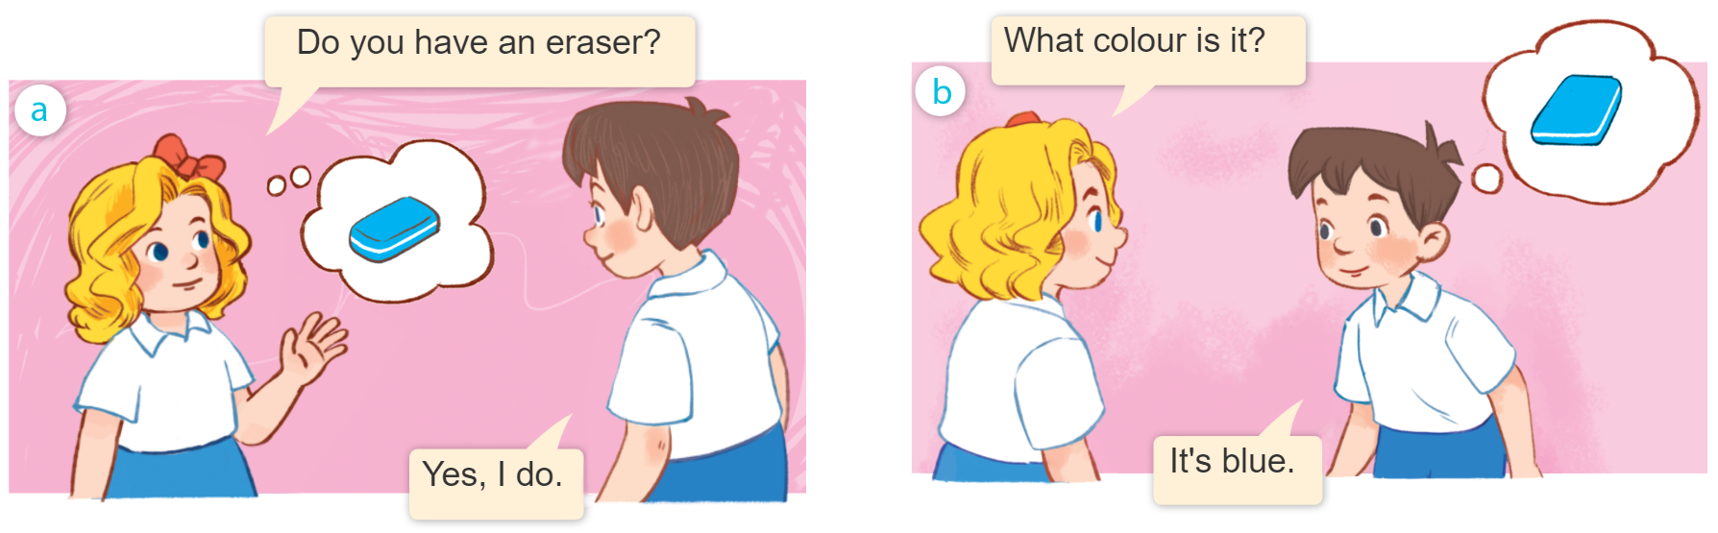
1
Look, listen and repeat.

Slide 11
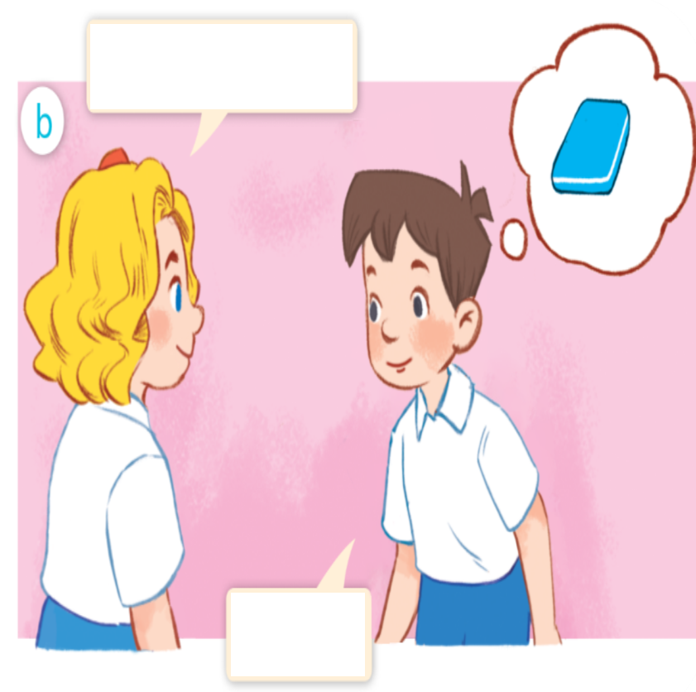
What colour is it?
It’s blue.

Slide 12


Structure
What colour is it?
It’s blue.

Slide 13
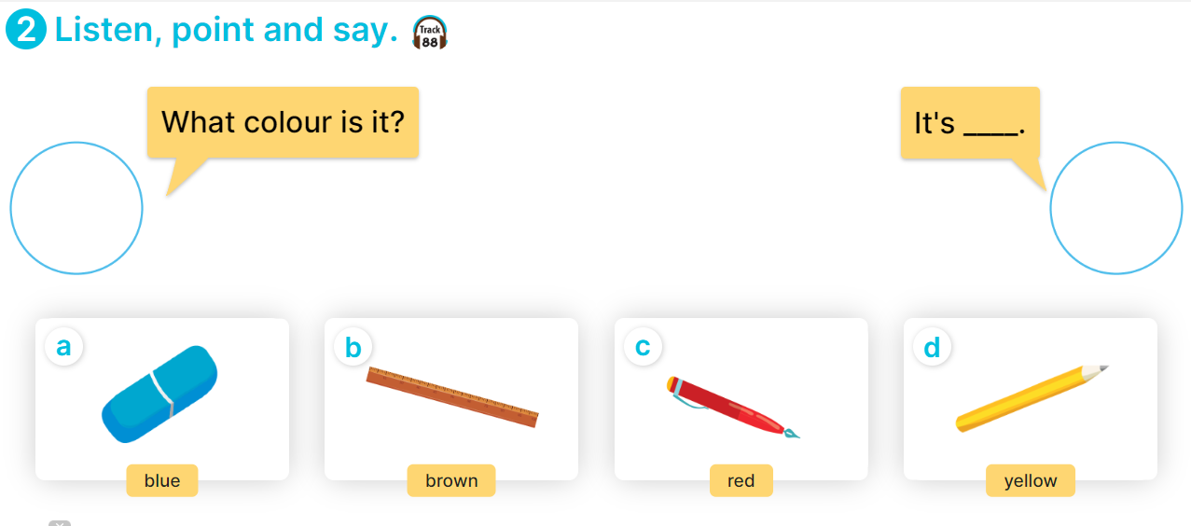

Slide 14





2
Listen, point and say.
What colour is it?
It’s ________.
blue
brown
red
yellow

Slide 15

3
Let‘s talk.
What color is it?
It’s ________.

Slide 16
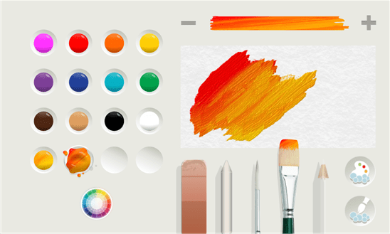
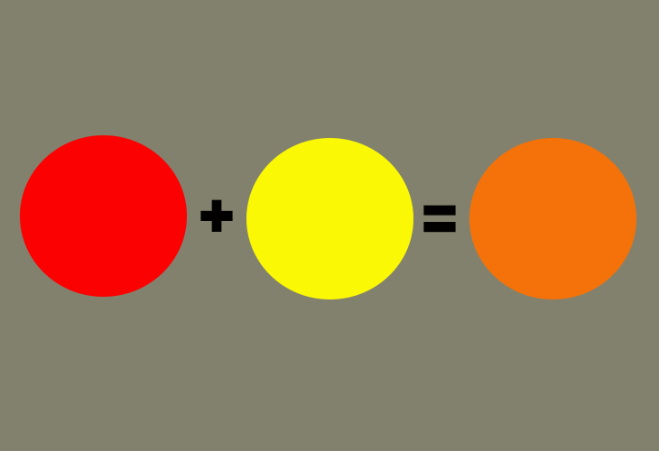
Mixing colours
Red and yellow make orange

Slide 17
Thank you!

