Slide 1




Slide 2







9
Colours
LESSON 1 + Lesson 2

Slide 3
I. OBJECTIVES.
By the end of the lesson, pupils will be able to:
1. Language.
- Use the words blue, brown, red, yellow related to the topic “Colours”;
- Use What colour is it? – It’s ______. to ask and answer questions about colours of school things;
- Listen to and demonstrate understanding of simple exchanges related to the topic “Colours”;
- Read and write about the colours of school things.
2. Core competencies.
- Teamwork, motivation, communication, planning and organization
3. General competencies.
- Listening: listen and tick
- Critical Thinking: listen, complete and read
- Oral Communication: let’s play (practice speaking)
- Written Communication: complete the sentence
- Communication and collaboration: work in pairs or groups
4. Attributes.
- Diligence: complete learning tasks
- Honesty: tell the truth about feelings and emotions
- Leadership: collaborate with teachers to enhance language skills

Slide 4
REVIEW

Slide 5
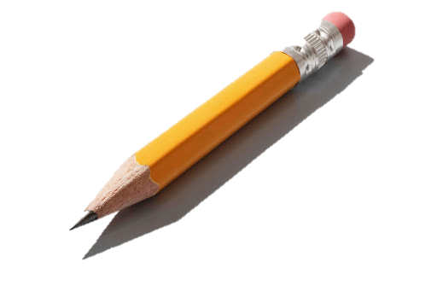
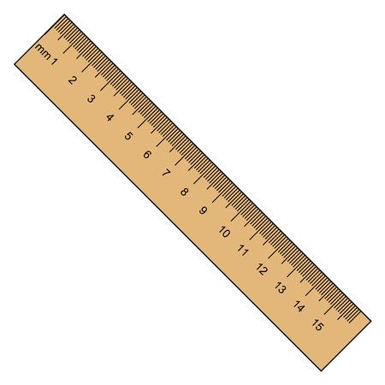






Look and say the colours.
yellow
black
pink
brown
blue
green
white
orange

Slide 6
What’s missing?
yellow
black
pink
brown
blue
green
white
orange

Slide 7
What’s missing?
yellow
black
pink
brown
blue
green
white
orange

Slide 8
What’s missing?
yellow
black
pink
brown
blue
green
white
orange

Slide 9
What’s missing?
yellow
black
pink
brown
blue
green
white
orange

Slide 10
What’s missing?
yellow
black
pink
brown
blue
green
white
orange

Slide 11
What’s missing?
yellow
black
pink
brown
blue
green
white
orange

Slide 12
What’s missing?
yellow
black
pink
brown
blue
green
white
orange

Slide 13
What’s missing?
yellow
black
pink
brown
blue
green
white
orange

Slide 14
What’s missing?
yellow
black
pink
brown
blue
green
white
orange

Slide 15
5. Look complete and read

Slide 16
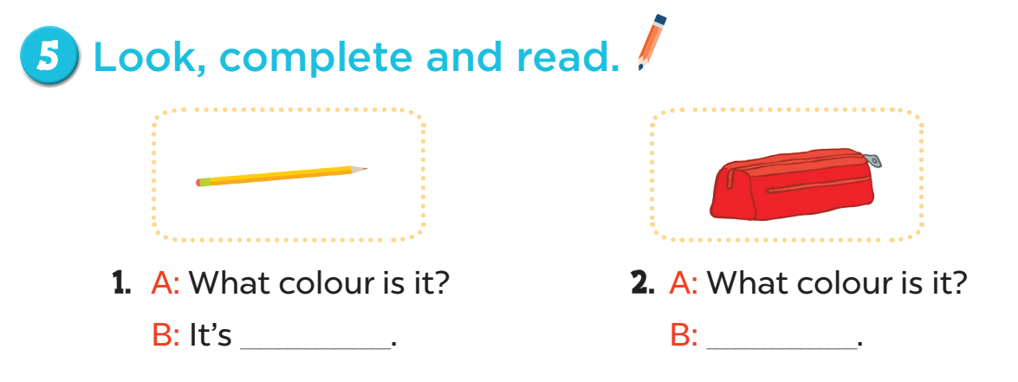
yellow
It’s red

Slide 17
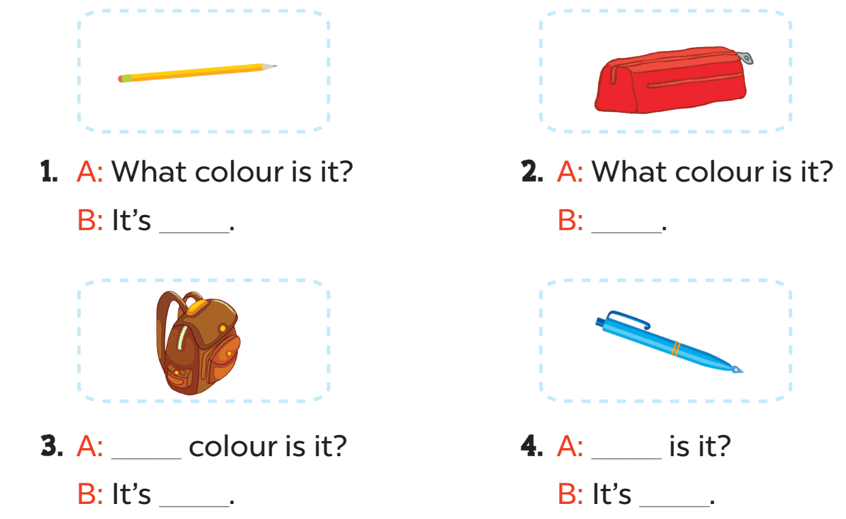
3. A: _______colour is it?
B: It’s __________.
4. A: ______________is it?
B: It’s __________.
What
What colour
brown
blue

Slide 18
5. Look complete and read

Slide 19
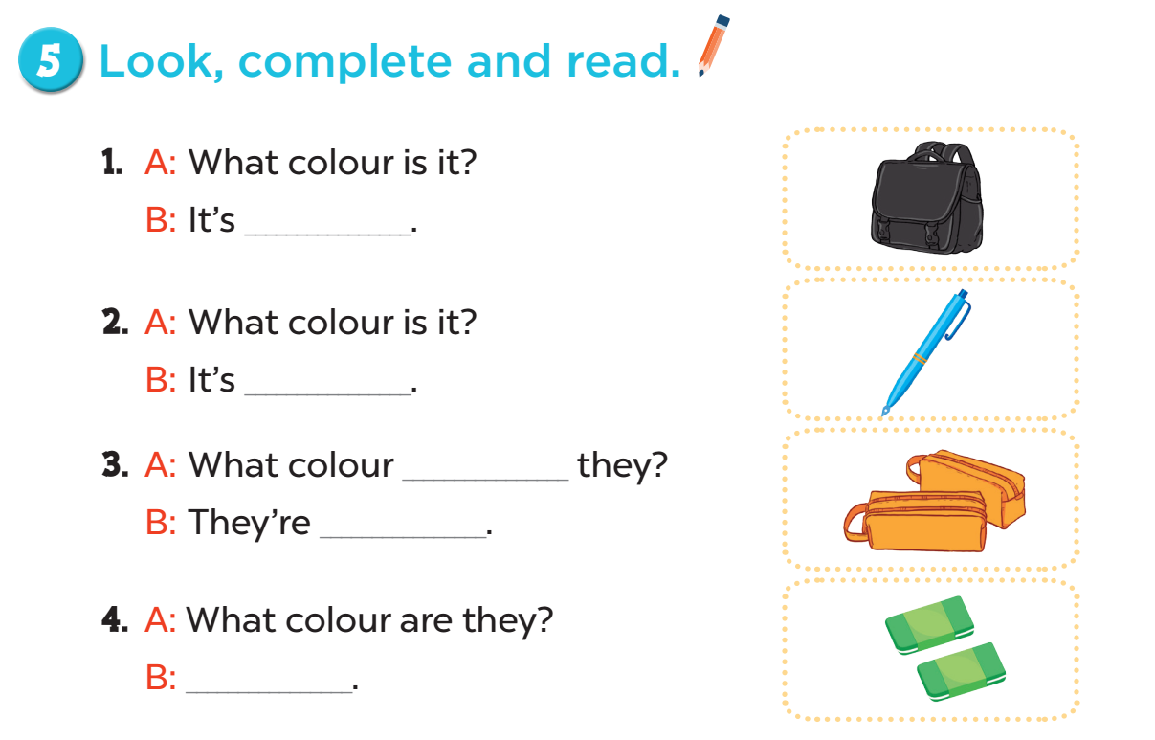

black
blue
are
orange
green

Slide 20
6. Let’s sing

Slide 21
