Slide 1
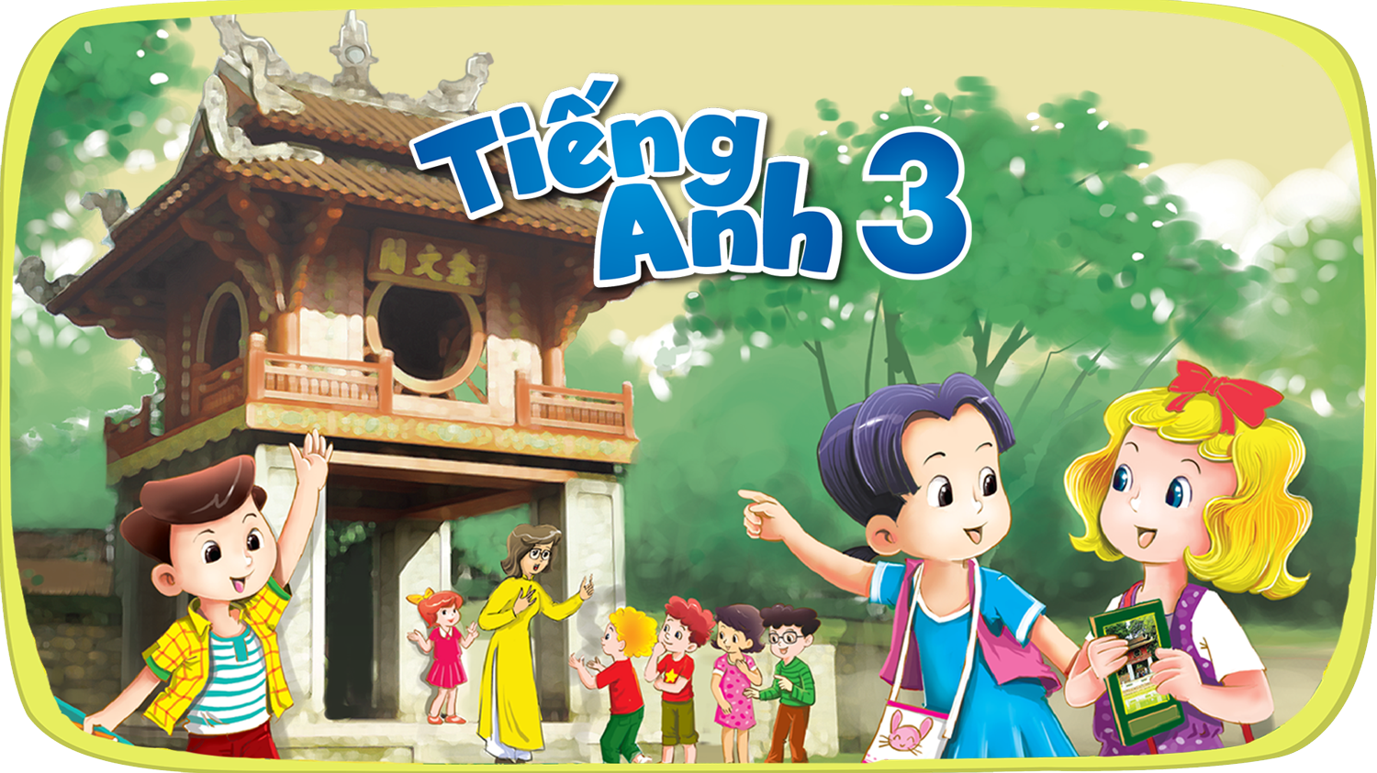


Slide 2


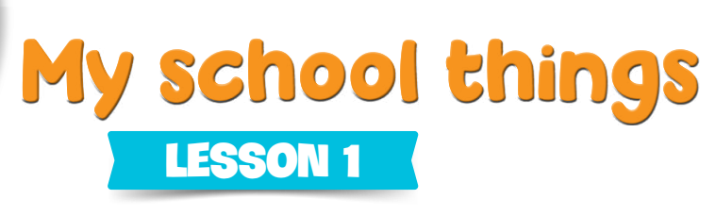
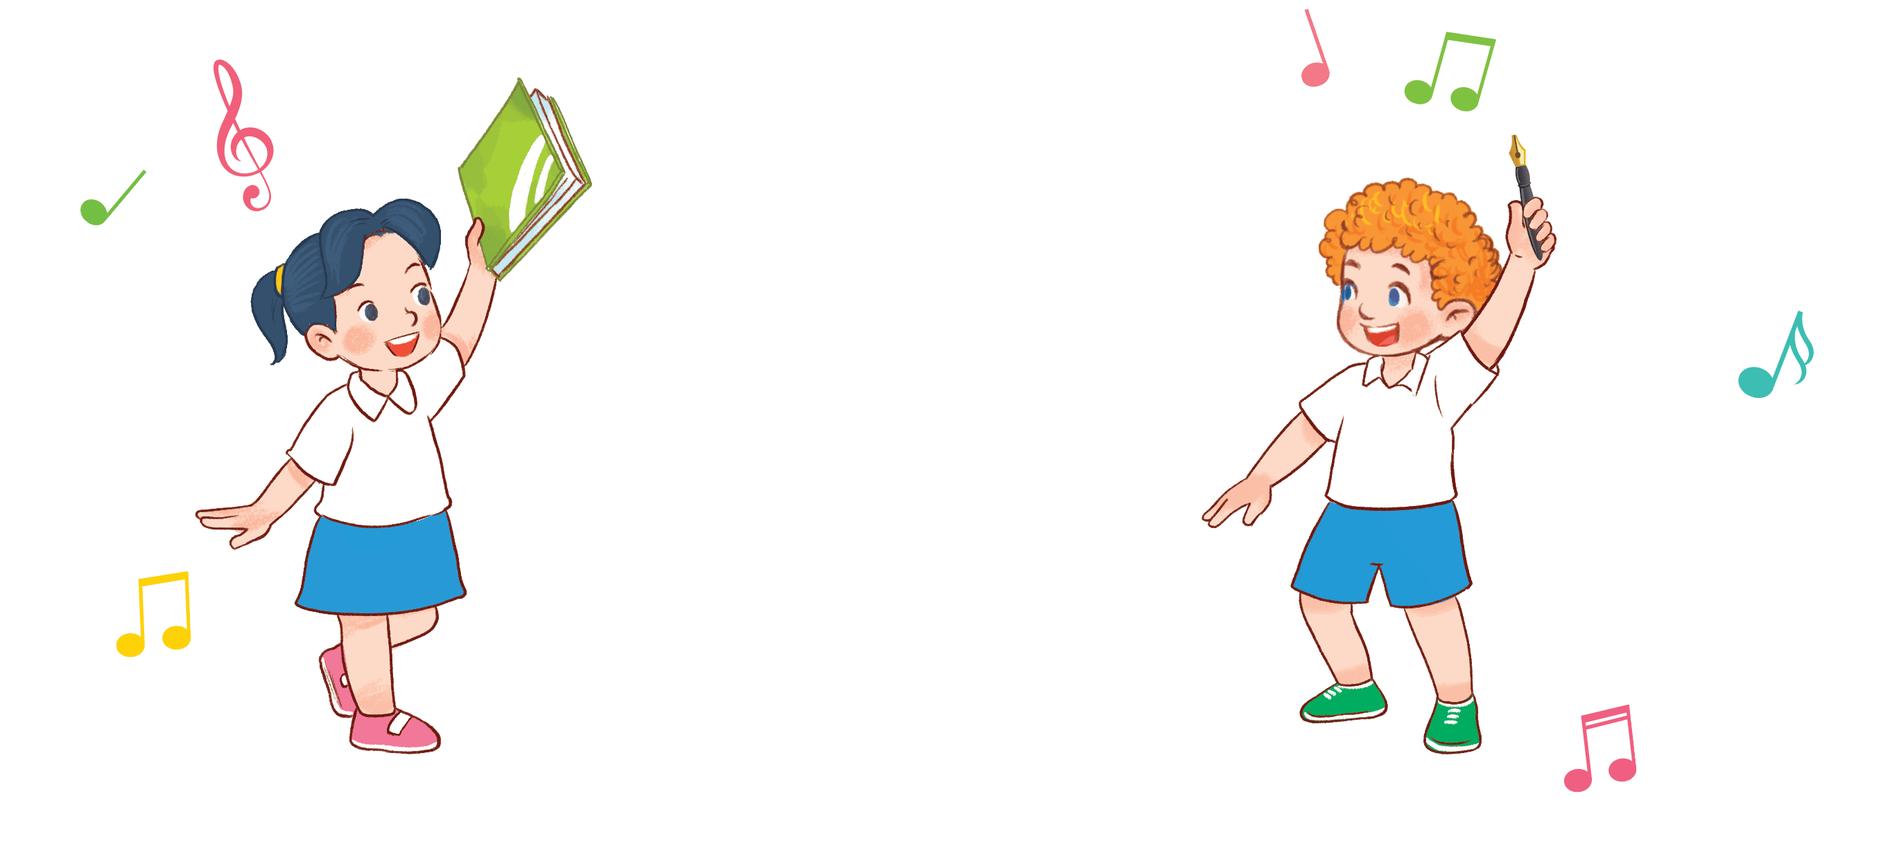
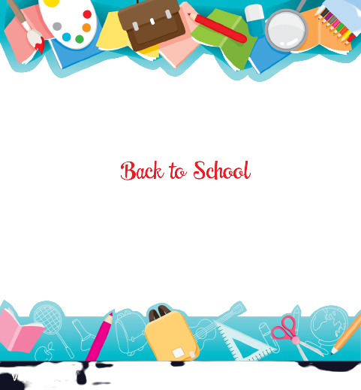
8
2

Slide 3
I. OBJECTIVES.
By the end of the lesson, pupils will be able to:
1. Language.
- Understand and correctly repeat the sentences in two communicative contexts (pictures) focusing on the questions and answers about having a school thing.
- Correctly say the words and use Do you have _____? − Yes, I do. / No, I don’t. to ask and answer questions about having a school thing.
- Enhance the correct use of Do you have _____? − Yes, I do. / No, I don’t. to ask and answer questions about having a school thing.
2. Core competencies.
problem-solving, decision making, teamwork, reliability, motivation, adaptability, and initiative
3. General competencies.
Listening: look, listen and repeat
Critical thinking: listen, point and say
Oral communication: let’s talk
Sociability: talk to each other, say good words to others
4. Attributes.
Diligence: complete learning tasks
Responsibility: appreciate kindness
Secure and organized: keep school things in the right ways

Slide 4
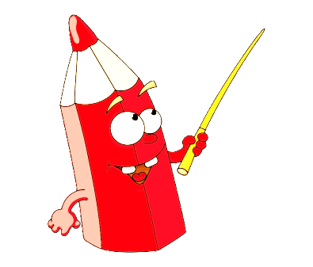

Warm-up and review

Slide 5

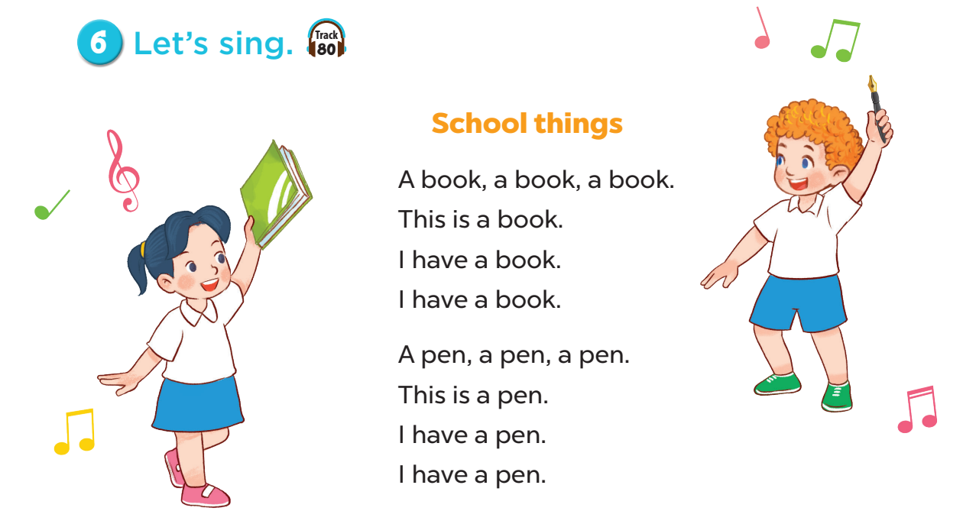
Notes:
Sing the song School things of Unit 8, page 57.
- Ask pupils to sing the song.
- Invite some of them to the board to role play and do action, the rest of the pupils will sing.
- Ask pupils to sing this song with some words covered. When they finish singing, check the lyrics.

Slide 6
1. Look, listen and repeat.

Slide 7
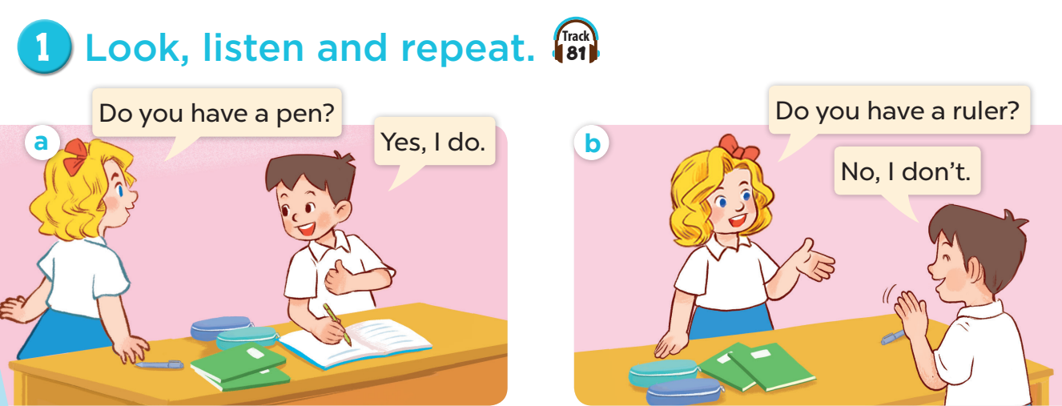

Slide 8
2. Listen, point and say.

Slide 9
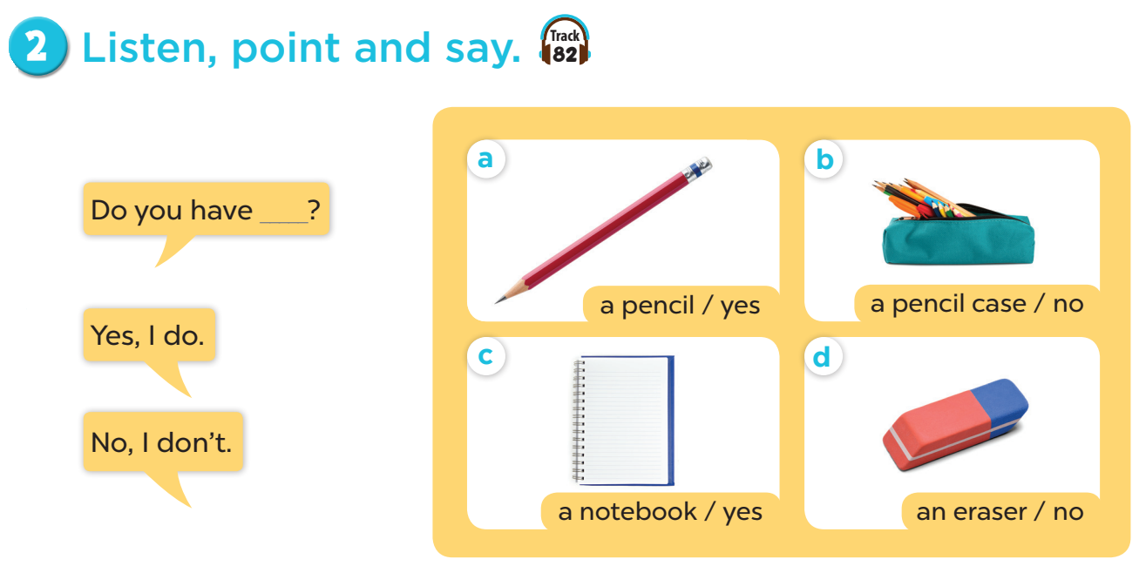

Slide 10


Slide 11




LUCKY WHEEL
30
20
1
2
3
40
10
Stop
SPIN
50
80
4
5
6
60
70
7
8
9
Next activity
Notes:
Game: LUCKY WHEEL
- Divide the class into four groups.
- Each group takes turns to pick a number.
- Look at the picture cue and answer the question on the slide.

Slide 12

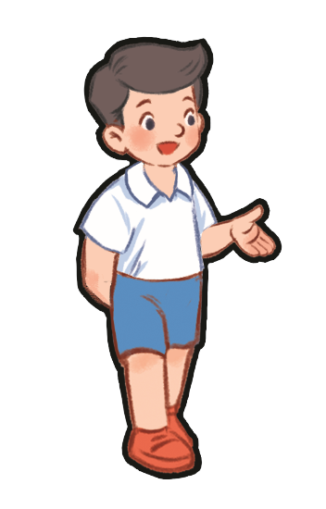
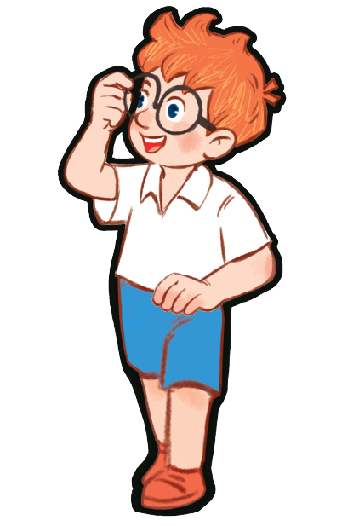
Do you have a pen?
☑
Yes, I do.
…………
Notes:
Game: Do you have…?

Slide 13
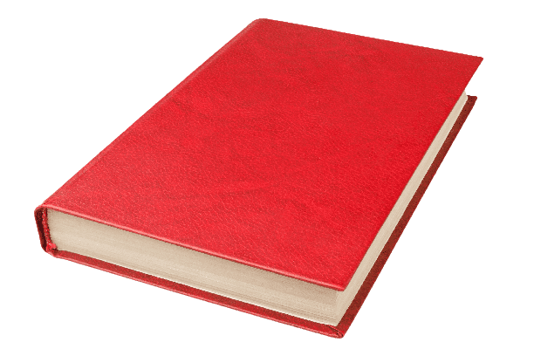
Do you have a book?

No, I don’t.
…………
Notes:
Game: Do you have…?

Slide 14
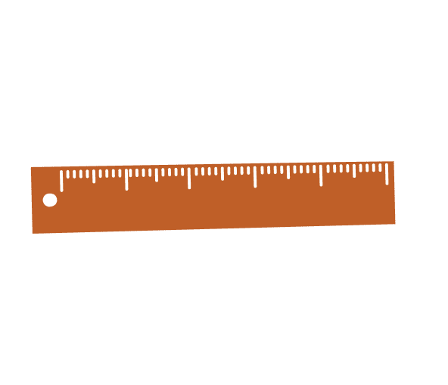
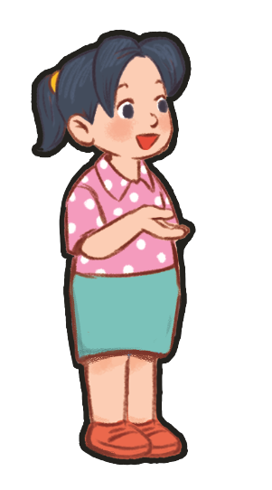
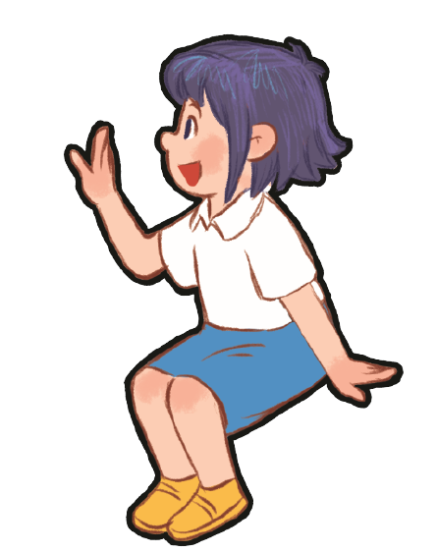
Do you have a ruler?

No, I don’t.
…………
Notes:
Game: Do you have…?

Slide 15

Do you have a pencil?
☑
Yes, I do.
…………
Notes:
Game: Do you have…?

Slide 16
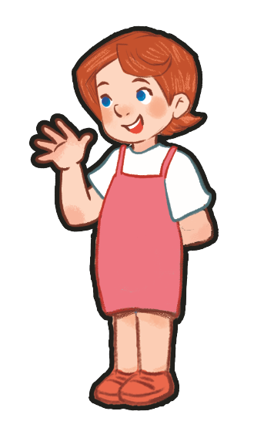
Do you have a ruler?
☑
Yes, I do.
…………
Notes:
Game: Do you have…?

Slide 17
Do you have a pen?

No, I don’t.
…………
Notes:
Game: Do you have…?

Slide 18
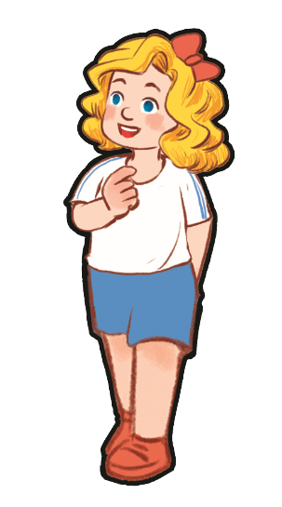
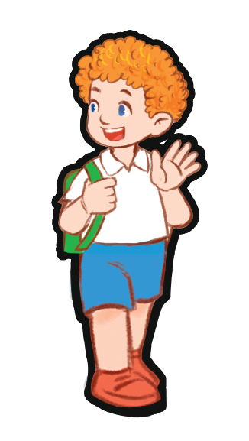
Do you have a book?

No, I don’t.
…………
Notes:
Game: Do you have…?

Slide 19
Do you have a pencil?

No, I don’t.
…………
Notes:
Game: Do you have…?

Slide 20
Do you have a ruler?
☑
Yes, I do.
…………
Notes:
Game: Do you have…?

Slide 21
1. Listen and number.

Slide 22
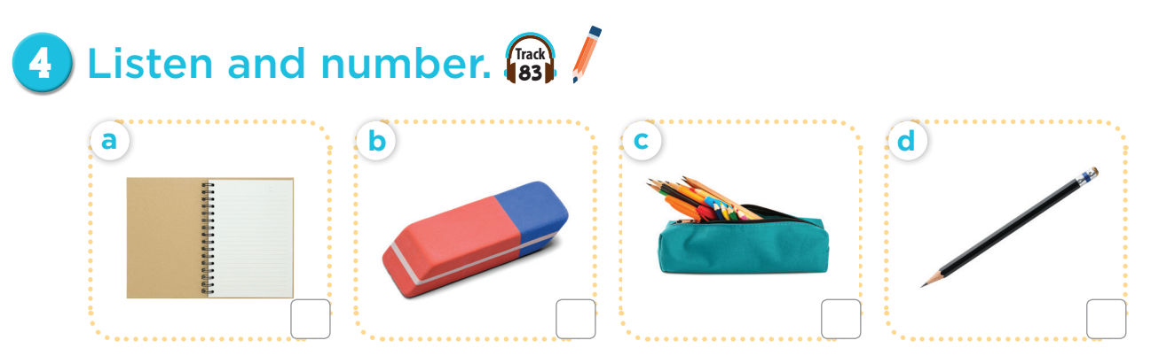
3
4
1
2

Slide 23
Fun corner and wrap-up
Notes:
Teacher tells pupils to put their school things on the desk.
Ask them: Do you have a pen/book/ruler…?
If they have that item, say: Yes, I do. If not, then say: No, I don’t.

Slide 24
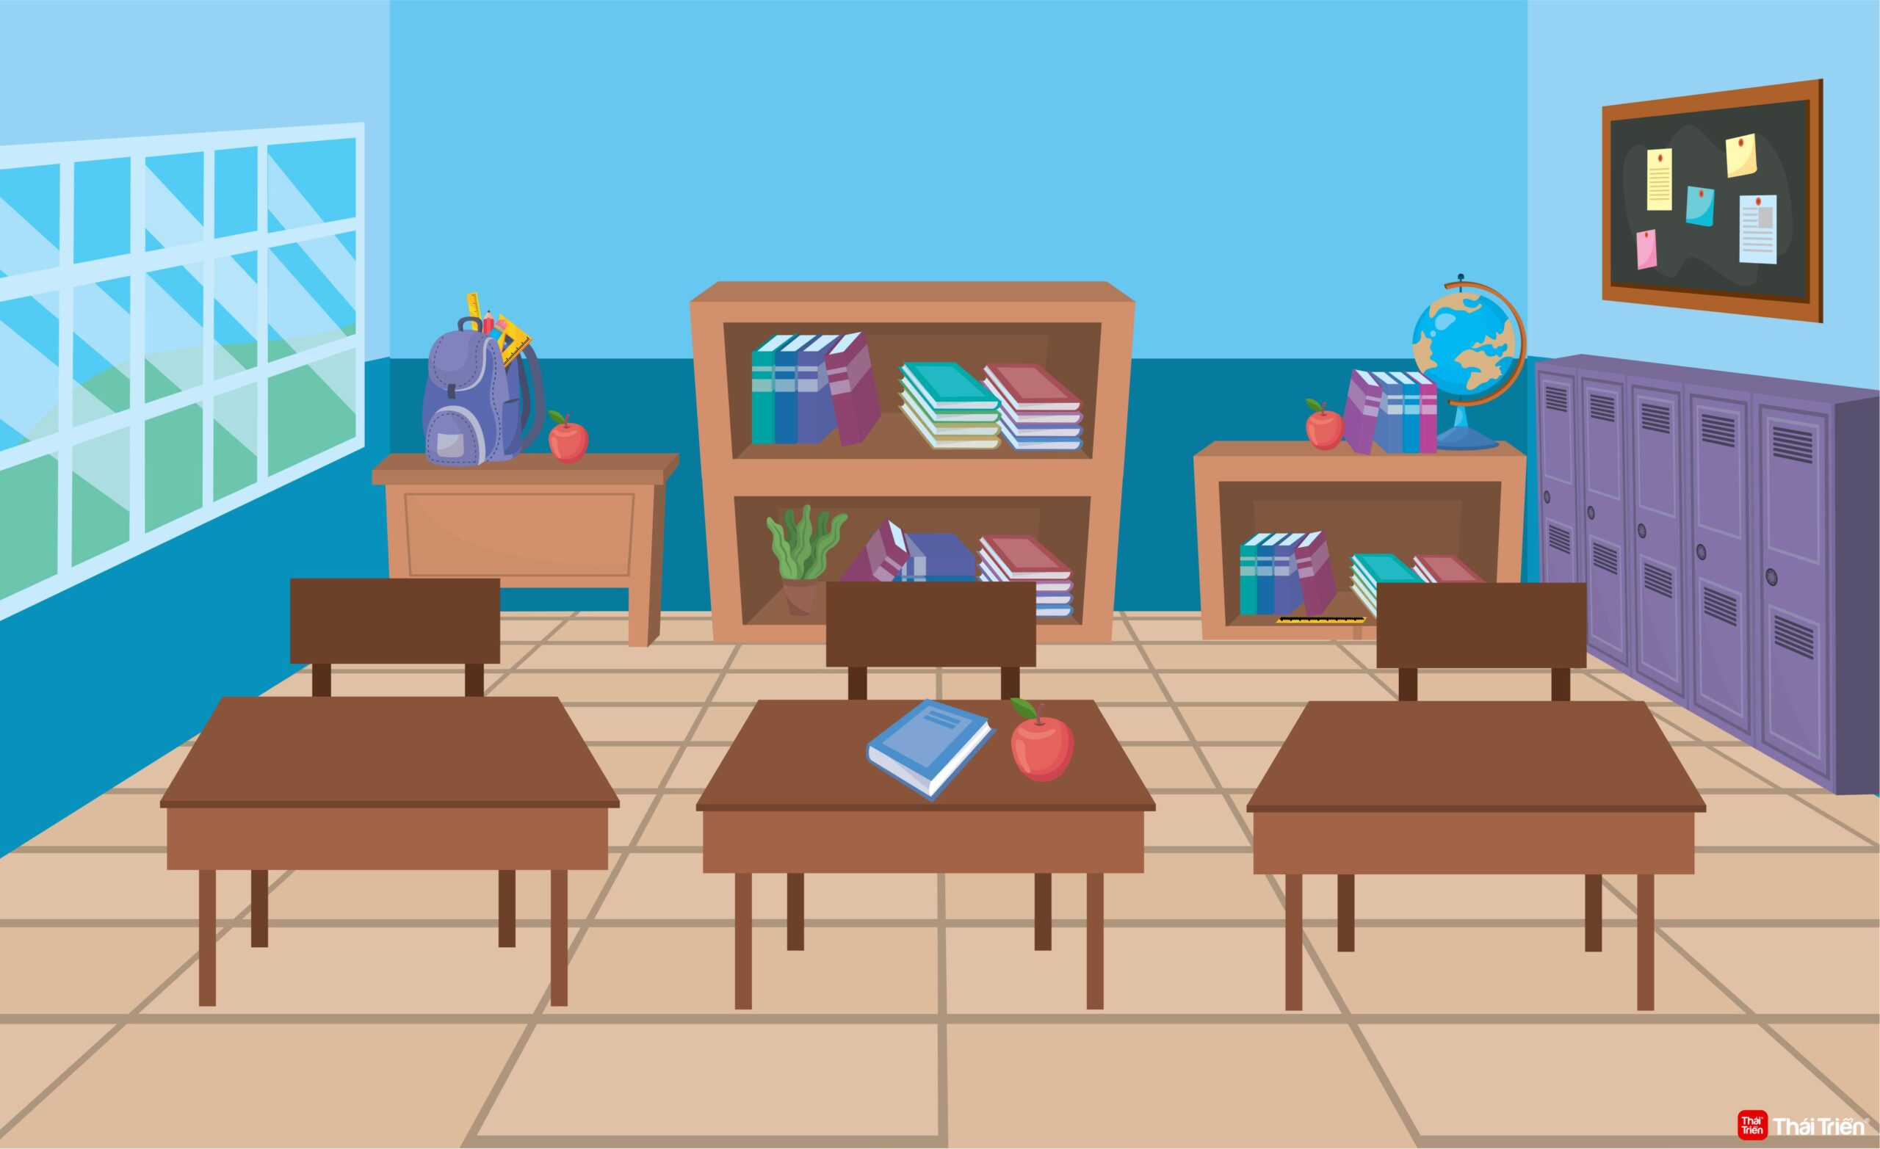
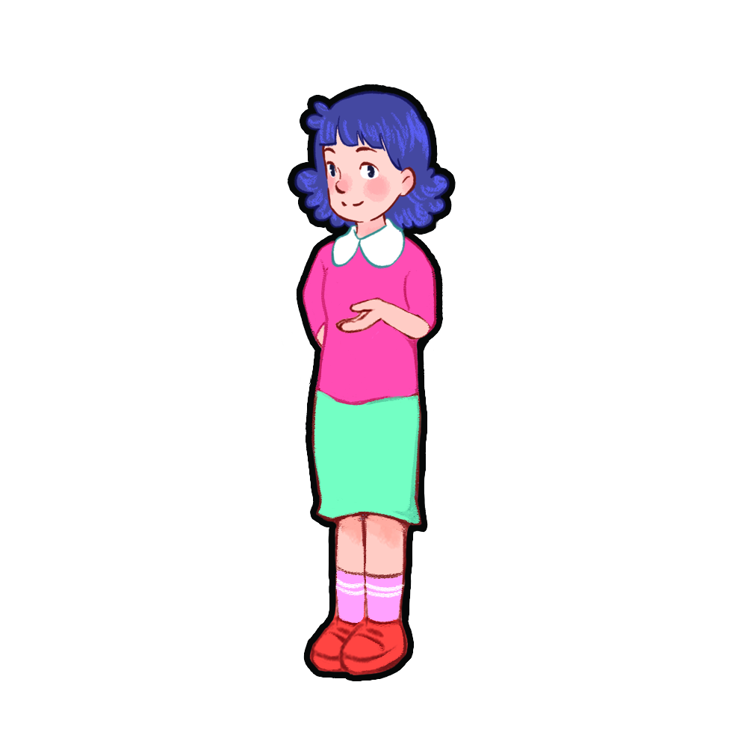
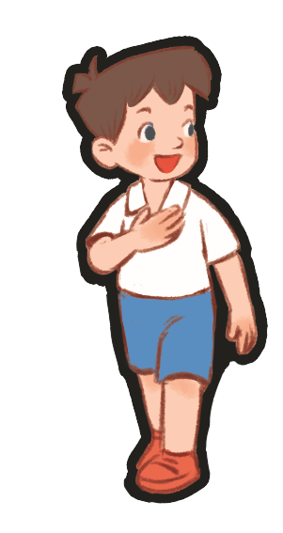

Do you have a ruler?
No, I don’t.
Yes, I do.
Yes, I do.

