Slide 1
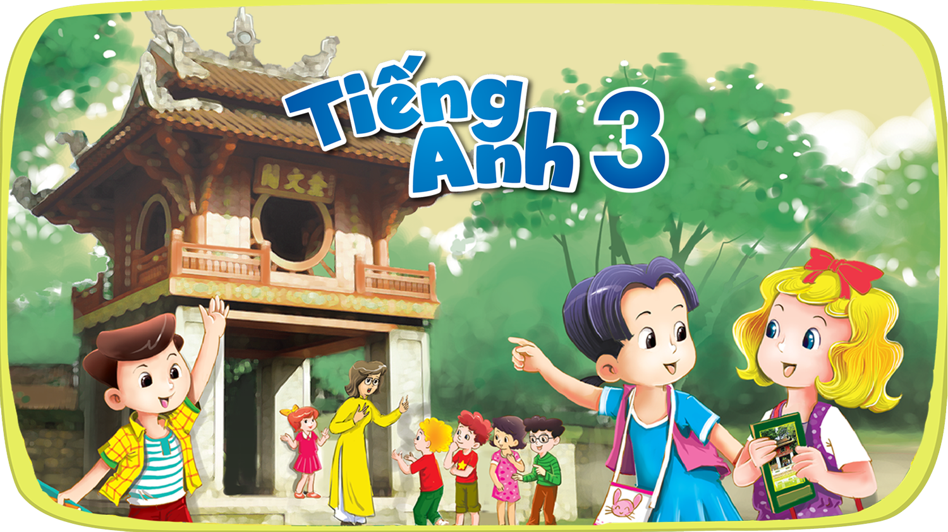


Slide 2


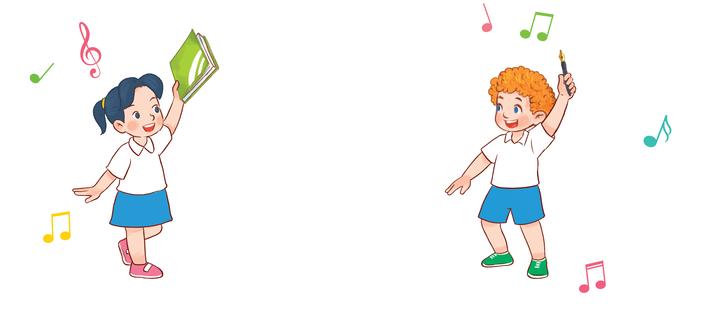

8
My school things
Lesson 1 + Lesson 2

Slide 3
I. OBJECTIVES.
By the end of the lesson, pupils will be able to:
1. Language.
- Read and complete the four gapped sentences with the help of the picture cues.
- Sing the song School things with the correct pronunciation and melody.
- Read and match four simple exchanges with the correct pictures
- Review vocabulary words for school things and use them in the sentence patterns
Do you have _____? and Yes, I do. / No, I don’t. by playing the matching game or Pelmanism.
2. Core competencies.
- Decision making, teamwork, motivation, adaptability, problem-solving, integrity, initiative
3. General competencies.
- Listening: listen and choose the correct answers
- Oral communication: sing a song
- Written communication: complete the sentences
- Self-control & independent learning: perform listening tasks
- Communication and collaboration: work in pairs or groups
4. Attributes.
- Kindness: pupils wait for their turns to answer the questions
- Diligence: complete learning tasks
- Leadership: collaborate with teachers to enhance language skills

Slide 4
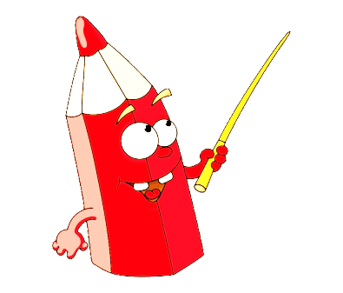

Warm-up and review
Notes:
Sentence Puzzle
- Divide the class into groups of four.
- Give each group a sentence that is broken/cut into pieces.
- Ask them to arrange the words to make a complete sentence, then read it aloud.
- The group that makes it first will be the winner.

Slide 5


Game: Sentence puzzle
pen.
have
I
a
I
have
a
pen.
Notes:
Wait for the clock to count down.
Click anywhere to show the answer.

Slide 6

Game: Sentence puzzle
book.
have
a
I
I
have
a
book.
Notes:
Wait for the clock to count down.
Click anywhere to show the answer.

Slide 7
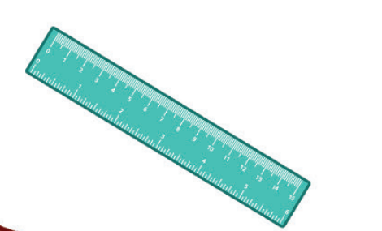
Game: Sentence puzzle
I
have
a
ruler.
I
have
a
ruler.
Notes:
Wait for the clock to count down.
Click anywhere to show the answer.

Slide 8
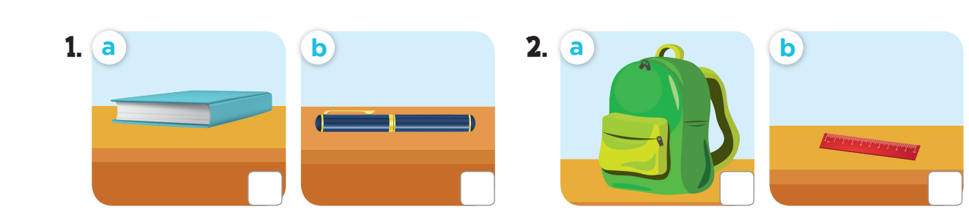

Let’s play:
Who says fast?
I have a book!
Notes:
Game: Who says fast? Teacher points to the picture, pupils say it as fast as they can. This can be played individually or in teams.

Slide 9
5. Look, complete and read.

Slide 10
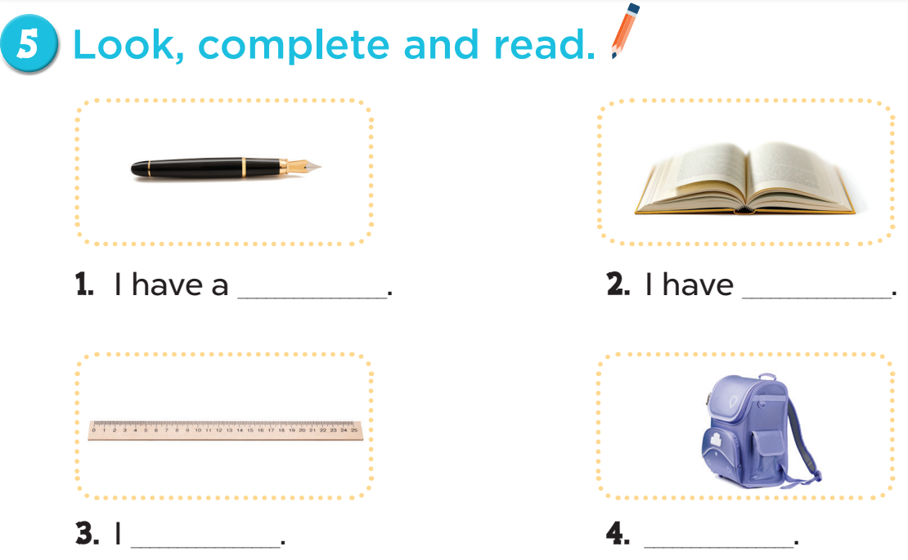
pen
a book
have a ruler
I have a school bag

Slide 11
Game: Choose the right pairs!
Notes:
Game: Choose the right pairs!
- Divide the class into two teams.
- Each pupil from each team comes to the board, choose a card from the left, then choose one from the right. If they match, he/she gets points for their team.

Slide 12


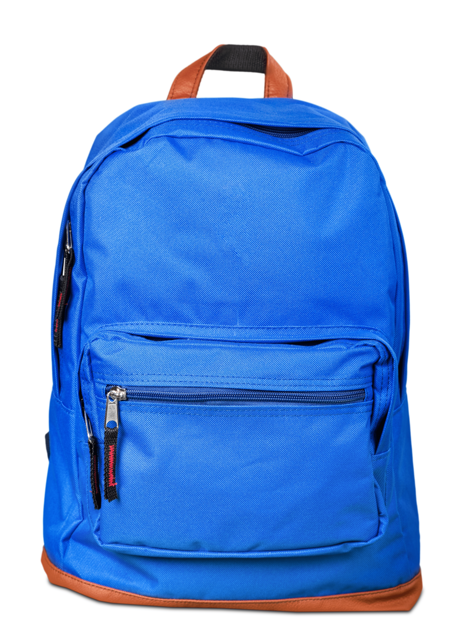
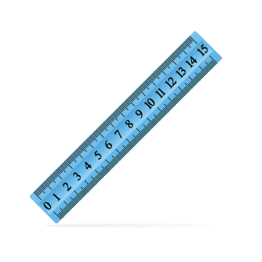

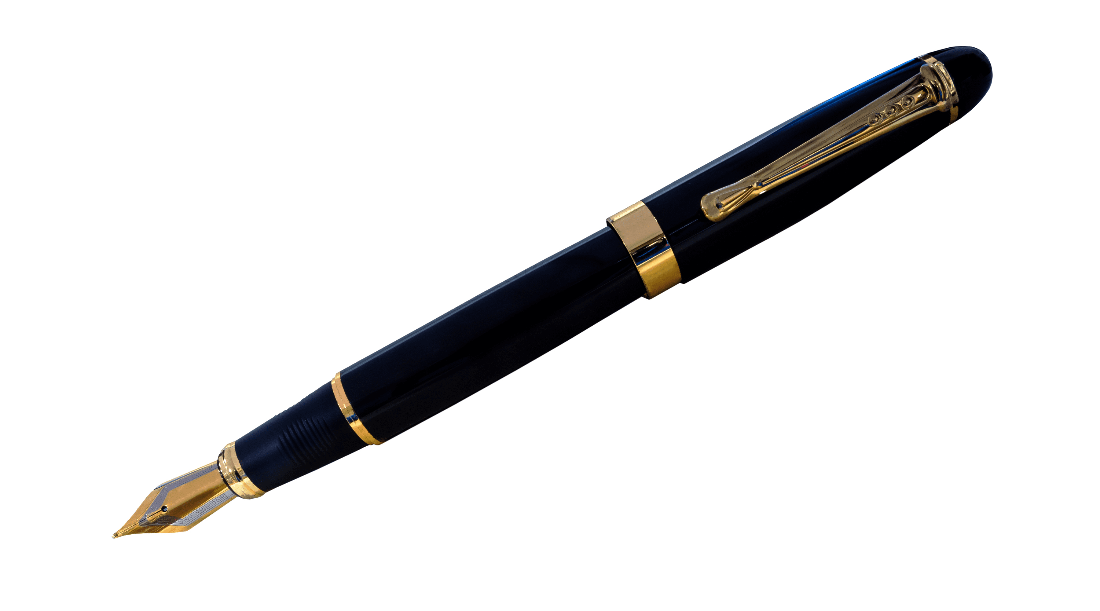
1
2
a
b
I have a ruler.
I have a pen.
3
4
c
d
I have a pencil.
I have a bag.
Notes:
Click the red circle to turn the cards face down again.

Slide 13
6. Let’s sing.

Slide 14
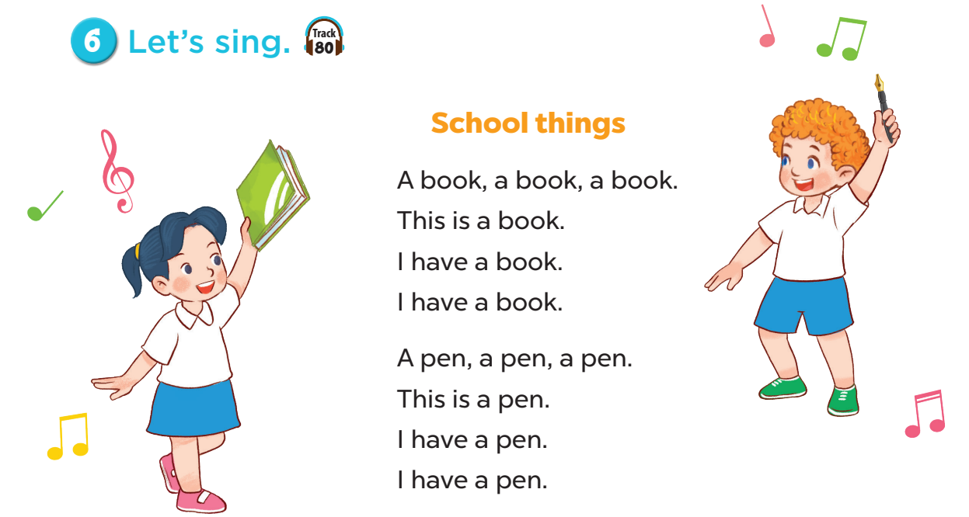


Slide 15
stop
Notes:
Play the song, ask pupils to sing and dance along the song. When the music stops, everybody has to stop moving. Pupils who can’t stop in time will be eliminated.

Slide 16
music

Slide 17
Fun corner and wrap-up

Slide 18
Game: Let’s sing and move!
Notes:
Play music – audio track 80, then ask pupil to sing and dance along with the song, when the music stops, every body has to stop moving. Who can make it is the winner.

Slide 19
6. Read and match.

Slide 20
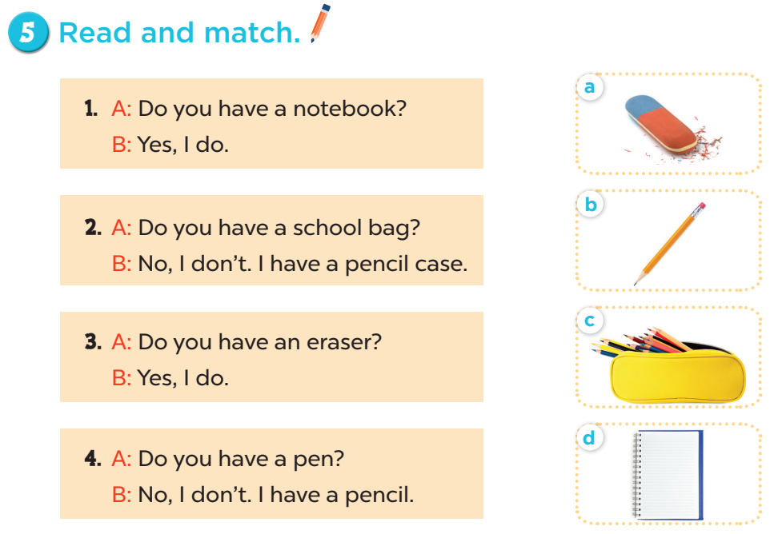

Slide 21

Let’s choose and say!
1
2
3
4
5
6
7
8
Next
Notes:
Let’s choose and say!
Pupils choose a number then choose the correct answer for the question. Who can say it correctly will get points for the team.

Slide 22
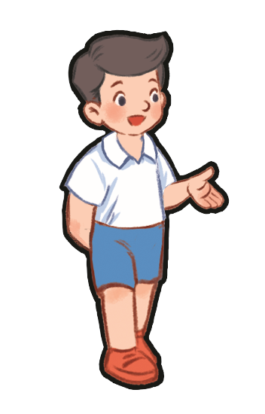



Do you have a pencil?
Yes, I do.
No, I don’t.
Notes:
- Click home to go back.

Slide 23

Do you have a ruler?
Yes, I do.
No, I don’t.
Notes:
- Click home to go back.

Slide 24
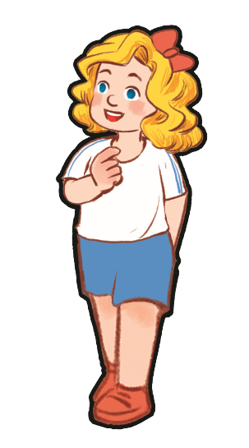
Do you have a book?
Yes, I do.
No, I don’t.
Notes:
- Click home to go back.

Slide 25
Do you have an eraser?
Yes, I do.
No, I don’t.
Notes:
- Click home to go back.

Slide 26
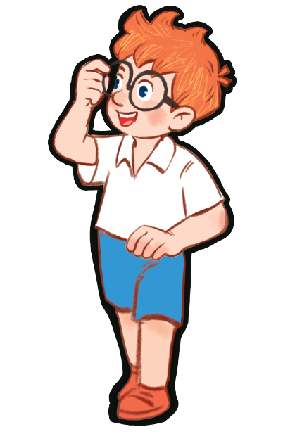
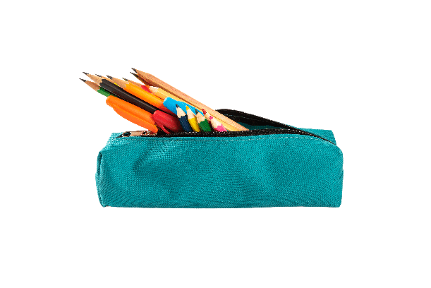
Do you have a pencil case?
Yes, I do.
No, I don’t.
Notes:
- Click home to go back.

Slide 27

Do you have a ruler?
Yes, I do.
No, I don’t.
Notes:
- Click home to go back.

Slide 28
Do you have a pen?
Yes, I do.
No, I don’t.
Notes:
- Click home to go back.

