Slide 1






Unit 6
Our school
Lesson 2 (1,2,3)

Slide 2



WARM - UP
GUESSING

Slide 3


Number 1
A. classroom
B. playground
C. library
C. library

Slide 4
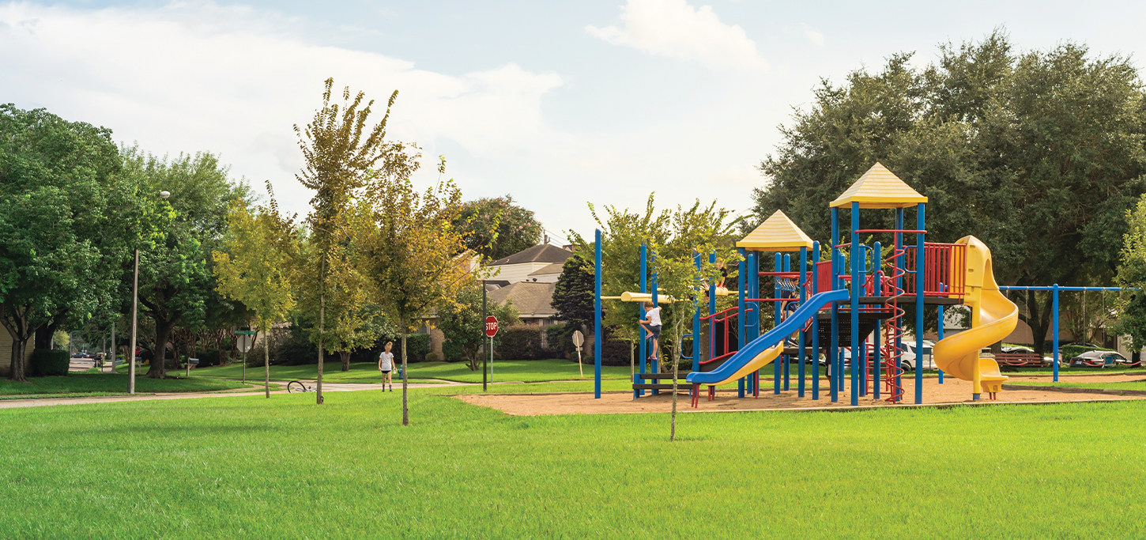

Number 2
A. classroom
B. playground
B. playground
C. library

Slide 5

Number 3
A. classroom
A. classroom
B. library
C. playground

Slide 6

Number 4
A. school
A. school
B. library
C. classroom

Slide 7


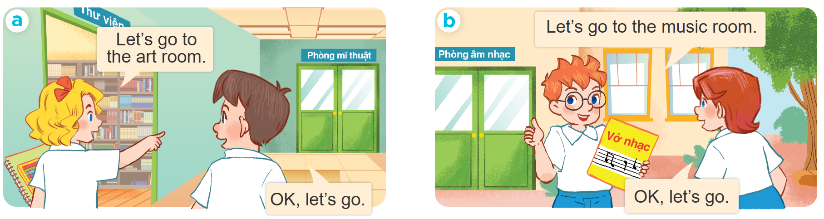

  Look, listen and repeat:

Slide 8


New words:
- Computer room: phòng tin học
- Art room: phòng vẽ
- Music room: phòng âm nhạc
- Gym: phòng thể chất

Slide 9
Model sentence:
A: Let's go to the + phòng học
( Hãy đến phòng .........)
B: Ok. Let's go.
( Được rồi đi thôi )

Slide 10
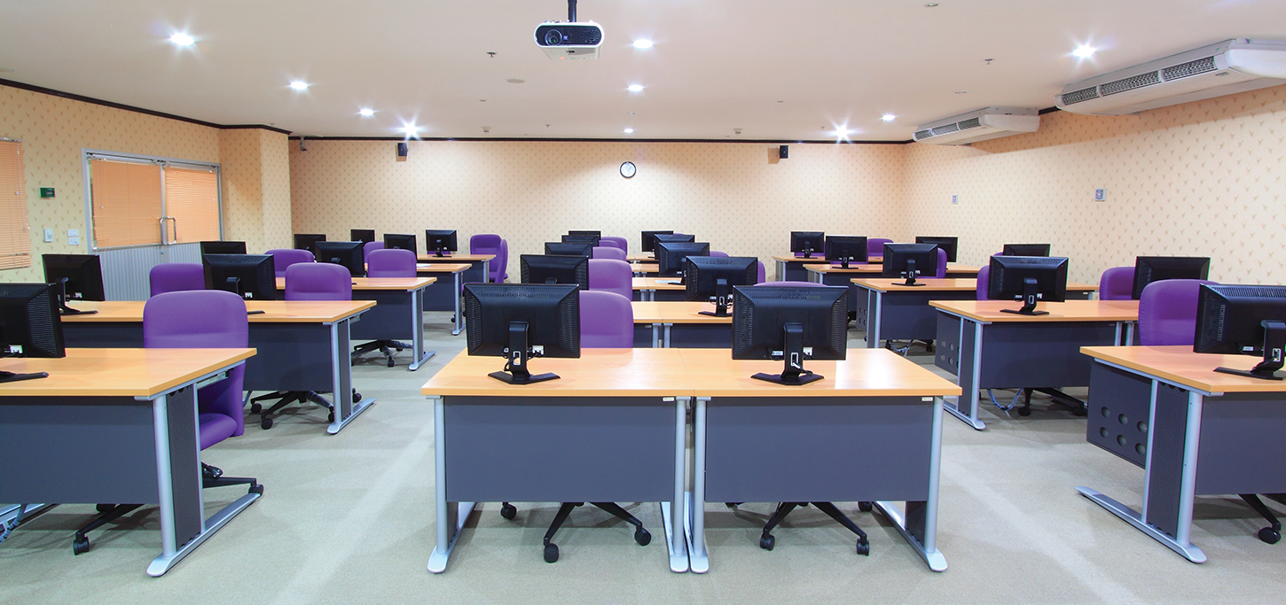

2.Listen, point and say:
Computer
room

Slide 11
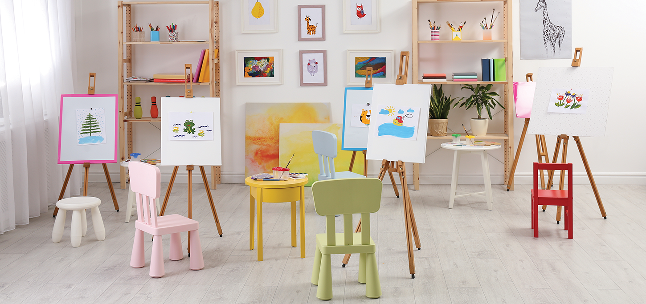
2.Listen, point and say:
Art
room

Slide 12
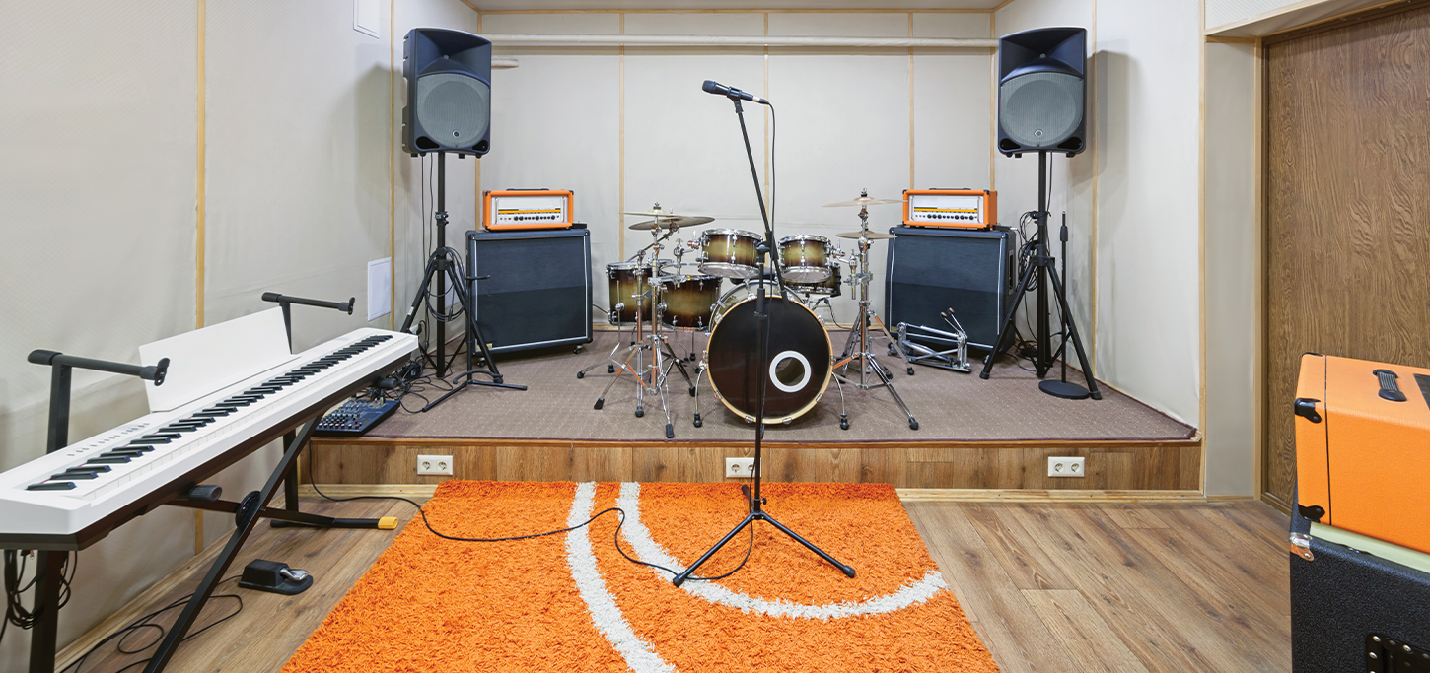
2.Listen, point and say:
Music
room

Slide 13
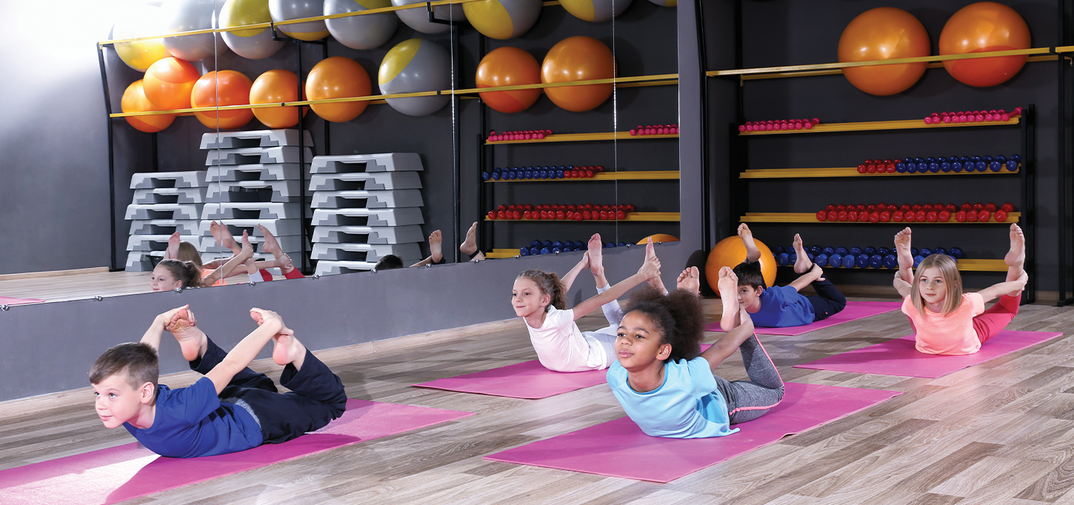
2.Listen, point and say:
Gym

Slide 14
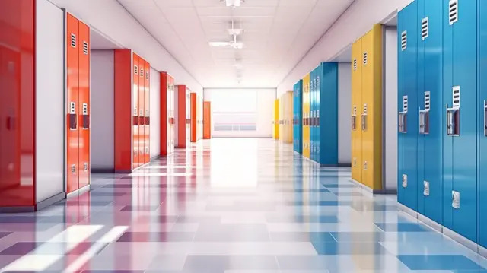




3. Let's talk:
Let's go to the ........
Ok. Let's go.

Slide 15
HOMEWORK:
- Do Activity Book at page 45,46
- Prepare Lesson 2 ( 4,5,6)

Slide 16
Thank
You

