Slide 1
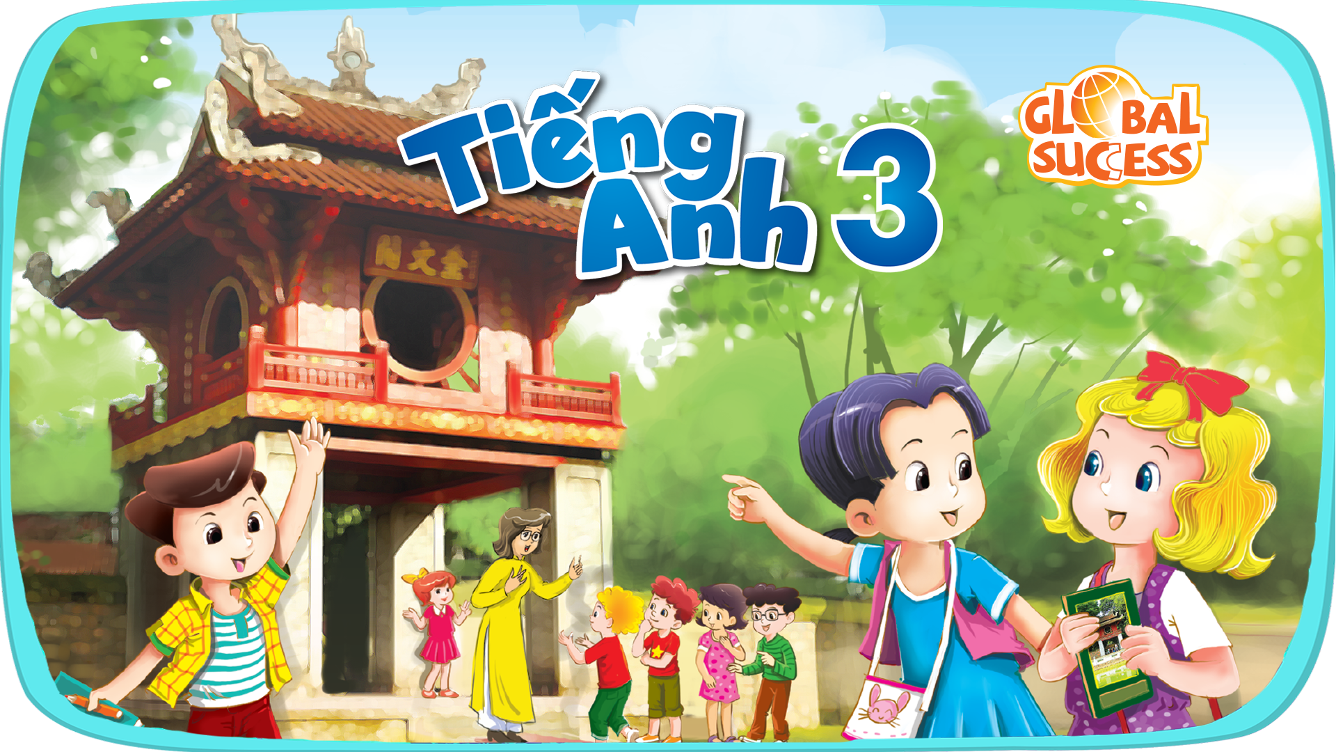
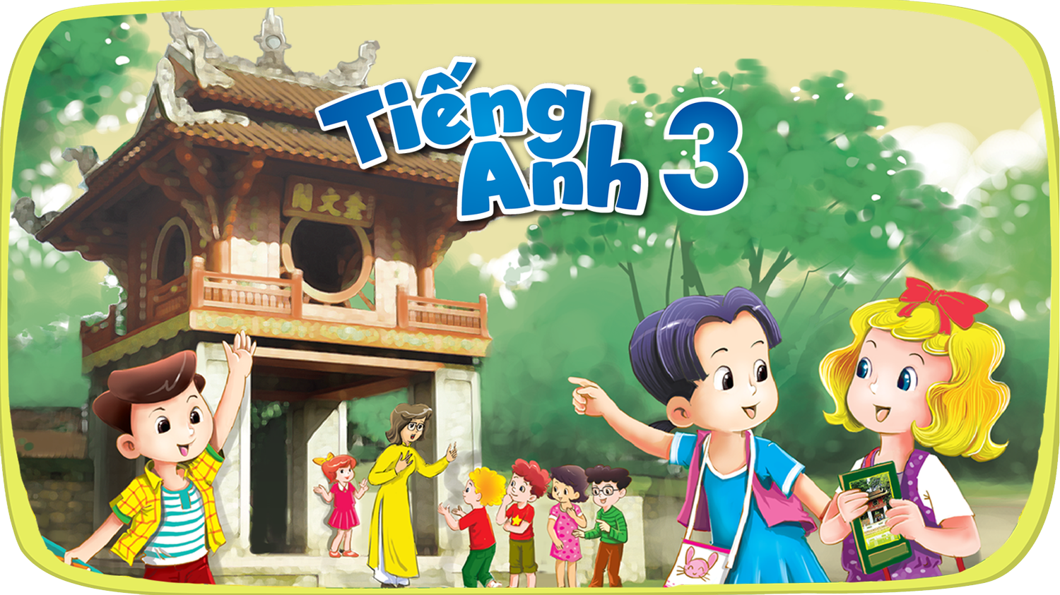


Slide 2



6
Our school
LESSON 1 - LESSON 2

Slide 3
I. OBJECTIVES.
By the end of the lesson, pupils will be able to:
1. Language.
- use the words school, classroom, library, playground, in the sentence pattern:
Is this our………..? – Yes, it is. / No, it isn’t.
- use Is this our ……………? – Yes, it is. / No, it isn’t. to ask and answer questions about their school.
2. Core competencies.
- decision making, teamwork, work standards, reliability, motivation, communication, planning and organization
3. General competencies.
- Listening: listen and recognize the school, then repeat.
- Oral communication: speak about school, ask and answer the questions
- Self-control & independent learning: perform listening tasks
- Written communication: practise writing about school
- Self-control & independent learning: perform listening tasks
- Communication and collaboration: work in pairs or groups
4. Attributes.
- Kindness: help partners to complete learning tasks
- Diligence: complete learning tasks
- Honesty: tell the truth about feelings and emotions

Slide 4
Warm-up

Slide 5
Is this our…….?
1
2
3
Notes:
Divide the class into 3 teams.
Each team has 1 sticky ball.
Play the music. Pupils in each team take turns to pass the ball. After the music ends, 3 pupils who have the ball stand up and say the words school, classroom, library, playground,
then make sentences using the sentence model.

Slide 6
5. LOOK, COMPLETE
AND READ.

Slide 7
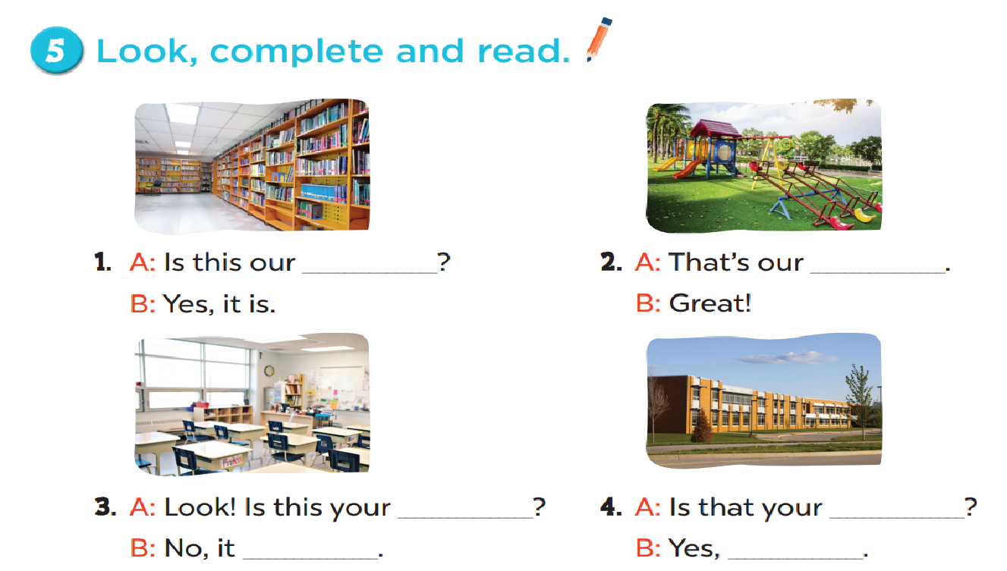
library
playground
classroom
school
isn’t
it is

Slide 8
6. LET’S SING.

Slide 9

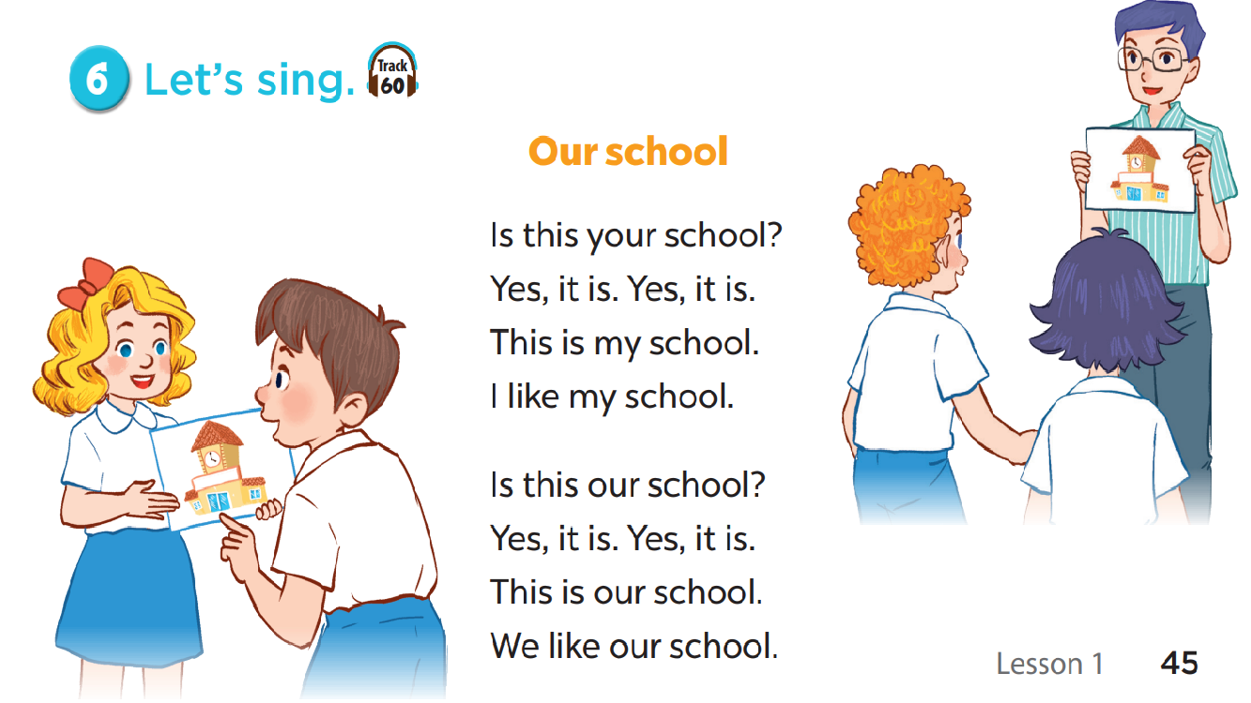

Slide 10
5. READ AND MATCH.

Slide 12
FUN CORNER

Slide 13







5
10
15
20
15
25
10
🡪

Slide 14
Read and choose.
………… this your classroom?
Is
Is
Are

Slide 15
Read and choose.
That is our…………………………
playground
playground
classroom

Slide 16
Read and choose.
Is ……….your classroom?
they
that
that

Slide 17
Read and choose.
Is that your library?
Yes, it isn’t.
Yes, it is.

Slide 18
Read and choose.
Is that ………….school?
look
your
your

Slide 19
Read and choose.
Is this our playground?
No, it isn’t.
No, it is.

Slide 20
Read and choose.
Is that your……………..?
library
school
school

