Slide 1
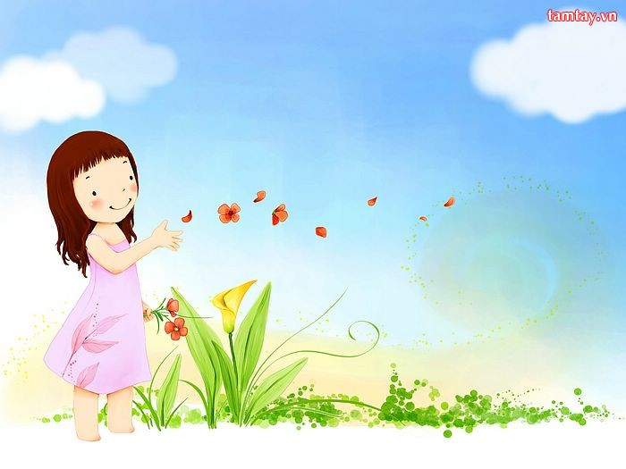









.........Primary School
Teacher: ........
Class: 3

Slide 2


Warm up
“Pass the ball”

Slide 3
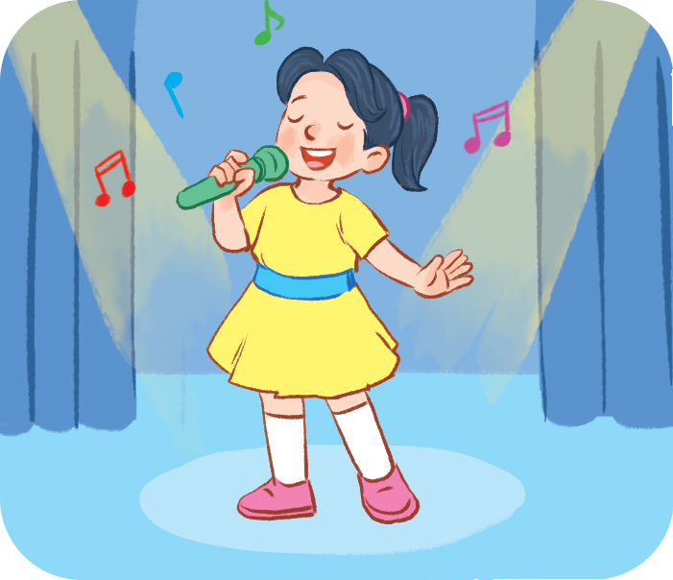
Pass the ball
What’s your hobby?
singing

Slide 4
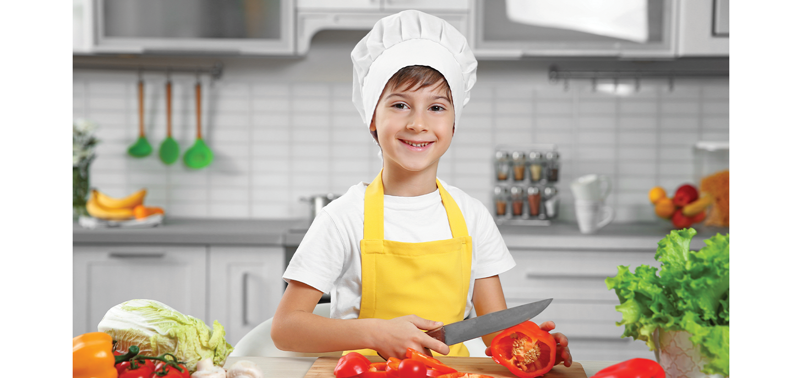
Pass the ball
What’s your hobby?
cooking

Slide 5
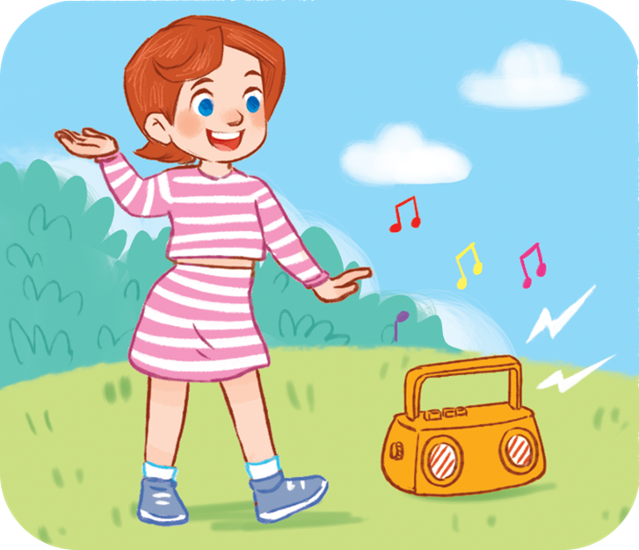
Pass the ball
What’s your hobby?
dancing

Slide 6
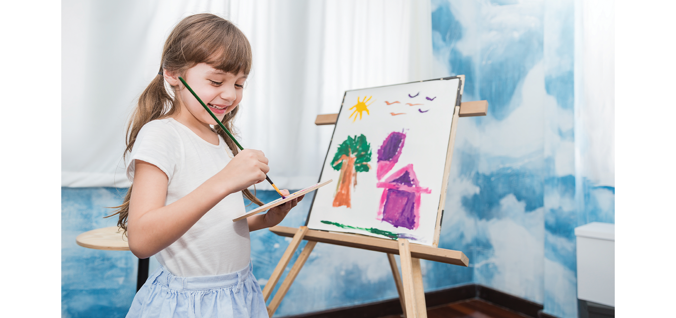
Pass the ball
What’s your hobby?
painting

Slide 7
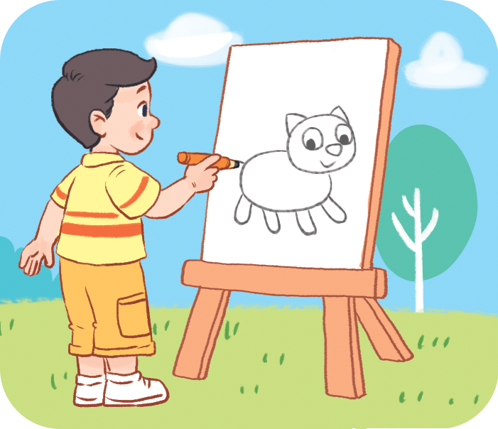
Pass the ball
What’s your hobby?
drawing

Slide 8
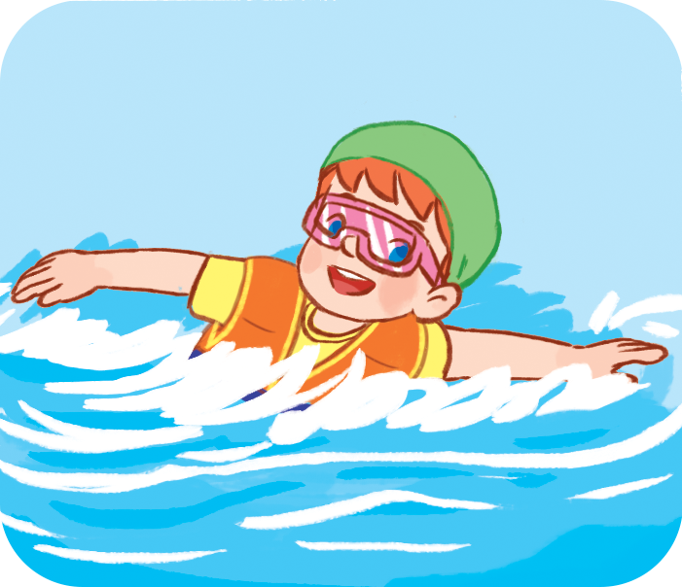
Pass the ball
What’s your hobby?
swimming

Slide 9


Pass the ball
1. singing
2. cooking
3. dancing
4. painting
5. drawing
6. swimming

Slide 10



Monday, October 31st, 2022
Unit 5: My hobbies
Lesson 3 (4, 5, 6)

Slide 11

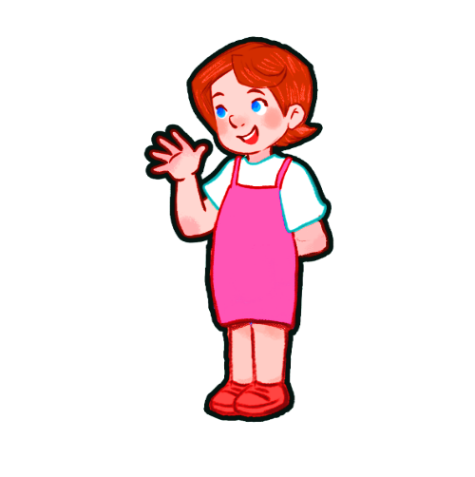
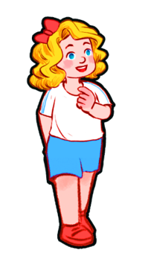
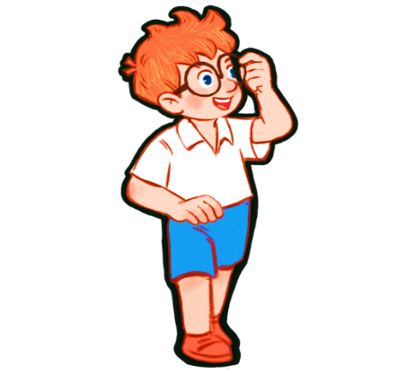
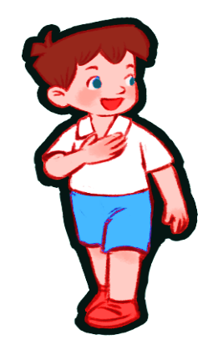
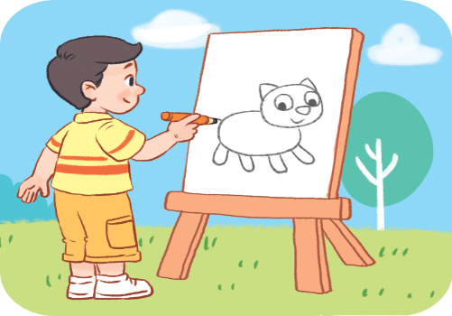


Unit 5: My hobbies
Lesson 3 (4, 5, 6)
4. Read and tick.
Ben
Lucy
Minh
Mary

Slide 12
Hobbies | cooking | dancing | painting | drawing
1. Ben
2. Lucy
3. Minh
4. Mary
√

Slide 13








4. Read and tick.
Teacher: What’s your hobby?
Ben: It’s
Lucy: It’s
Minh: I like
Mary: I like

Slide 14

4. Read and tick.
Teacher: What’s your hobby?
cooking
Ben: It’s cooking.
dancing
Lucy: It’s dancing.
painting
Minh: I like painting.
drawing
Mary: I like drawing.
Hobbies | cooking | dancing | painting | drawing
1. Ben
2. Lucy
3. Minh
4. Mary

Slide 15
5. Let’s write.
Hello. My name is _______.
I like _______.
I like _______.
What’s your hobby?
Huong
singing
cooking

Slide 16
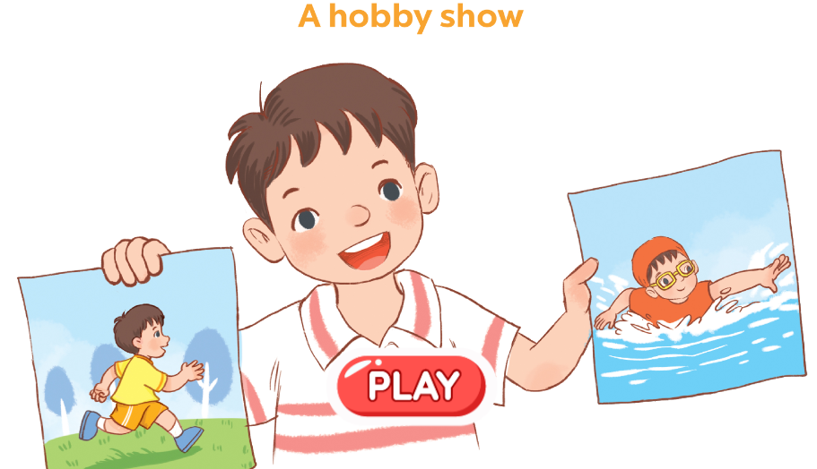
6. Project.
Hello. My name is _______.
I’m _______ years old.
I like _______.
I like _______.
What’s your hobby?
Goodbye.

Slide 17
Homework.
- Learn vocabulary by heart.
- Practise speaking about your hobby.

Slide 18


Slide 19

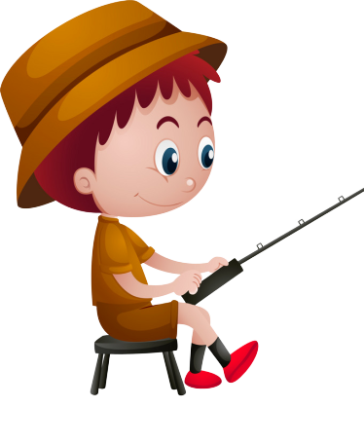
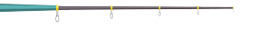
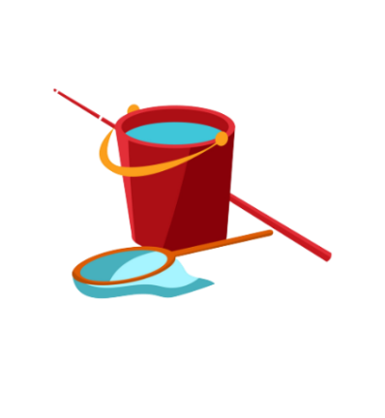
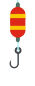

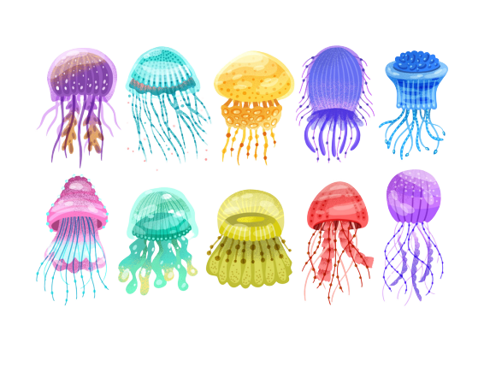

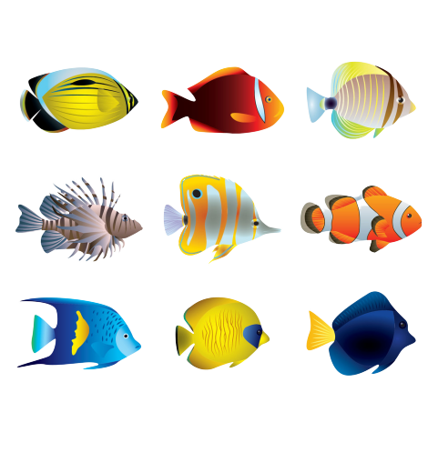

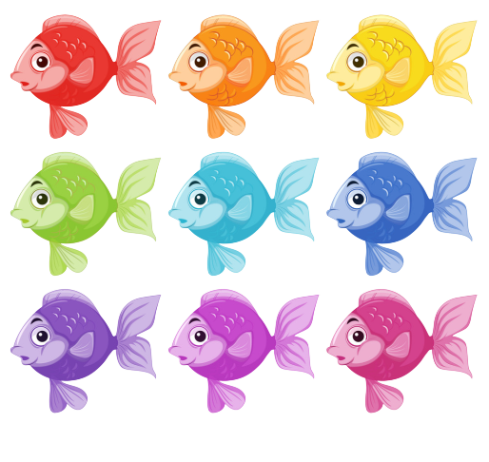
GO FISHING
Game
PLAY

Slide 20










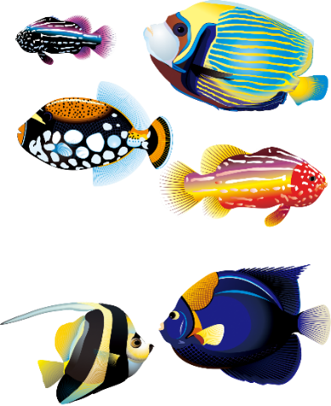

EXIT
7
6
8
2
4
9
1
5
3
13
12
11
14
15

Slide 21

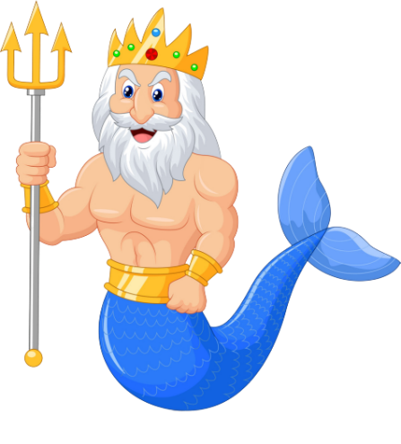

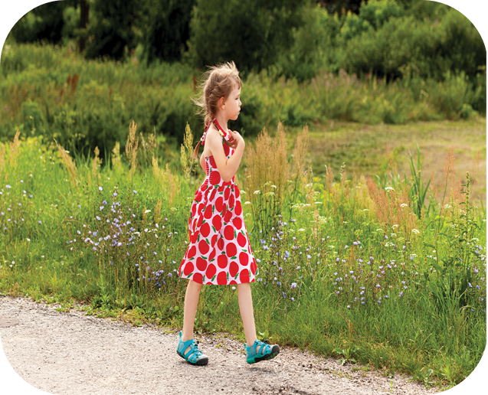

A
It’s walking.
B
It’s running.
C
It’s swimming.
D
STOVE
What’s your hobby?

Slide 22
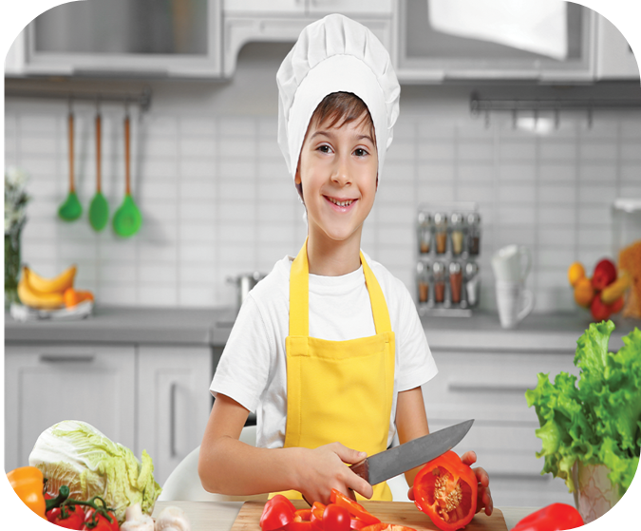
A
I like painting.
B
I like cooking.
C
I like walking.
D
Climb
What’s your hobby?

Slide 23
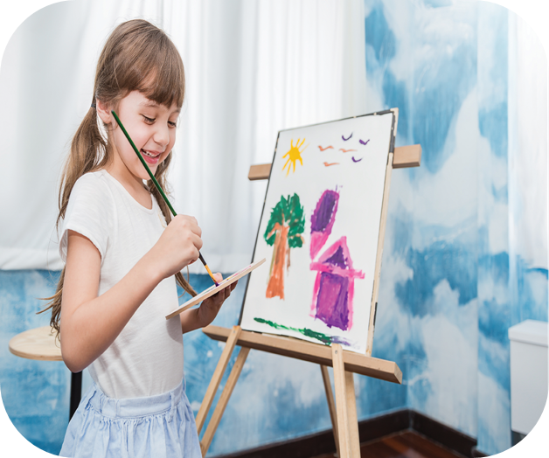
A
hobby
B
name
C
old
What’s your ________?
It is painting.
D
May

Slide 24
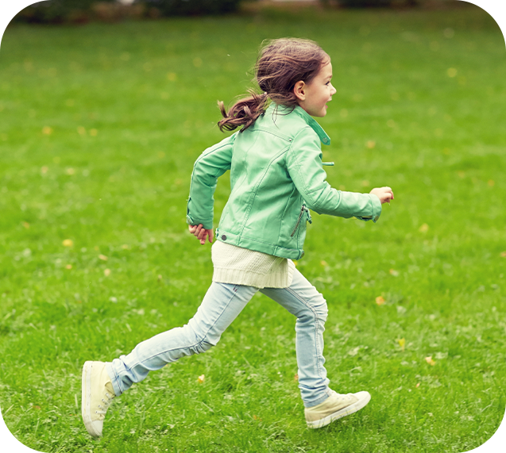
A
I play football.
B
I like running.
C
It is dancing.
D
Watch
What’s your hobby?

Slide 25
A
No, it isn’t.
B
Yes, it is.
C
I like drawing.
D
Next to
What’s your hobby?

Slide 26
A
I like singing.
B
It is running.
C
I like walking.
D
Next to
What’s your hobby?

Slide 27
A
I like cooking.
B
It is swimming..
C
I like painting.
D
She plays chess
in his free time.
What’s your hobby?

Slide 28
A
his
B
my
What’s ___ hobby?
C
your
D
They likes sport.

Slide 29
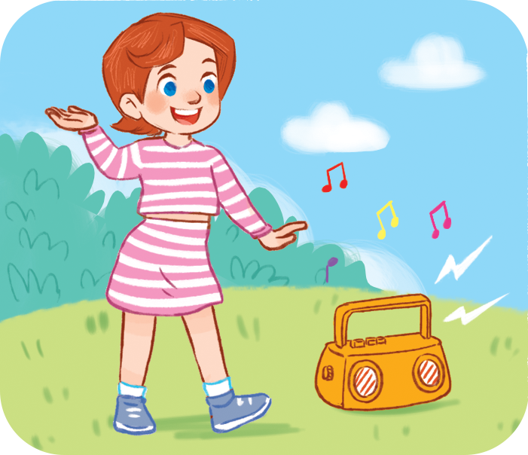
A
What’s your hobby?
B
What’s your name?
C
What’s this?
_____________?
I like dancing.
D
She should take some warm water.

Slide 30




Goodbye !
Thanks for your joining!

