Slide 1
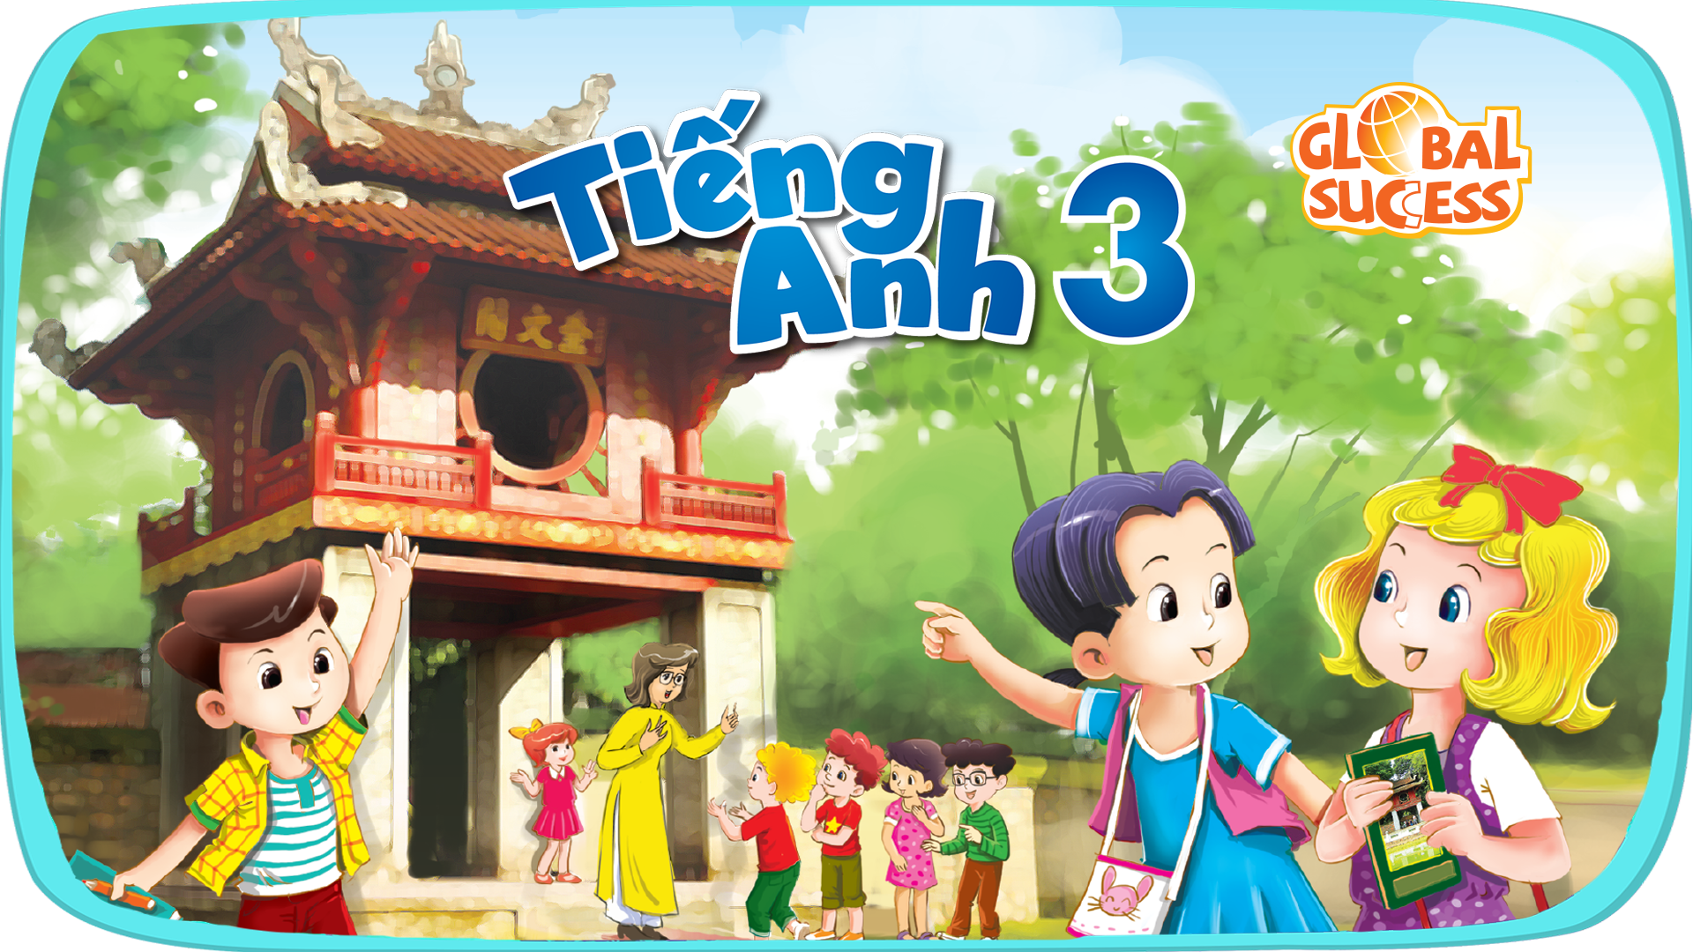

Slide 2




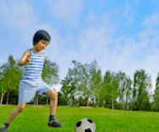
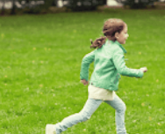

5
My hobbies
LESSON 2

Slide 3
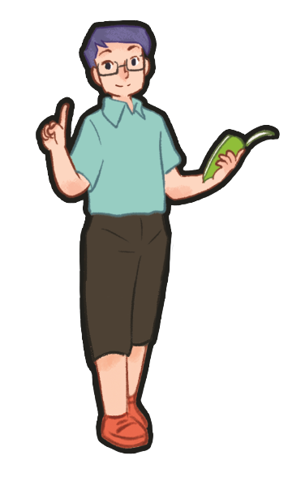
Game
Warm-up

Slide 4
I. OBJECTIVES.
By the end of the lesson, pupils will be able to:
1. Language.
- Understand and correctly repeat the sentences in two communicative contexts (pictures) focusing on asking and answering about hobbies.
- Correctly say the words and use What's your hobby? – I like _____. to ask and answer questions about someone's hobby.
- Enhance the correct use of What's your hobby? – I like _____. to ask and answer questions about someone's hobby.
2. Core competencies.
- Teamwork, work standards, adaptability, problem-solving, communication, planning and organization, stress tolerance.
3. General competencies.
- Listening: look, listen and repeat
- Critical thinking: listen, point and say
- Oral communication: let’s talk
- Written communication: complete the sentence
- Self-control & independent learning: perform listening tasks
- Communication and collaboration: work in pairs or groups
- Problem-solving and creativity: answer comprehension questions after reading the story.
- Sociability: talk to each other, say good words to others.
3. Attributes.
- Kindness: help partners to complete learning tasks
- Diligence: complete learning tasks
- Honesty: tell the truth about feelings and emotions
- Responsibility: appreciate kindness

Slide 5



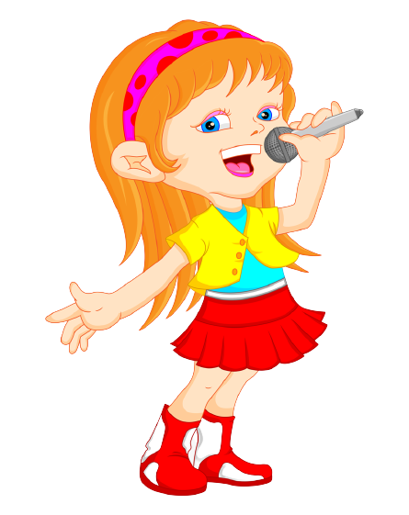
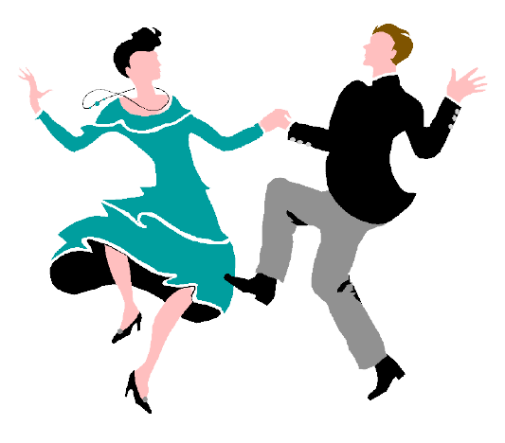
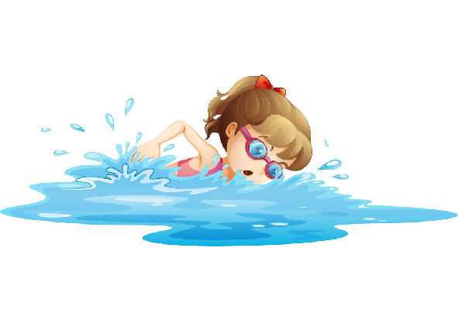
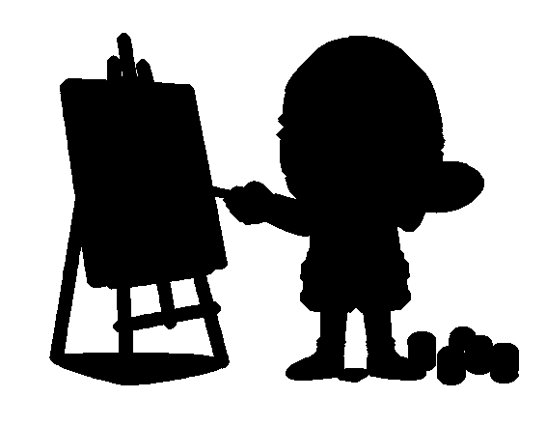

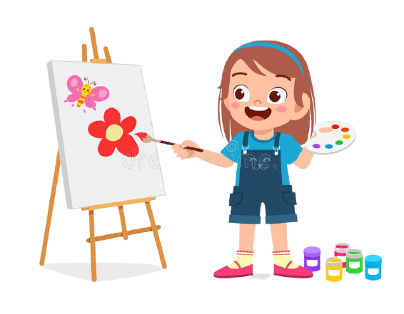
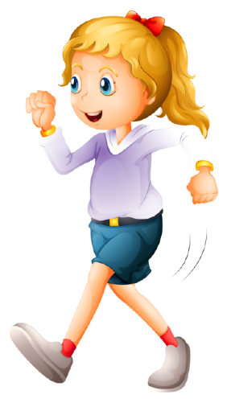

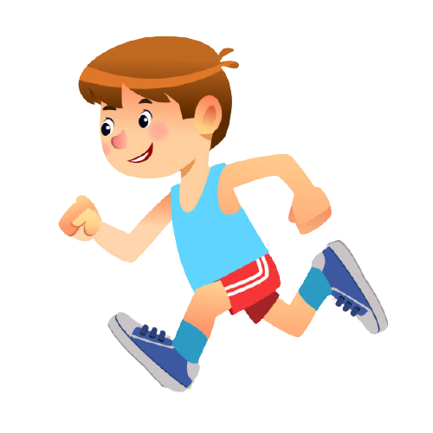
1
2
3
4
5
6
7
8
9
10
11
12
Notes:
- T divides class into 2 teams (Boys and Girls).
- Pupils in 2 teams take turn to open the boxes to match the shadows and their original pictures (open: click the numbers - close: click the red signs).
- Pupils of each team will get points if their matching is correct.
- Review hobbies: singing, drawing, dancing, swimming.

Slide 6
singing
Notes:
T shows the shadows with their pictures and say the words and gives sentences: “They are _____.”, “She is _____.”, “He is _____.”.

Slide 7
drawing
Notes:
T shows the shadows with their pictures and say the words and gives sentences: “They are _____.”, “She is _____.”, “He is _____.”.

Slide 8
swimming
Notes:
T shows the shadows with their pictures and say the words and gives sentences: “They are _____.”, “She is_____.”, “He is _____.”.

Slide 9
dancing
Notes:
T shows the shadows with their pictures and say the words and gives sentences: “They are _____.”, “She is _____.”, “He is _____.”.

Slide 10
running
Notes:
T shows the shadows with their pictures and say the words and gives sentences: “They are _____.”, “She is _____.”, “He is _____.”.

Slide 11

walking
Notes:
T shows the shadows with their pictures and say the words and gives sentences: “They are _____.”, “She is _____.”, “He is _____.”

Slide 12
1. Look, listen and repeat.
Notes:
Review Numbers 1-10 and Alphabet

Slide 13
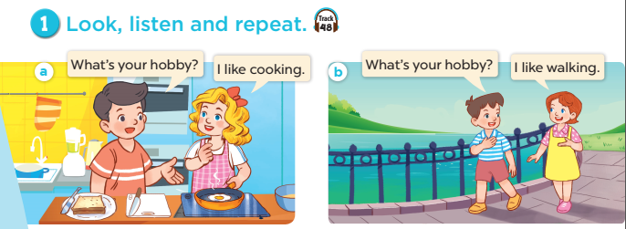
Notes:
Step 1: Have pupils look at Pictures a and b and identify the characters in the pictures.
Step 2: Ask pupils to look at Picture a. Play the recording for them to listen. Play the recording
again, sentence by sentence, for pupils to listen and repeat. Follow the same procedure with
Picture b. Correct their pronunciation where necessary.
Step 3: Play the recording again for pupils to listen and repeat in chorus sentence by sentence.
Step 4: Invite a few pairs to the front of the classroom to listen and repeat the sentences in the
recording.
Step 5: Draw their attention to the question What’s your hobby? and the answers I like cooking.
and I like walking. Tell pupils that they are a question and answers about hobbies.

Slide 14

Notes:
Step 1: Have pupils look at Pictures a and b and identify the characters in the pictures.
Step 2: Ask pupils to look at Picture a. Play the recording for them to listen. Play the recording
again, sentence by sentence, for pupils to listen and repeat. Follow the same procedure with
Picture b. Correct their pronunciation where necessary.
Step 3: Play the recording again for pupils to listen and repeat in chorus sentence by sentence.
Step 4: Invite a few pairs to the front of the classroom to listen and repeat the sentences in the
recording.
Step 5: Draw their attention to the question What’s your hobby? and the answers I like cooking.
and I like walking. Tell pupils that they are a question and answers about hobbies.

Slide 15
2. listen, point and say.
Notes:
Review Numbers 1-10 and Alphabet

Slide 16
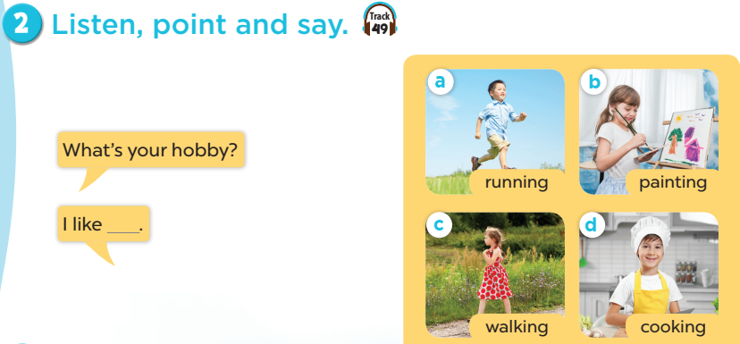
Notes:
Step 1: Have pupils look at the pictures and elicit the names of the hobbies.
Step 2: Have pupils point at Picture a (a boy running), listen to the recording and repeat the
word (running). Follow the same procedure with the other three pictures. Have the class
repeat the words a few times.
Step 3: Point at the bubble and have pupils listen and repeat after the recording (What’s your
hobby?). Point at Picture a and have pupils listen and repeat after the recording (I like
running.). Follow the same procedure with the other three pictures.
Step 4: Have pairs practise asking and answering the question What’s your hobby? – I like
_____.
Step 5: Invite a few pairs to point at the pictures and say the questions and answers in front of
the class.

Slide 17
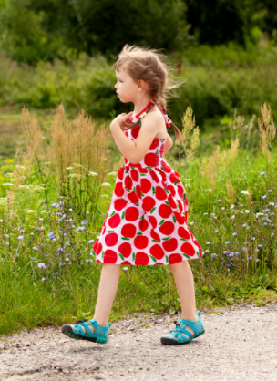
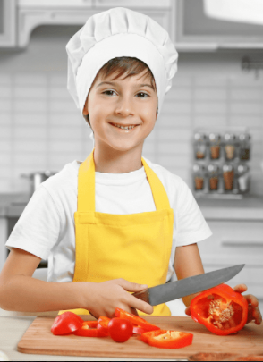
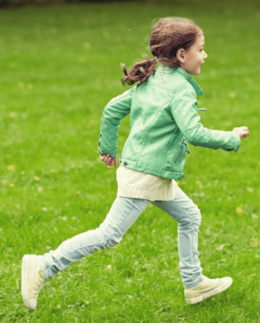
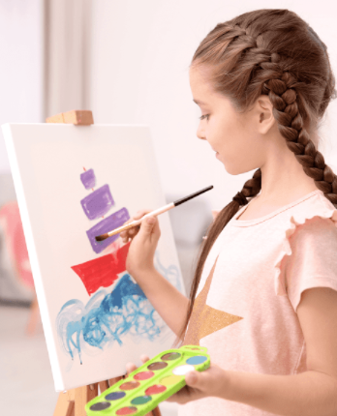
walking
cooking
painting
running
Notes:
Let pupils do the action and say.
Set group competition to make it more interesting.

Slide 18



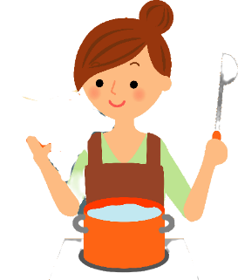
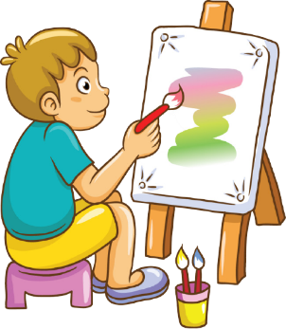
What’s your hobby?
running
walking
cooking
painting
Notes:
T shows 4 pictures on the board and asks pupils to practise more.

Slide 19
4. Listen and tick.

Slide 20
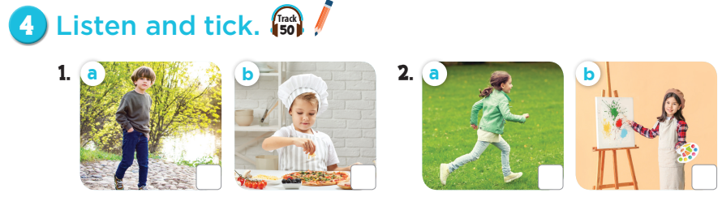
Notes:
Step 1: Draw pupils’ attention to Pictures 1a and 1b. Tell them about the activity. Elicit the
hobby in each picture. Play the recording of the first exchange. Play the recording again for
pupils to do the task. Play the recording a third time for pupils to check their answers.
Step 2: Repeat Step 1 for the second exchange.
Step 3: Tell pupils to swap books with a partner, then check answers as a class. Write the
correct answers on the board for pupils to correct their answers.
Step 4: Play the recording again for pupils to double-check their answers.
Extension: If time allows, play the recording sentence by sentence for the class to listen and
repeat in chorus. Correct their pronunciation where necessary.

Slide 21
✓
✓
Let’s check!
Notes:
Step 1: Draw pupils’ attention to Pictures 1a and 1b. Tell them about the activity. Elicit the
hobby in each picture. Play the recording of the first exchange. Play the recording again for
pupils to do the task. Play the recording a third time for pupils to check their answers.
Step 2: Repeat Step 1 for the second exchange.
Step 3: Tell pupils to swap books with a partner, then check answers as a class. Write the
correct answers on the board for pupils to correct their answers.
Step 4: Play the recording again for pupils to double-check their answers.
Extension: If time allows, play the recording sentence by sentence for the class to listen and
repeat in chorus. Correct their pronunciation where necessary.

Slide 22
Game time

Slide 23
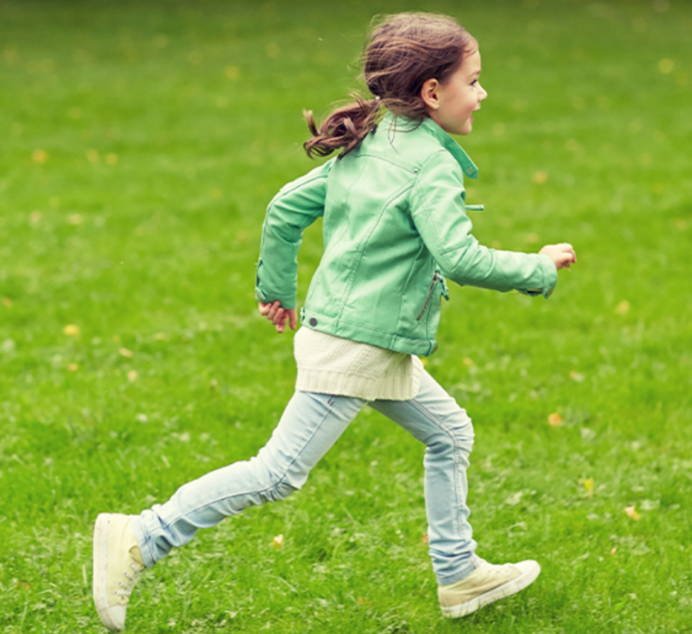
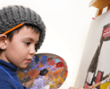
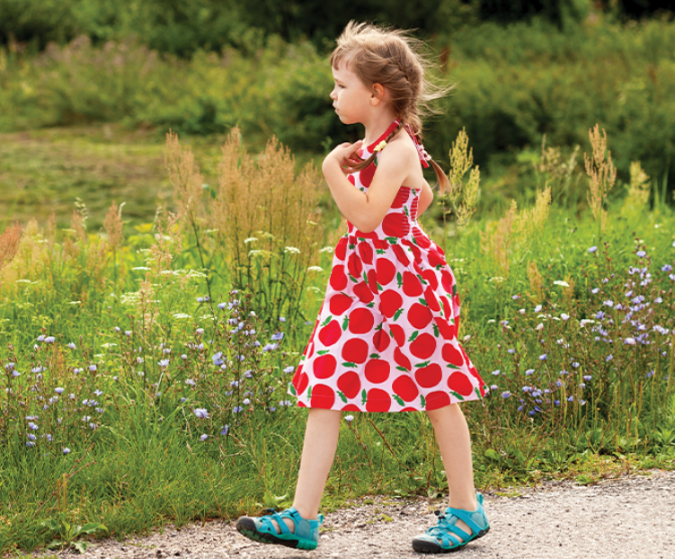
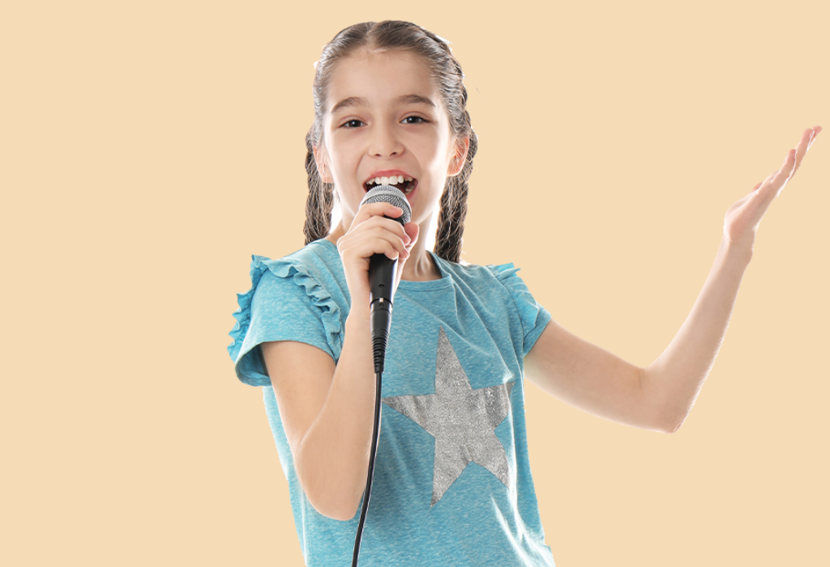
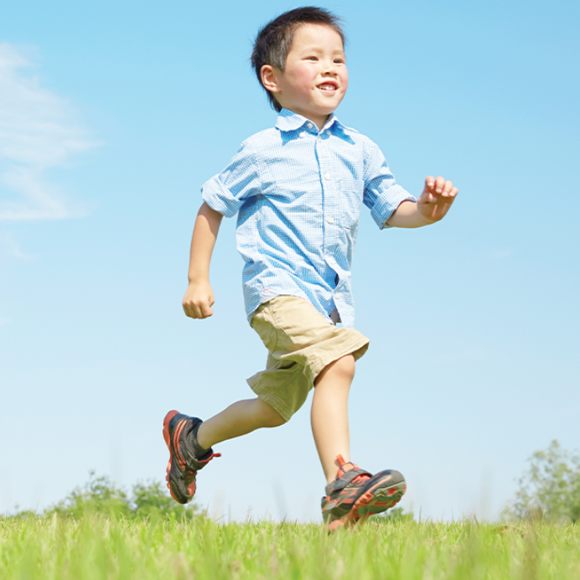
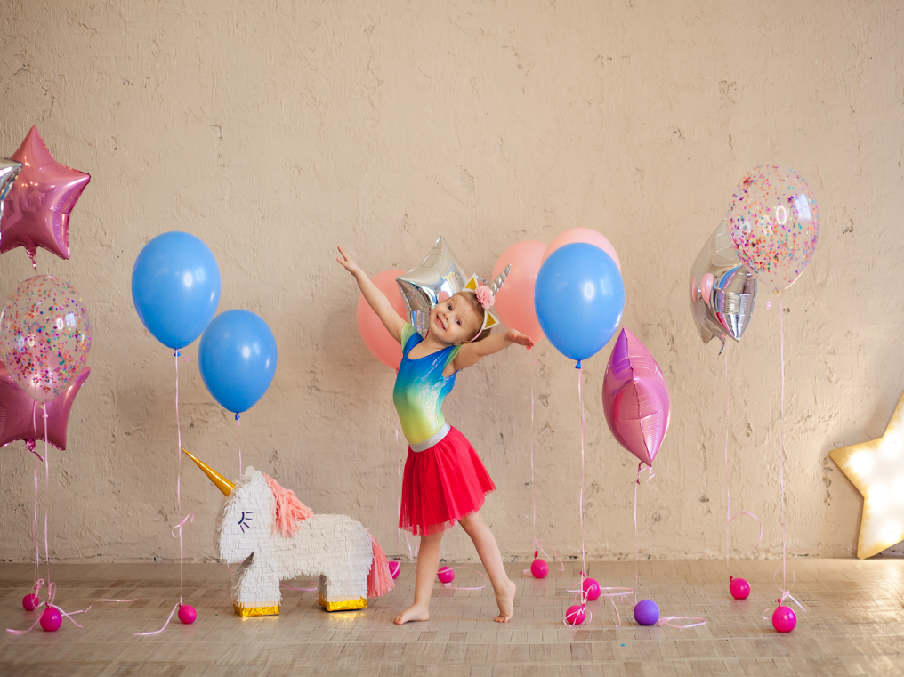
Notes:
T lets the pupils review the pictures of hobbies. (flash cards)

Slide 24





1
2
3
4
5
6
7
8
9
10
11
12
13
14
15
16
17
18
19
20
Notes:
- T divides class into 2 teams.
- Pupils in 2 teams take turn choosing a box and answer the questions: What’s your hobby? (T uses flash cards of hobbies and ask pupils to say out loud the hobbies-flash cards/ pictures of hobbies).
- T clicks on the box to reveal the points beneath.
- The team with the most points is the winner.

Slide 25

Fun corner and
Wrap-up
Notes:
Jigsaw puzzle:
Click on the puzzles and let the pupils get when the pictures of hobbies revealed.

Slide 26
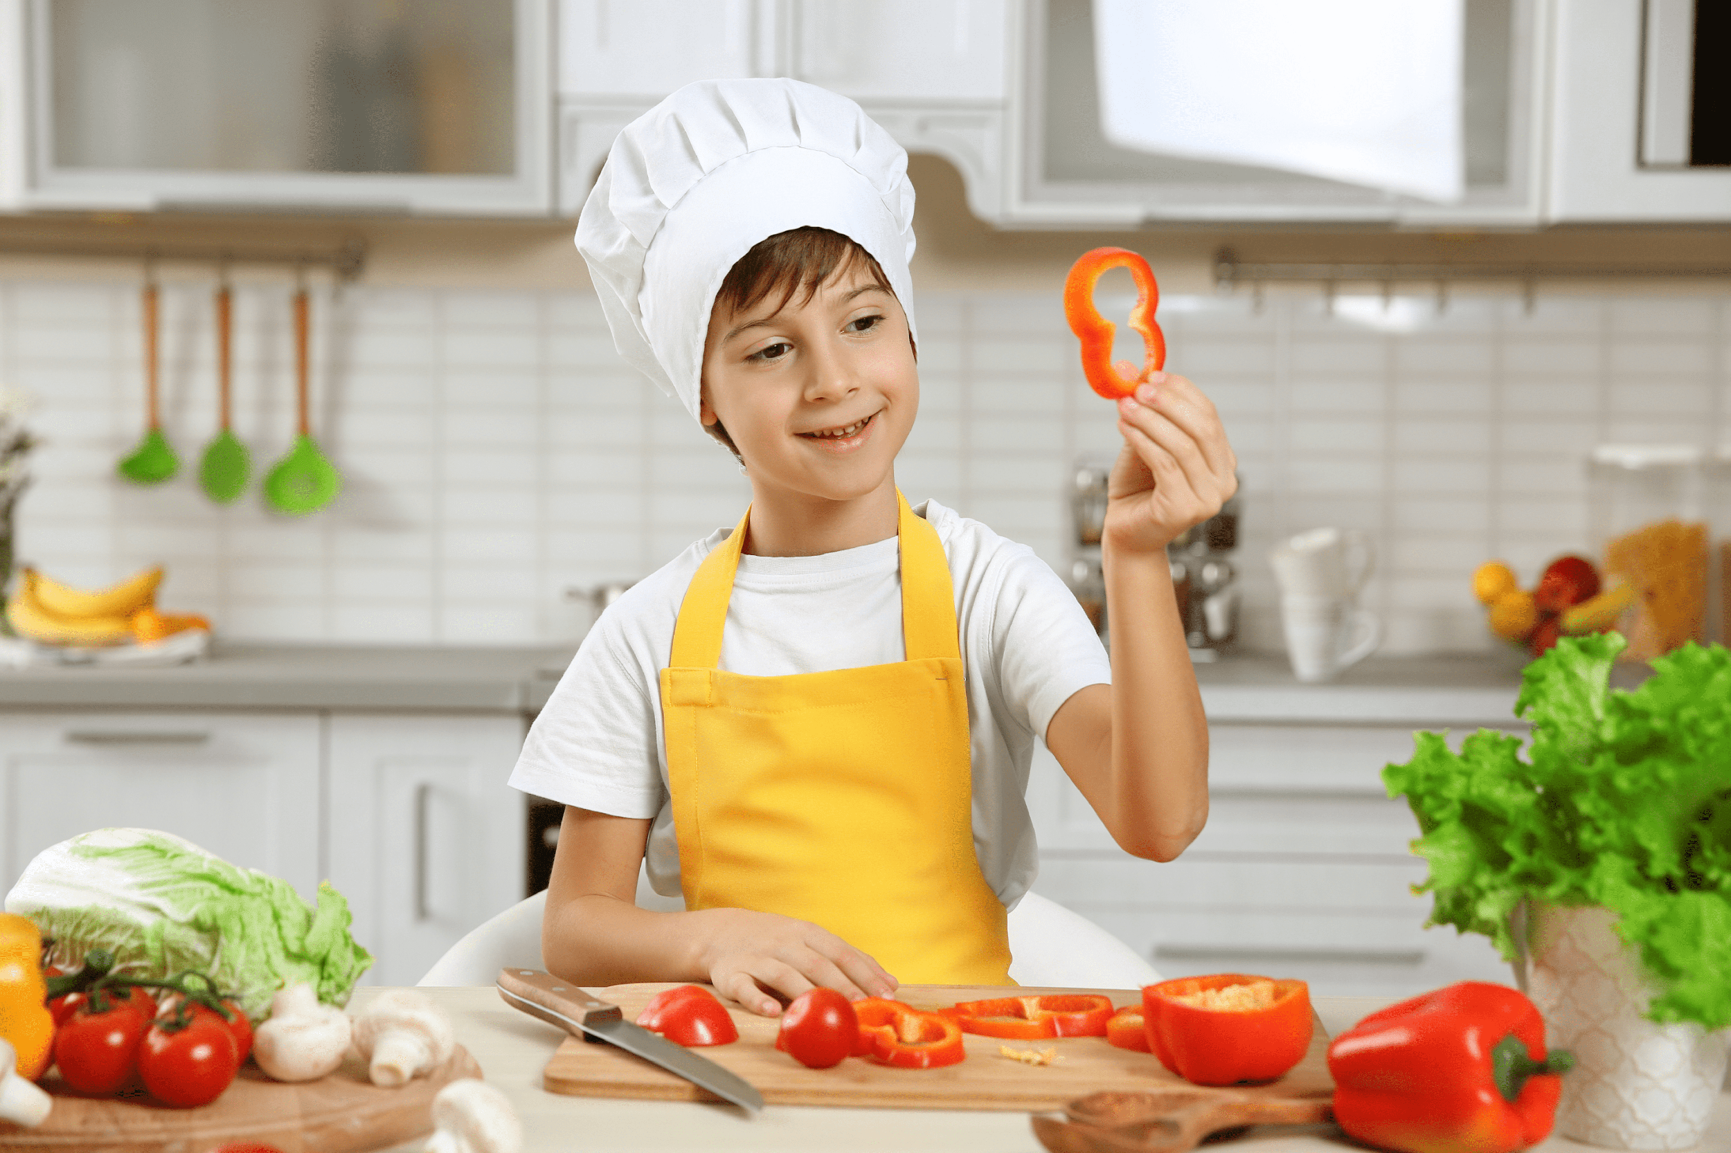
What’s your hobby?
Notes:
Jigsaw puzzle:
Click on the puzzles and let the pupils get when the pictures of hobbies revealed.

Slide 27
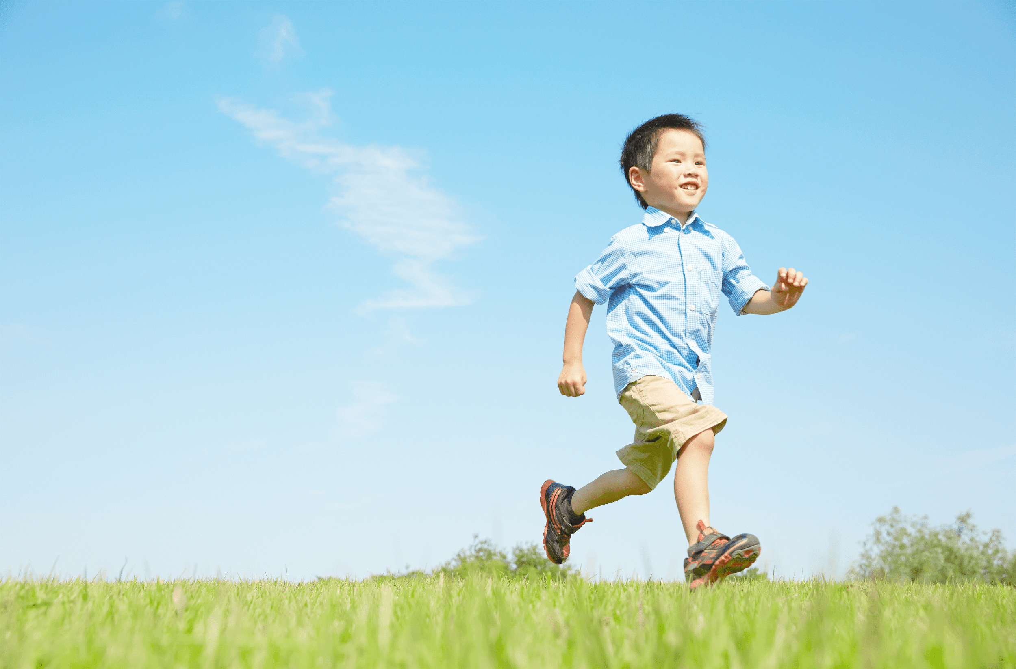
What’s your hobby?
Notes:
Jigsaw puzzle:
Click on the puzzles and let the pupils get when the pictures of hobbies revealed.

Slide 28
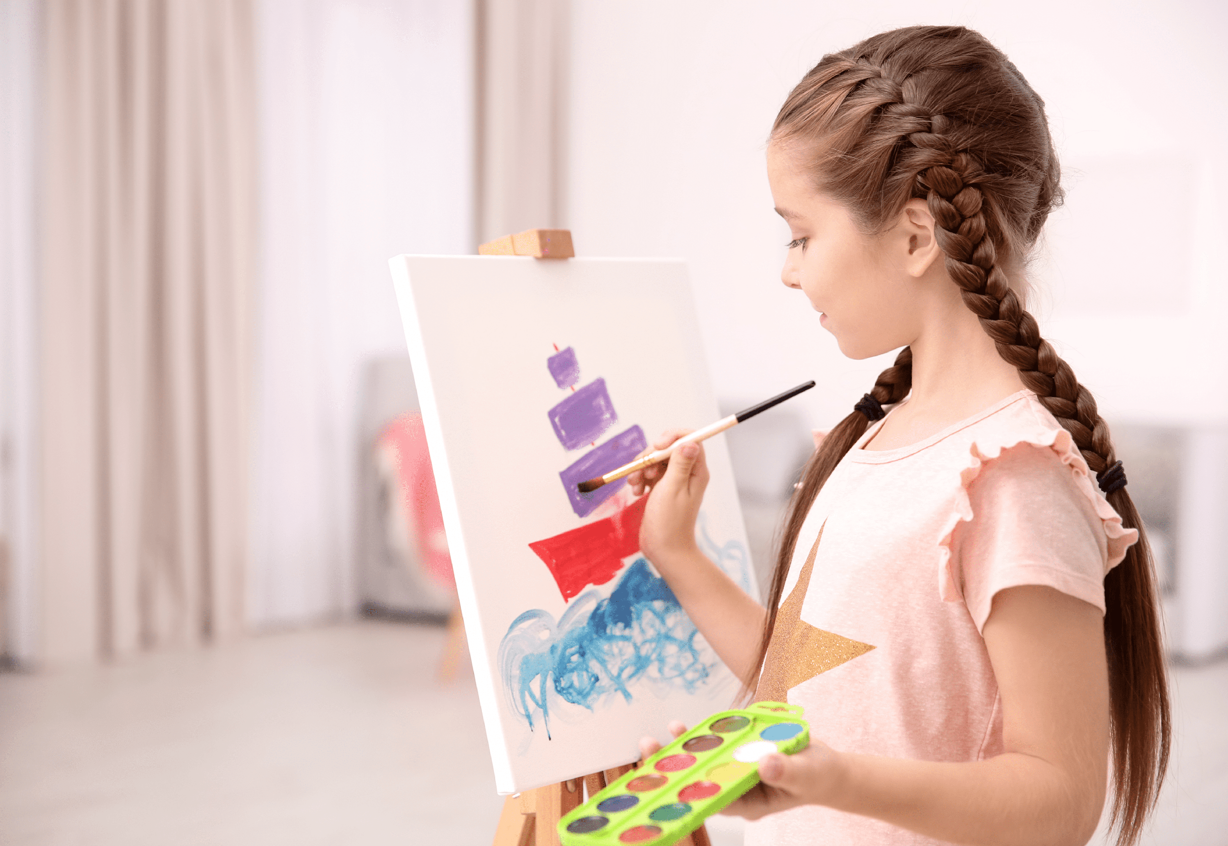
What’s your hobby?
Notes:
Jigsaw puzzle:
Click on the puzzles and let the pupils get when the pictures of hobbies revealed.

Slide 29
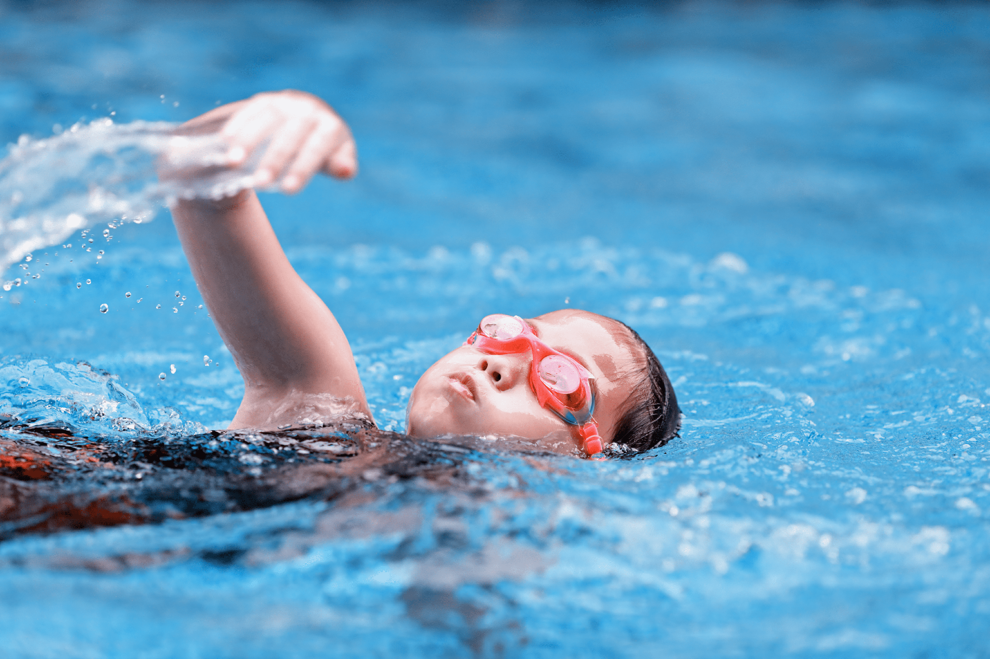
What’s your hobby?
Notes:
Jigsaw puzzle:
Click on the puzzles and let the pupils get when the pictures of hobbies revealed.

Slide 30
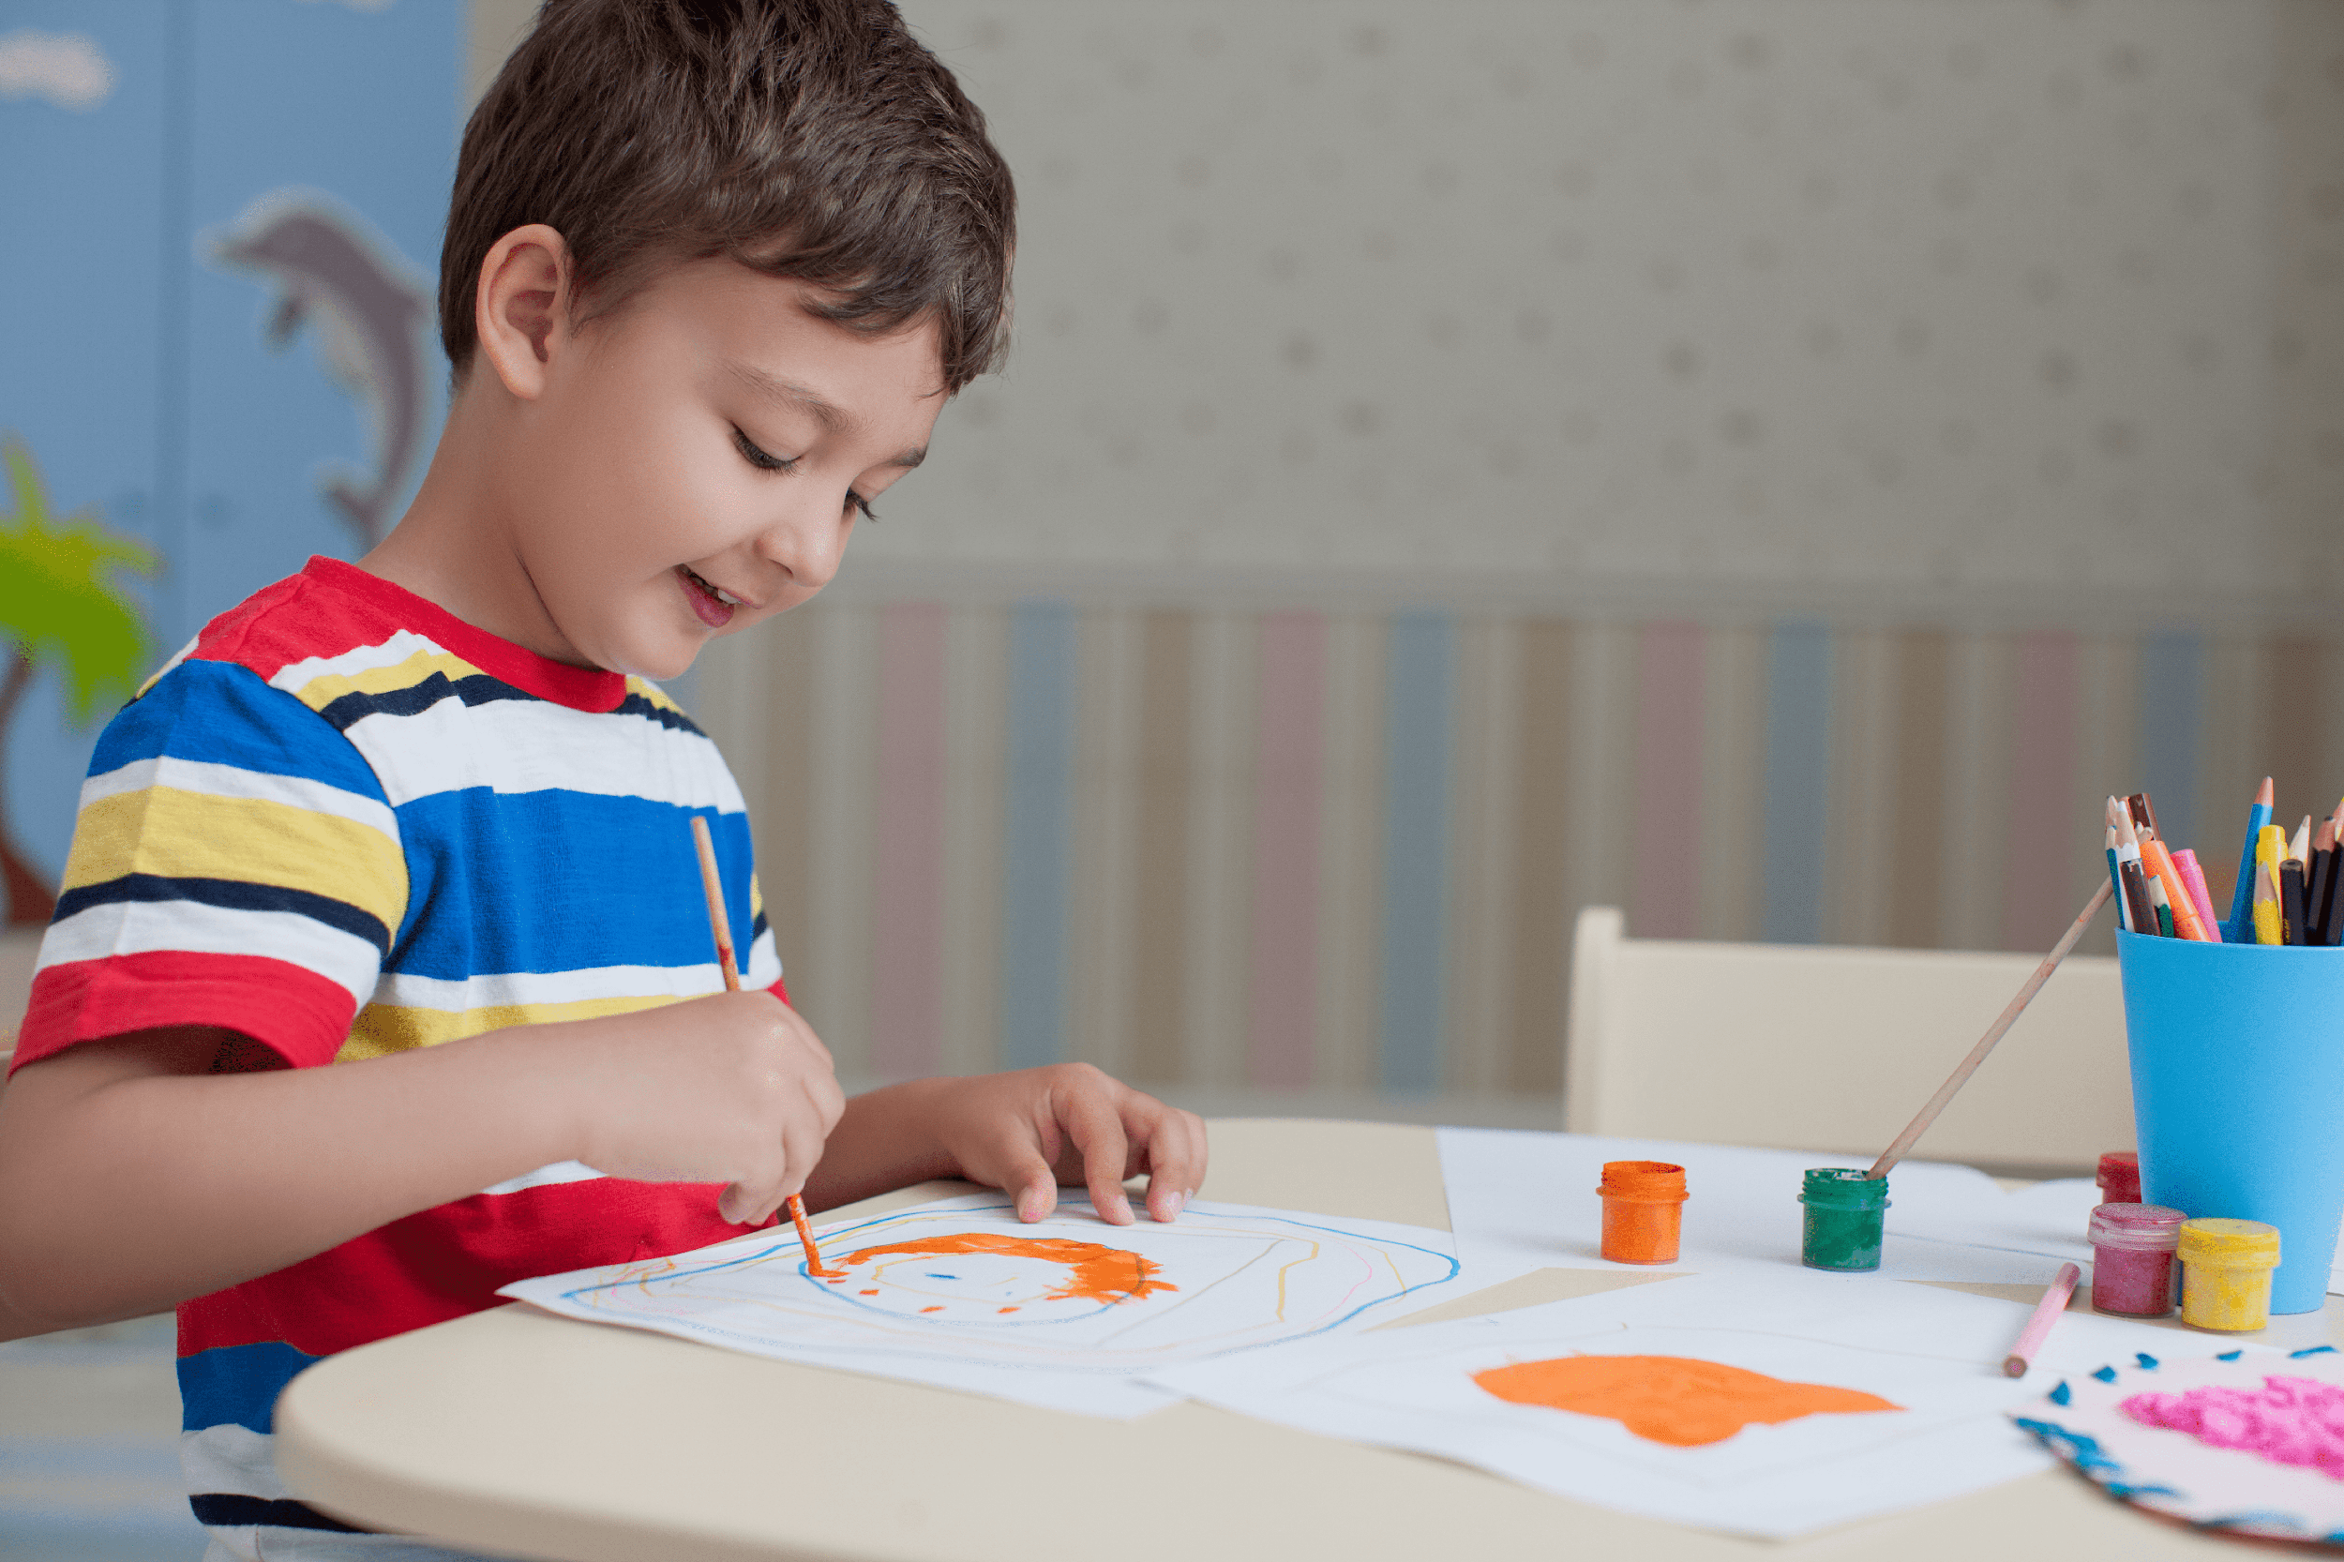
What’s your hobby?
Notes:
Jigsaw puzzle:
Click on the puzzles and let the pupils get when the pictures of hobbies revealed.

Slide 31

What’s your hobby?
Notes:
Jigsaw puzzle:
Click on the puzzles and let the pupils get when the pictures of hobbies revealed.

