Slide 1



Slide 2


Our names
2
9
LESSON 2

Slide 3
WARM-UP

Slide 4
WHO’S FASTER?

Slide 5
I. OBJECTIVES.
By the end of the lesson, pupils will be able to:
1. Language.
- use the words what, your, name, my, how old, years old in relation to the topic “Our names”;
- use
How old are you?
I'm .
to ask and answer questions about someone’s age;
- listen to and demonstrate understanding of simple communicative contexts in relation to the topic "Our names";
- read and write about people’s names and ages.
2. Core competencies.
teamwork, work standards, motivation, adaptability, communication, and initiative.
3. General competences.
Oral communication: speak about ages, ask and answer the questions
Self-control & independent learning: perform listening tasks
Communication and collaboration: work in pairs or groups
Problem-solving and creativity: answer comprehension questions
Sociability: talk to each other
4. Attributes.
Kindness: help partners to complete learning tasks
Diligence: complete learning tasks
Leadership: collaborate with teachers to enhance language skills

Slide 6


Slide 7


Slide 8
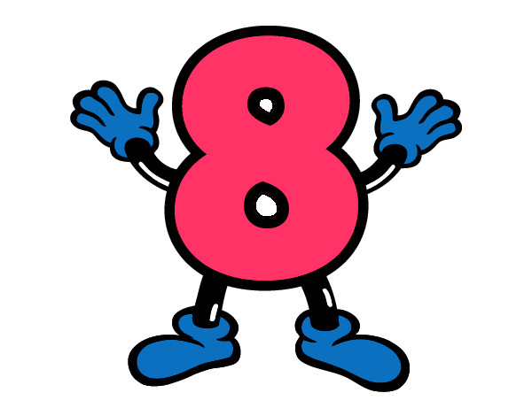

Slide 9
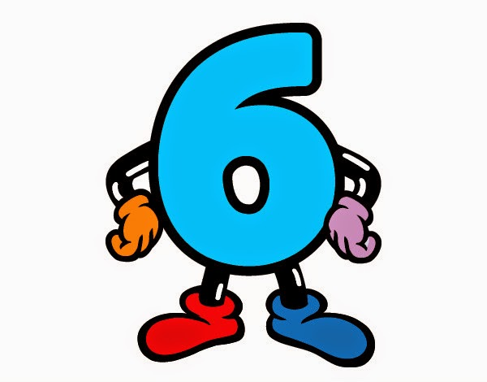

Slide 10


Slide 11


Slide 12


Slide 13


Slide 14



Slide 15


Slide 16






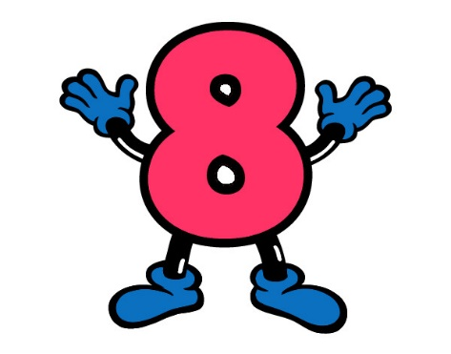


Let’s count together!

Slide 17
MODEL SENTENCES

Slide 18
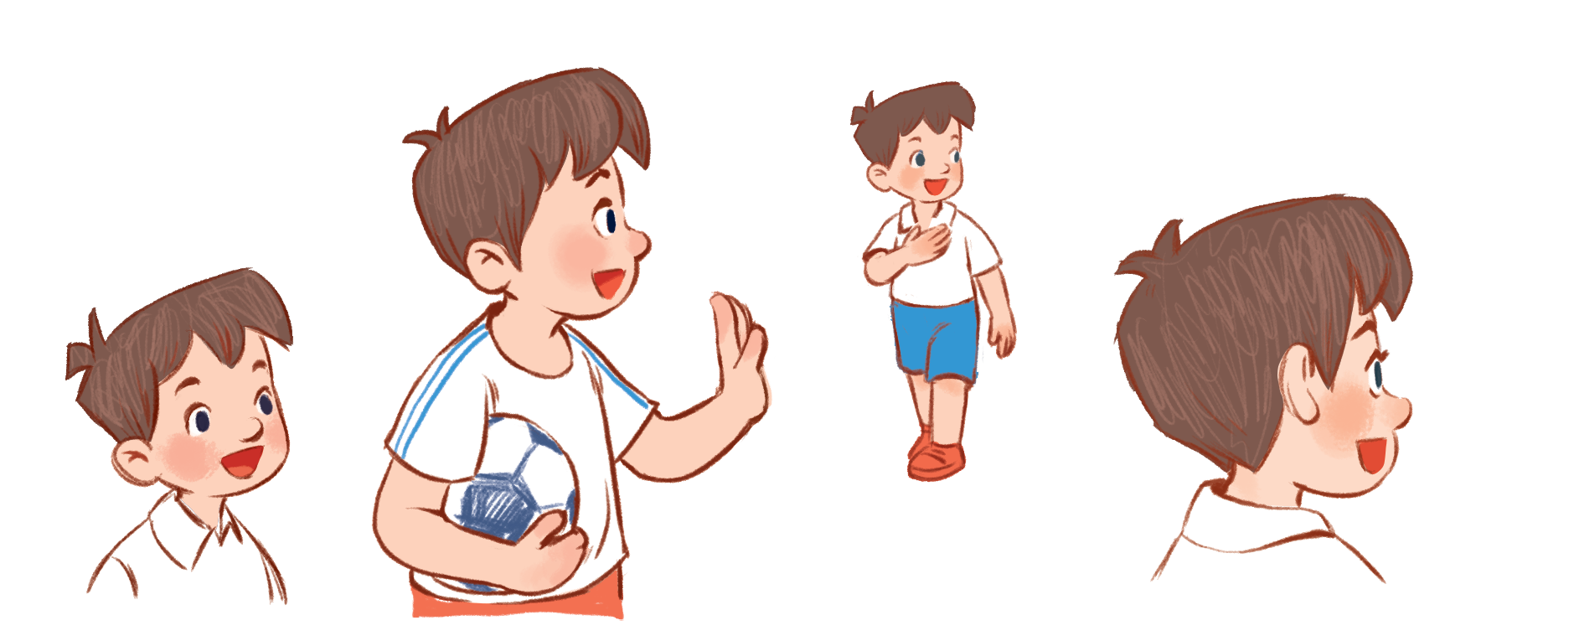
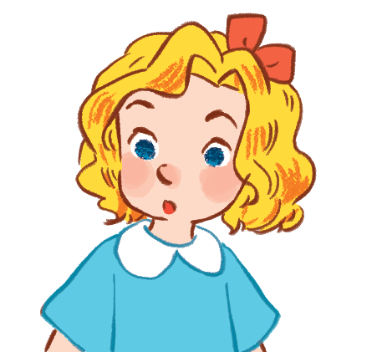
I’m Minh.
What’s your name?
Hello!
My name’s Mary.
Hi!

Slide 19
How old are you?
I’m …… years old.
eight
8

Slide 20
Look, listen and reapeat
1

Slide 21

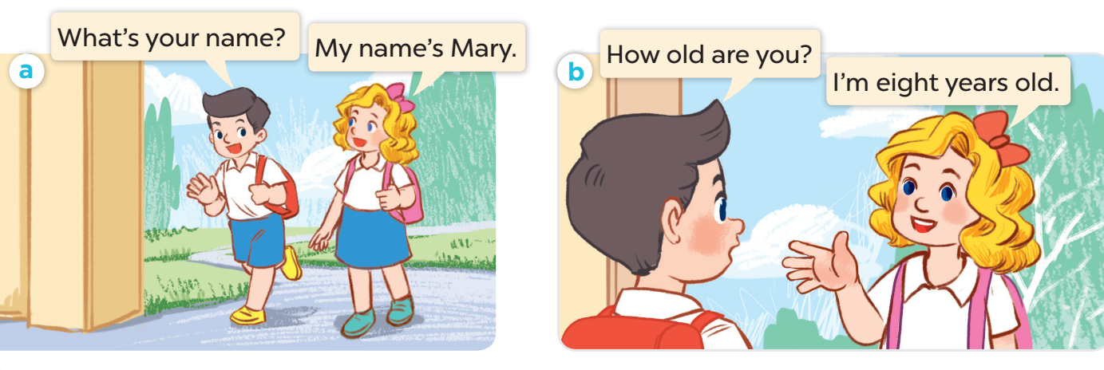

Slide 22
Listen, point and say
2

Slide 23
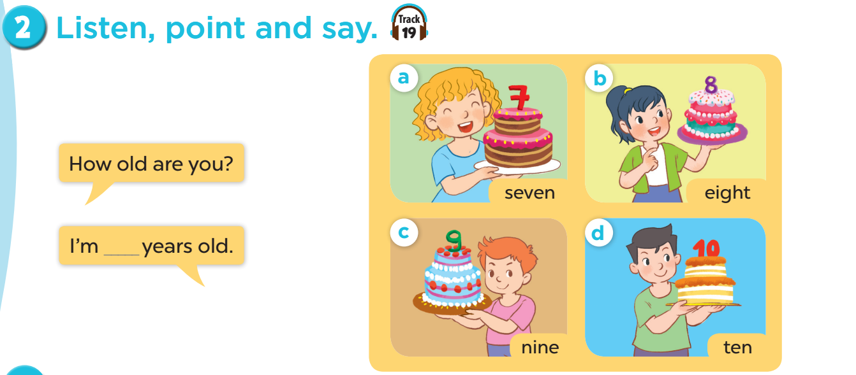

Slide 24
Listen and number
4

Slide 25
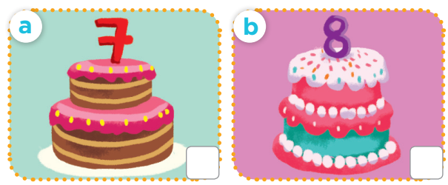
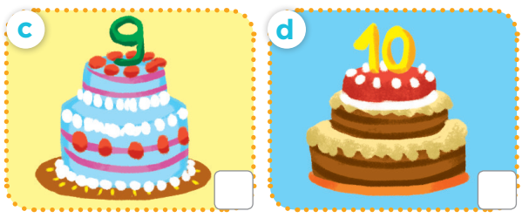
Notes:
Ask questions: How many pictures are there? What can you see in each picture?

Slide 26
Notes:
Ask and answer: How old are you?

Slide 27
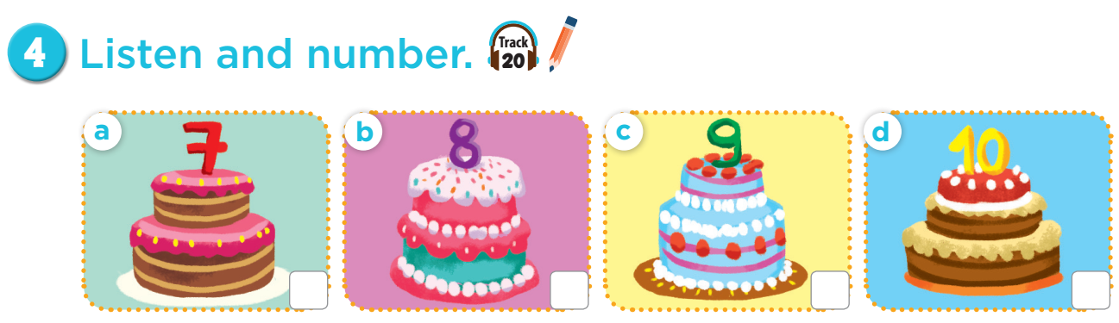
4
1
3
2

Slide 28


Slide 29


1. Work in teams (girls & boys)
2. Choose and answer.

Slide 30
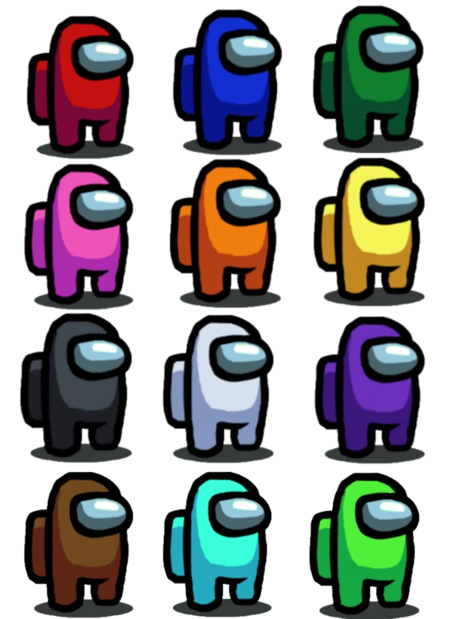
Notes:
CLICK THE CLOUD – GO TO PART 4

Slide 31



How old are you?
I’m __ years old.
7
Notes:
CLICK PINK AMONG US – GO TO THE POINTS

Slide 32

How old are you?
I’m __ years old.
5
Notes:
CLICK PINK AMONG US – GO TO THE POINTS

Slide 33

How old are you?
I’m __ years old.
9
Notes:
CLICK PINK AMONG US – GO TO THE POINTS

Slide 34

How old are you?
I’m __ years old.
8
Notes:
CLICK PINK AMONG US – GO TO THE POINTS

Slide 35

How old are you?
I’m ___ years old.
10
Notes:
CLICK PINK AMONG US – GO TO THE POINTS

Slide 36
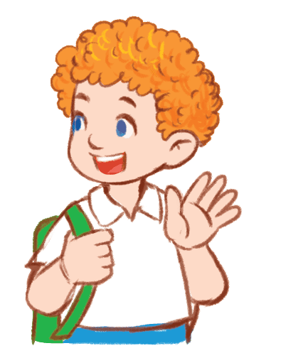
What’s your name?
My name’s ____.
Bill
Notes:
CLICK PINK AMONG US – GO TO THE POINTS

Slide 37
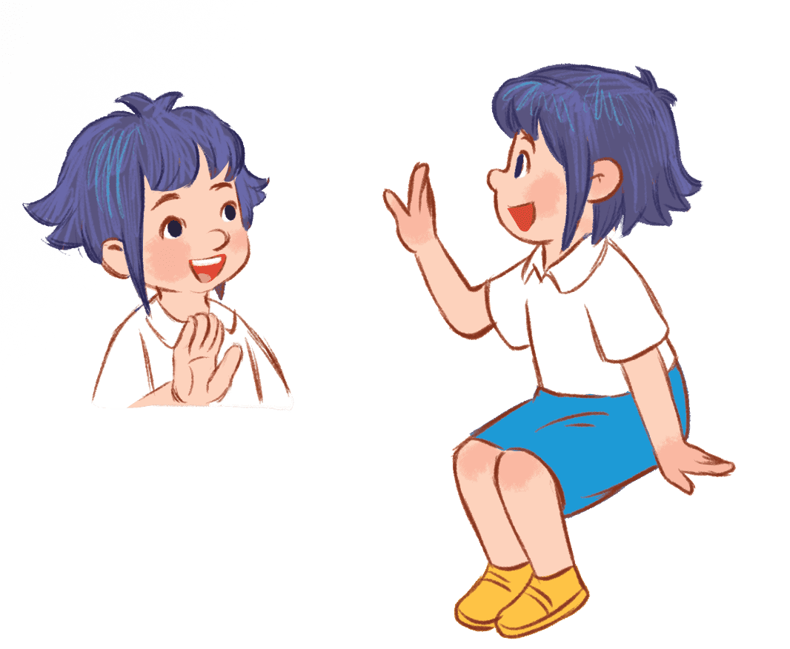
What’s your name?
My name’s ____.
Linh
Notes:
CLICK PINK AMONG US – GO TO THE POINTS

Slide 38
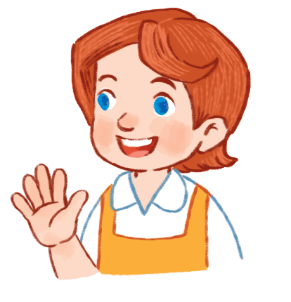
What’s your name?
My name’s ____.
Lucy
Notes:
CLICK PINK AMONG US – GO TO THE POINTS

Slide 39





Slide 40



Slide 41


Slide 42


Slide 43
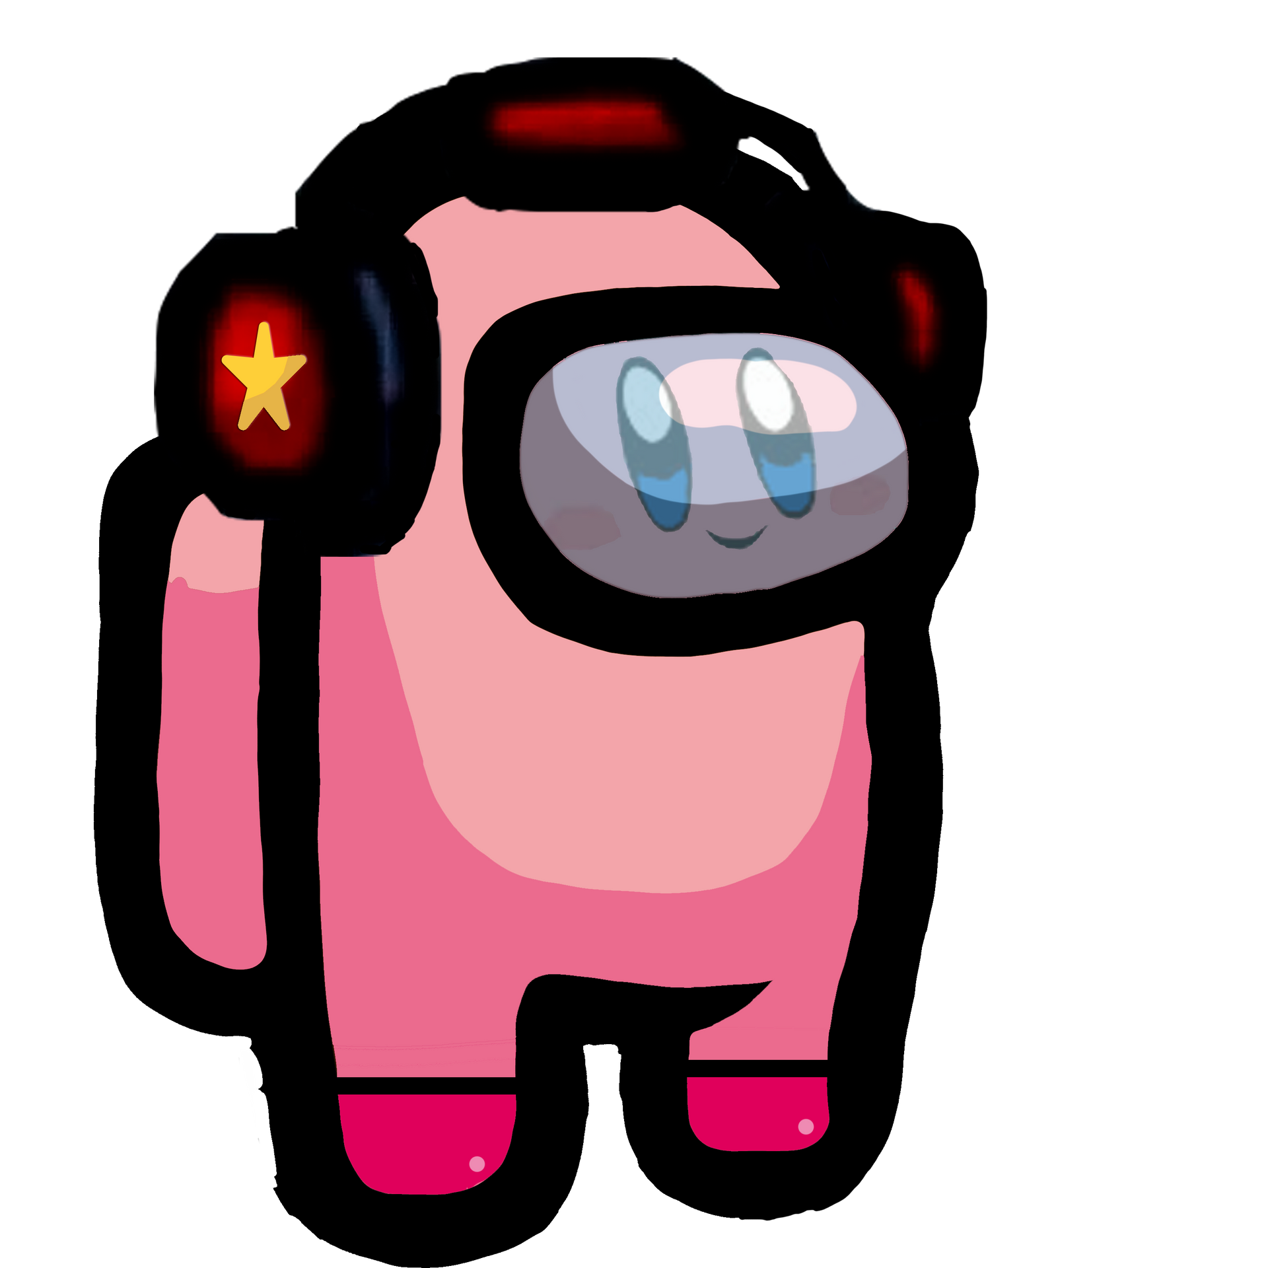

Slide 44


Slide 45


Slide 46


Slide 47
FUN TIME

Slide 48


5
10
1
7
8
SPIN
8
3
9
4
4
6
2
tekhnologic

