Slide 1

Our names
Unit 2
9
LESSON 1

Slide 2
I. OBJECTIVES.
By the end of the lesson, pupils will be able to
1. Language .
- use the words what, your, name, my in relation to the topic “Our names”;
- Use What’s your name? – My name’s . to ask and answer questions about names;
- Listen to and demonstrate understanding of simple communicative contexts in relation to the topic "Our names";
2. Core competencies.
- teamwork, reliability, motivation, communication and initiative.
3. General competences.
Listening: listen and recognize the names, then repeat.
Critical thinking: talk about names.
Oral communication: speak about names, ask and answer the questions
Self-control & independent learning: perform listening tasks
Communication and collaboration: work in pairs or groups
4. Attributes.
- Diligence: complete learning tasks
- Leadership: collaborate with teachers to enhance language skills

Slide 3
WARM-UP

Slide 4

Sing with me!

Slide 5

Notes:
Youtube link: https://www.youtube.com/watch?v=tVlcKp3bWH8

Slide 6
Look, listen and repeat.
1

Slide 7


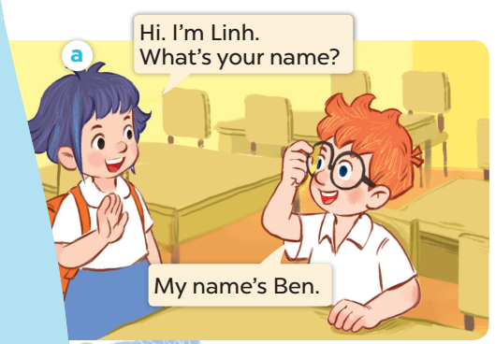
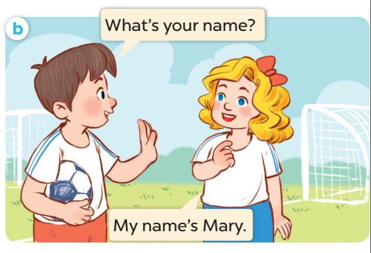

Slide 8
Listen, point and say
2

Slide 9
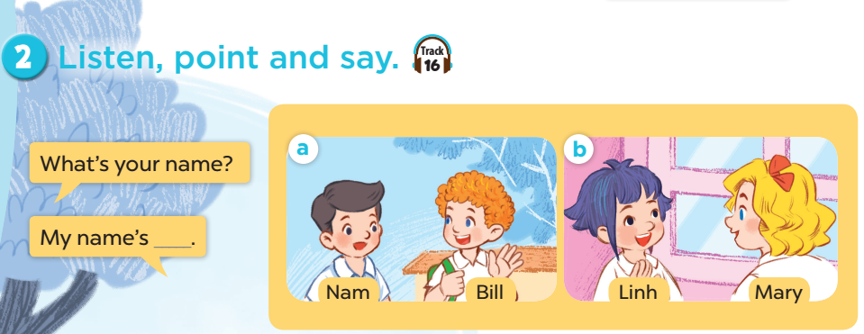

Slide 10
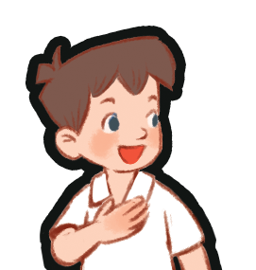
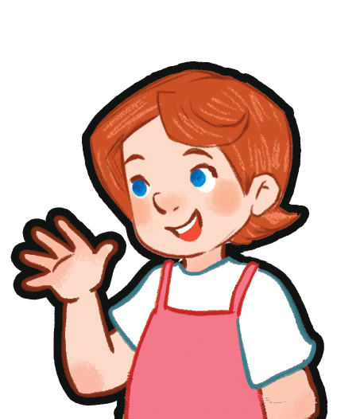
I’m Minh.
What’s your name?
Hello!
My name’s Lucy.
Hi!

Slide 11
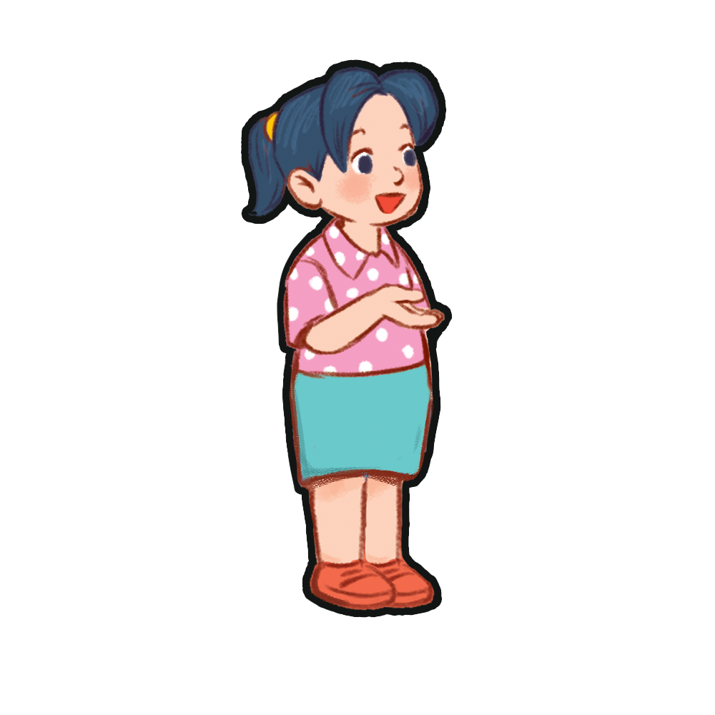
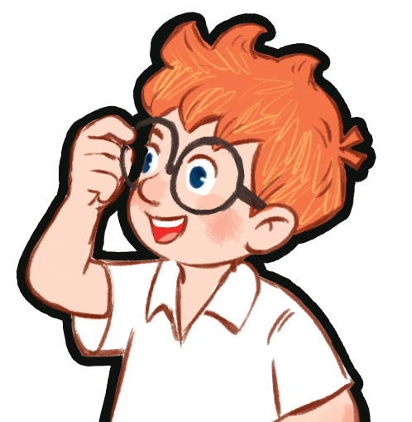
I’m Minh.
What’s your name?
My name’s _____.
Mai
Ben

Slide 12

Blow up balloons
Notes:
Divide the class into 2 teams. Let each pupil choose a balloon by its colour. Pupil(s) answer the question(s). If their answer(s) are correct, they get points (behind each balloon) for their teams. The winning team is the team with more points.

Slide 13







5
15
15
20
5
10
25

Slide 14
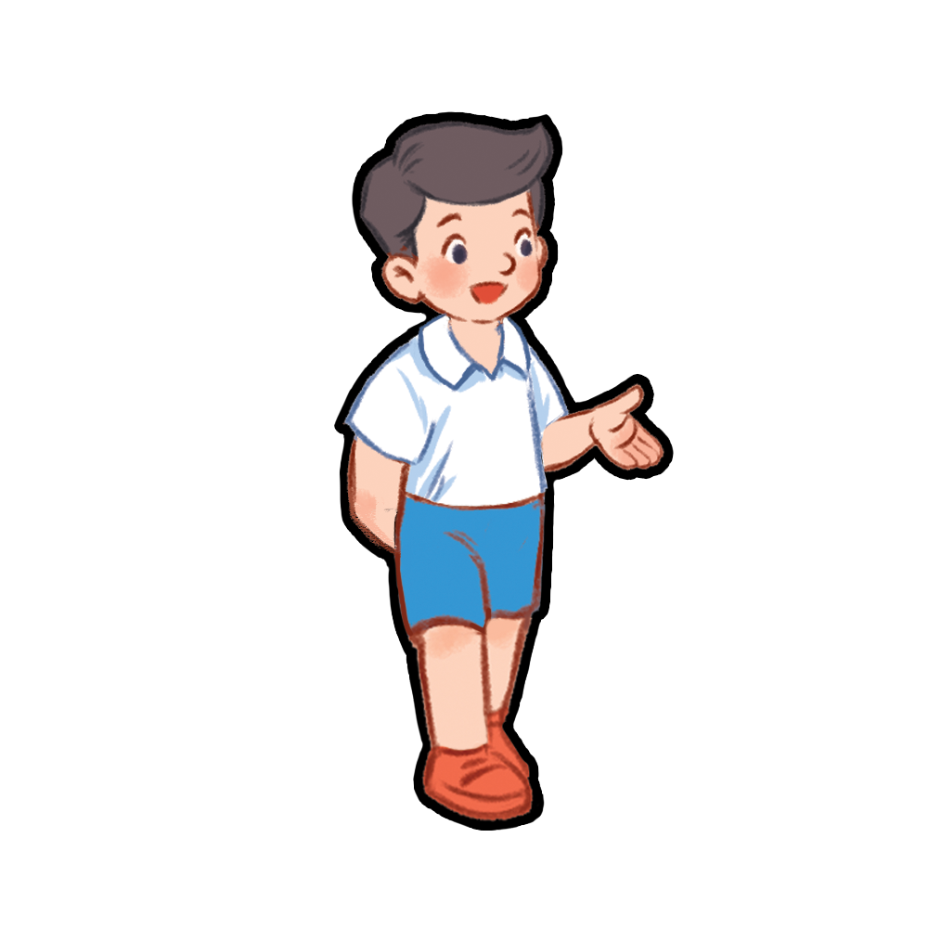
What’s your name?
Nam

Slide 15
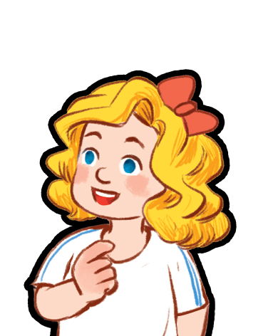
What’s your name?
Mary

Slide 16

What’s your name?
Bill

Slide 17
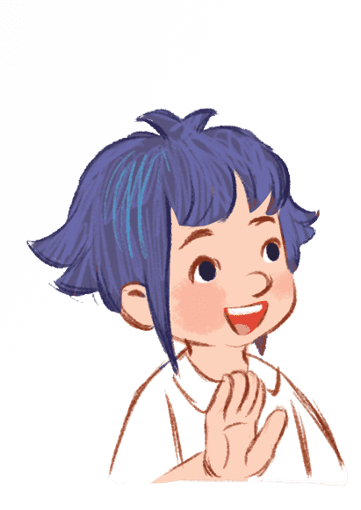
What’s your name?
Linh

Slide 18
What’s your name?
Ben

Slide 19
What’s your name?
Mai

Slide 20
What’s your name?
Lucy

Slide 21
ACTIVITY 4

Slide 22
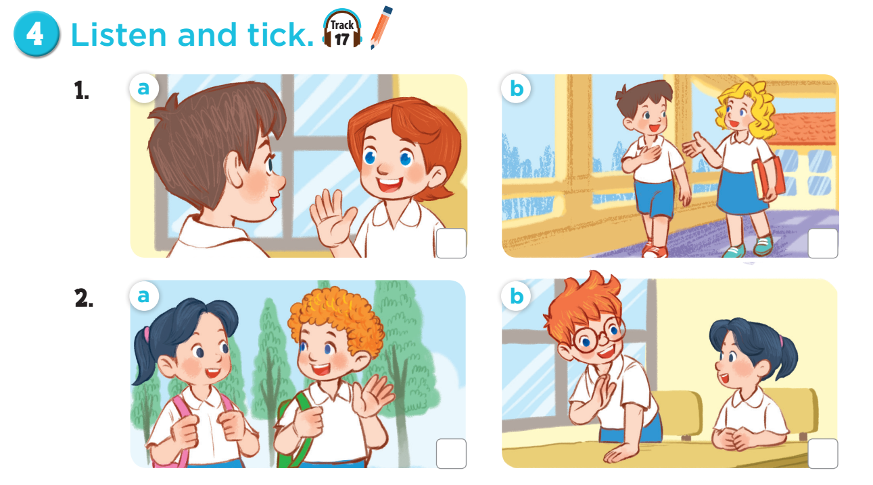
Ask and answer questions.
Notes:
Ask pupils some questions about Activity: How many pictures are there? Who can you see? What are they doing?

Slide 23


Slide 24
FUN TIME

Slide 25
Let’s ask people around you!
 | What’s your name?
You | NGUYÊN
Your friend | …………………………………………………
Your grandma / grandpa | …………………………………………………
Your mom / dad | …………………………………………………
Your sister/brother | …………………………………………………

