Slide 1



1
Hello
LESSON 3

Slide 2
I. OBJECTIVES.
By the end of the lesson, pupils will be able to:
1. Language.
- to correctly repeat the sounds of the letters h and b in isolation, in the words hello and bye, and in the sentences Hello, Ben. and Bye, Ben. with the correct pronunciation and intonation.
- to identify the target words hello and bye while listening.
- use the names Ben, Mai, Minh, Lucy, the words hello, hi, bye, goodbye, and the sentence patterns Hello, / Hi, I’m _____.; How are you? and Fine, thank you. in relation to the topic “Greetings”.
– use Hello. / Hi. I’m ______. and Hello, / Hi,____ . I’m_____ . to greet, self-introduce and respond to greetings.
– use Hi. How are you? and Fine, thank you. to greet others, respond to greetings and use Goodbye / Bye ______. to say goodbye.
2. Core competencies.
teamwork, reliability, motivation
3. General competences.
Self-control & independent learning: perform listening tasks
Communication and collaboration: work in pairs or groups
3. Attributes.
Kindness: help partners to complete learning tasks
Diligence: complete learning tasks
Honesty: tell the truth about feelings and emotions

Slide 3
Warm-up

Slide 4



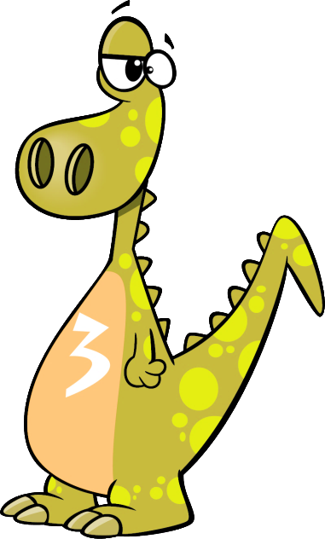


Notes:
Review the numbers.
Divide class into 4 teams. Invite pupils go to the monitor and choose the correct answer. If correct, one point for the team.
- Give points for the teams and encourage pupils.

Slide 5

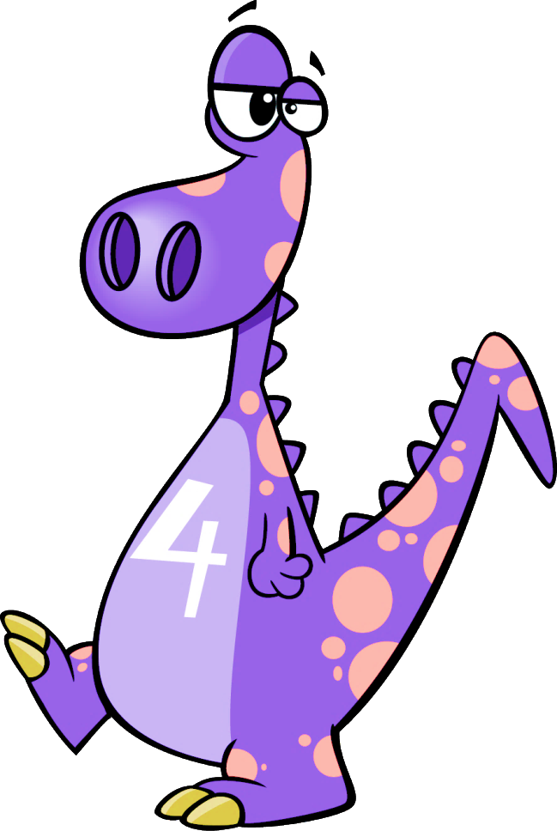

I’m dino number _______
four
one
ten
four
NEXT
Notes:
Divide the class into 4 groups. Invite pupils to go to the monitor and touch to choose the numbers. Pupils will get points for their teams if their answers are correct.
Give points to the groups and encourage them.

Slide 6

I’m dino number _______
one
one
ten
two
NEXT
Notes:
Review the numbers.
Divide class into 4 teams. Invite pupils go to the monitor and choose the correct answer. If correct, one point for the team.
- Give points for the teams and encourage pupils.

Slide 7
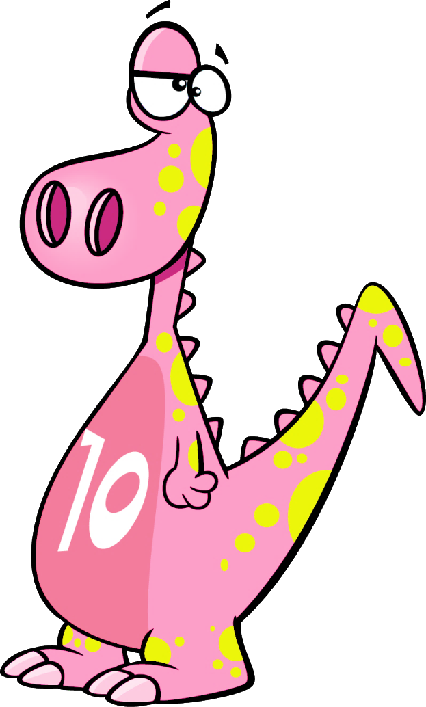
I’m dino number _______
ten
nine
ten
eight
NEXT
Notes:
Review the numbers.
Divide class into 4 teams. Invite pupils go to the monitor and choose the correct answer. If correct, one point for the team.
- Give points for the teams and encourage pupils.

Slide 8
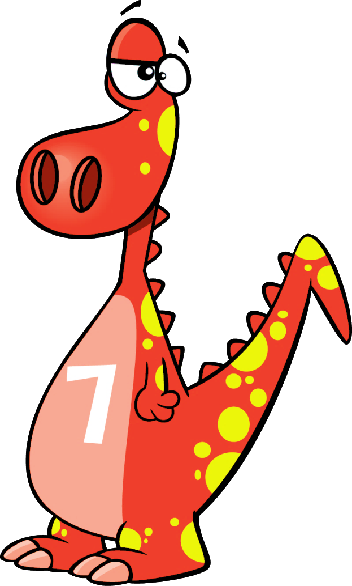
I’m dino number _______
seven
one
ten
seven
NEXT
Notes:
Review the numbers.
Divide class into 4 teams. Invite pupils go to the monitor and choose the correct answer. If correct, one point for the team.
- Give points for the teams and encourage pupils.

Slide 9
1
Listen and repeat.

Slide 10




Slide 11
2
Listen and circle.

Slide 12

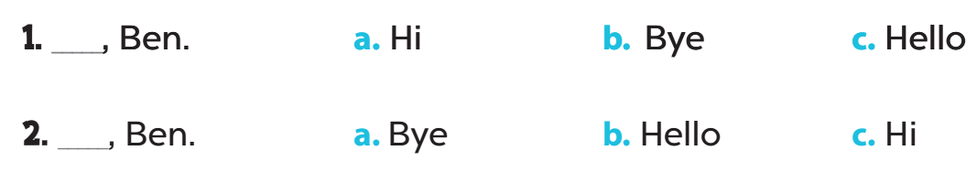

Slide 13
4
Read and circle.

Slide 14
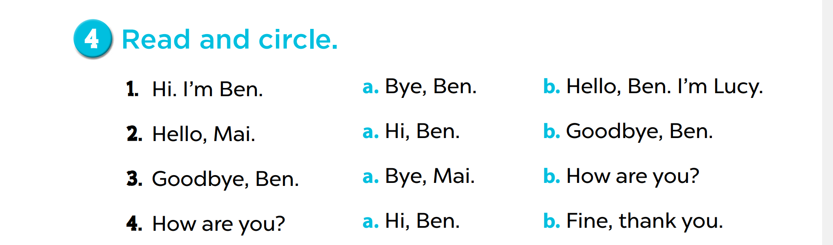

Slide 15
Let’s write.
5

Slide 16

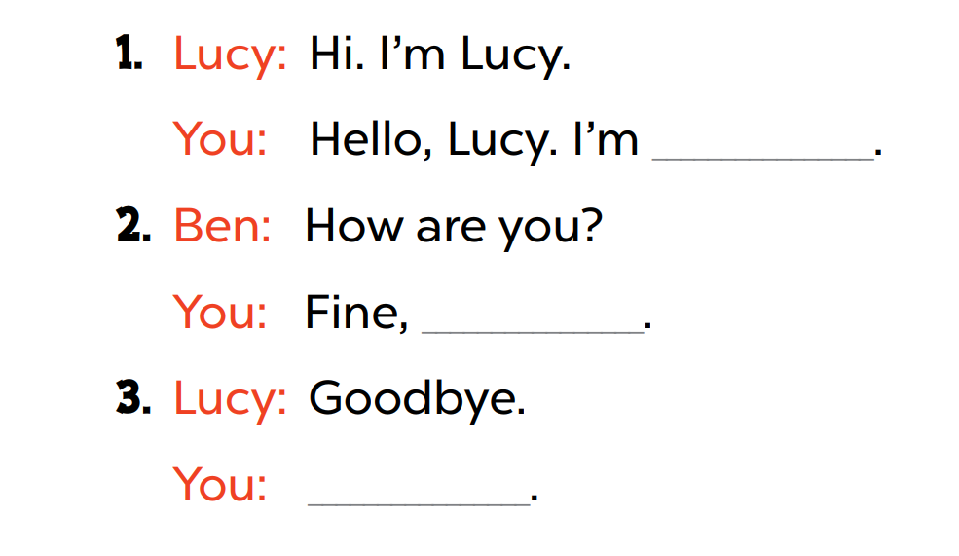
thank you
Bye

Slide 17
Fun corner and wrap-up

Slide 18

Sing, do actions, then stop!
Game time!!!
Notes:
Step 1: Divide the class into 4 teams.
Step 2: Have pupils sing and dance with the lyrics and rhythm of the chant.
Step 3: Invite each team to sing and do actions. When the music stops, all of them have to stop doing actions (freeze). Who can freeze longer will win.
Step 4: Encourage pupils to join the game. Give point to teams.

