Slide 1



Slide 2



1
Hello
LESSON 1
Period 1

Slide 3
OBJECTIVES
Language: By the end of the lesson, pupils will be able to:
- use the names Ben, Mai, Minh, Lucy, the words hello, hi.
- use Hello/ Hi. I’m _____. and Hello, / Hi, ____. I’m ___. to greet, self-introduce and respond to greetings.
- listen to and demonstrate understanding of simple communicative contexts in relation to the topic “Greetings”
Core competencies:
- Teamwork, reliability, motivation
General competencies:
- Listening: listen and recognize the characters, then repeat
- Critical Thinking: self-introduce
- Self-control & independent learning: perform listening tasks
- Communication and collaboration: work in pairs or groups
Attributes:
- Kindness: help partners to complete learning tasks
- Diligence: complete learning tasks
- Honesty: tell the truth about feelings and emotions
Responsibility: appreciate kindness

Slide 4
Warm-up
Game
Notes:
Review Numbers 1-10 and Alphabet

Slide 5

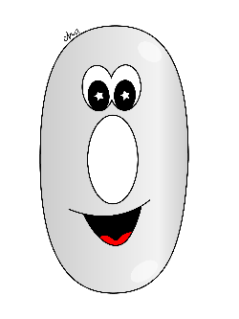









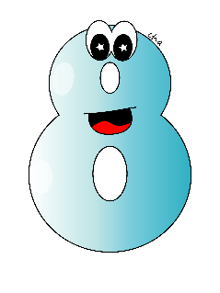

Notes:
Review numbers 1-10 by picking numbers
Step 1: Say the numbers for pupils to choose.
Step 2: Give points to pupils with the correct choosing.

Slide 6













Slide 7


Slide 8


Slide 9


Slide 10
Game: Look and say the missing letters.
Notes:
Step 1: Ask pupils to say the missing letters, then check with the class.
Step 2: Give points to the pupils and encourage them.

Slide 11
a
b
c
d
e
f

Slide 12
m
n
o
p
q
r

Slide 13
s
t
u
w
x
v

Slide 14
1
Look, listen and repeat.

Slide 15



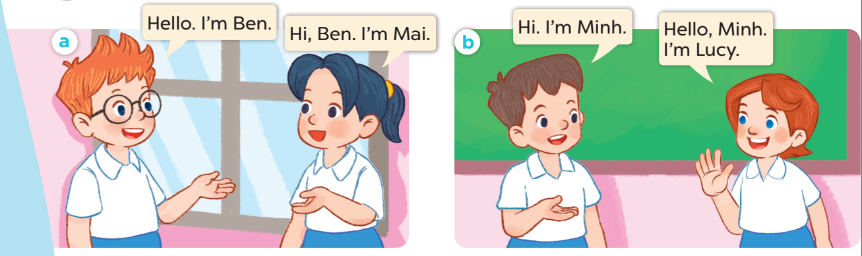

Slide 16
2
Listen, point and say.

Slide 17

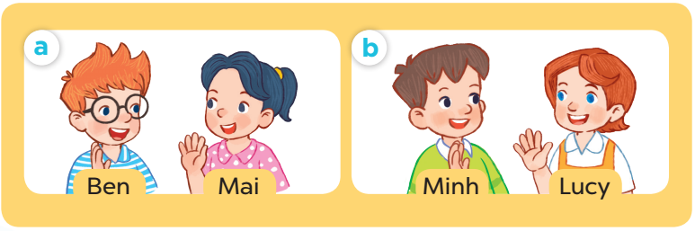
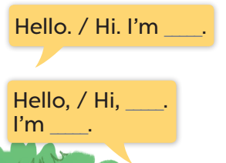

Slide 18

Hello.
I’m Mai.
I’m Minh.
Pair work
Hi, Mai.

Slide 19
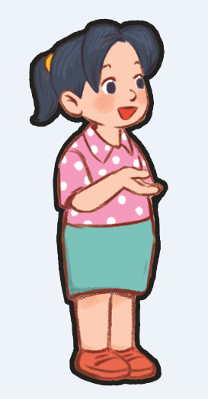
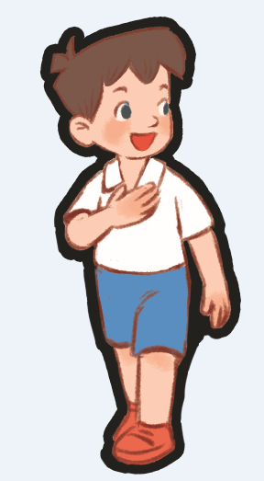
Game time!
Say “Hello”!!!
Notes:
Divide the class into 2 groups: boys and girls. Ask each pupil from one group tp come and practise greeting, self-introducing and responding to greetings with one pupil from the other group. Give points to the groups, praise the pupils.

Slide 20
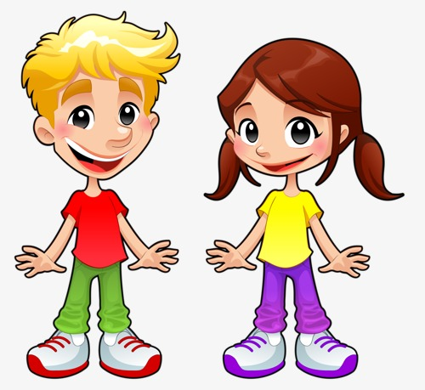

Slide 21
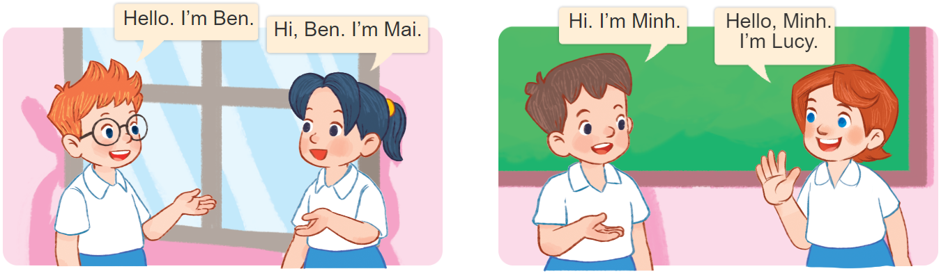
Can you say this?
Notes:
Divide the class into groups of four. Ask pupils of each group to come to the board and practise saying the conversation of the characters. Give point to the groups.

Slide 22
4
Listen and circle.

Slide 23

