Slide 1



1
Hello
LESSON 1 + LESSON 2
P11, 13

Slide 2
I. OBJECTIVES.
1. Language.
- listen to and demonstrate understanding of simple communicative contexts in relation to the topic “Greetings”
- Use Hello. / Hi. I’m ______. and Hello, / Hi,____ . I’m_____ . to greet,
self-introduce and respond to greetings.
- use Hi. How are you? and Fine, thank you. to greet others, respond to greetings and use Goodbye / Bye ______. to say goodbye.
2. Core competencies.
- teamwork, motivation, adaptability, communication
3. General competences.
Listening: listen and recognize the characters, then repeat
Critical Thinking: self-introducing
Self-control & independent learning: perform listening tasks
Communication and collaboration: work in pairs or groups
4. Attributes.
Kindness: help partners to complete learning tasks
Diligence: complete learning tasks
Honesty: tell the truth about feelings and emotions
1

Slide 3
Warm-up and review
Game

Slide 4

a
c
b
d
f
e
g
h
i
j
Notes:
Step 1: Divide the class into 4 teams.
Step 2: Set rule: Pupils go to the monitor/screen and touch/click the correct letter in the tree that is the same to the letter that Mary says.
Step 3: Encourage pupils to join the game.
Step 4: Give points to the teams and encourage them.

Slide 5
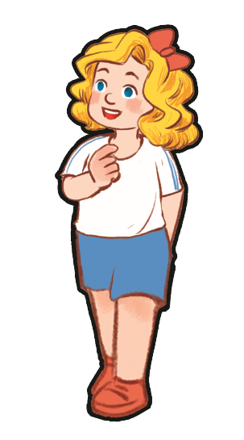
v
r
f
o
h
A
a

Slide 6
n
t
w
a
b
c
N
Notes:
\

Slide 7
v
s
l
h
f
H
j

Slide 8
n
r
i
o
B
g
b

Slide 9
n
o
b
a
u
O
s

Slide 10
5
Look, complete and read.

Slide 11


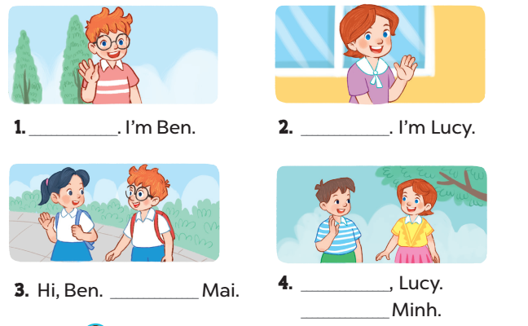
Hello
Hi
I’m
Hello
I’m

Slide 12
6
Read and match.

Slide 13
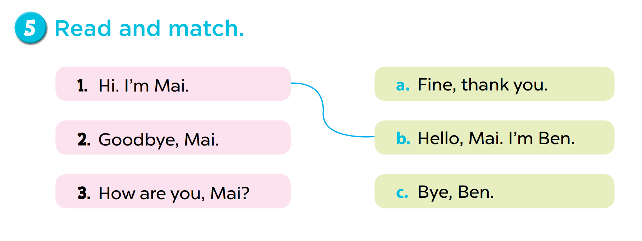

Slide 14

Role play
Game time
Notes:
Step 1: Divide the class into 2 teams.
Step 2: Invite 1 student in each team go to the board and role play.
Step 3: Give points to each team.
Step 4: Encourage students to role play to practise speaking English.

Slide 15
6
Let’s sing.

Slide 16
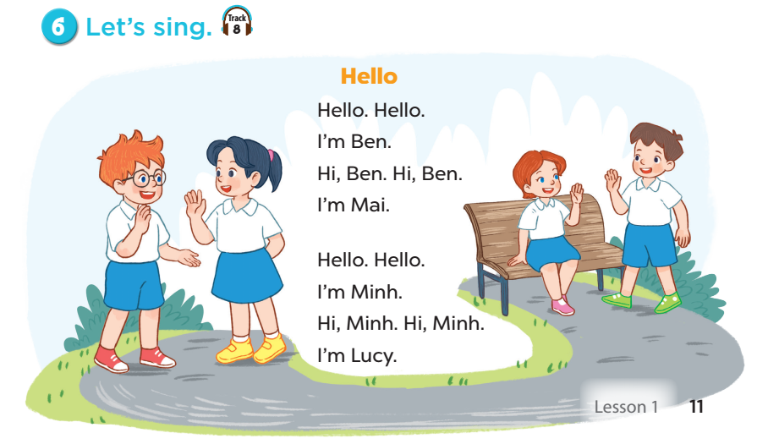


Slide 17
Fun corner and wrap-up

Slide 18
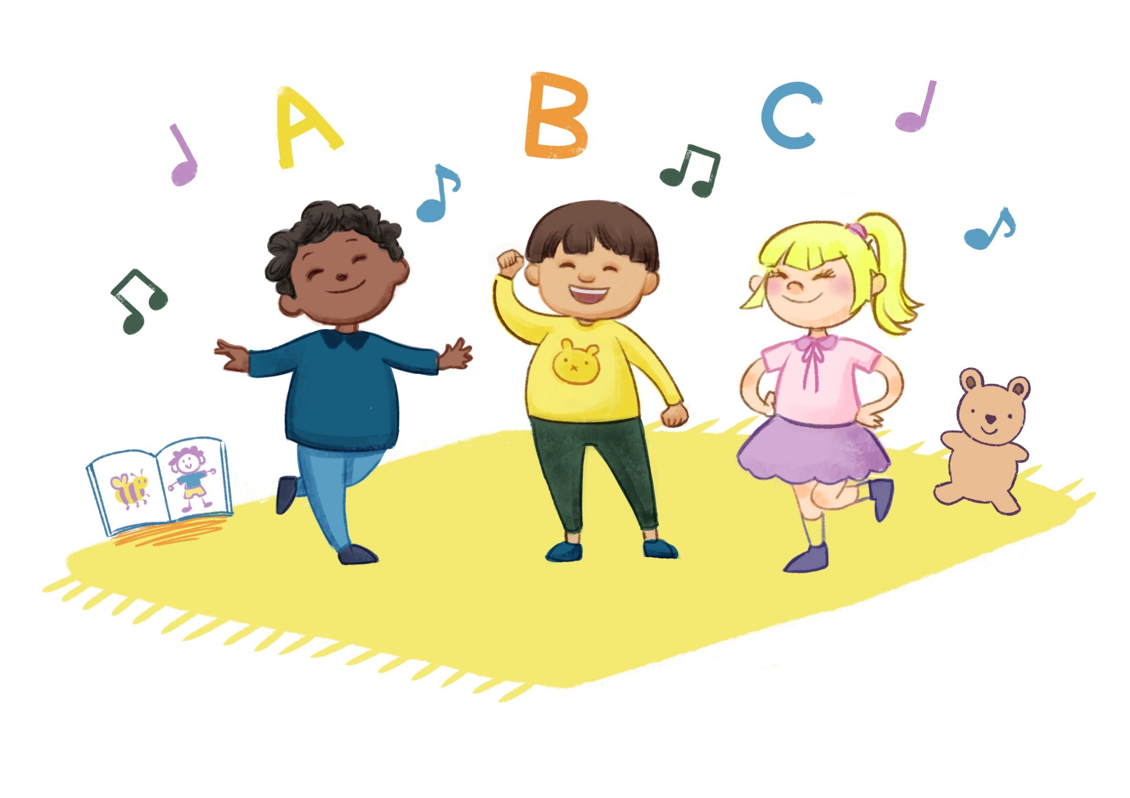
Game:
Sing and do. Then stop!
Notes:
Divide the class into 4 teams: Apple, Banana, Orange, Watermelon. Set the rules: Teacher plays the music, pupils will sing and do the actions of the song. Then teacher stops the music, pupils stop doing. Those who cannot make it have to sit down. The team having more pupils left and more beautiful dancing is the winner. Give points to pupils.

Slide 19




Teams
Notes:
Team winner is …

