Slide 1
Wednesday 07th-09-2022

Slide 2




Ben
Mai
Minh
Lucy

Slide 3
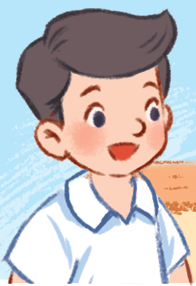

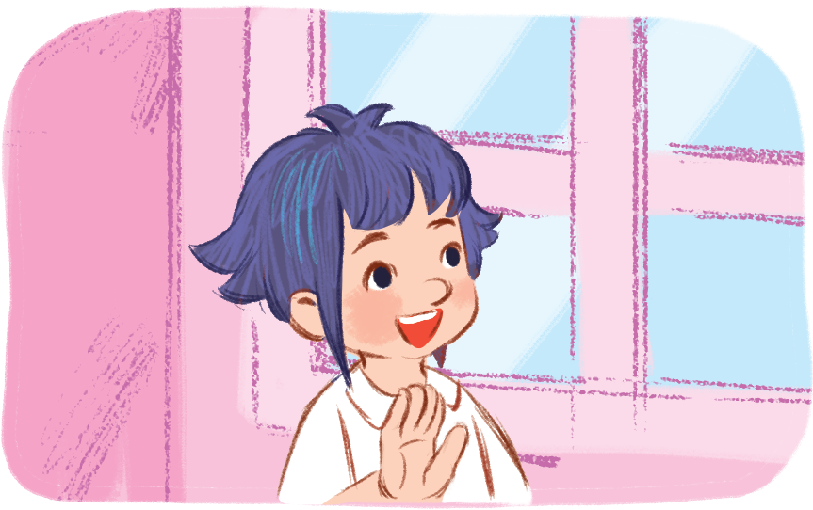
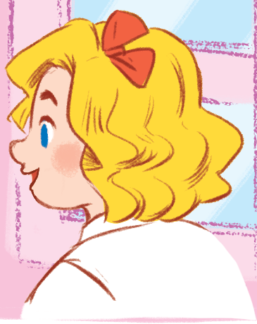
Nam
Bill
Linh
Mary

Slide 4
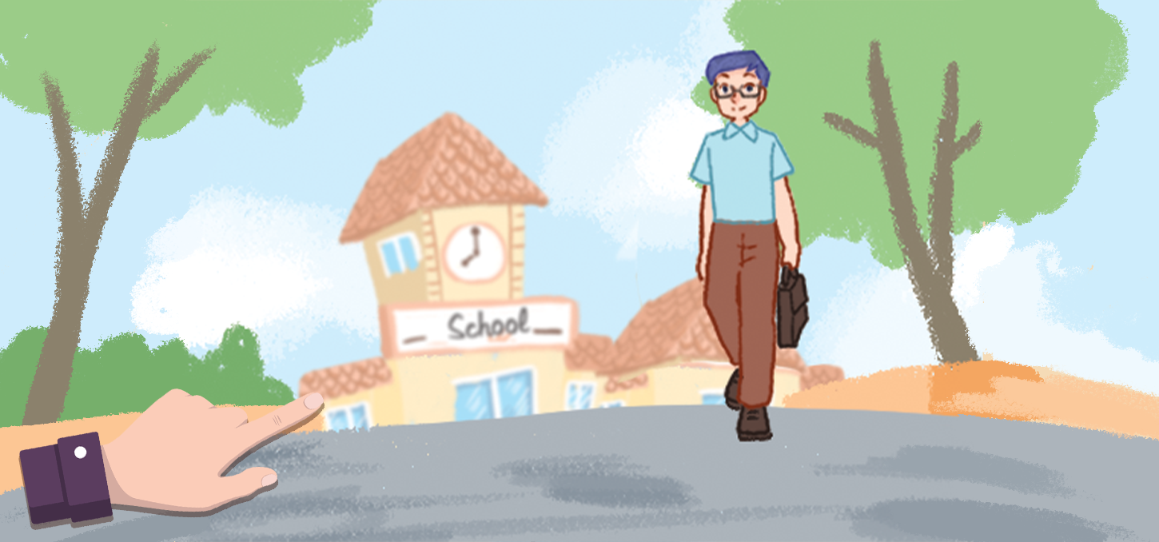
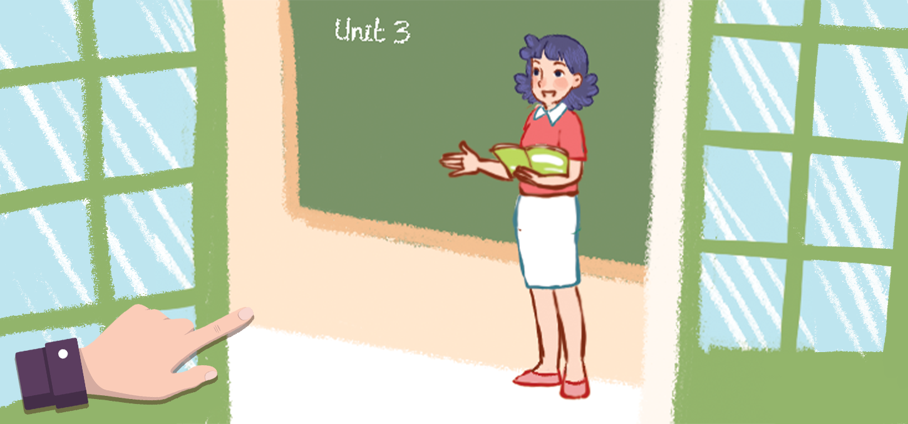
Mr Long
Ms Hoa

Slide 5


Slide 6
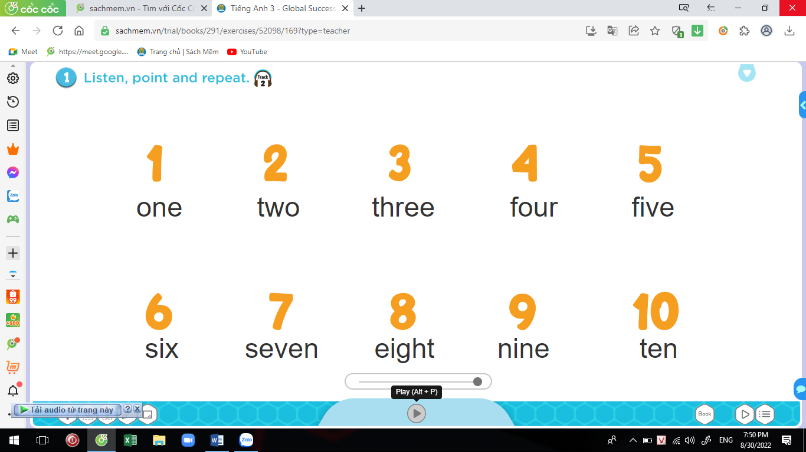


Slide 7
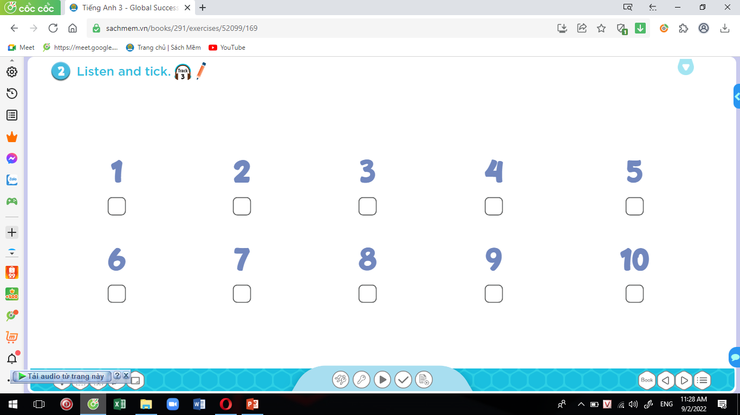
2.Listen and tick
√
√
√
√

Slide 8
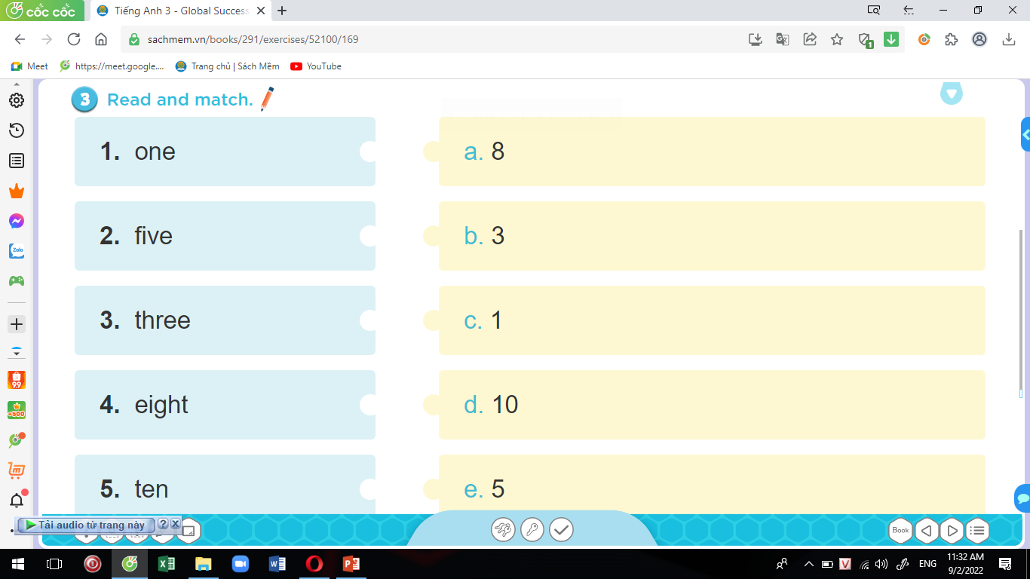
3. Read and match

Slide 9


Slide 10
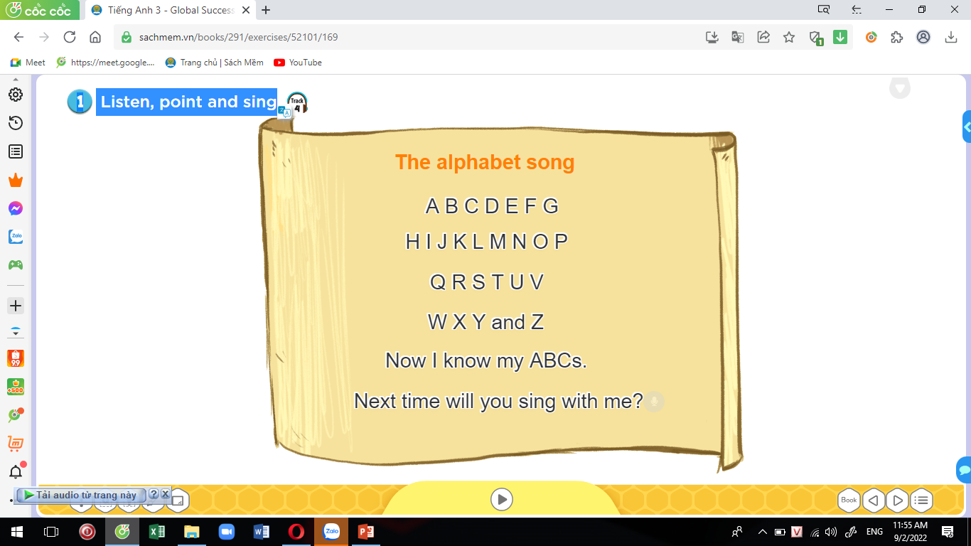
1. Listen, point and sing

Slide 11
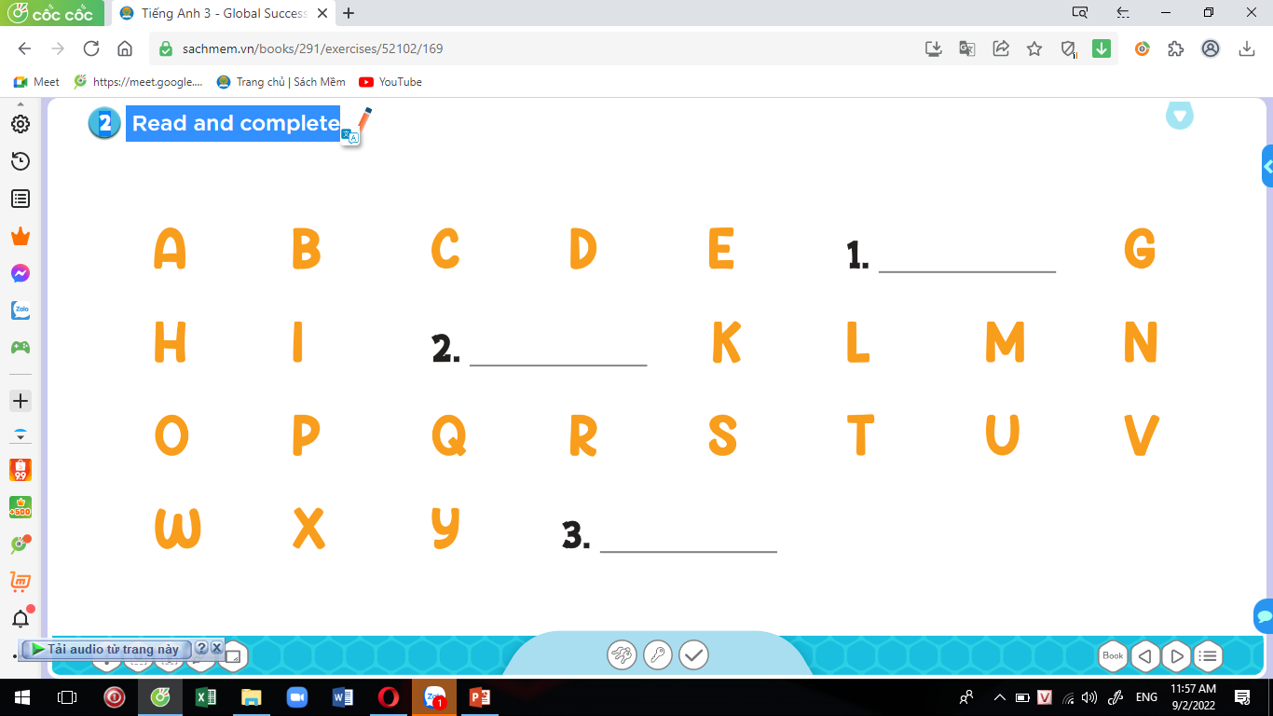
2. Read and complete
F
J
Z

Slide 12
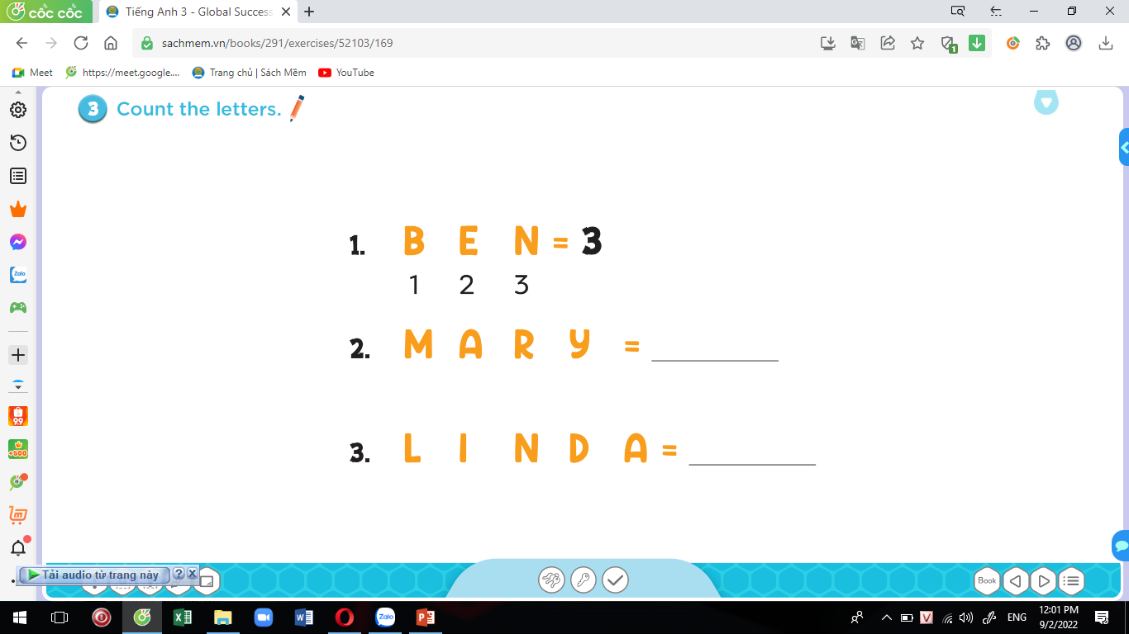
3. Count the letters.
4
5

Slide 13
1
2
3
4
5
6
7
8
9
10
10
9
8
7
6
5
4
3
2
1

Slide 14
5

Slide 15
8

Slide 16
4

Slide 17
9

Slide 18
1

Slide 19
10

Slide 20
7

Slide 21
3

Slide 22
2

Slide 23
6

Slide 24
2. Let’s play
v

Slide 25
