Slide 1




Slide 2
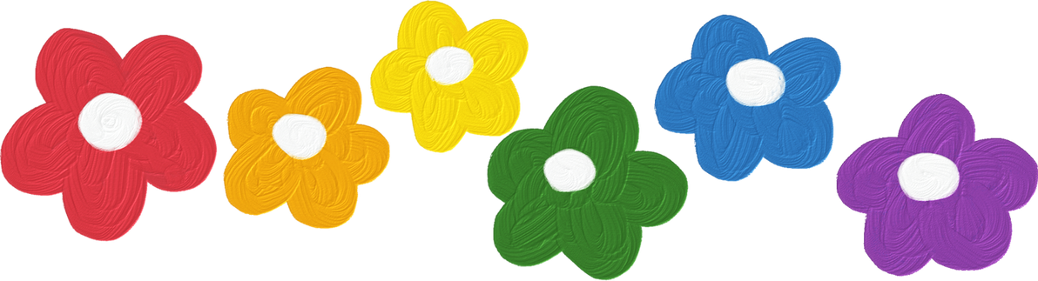




REVIEW 1
PERIOD 1

Slide 3
I. OBJECTIVES.
By the end of the lesson:
- Pupils will be able to review the following sentences patterns:
1. Language.
Hello. / Hi. I’m ____. – Hello , / Hi, I’m ___.
How are you? − Fine, thank you.
What's your name? − My name's ____.
How old are you? – I’m _____ years old.
Is this / that ? − Yes, it is. / No, it isn't. It's ___.
What’s this? - It’s _____.
Touch/ Open your ______!
What's your hobby? − It's ____.
What do you like? – I like ____.
2. Core competencies.
- Decision making, teamwork, motivation, problem-solving
3. General competencies.
- Self-control & independent learning: perform listening tasks
- Communication and collaboration: work in pairs or groups
- Oral Communication: let’s talk
4. Attributes.
- Kindness: help partners to complete learning tasks
- Diligence: complete learning tasks
- Honesty: tell the truth about feelings and emotions

Slide 4

Warm-up and review

Slide 5

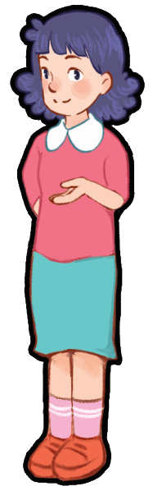
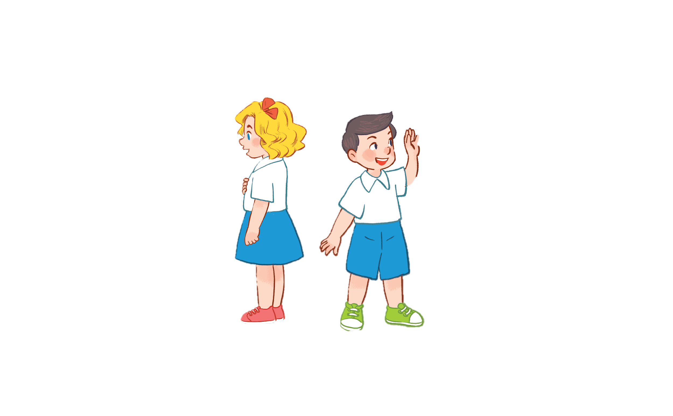

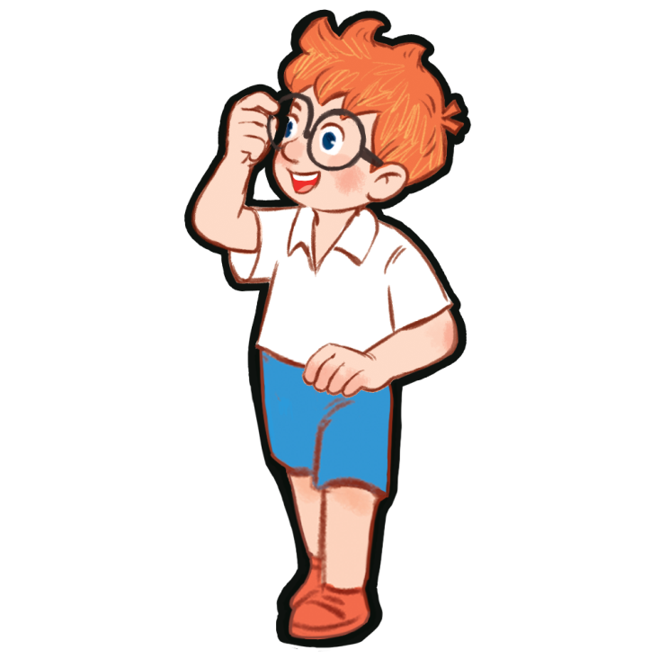
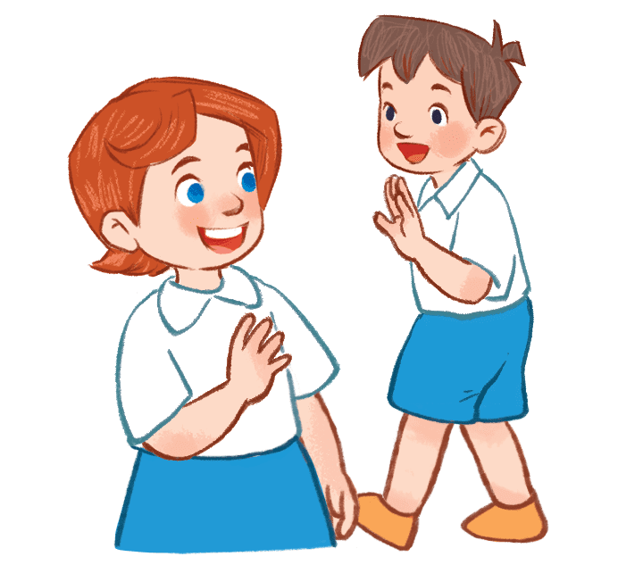
Notes:
- Divide the class into 2 groups.
- Ask pupils in each group to stand closely in a straight line.
- Teacher says a word or phrase to the first pupil in line.
- Then, the first pupil whispers what she/ he hears to the second person in line and so on until the last pupil in the line.
- The last pupil will say the word or phrase out loud.

Slide 6

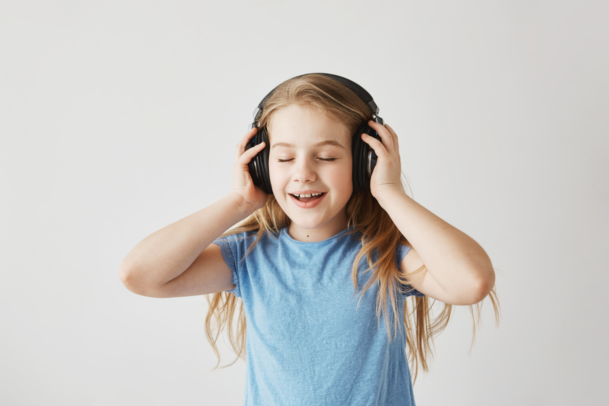

1. Listen and
tick.

Slide 7

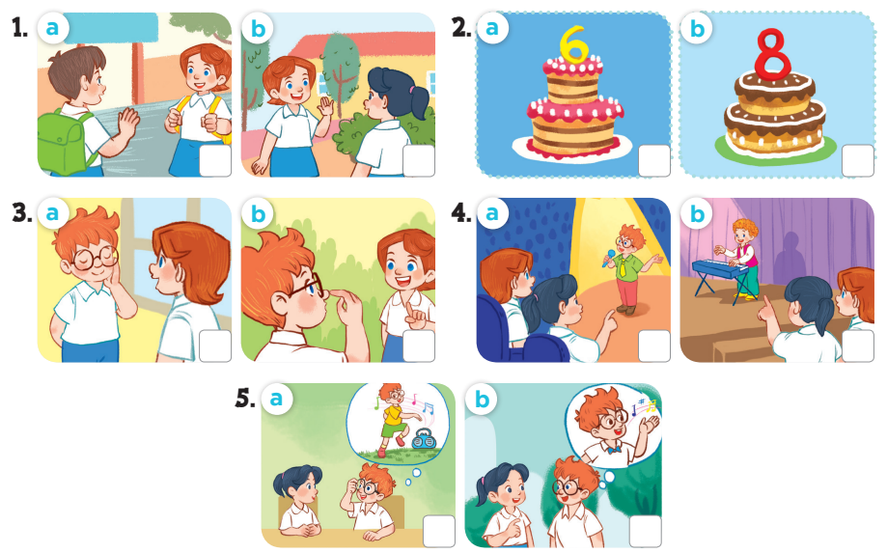
Notes:
Key: 1. b 2. b 3. a 4. b 5. b

Slide 8


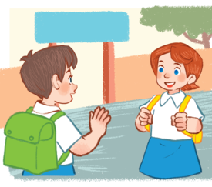
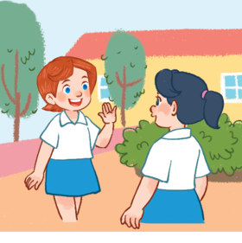



1
a
b

Slide 9



2
a
b

Slide 10
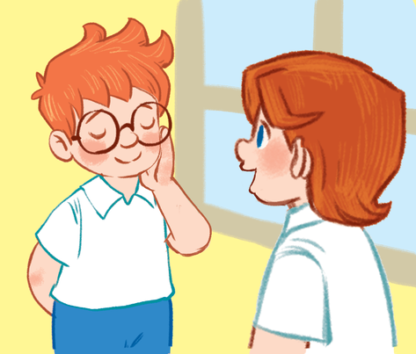
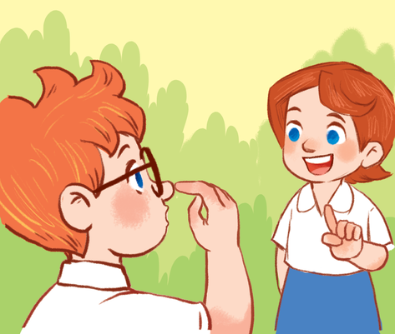

3
a
b

Slide 11
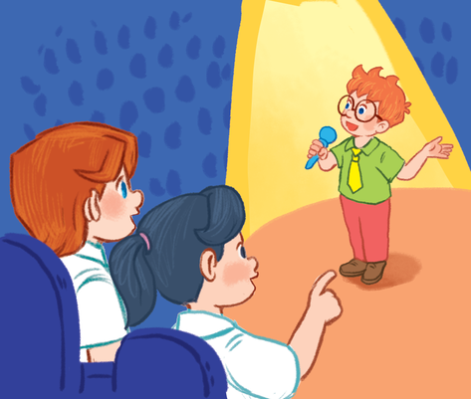
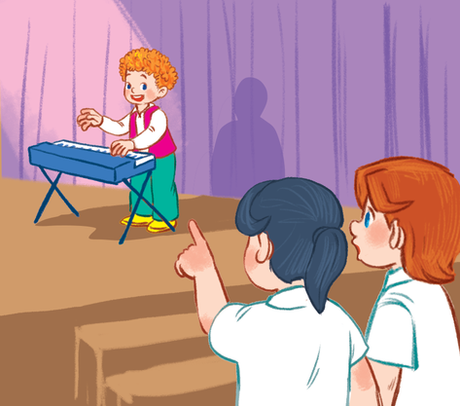

4
a
b

Slide 12
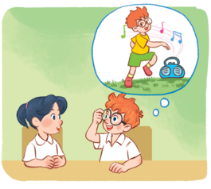
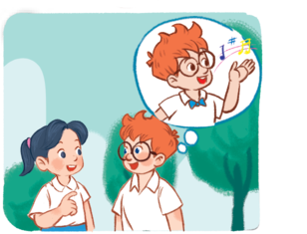
5
a
b

Slide 13
2.Listen and
number.

Slide 14

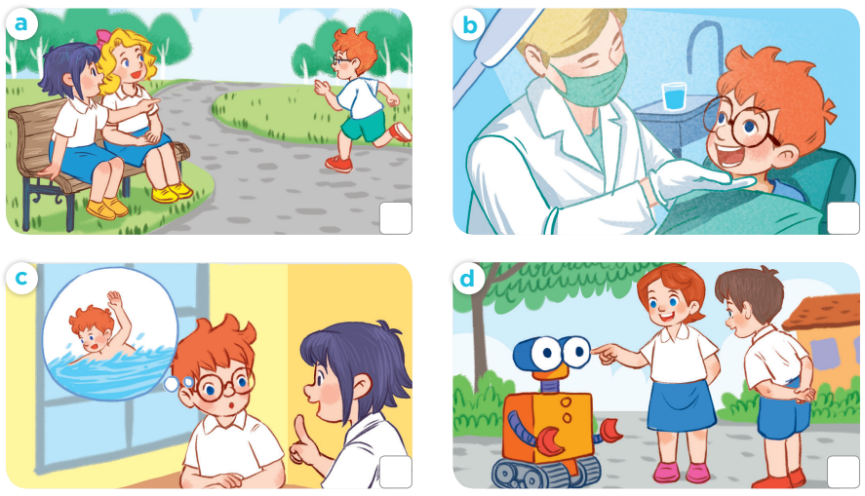
4
1
2
3
Notes:
Key:
1. b
2. c
3. d
4. a

Slide 15


3. Read
and
match.

Slide 16

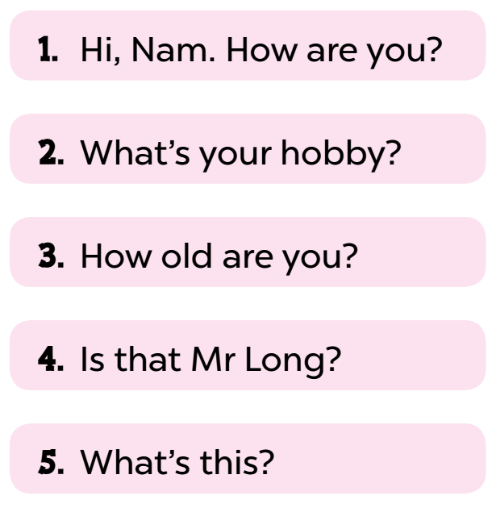
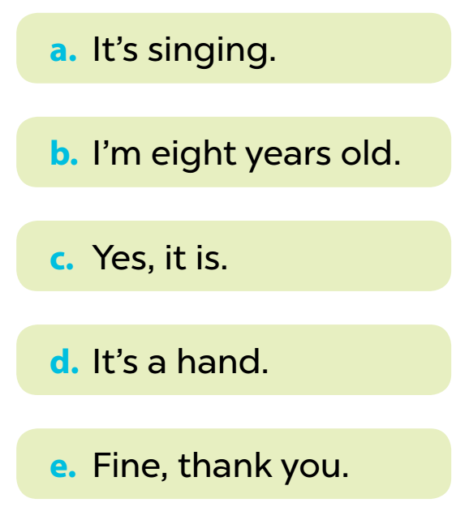

Notes:
Key: 1. e 2. a 3. b 4. c 5. d

Slide 17

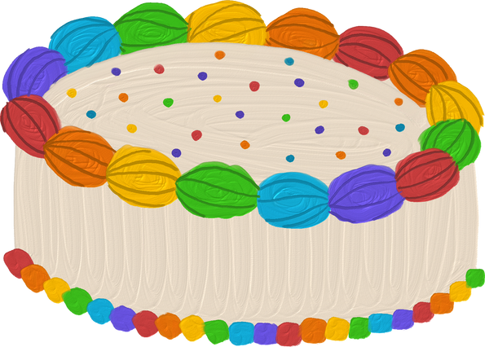
Fun corner and wrap-up
Notes:
A survey
- Pupils use the questions to interview their friends.
+ What's your name? − My name's ...
+ How old are you? – I’m _____ years old.
+ What's your hobby? − It's ...
- Afterwards, pupils can tell the class what they found out about their friends.

Slide 18
Name | Age | Hobby
1.
2.
3.
4.
5.
6.
7.
Notes:
A survey
− Pupils use the questions to interview their friends.
+ What's your name? − My name's...
+ How old are you? – I’m _____ years old.
+ What's your hobby? − It's ____.
- Afterwards, pupils can tell the class what they found out about their friends.

Slide 19
Name | Age | Hobby
1. Minh | 8 | drawing
2.
3.
4.
5.
6.
7.
Notes:
Example

