Slide 1
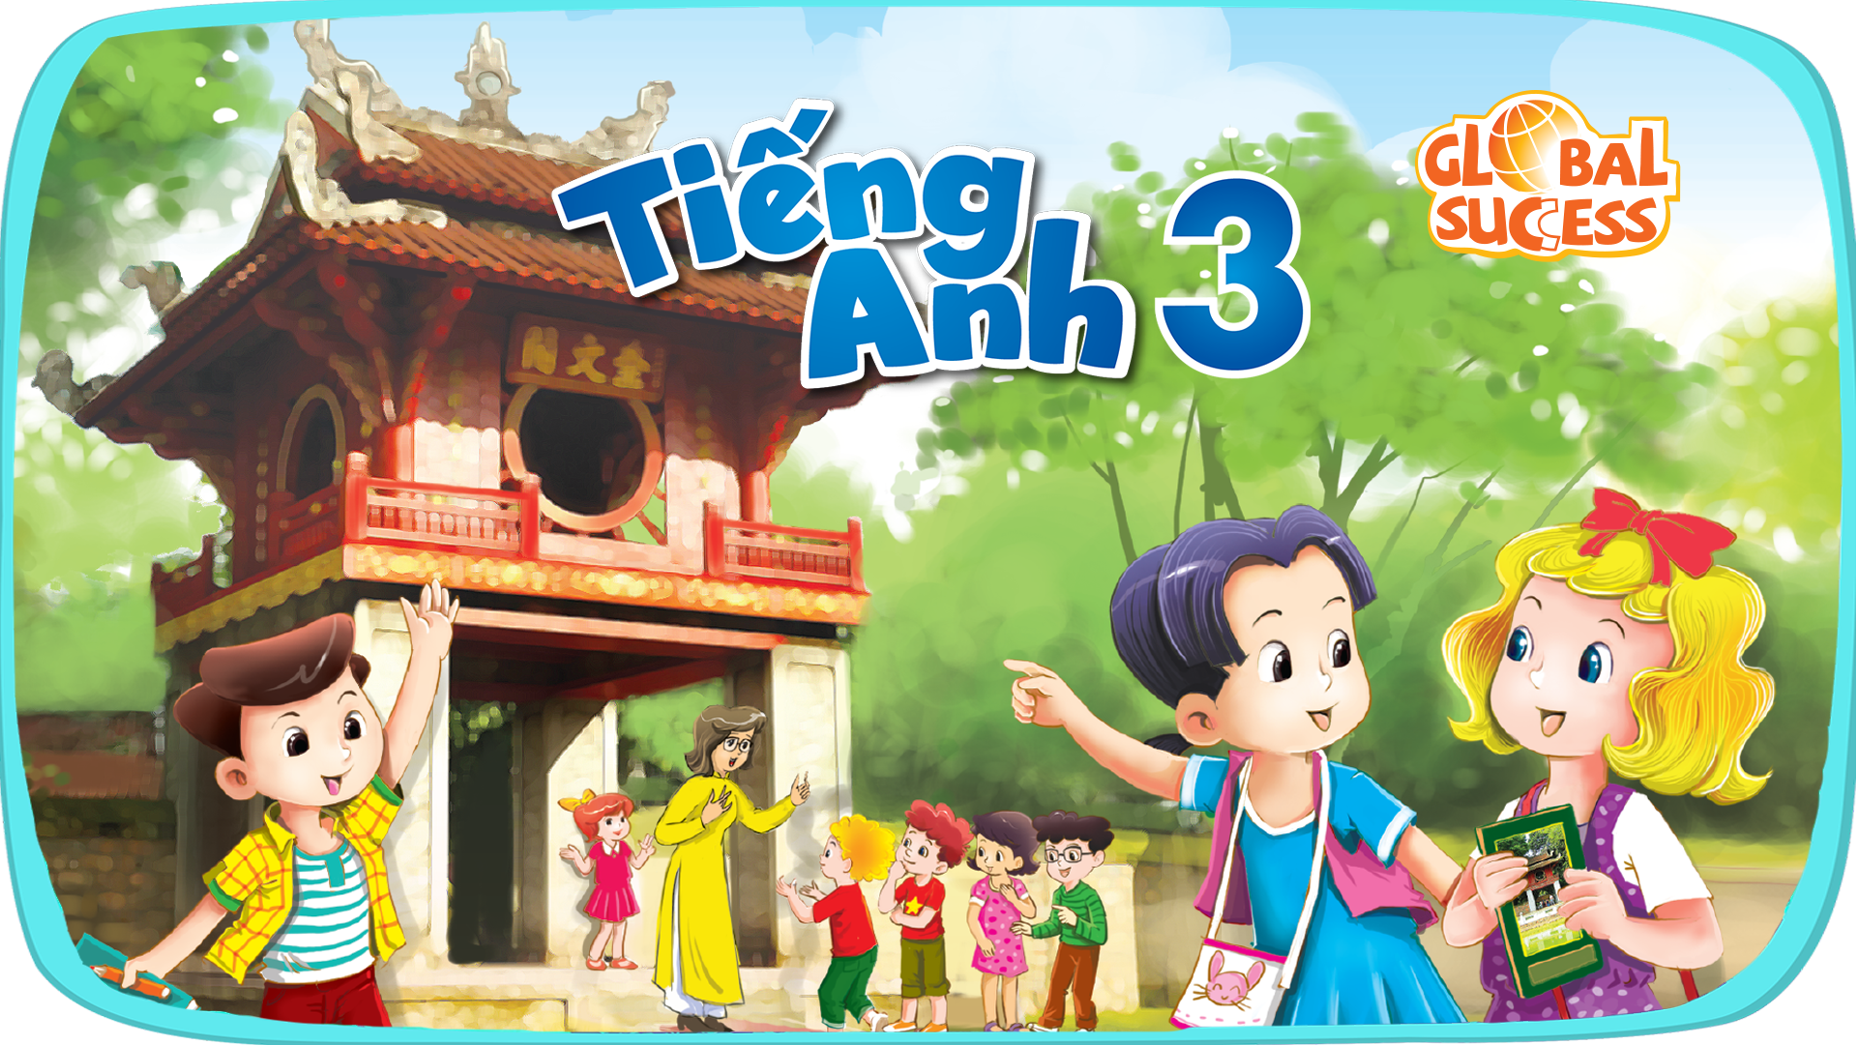
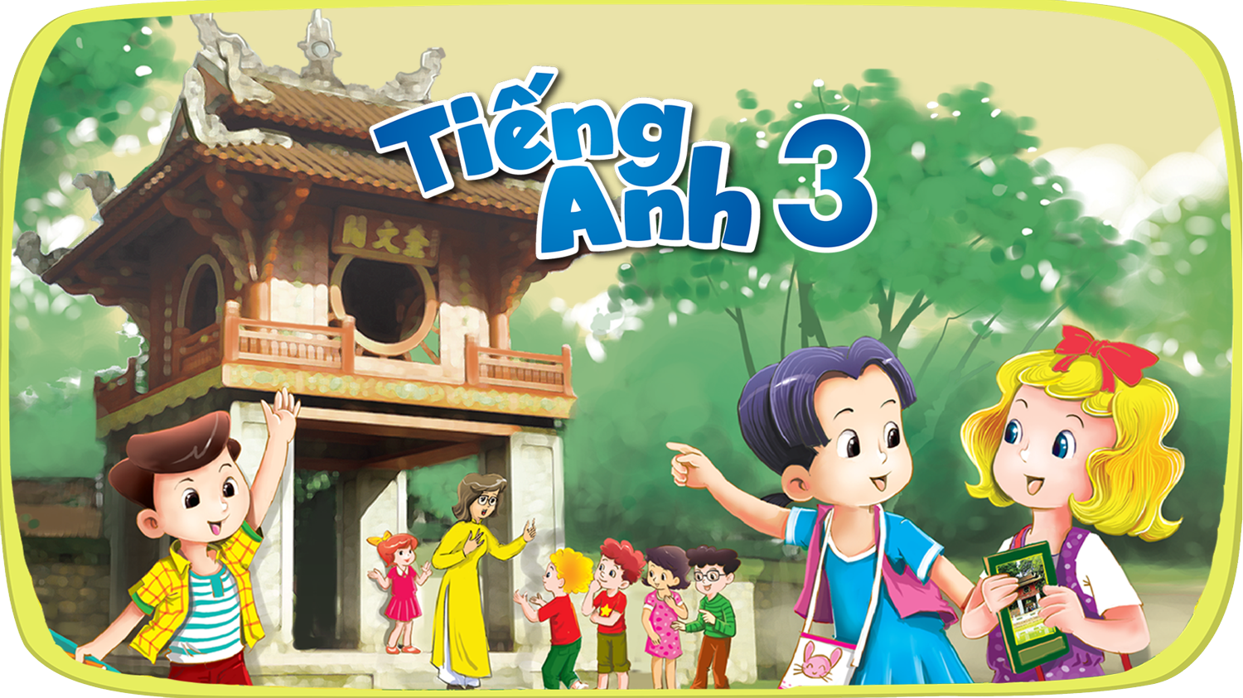


Slide 2


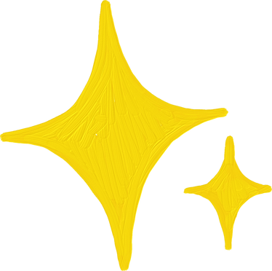



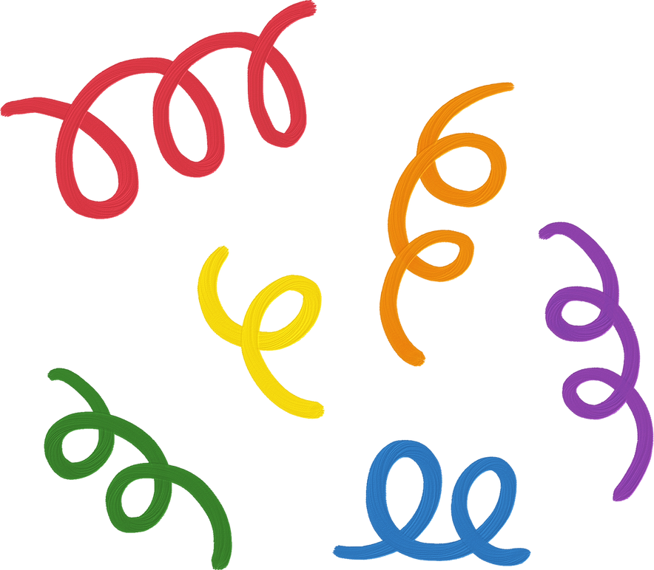
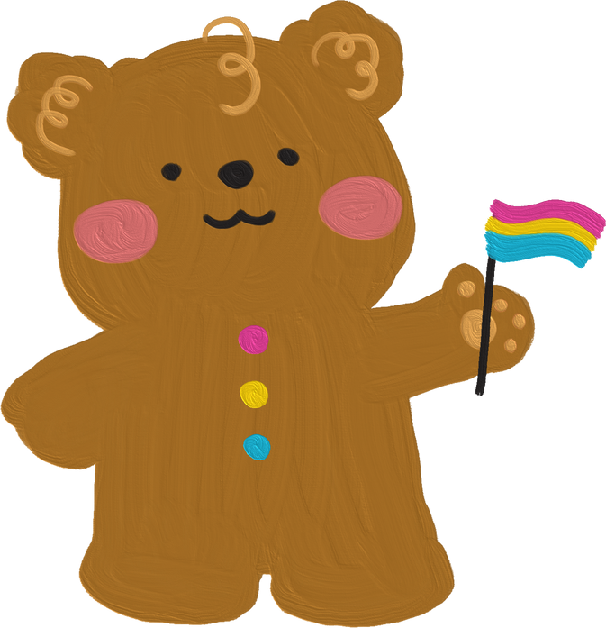
Period 3

Slide 3
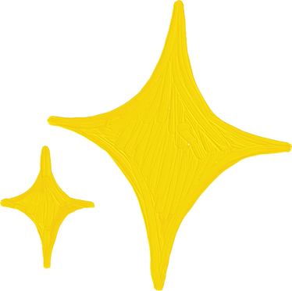
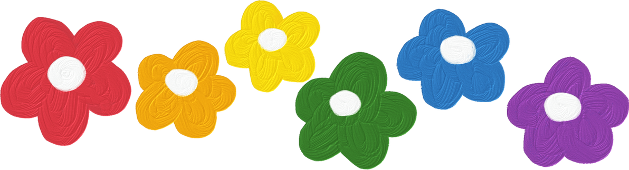
I. OBJECTIVES.
By the end of the lesson, pupils will:
1. Language.
- Take part in three fun activities relating to their language knowledge and competences.
2. Core competencies.
- Decision making, teamwork, problem-solving, communication, stress tolerance
3. General competencies.
- Oral communication: let’s talk
- Self-control & independent learning: perform reading tasks
- Communication and collaboration: work in pairs or groups
4. Attributes.
- Kindness: help partners to complete learning tasks
- Diligence: complete learning tasks

Slide 4
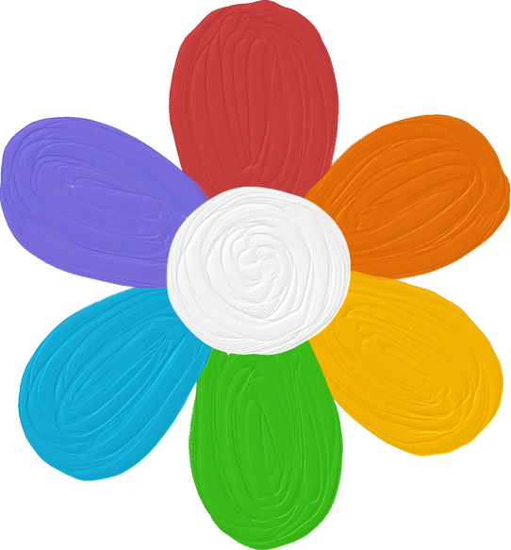

Warm-up and review

Slide 5






Warm-up
Who is
FASTER?!!!
Notes:
Divide the class into 2 big groups. Each group has a leader to check their group’s work.
Teacher sticks the flashcards and writes numbers 1-6 on the board.
Teacher says a number, each member from 2 groups says the word.

Slide 6
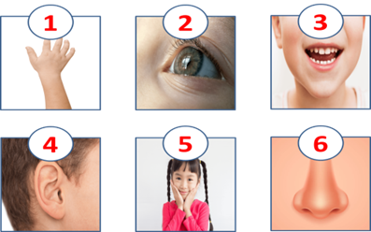

Slide 7
WORD
GAME
Notes:
- Teacher uses flashcards to review vocabulary from Unit 1 to Unit 5.
- Then asks pupils to look at the given letter, rearrange them to find the correct word.
- Teacher gives points or candies to the fastest pupil with the correct answer.

Slide 8



Question
1
This is a name.
N
B
E

Slide 9
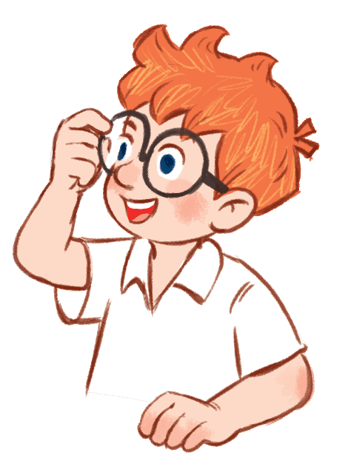
Question
1
B
E
N

Slide 10
Question
2
This is a part of your body.
A
F
C
E

Slide 11
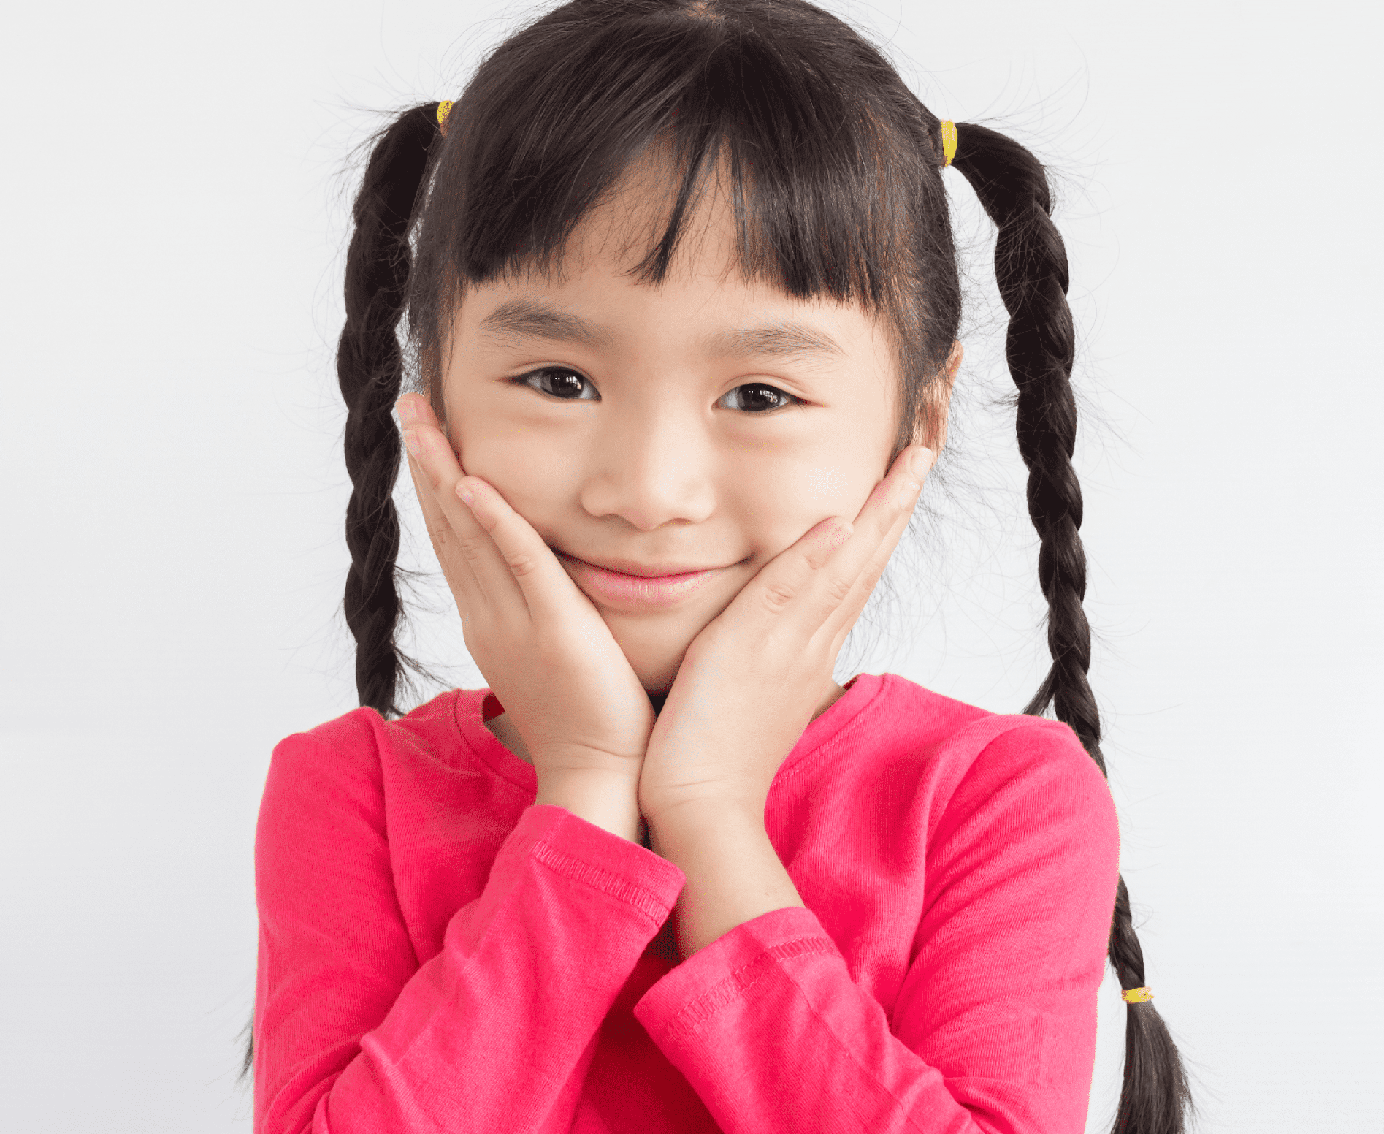
Question
2
F
A
C
E

Slide 12
Question
3
This is a number.
E
T
H
G
I

Slide 13
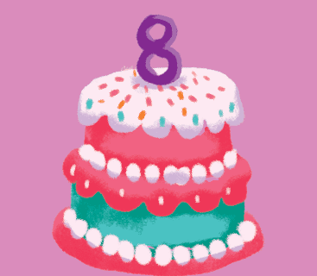
Question
3
E
I
G
H
T

Slide 14
Question
4
This is a hobby.
W
I
S
M
G
N
M
I

Slide 15
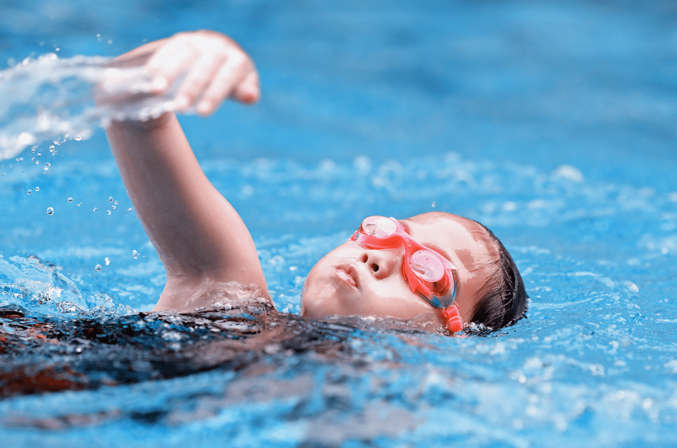
Question
4
S
W
I
M
M
I
N
G

Slide 16
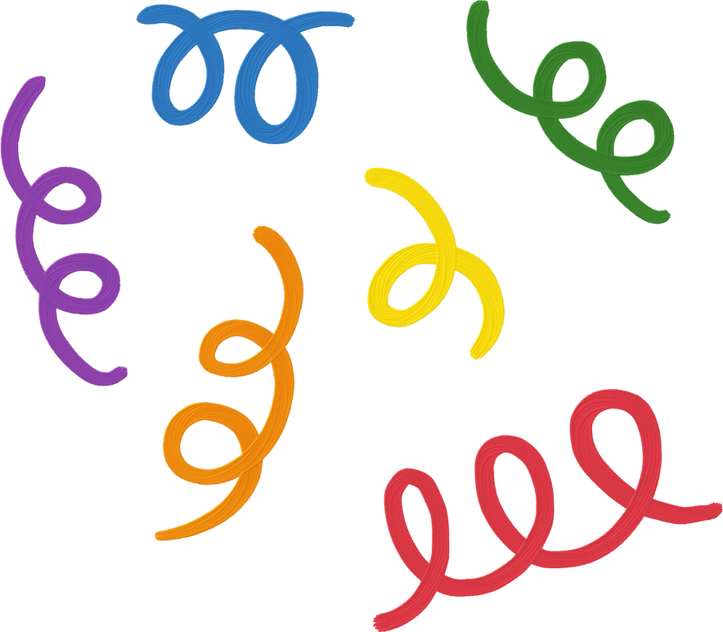


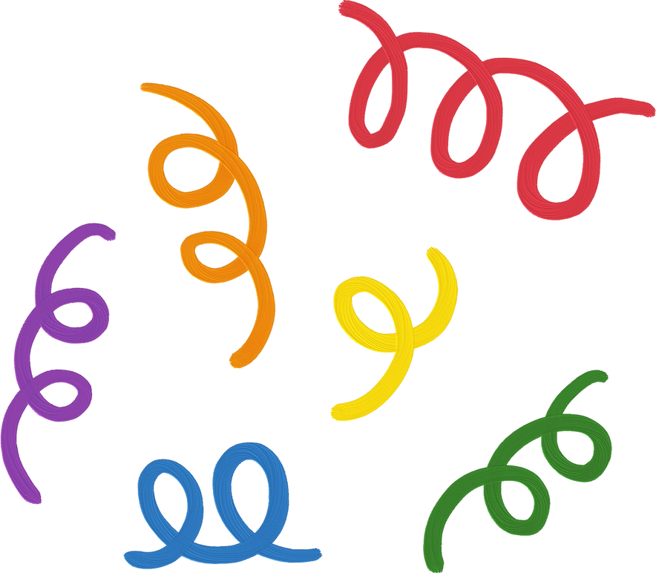
1. Find, circle
and match

Slide 17
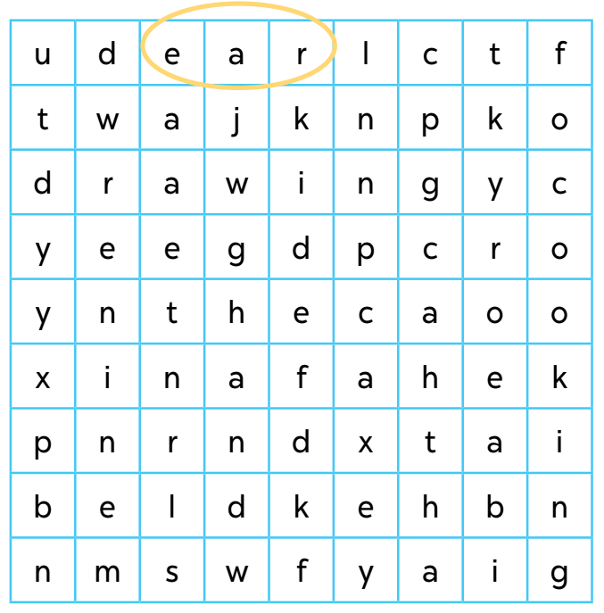
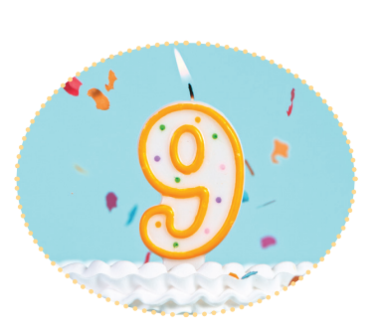
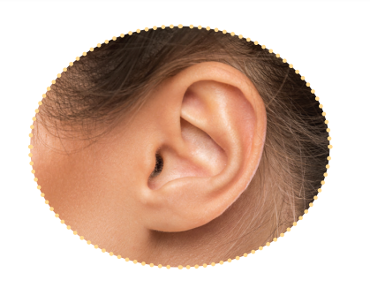
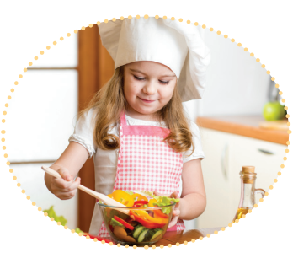
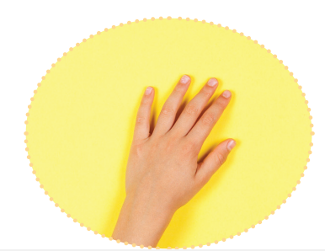
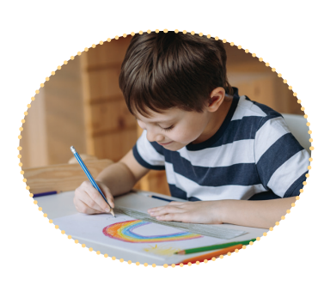

Slide 24
2. Quiz time

Slide 25
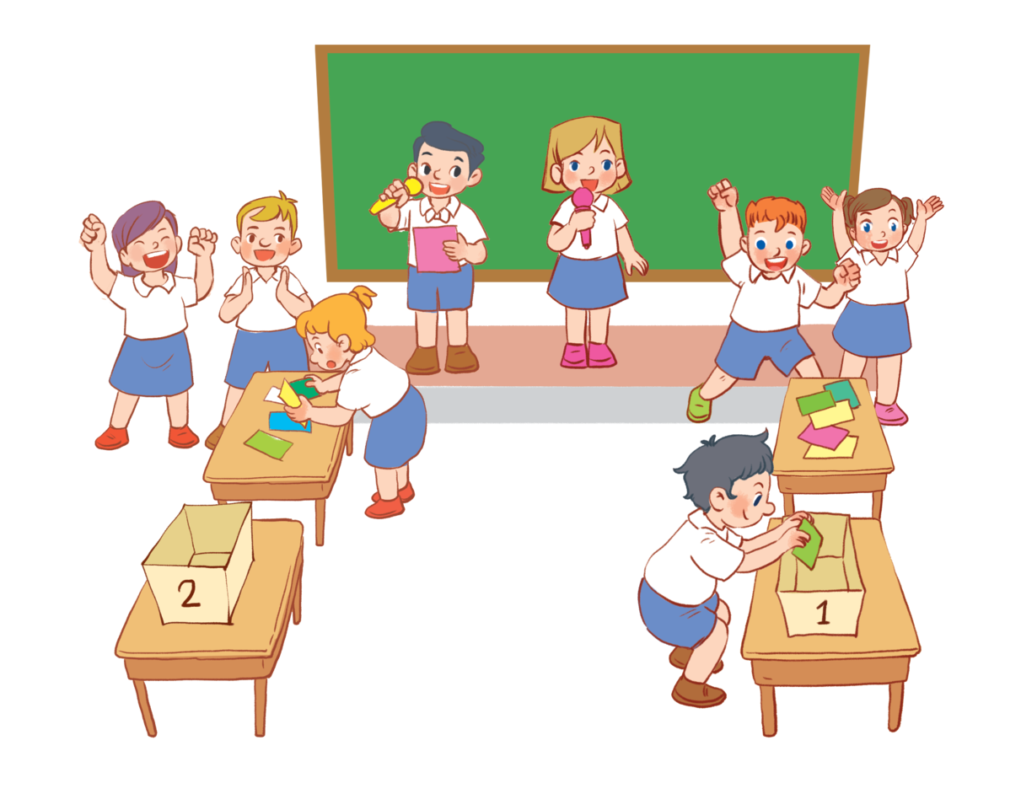

Slide 26
3. Look and match.

Slide 27
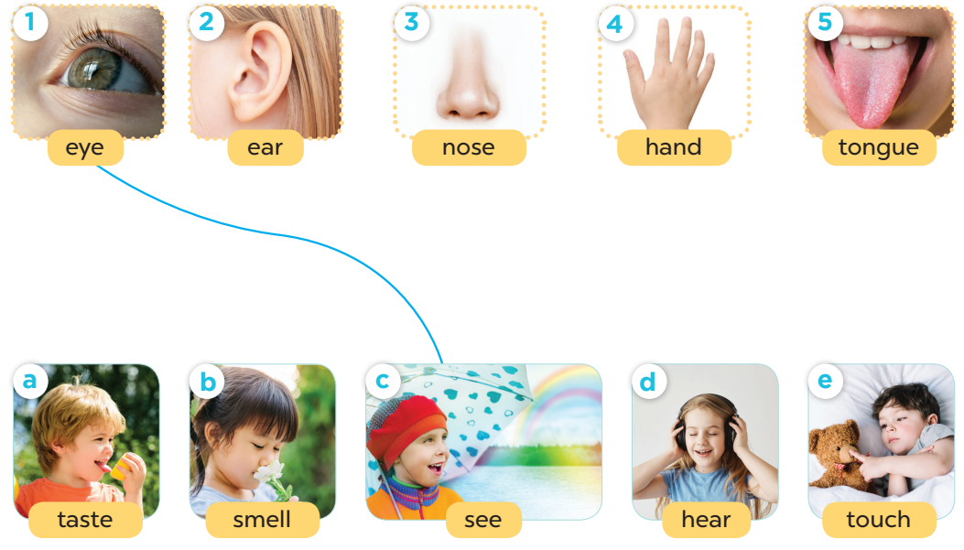

Slide 28
Fun corner and wrap-up

Slide 29


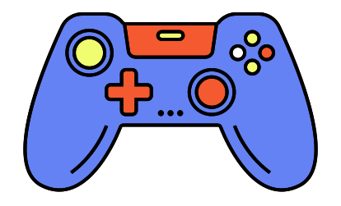

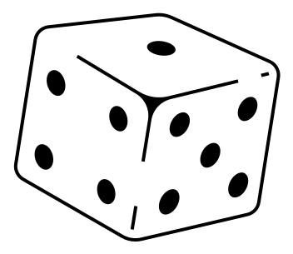
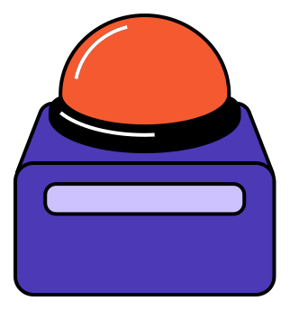


Game time!
Notes:
Vocabulary review.

Slide 30
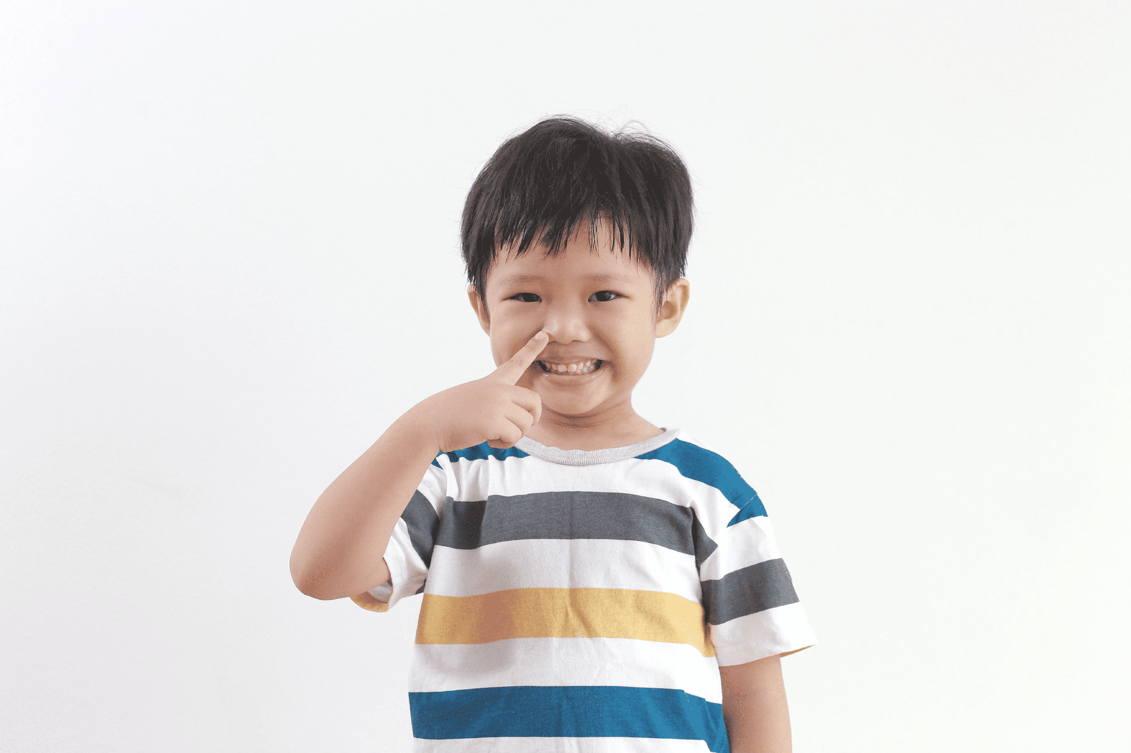
We can use THIS BODY PART to smell.
a nose
Notes:
A nose

Slide 31
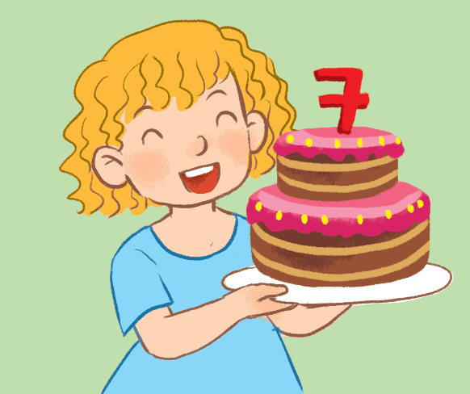
2. It’s between Number six and eight.
seven
Notes:
Number 7

Slide 32
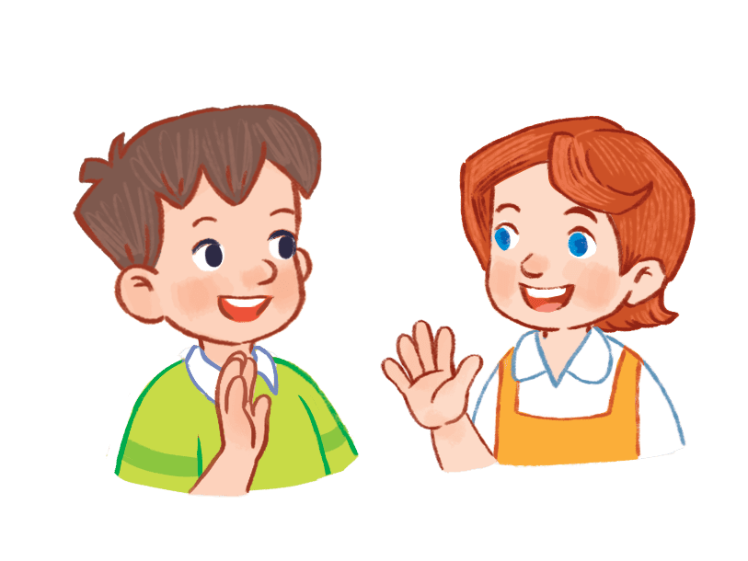
3. We say it to greet people.
Hello/ Hi!
Notes:
Hello/ Hi!

Slide 33
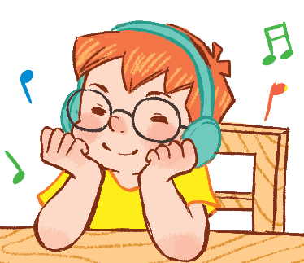
4. We can use this to listen to music.
an ear
Notes:
dancing

Slide 34
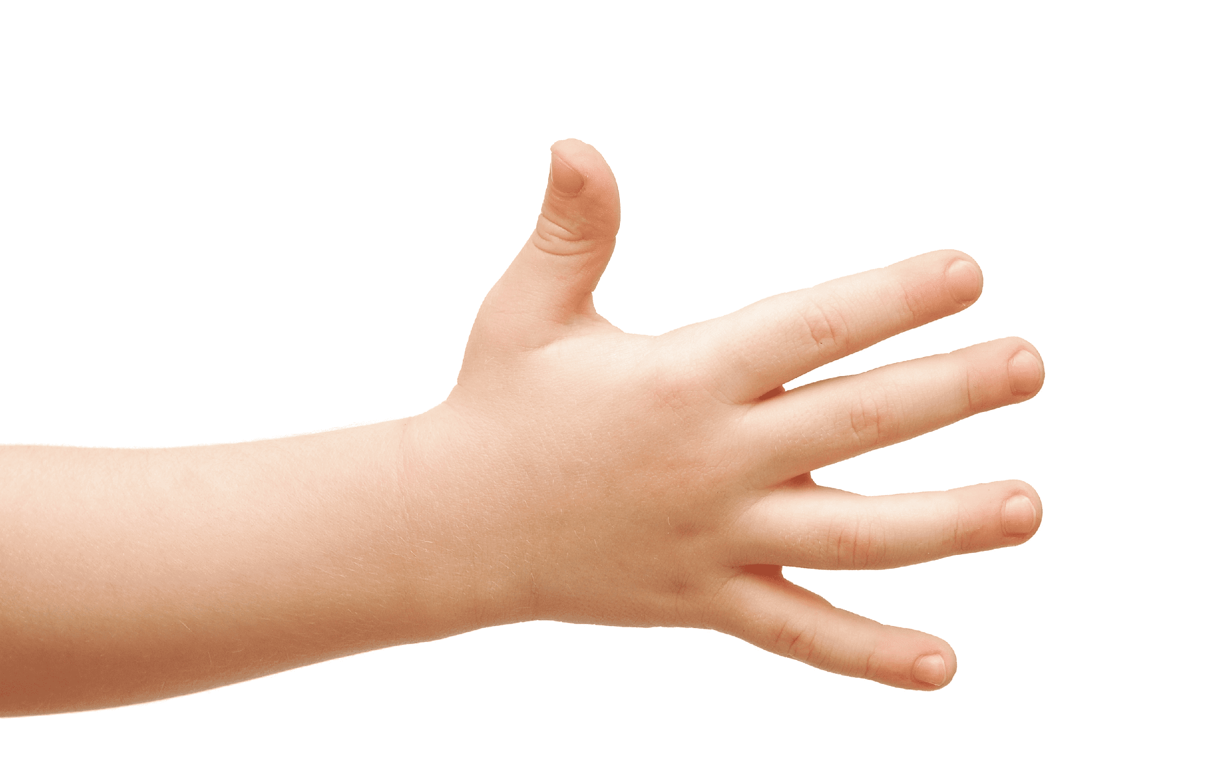
5. We use it to touch things.
a hand
Notes:
A hand

