Slide 1


Slide 2






Unit
1. Listen and repeat.
2. Point and say.

Slide 3

Warm-up

Slide 4
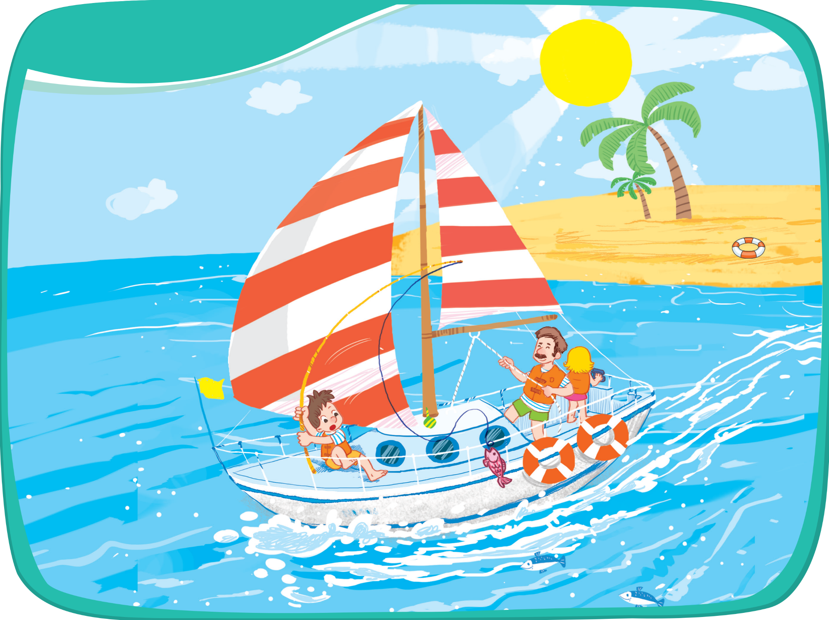




Listen and repeat.
sail
sand
sea

Slide 5



sail
sand
sea
s

Slide 6


Point and say.
sail
sand
sea

Slide 7

Time to say goodbye!
s

Slide 8





