Slide 2


Unit 7
In the kitchen
Lesson 2 + Lesson 3

Slide 3
Warm-up
and review

Slide 4
I. OBJECTIVES.
By the end of this lesson, pupils will be able to:
1. Knowledge and skills.
write the letter J/j and complete the words juice, jam and jelly.
- use the sentence structures “Pass me the _____, please.” and “Here you are.” to make and respond to a request.
- sing a song with the sentence structures “Pass me the _____, please.” and “Here you are.”.
2. Competences.
- Communication and collaboration: work in pairs or groups to complete the learning tasks.
- Self-control & independent learning: perform listening and writing tasks.
- Problem-solving and creativity: confidently answer appropriate questions.
3. Attributes.
- Show their love and interest in the food and drink.
- Be aware of choosing healthy food and drink.
- Feel confident in expressing their opinions.
II. MATERIALS .
- Pupil’s book: Page 32, 33
- Audio Tracks 36, 37, 38, 39
- Teacher’s guide: Pages 55, 56, 57, 58
- Flashcards/ pictures and posters (Unit 7)
- Computer, projector, …

Slide 5



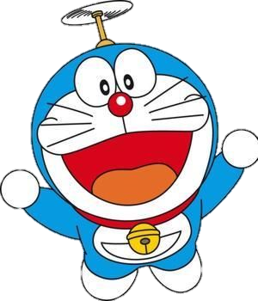

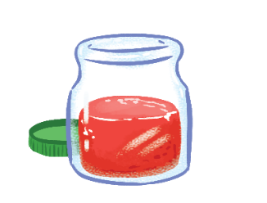


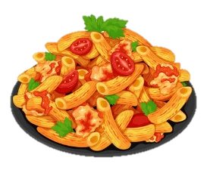





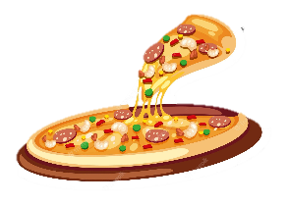



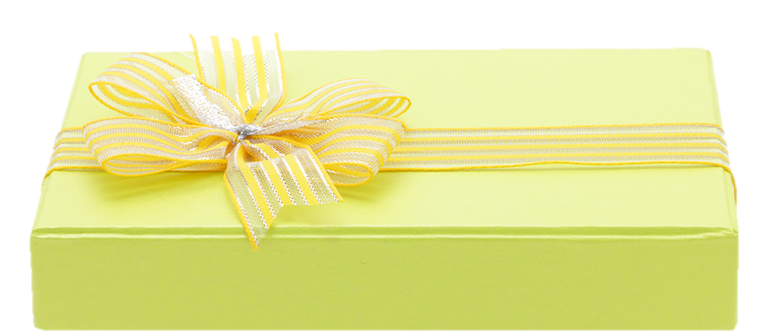







I like …
You are given 3 points
You are given 8 points
You are given 10 points
You are given 5 points
You are given 4 points
You are given 2 points

Slide 6
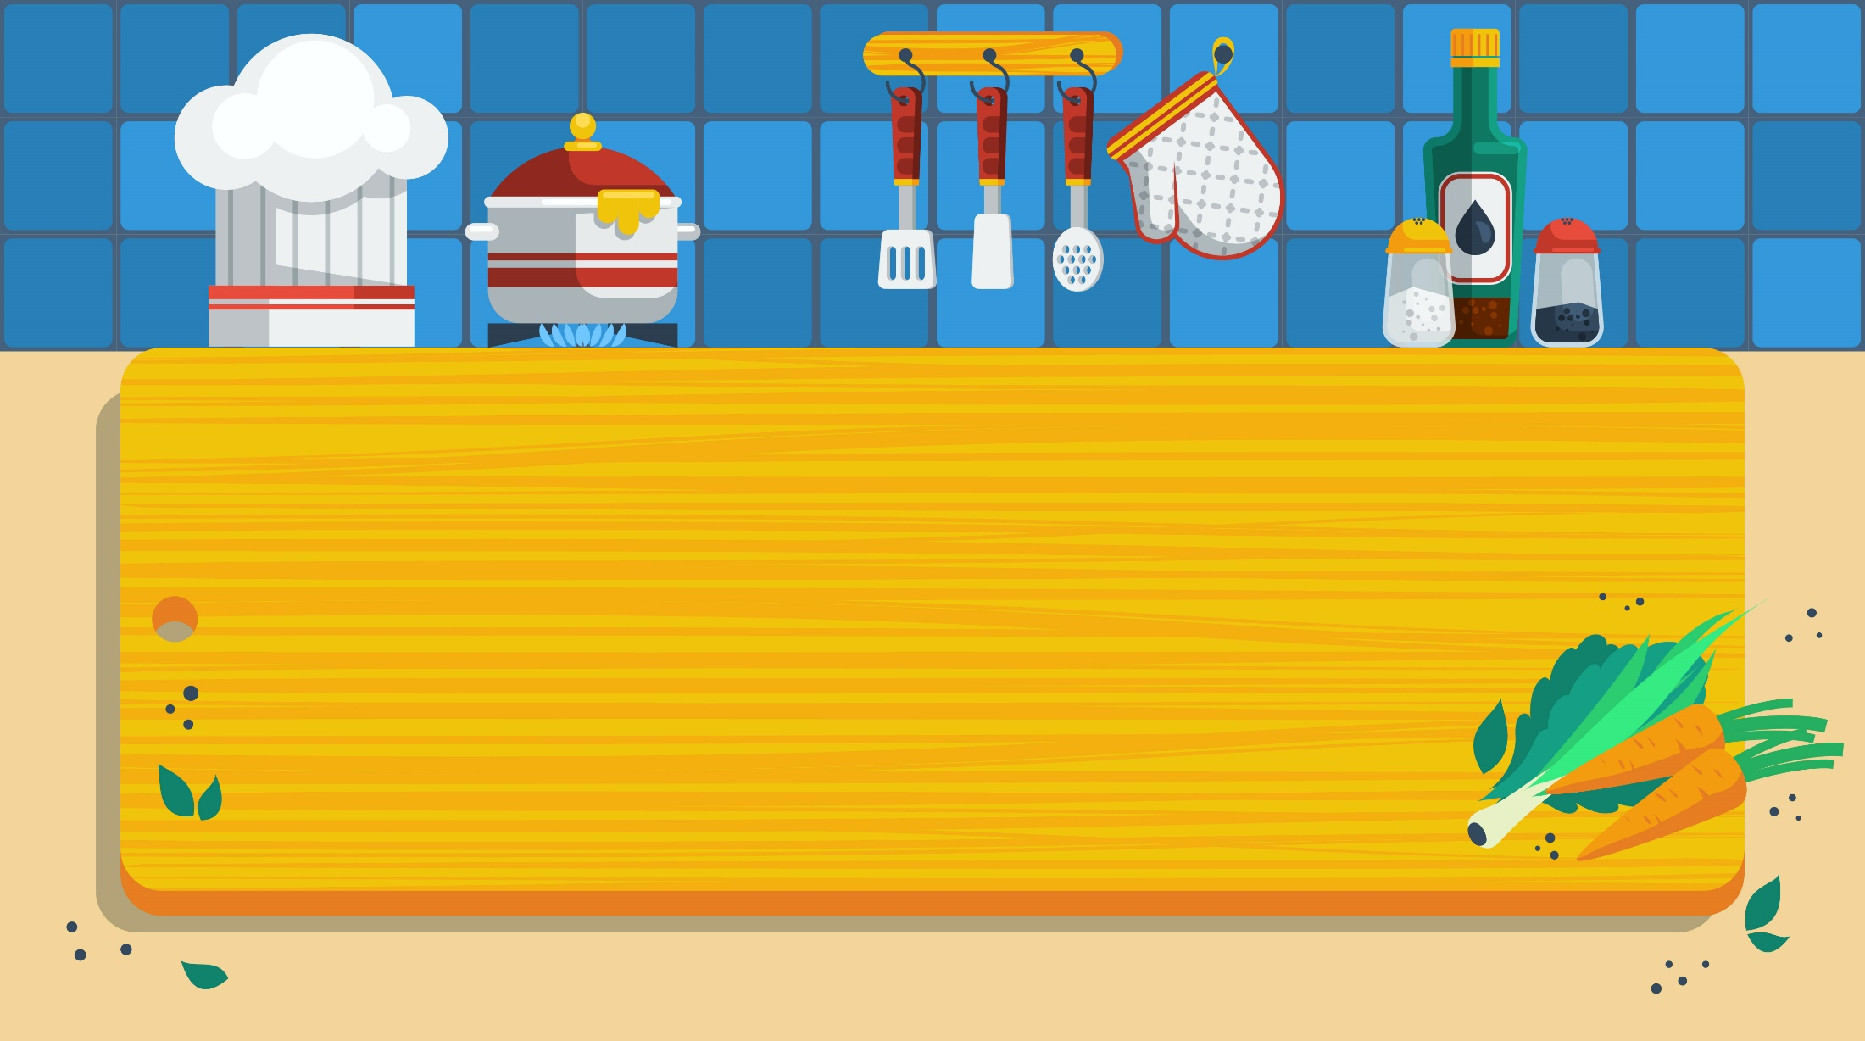
5. Look and write.

Slide 7



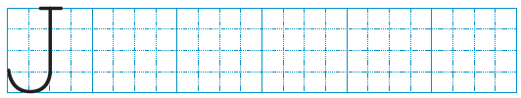
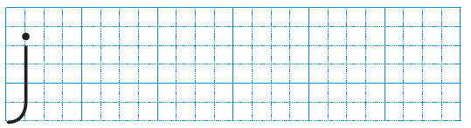

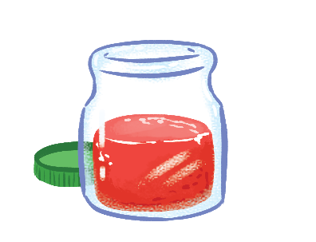
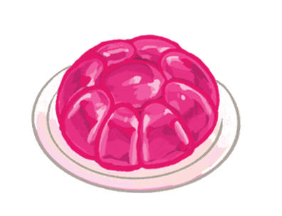
Look and write
j
elly
j
uice
j
am

Slide 8
6. Listen and repeat.

Slide 9
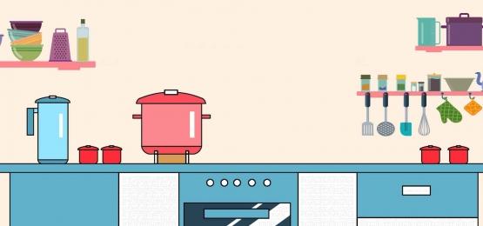




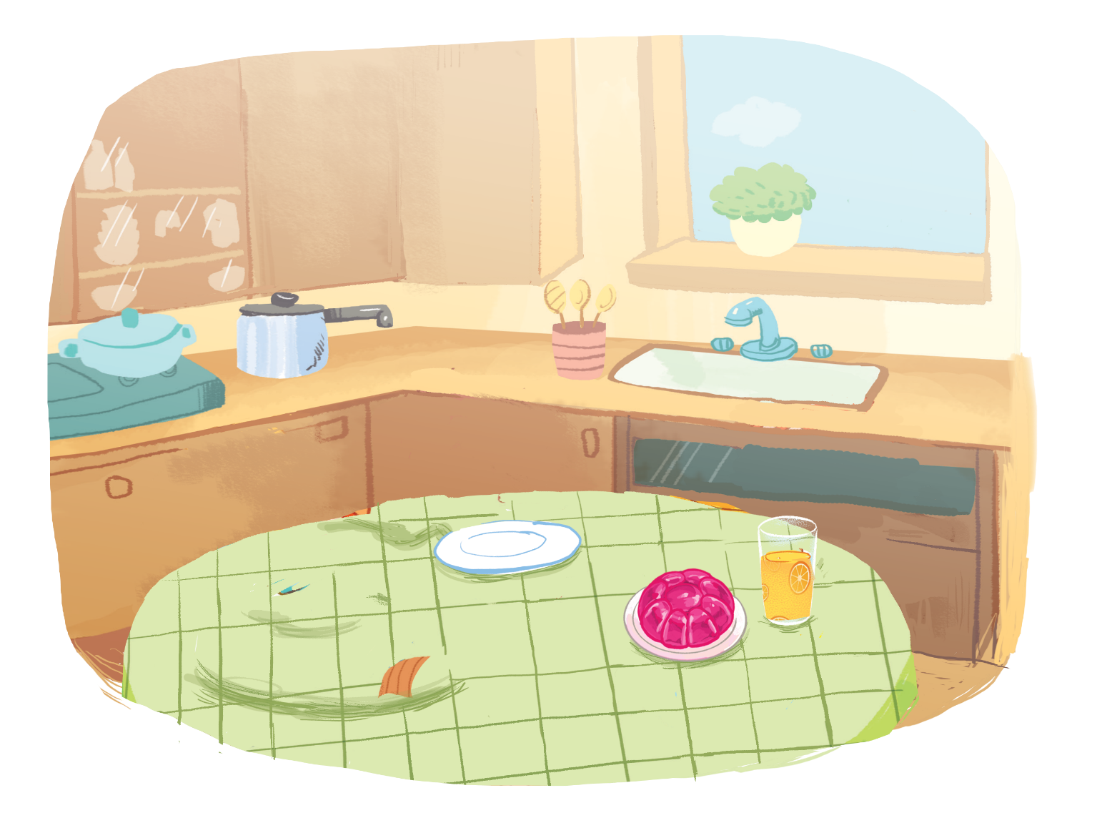
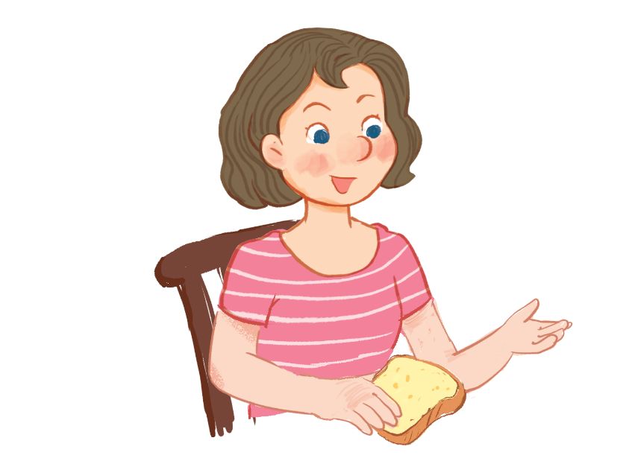
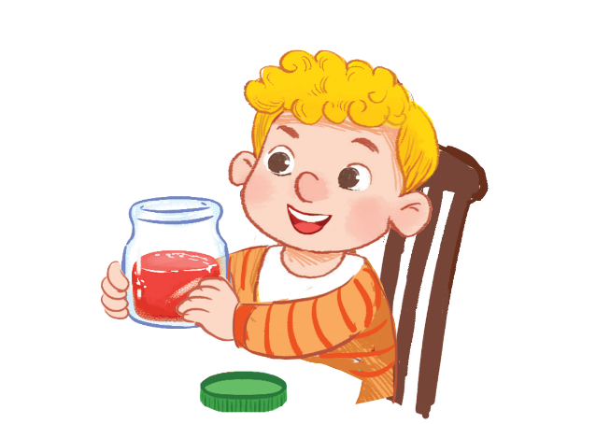

Listen and repeat.
Pass me the jam, please.
Pass me the jam, please.
Pass me the jam, please.
Pass me the jam, please.
Here you are.
Here you are.
Here you are.
Here you are.

Slide 10
7. Let’s talk.

Slide 11




Let’s talk.
, please.
Here .
a
b
c

Slide 12
, please.
Here .
a

Slide 13
, please.
Here .
b

Slide 14
, please.
Here .
c

Slide 15
8. Let’s sing!

Slide 16


Let’s sing!
Jam, juice, jelly.
Jam, juice, jelly.
Jam, juice, jelly.
Jam, juice, jelly.
Pass me the jam.
Pass me the jam.
Pass me the jam.
Pass me the jam.
Pass me the juice.
Pass me the juice.
Pass me the juice.
Pass me the juice.
Pass me the jelly.
Pass me the jelly.
Pass me the jelly.
Pass me the jelly.
Here you are.
Here you are.
Here you are.
Here you are.
Here you are.
Here you are.
Here you are.
Here you are.
Here you are.
Here you are.
Here you are.
Here you are.

Slide 17
Fun corner
and wrap-up

Slide 18


Option 1
Option 2

Slide 19
Vocabulary Race

Slide 20





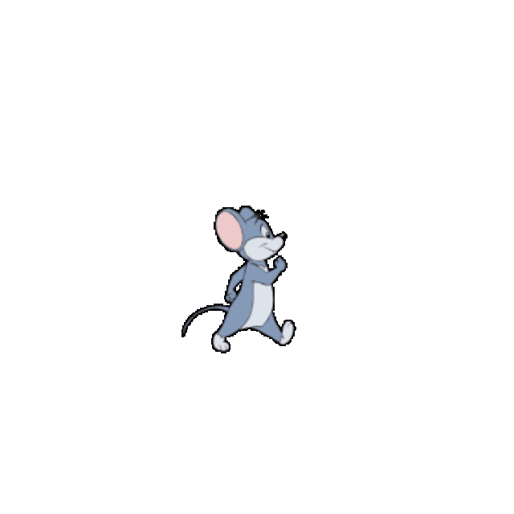

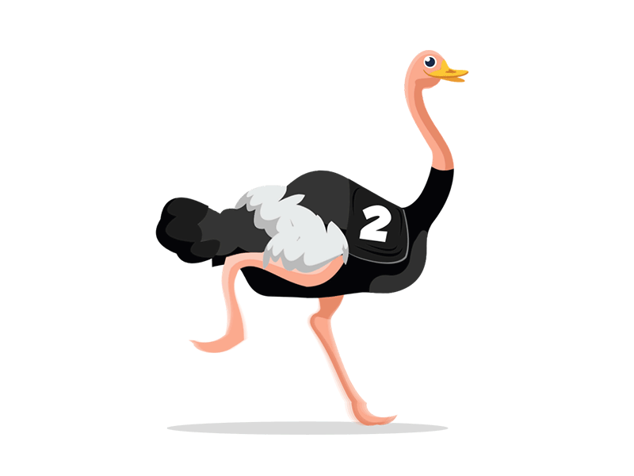

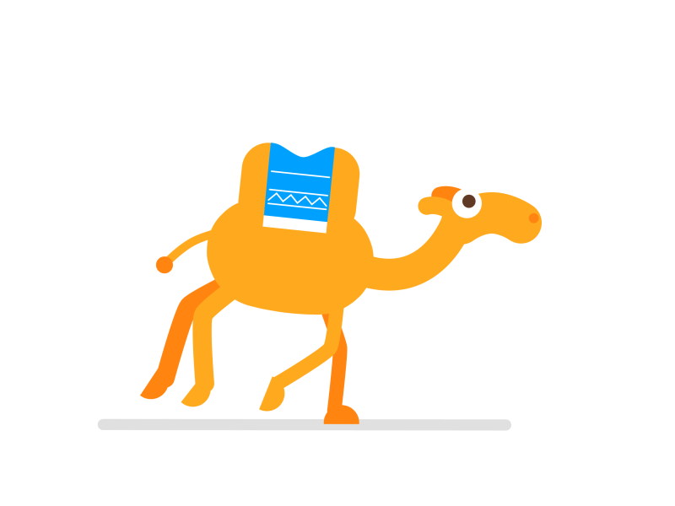
Vocabulary Race
c a k e
p a s t a
j a m
j e l l y
j u i c e
___ ___ ___ ___
___ ___ ___ ___ ___
___ ___ ___ ___ ___
___ ___ ___
___ ___ ___ ___ ___

Slide 21


Slide 22
ROLE-PLAY

Slide 23




Get the points!
+3
+1
+4
+2
+5

Slide 24
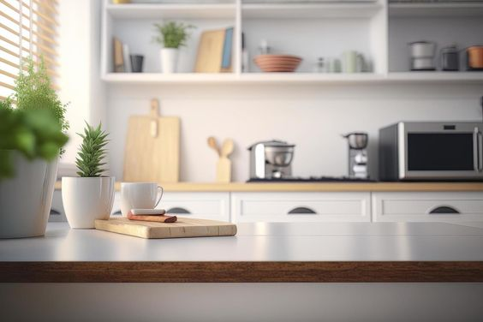



…………..,………..
…….……...

Slide 25




…………
………..…,……...

Slide 26



…………….…, ……..
…………

Slide 27


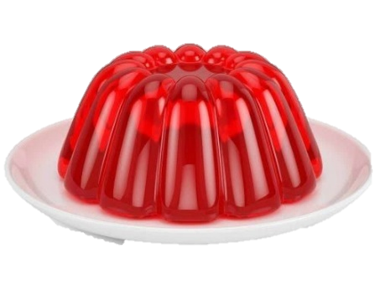
…………….…., ……..
…………...

Slide 28


…………….…., ……..
…………...

Slide 30

Time to say goodbye!
j

