Slide 2
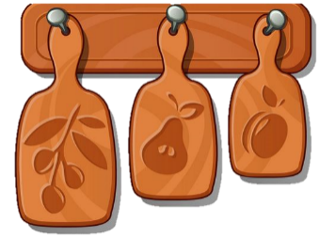
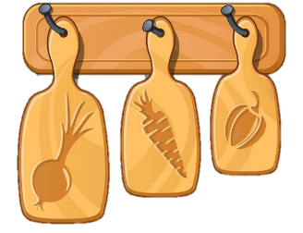
Unit 7
In the kitchen
Lesson 1 + Lesson 2

Slide 3


I. OBJECTIVES.
By the end of this lesson, pupils will be able to:
1. Knowledge and skills.
- correctly pronounce the name of the letter J/j (/dʒeɪ/).
- correctly pronounce the sound of the letter J/j (/dʒ/) in isolation and in the words juice, jelly and jam.
2. Competences.
- Communication and collaboration: work in pairs or groups to complete the learning tasks.
- Self-control and independent learning: perform pronunciation task.
3. Attributes.
- Show their love and interest in the food and drink.
- Be aware of choosing healthy food and drink.
- Feel confident in expressing their opinions.
II. MATERIALS.
- Pupil’s book: Page 31
- Audio Track 35
- Teacher’s guide: Pages 53, 54, 55
- Flashcards/ pictures and posters (Unit 7)
- Computer, projector, …

Slide 4
Warm-up
and review

Slide 5
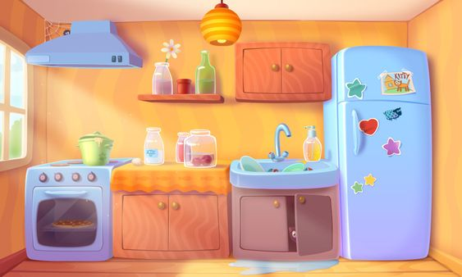

BEHIND THE BINOCULARS

Slide 6




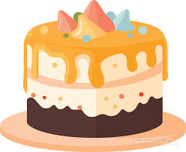

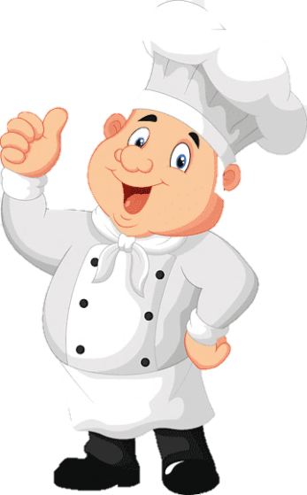
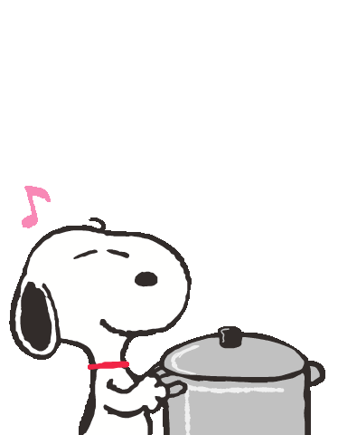
cake

Slide 7
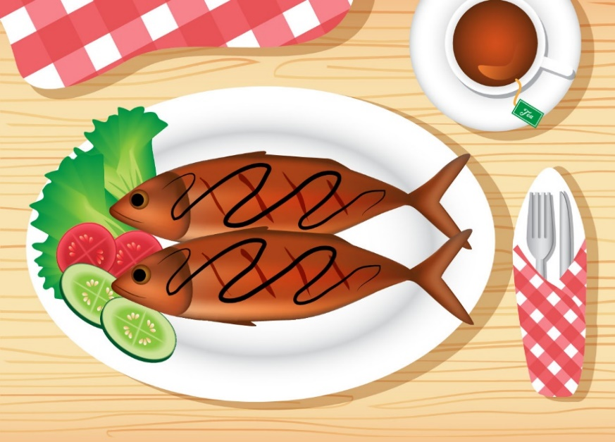

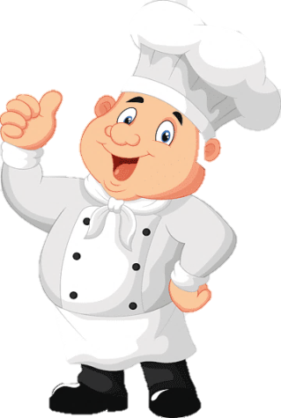
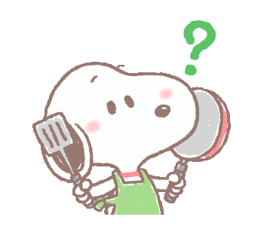
fish

Slide 8
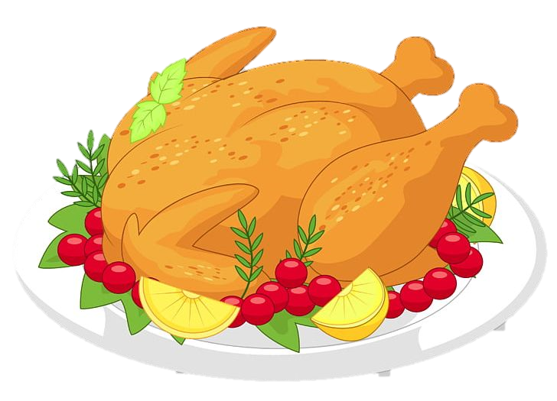
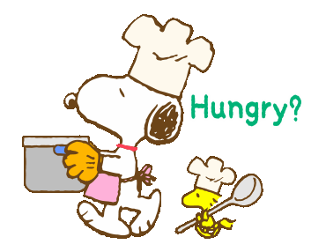
chicken

Slide 9

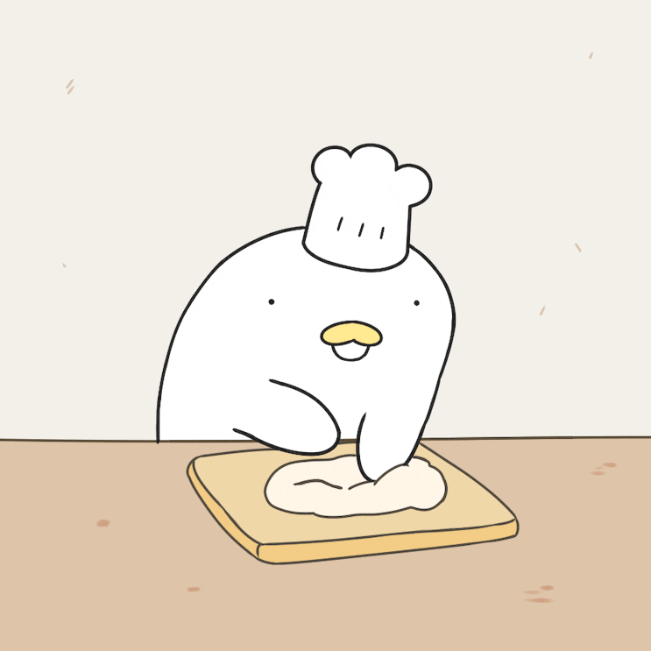
chips

Slide 10

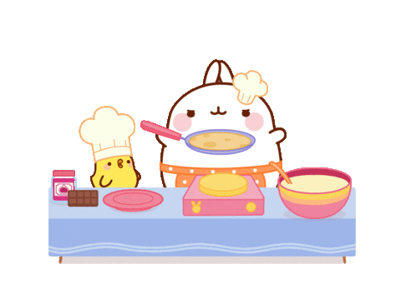
popcorn

Slide 11
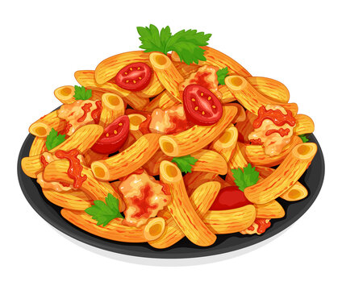
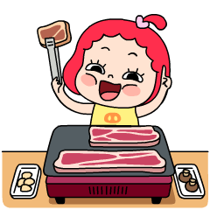
pasta

Slide 12
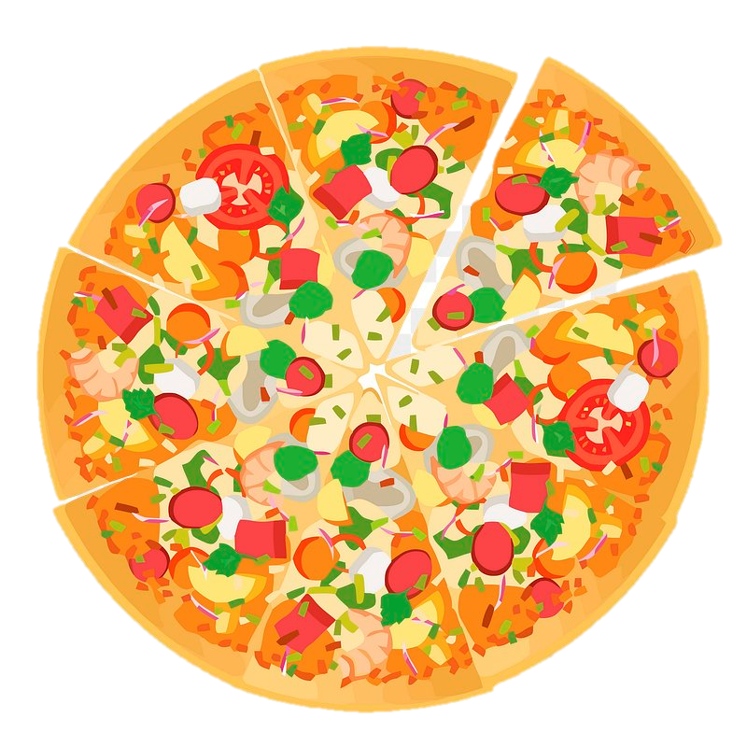
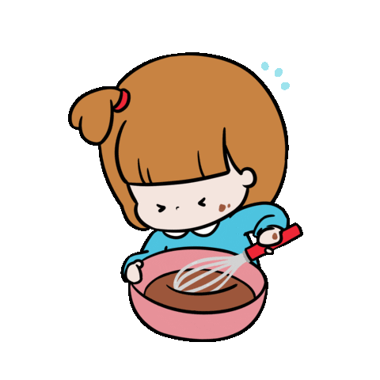
pizza

Slide 13
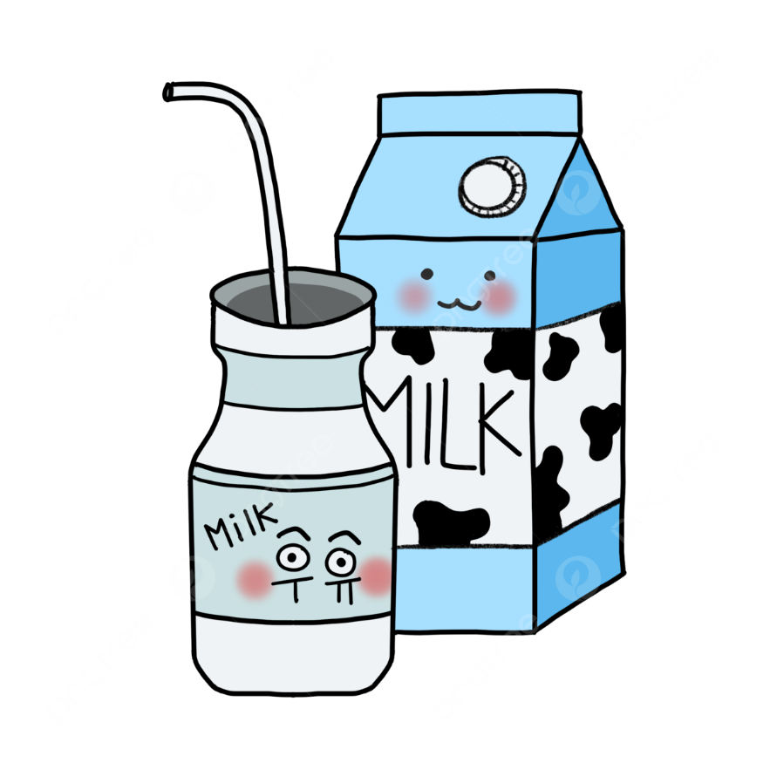
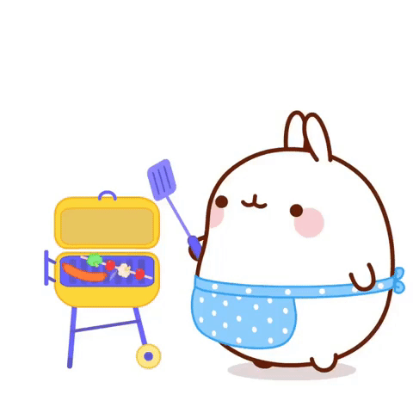
milk

Slide 14

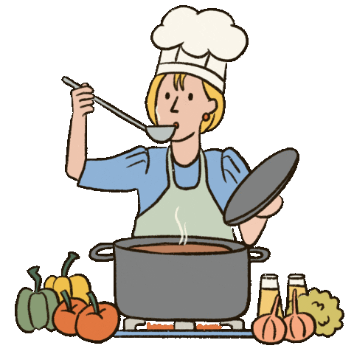

water

Slide 15


Slide 16
1. Listen and repeat.

Slide 17

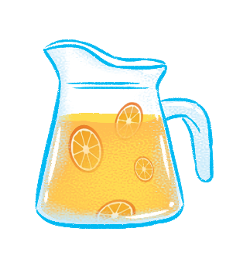
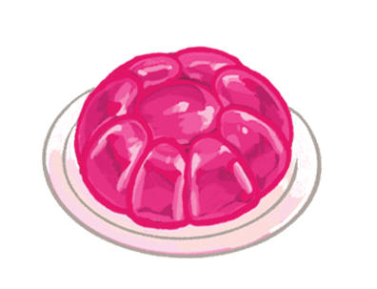
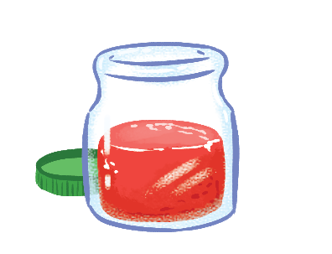

juice
jelly
jam
j

Slide 18
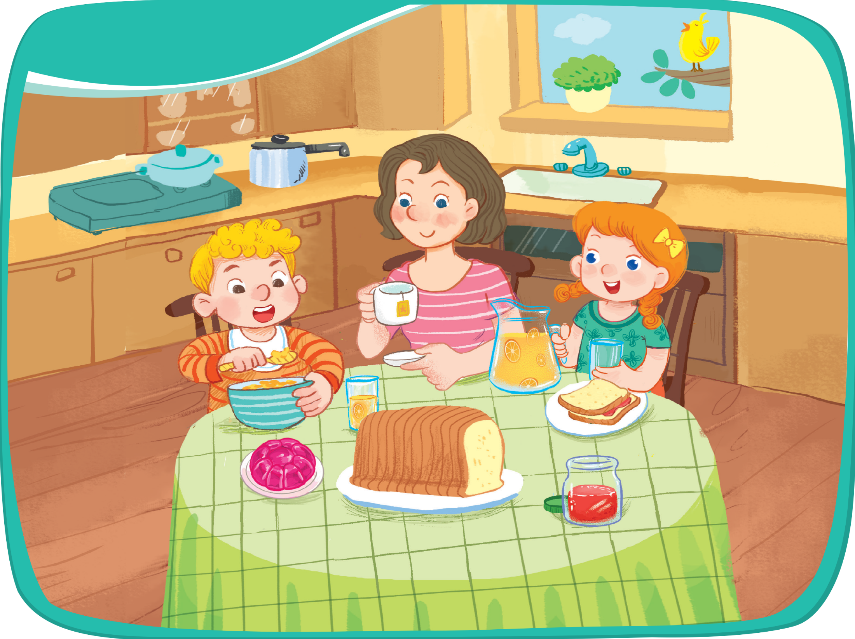



Listen and repeat.
juice
jelly
jam

Slide 19
2.Point and say.

Slide 20



Point and say.
juice
jelly
jam

Slide 21
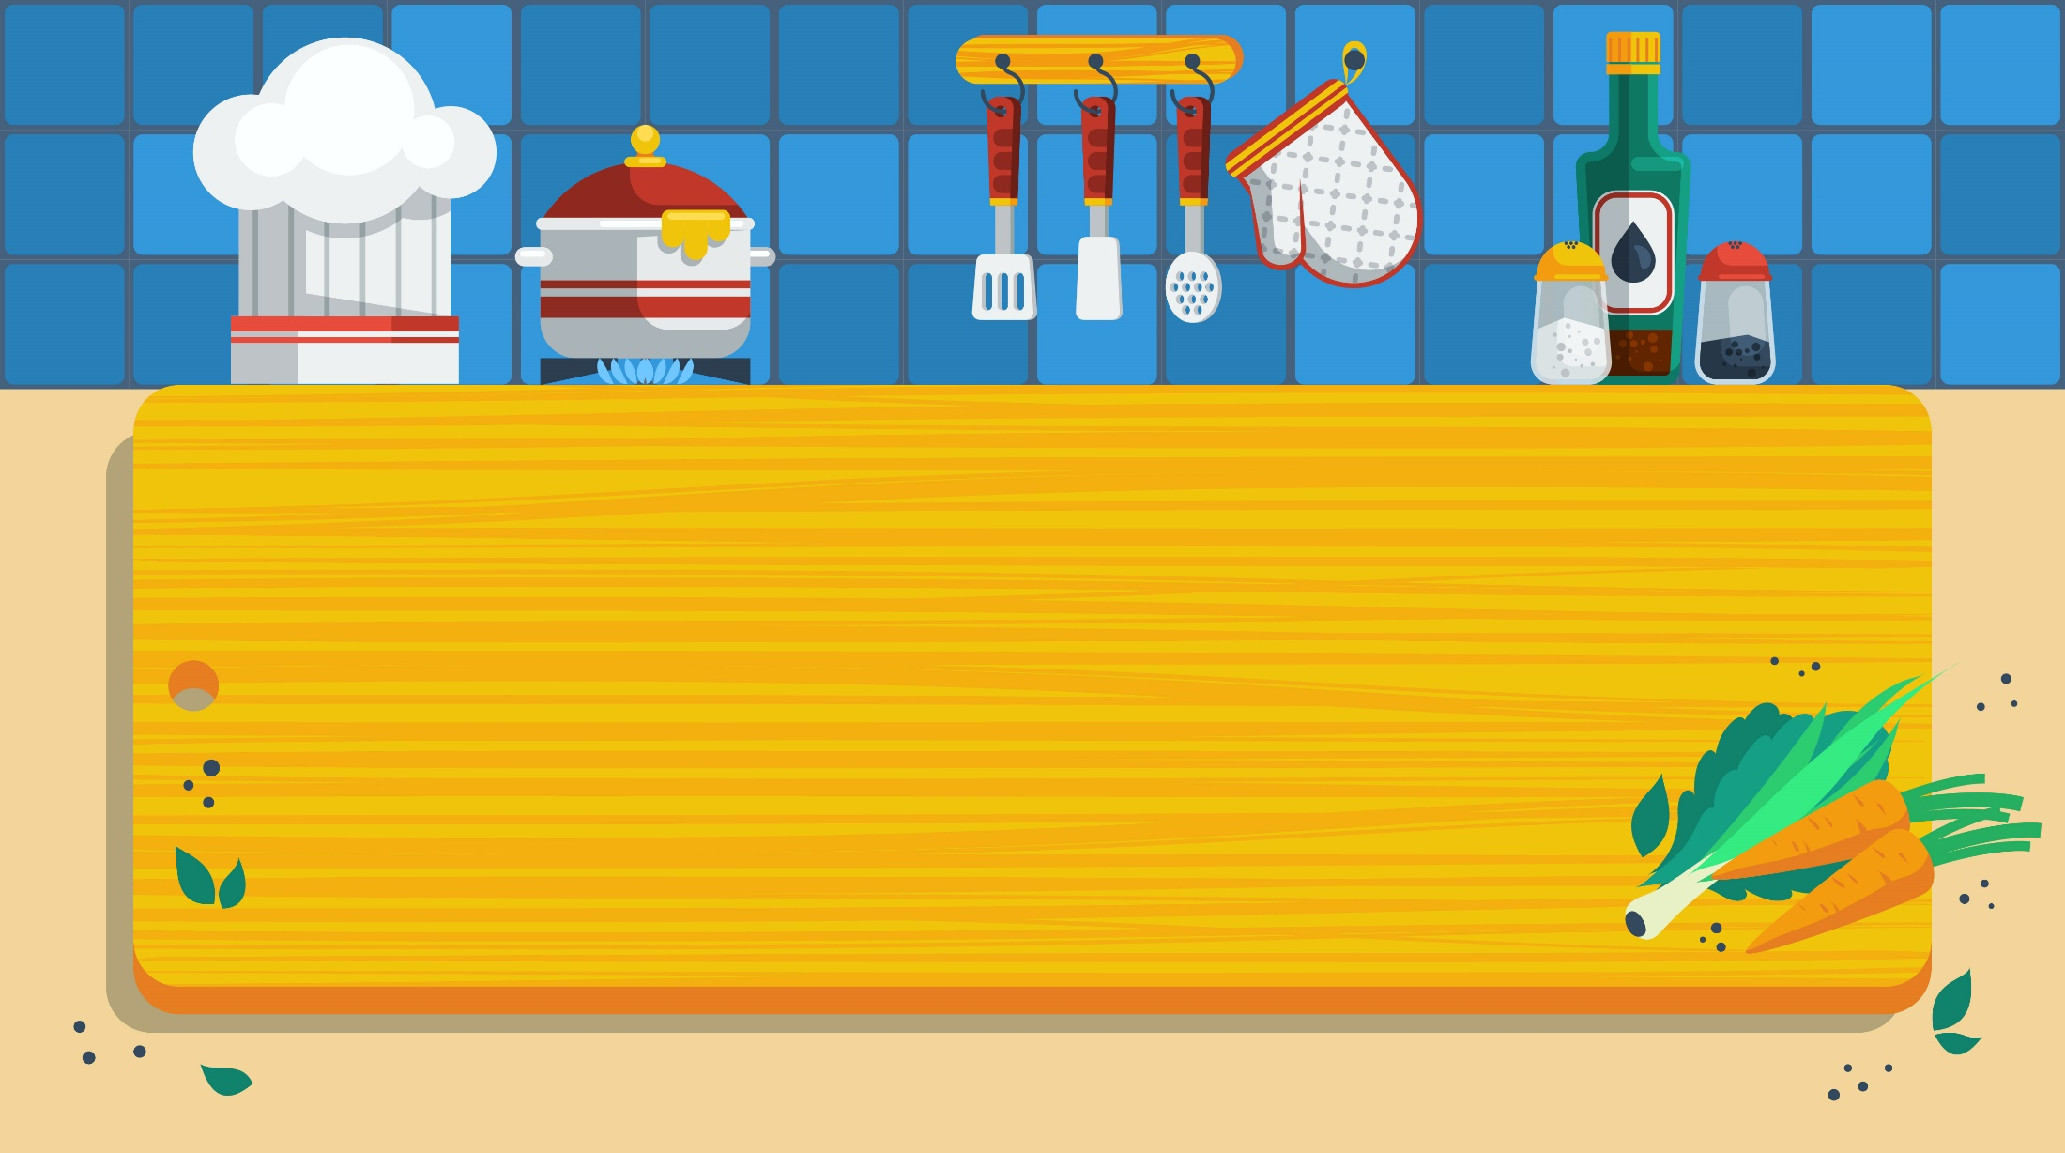
3. Listen and chant

Slide 22
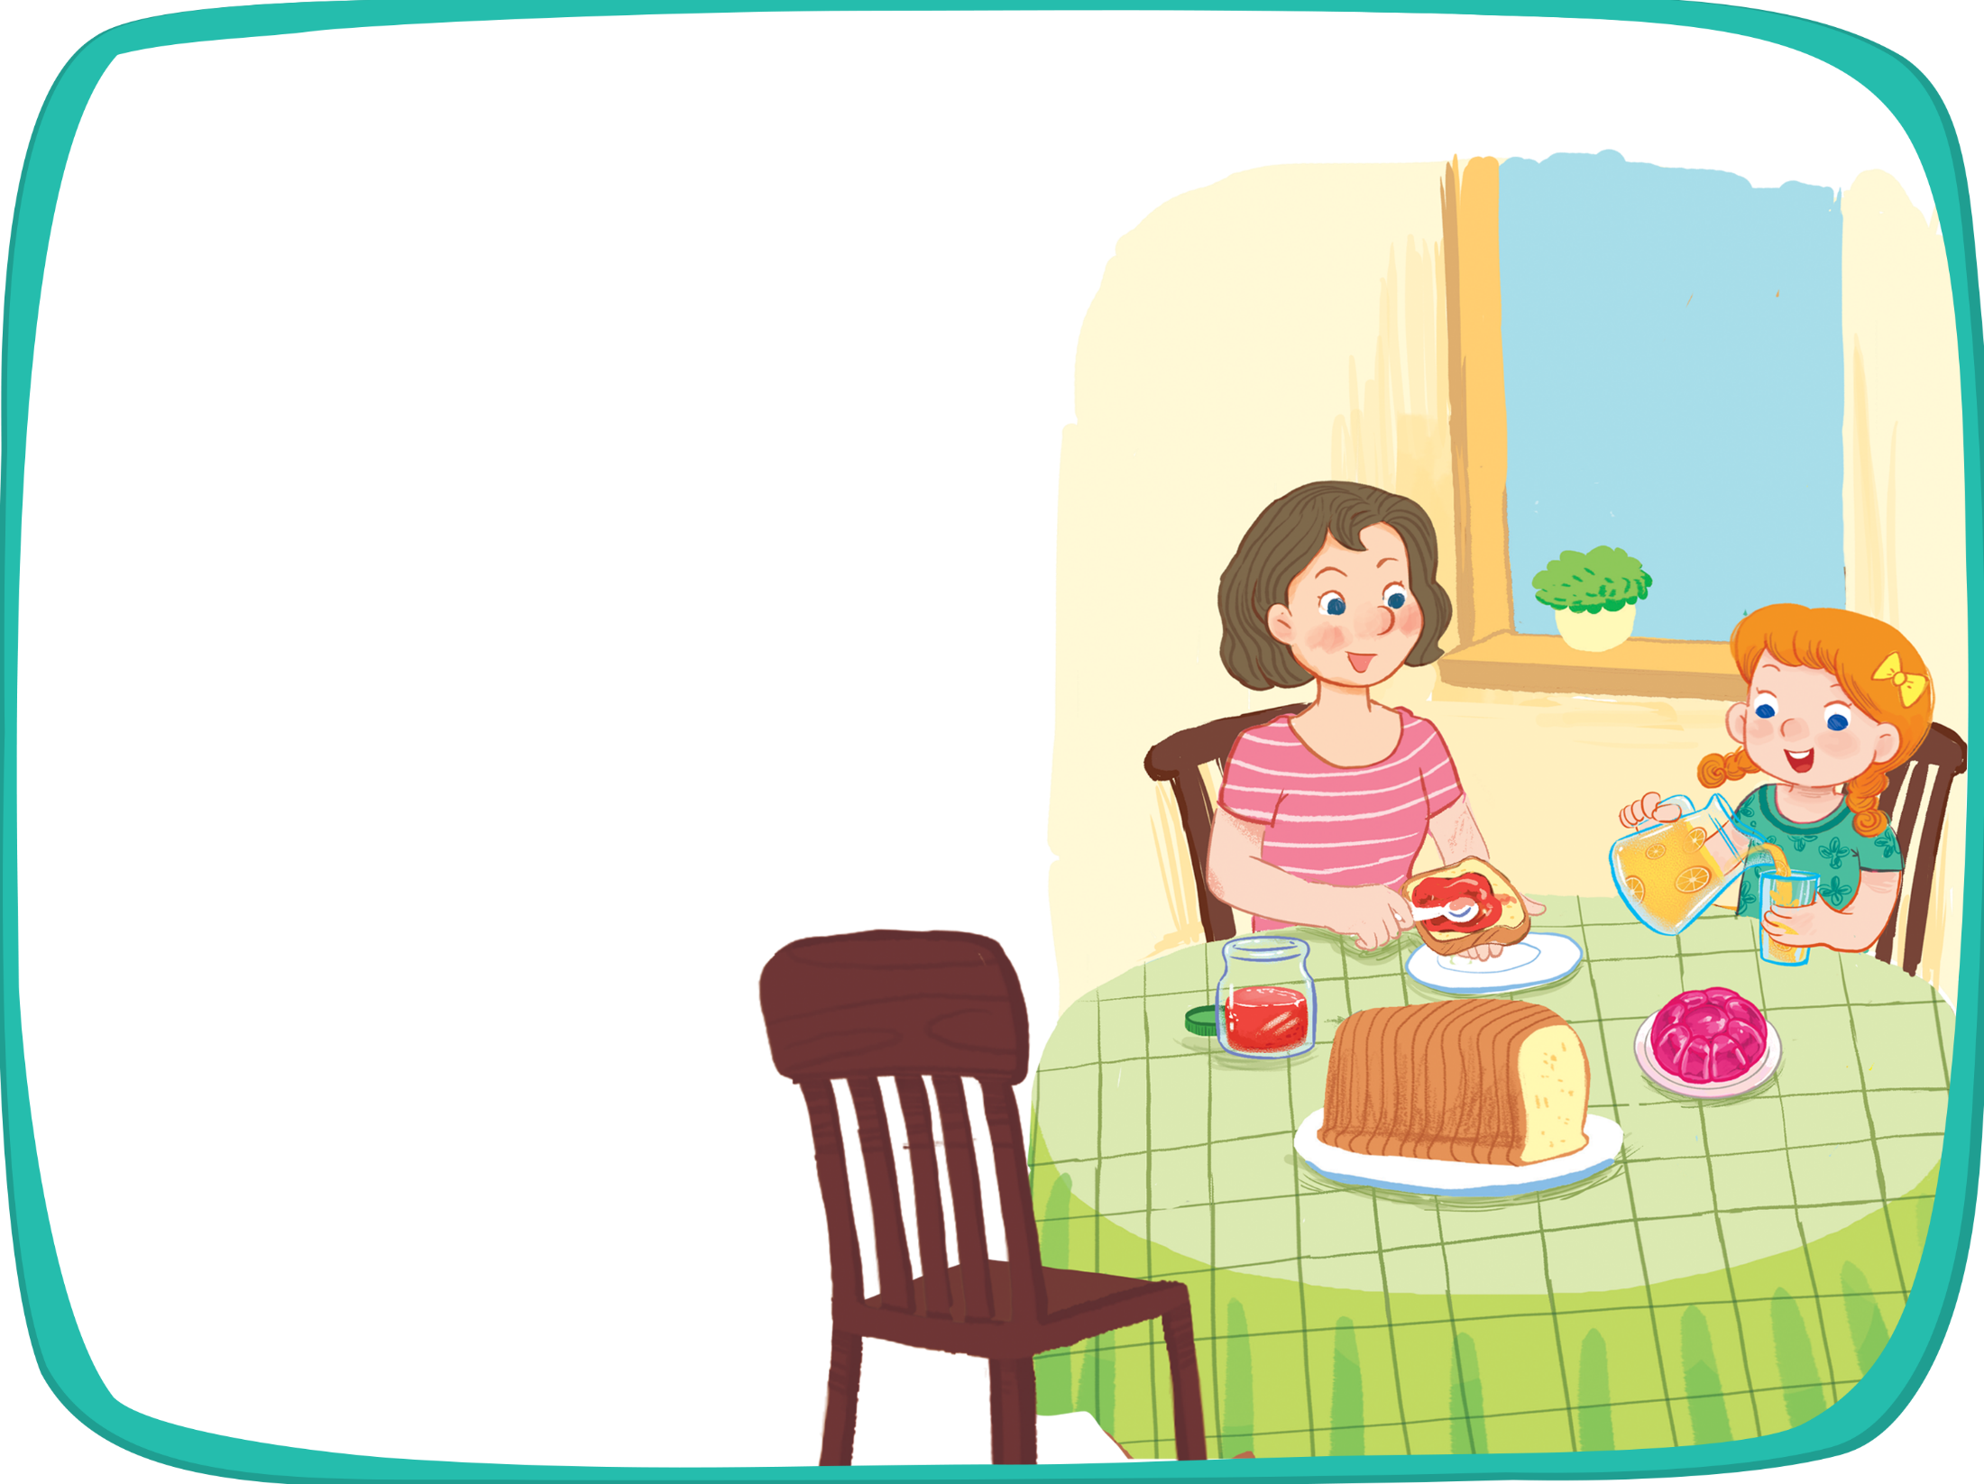


Listen and chant.
J, j, jam.
J, j, jam.
J, j, jam.
J, j, jam.
I like jam.
I like jam.
I like jam.
I like jam.
J, j, juice.
J, j, juice.
J, j, juice.
J, j, juice.
I like juice.
I like juice.
I like juice.
I like juice.
J, j, jelly.
J, j, jelly.
J, j, jelly.
J, j, jelly.
I like jelly.
I like jelly.
I like jelly.
I like jelly.

Slide 23
4. Listen and tick.

Slide 24

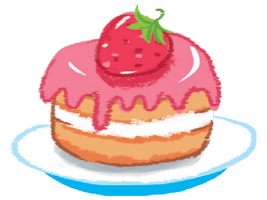


1
2

Slide 25
1


Slide 26
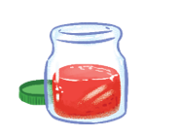
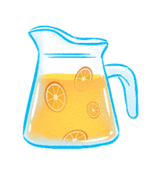
2


Slide 27
Fun corner
and wrap-up

Slide 28



Slide 29

Slap the board

Slide 30

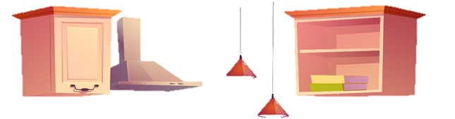
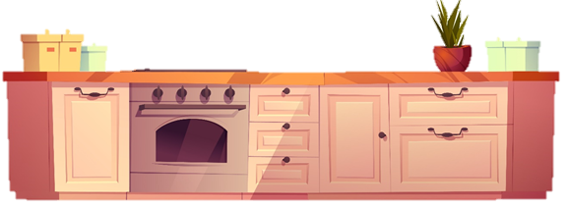
Jj
jelly
juice
jam
0
1
5
4
2
6
8
3
10
9
7
1
7
2
6
3
9
5
0
4
8
10

Slide 31
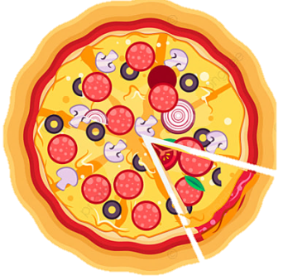
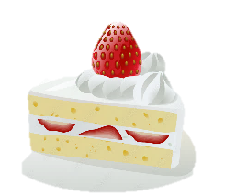
0
1
5
4
2
6
8
3
10
9
7
1
7
2
6
3
9
5
0
4
8
10

Slide 32


Slide 33

Time to say goodbye!
j

