Slide 2
Unit 5: In the classroom
Lesson 1 –Period 1

Slide 3
I. OBJECTIVES
By the end of this lesson, pupils will be able to:
1. Knowledge and skills.
- correctly pronounce the name of the letter Q/q (/kjuː/).
- correctly pronounce the sound of the letter Q/q (/k/) in isolation and in the words question, square and quiz.
2. Competences.
- Communication and collaboration: work in pairs or groups to complete the learning tasks.
- Self-control and independent learning: perform pronunciation task.
3. Attributes.
- Be aware of and responsible for the activities in their classroom.
- Listen carefully to the teacher’s explanation.
- Kindness: help partners to complete learning tasks
- Diligence: complete learning tasks
- Honesty: tell the truth about feelings and emotions
4. General competencies.
- Listening: listen and number
- Critical thinking: read and match
- Oral communication: let’s play
- Self-control & independent learning: perform listening tasks
- Communication and collaboration: work in pairs or groups
- Sociability: talk to each other, say good words to others.

Slide 4



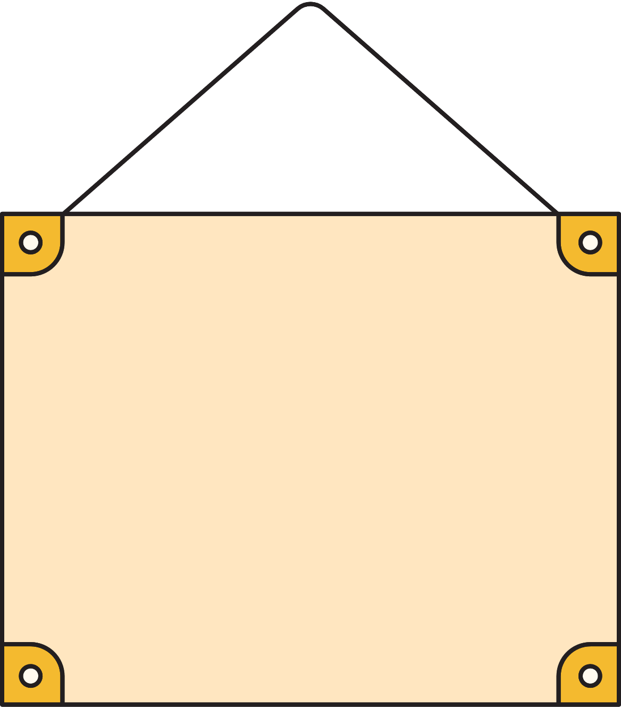
Warm-up & review
Game: “Crossword puzzle”

Slide 5







Game: “Crossword puzzle”
6
R
2
O
S
3
5
R
A
I
N
B
O
W
A
4
S
A
N
D
1
R
I
V
E
R
L
A
Score

Slide 6
1. Listen and repeat

Slide 7





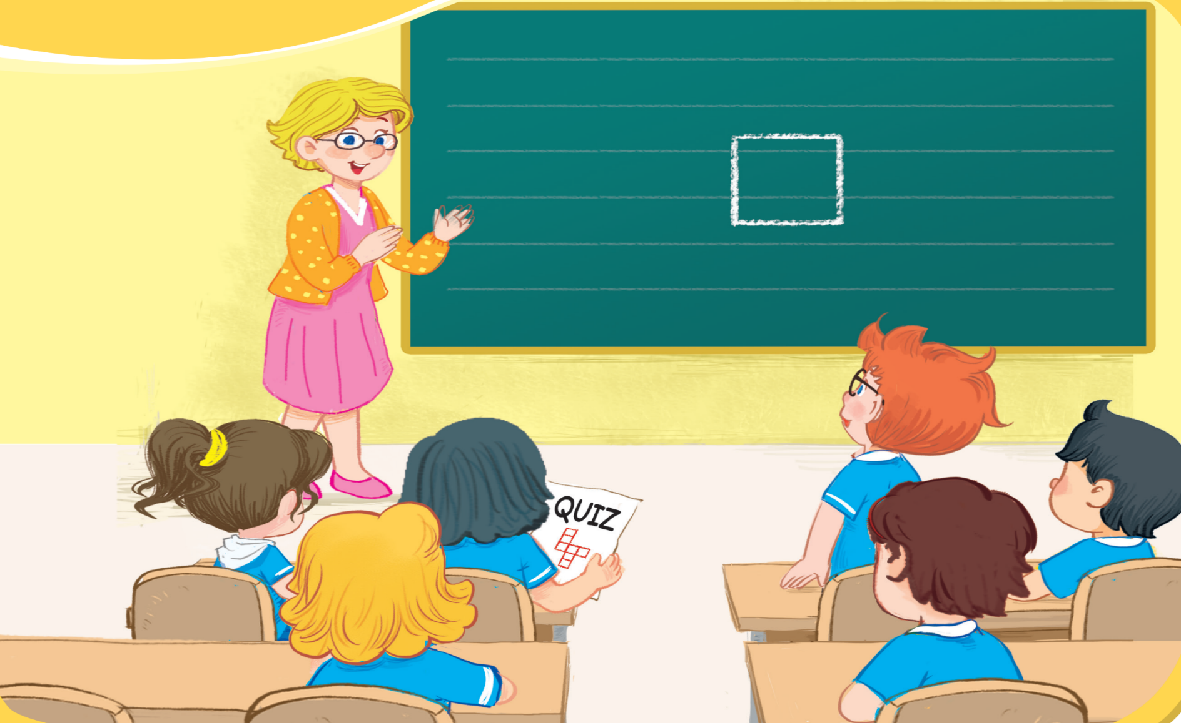

1. Listen and repeat.

Slide 8




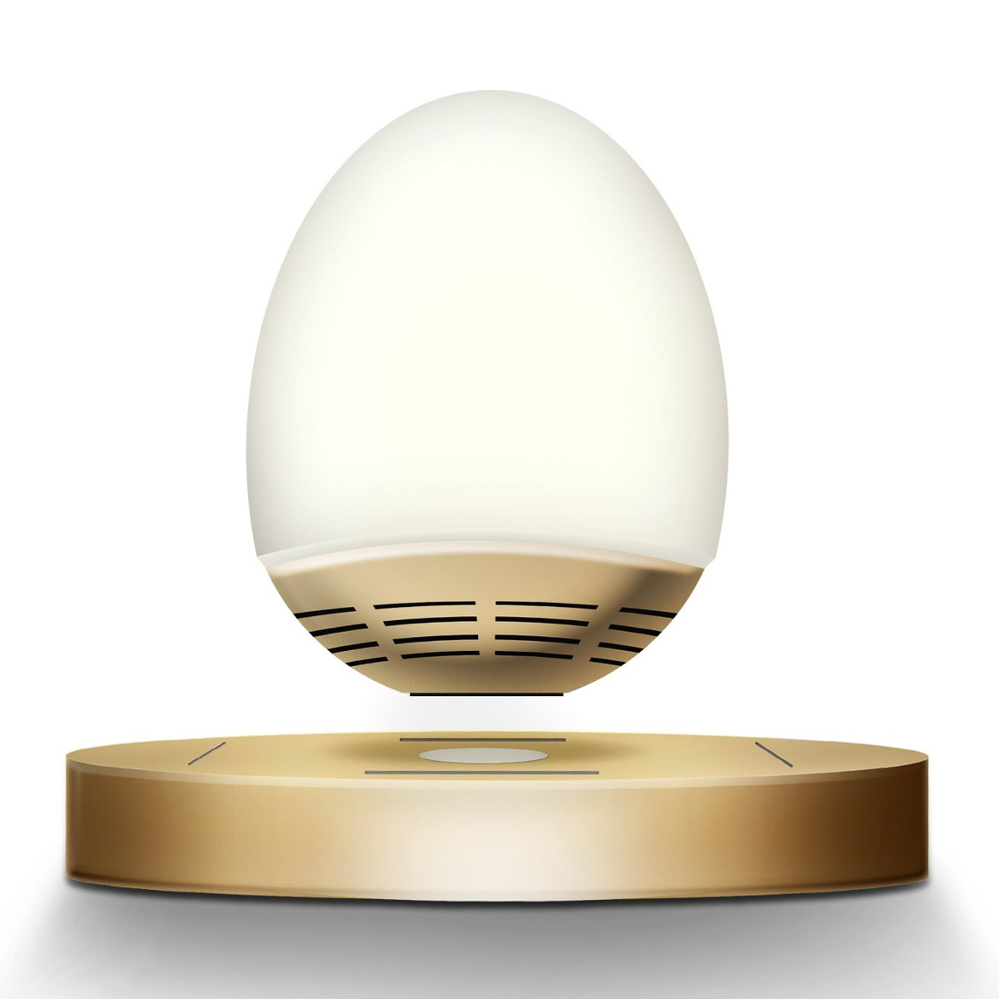
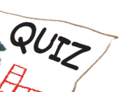
1. Listen and repeat.
question
square
quiz

Slide 9
Look and say aloud
q
question

Slide 10

Look and say aloud
q
square

Slide 11
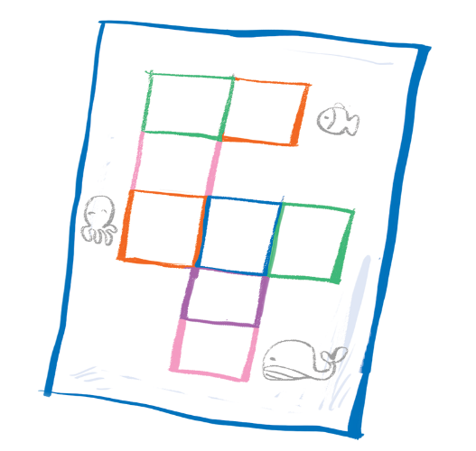
Look and say aloud
q
quizz

Slide 12
2. Point and say

Slide 13

2. Point and say.
question
square
quiz

Slide 14

3.Listen and chant.

Slide 15

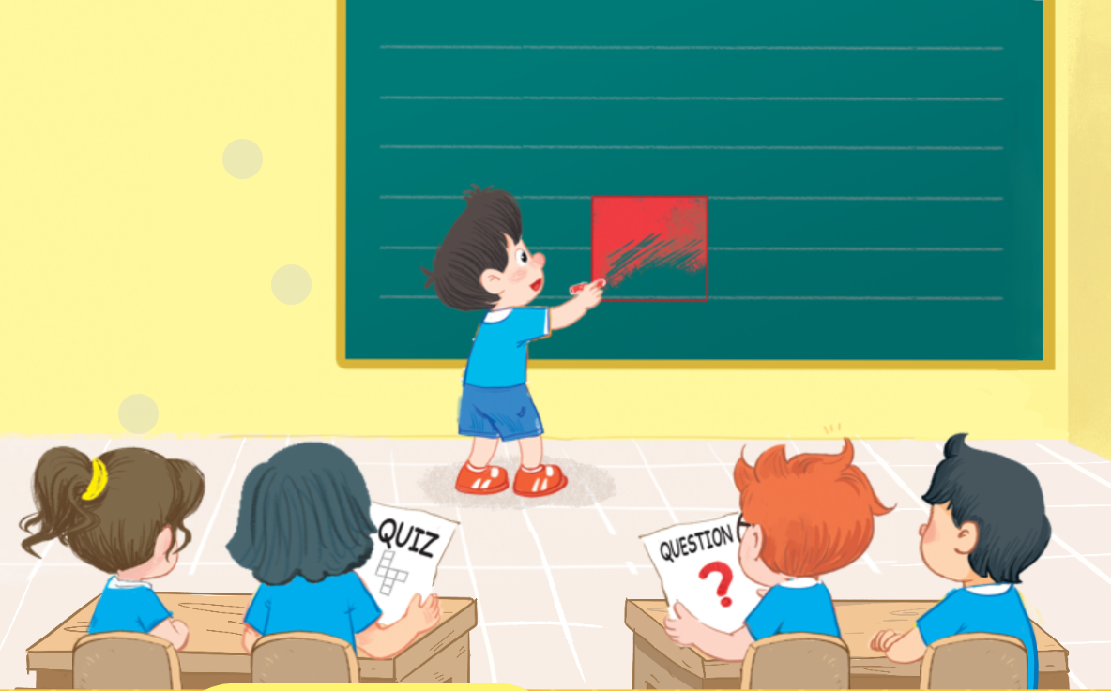
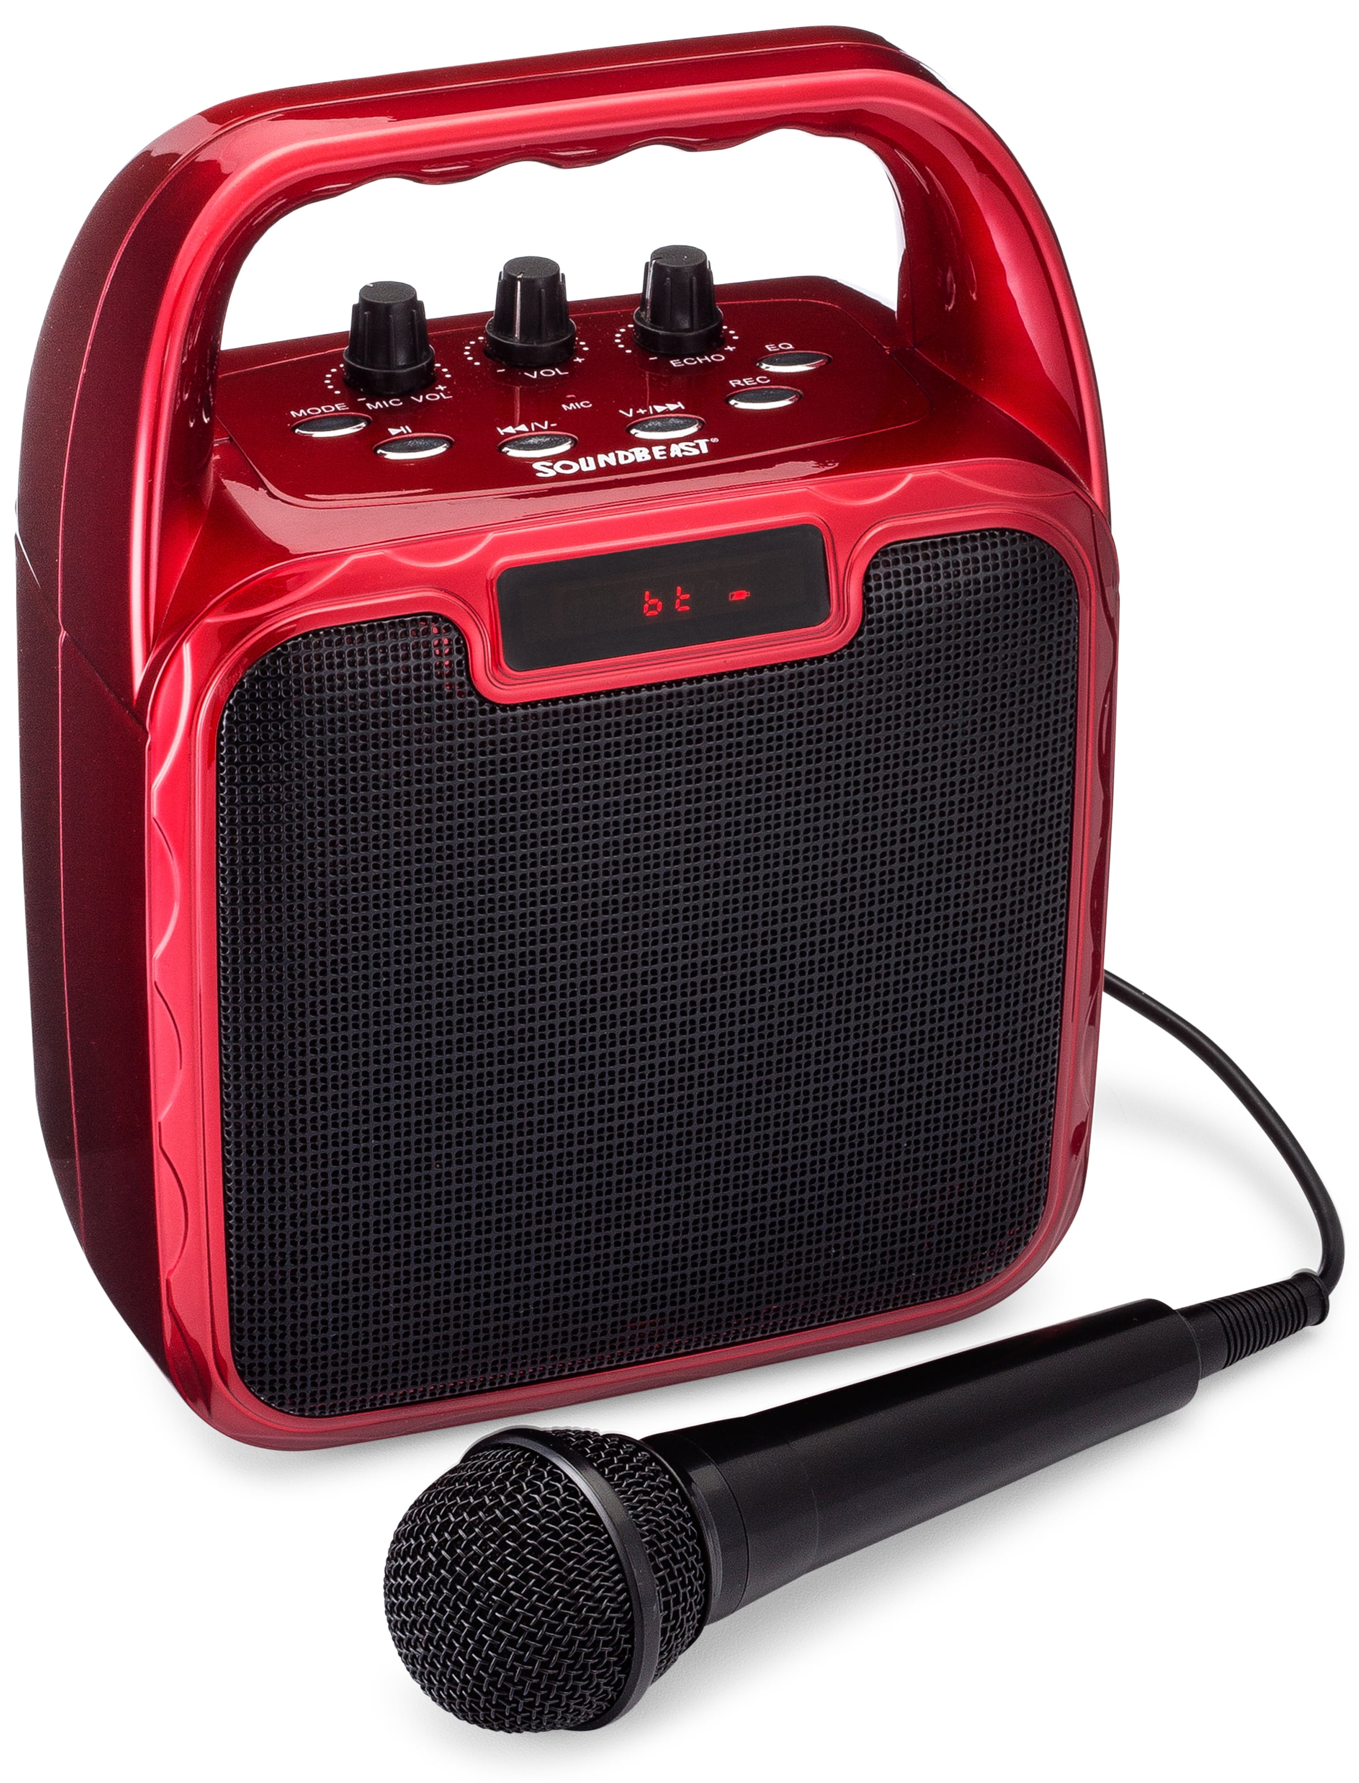
3. Listen and chant.
Q, q, a square.
He’s colouring a square.
Q, q, a question.
He’s answering a question.
Q, q, a quiz.
She’s doing a quiz.
SPIN WHEEL

Slide 16
4. Listen and tick.

Slide 17


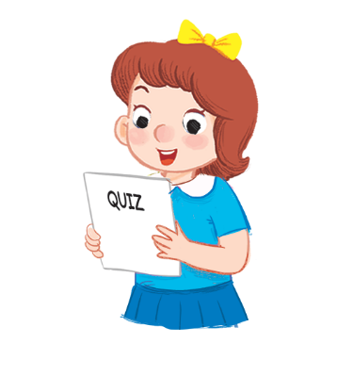




1
2

Slide 18


1


Slide 19


2


Slide 20
Fun corner/ Wrap-up

Slide 21
Game: “Whispers”

Slide 22

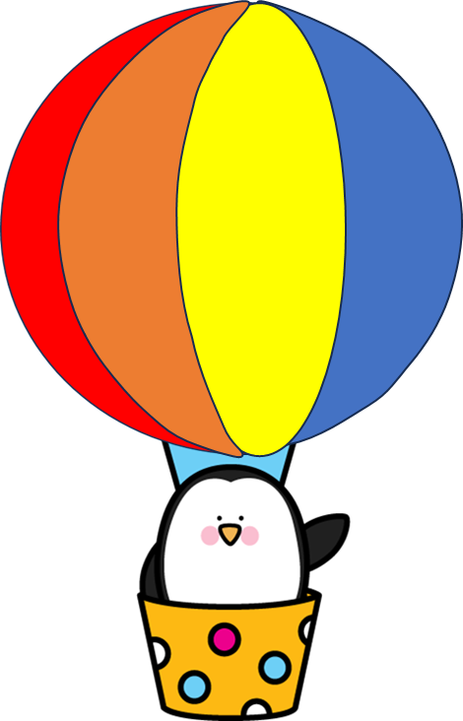
Game: “Whispers”
q
Notes:
Click the hot-air balloon to see the picture
Click the picture to hear the sound

Slide 23
Game: “Whispers”
q
Notes:
Click the hot-air balloon to see the picture
Click the picture to hear the sound

Slide 24
Game: “Whispers”
q
Notes:
Click the hot-air balloon to see the picture
Click the picture to hear the sound

Slide 25

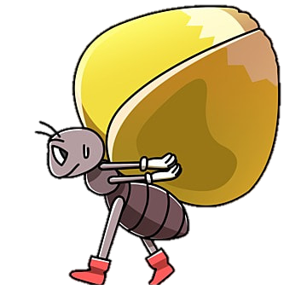



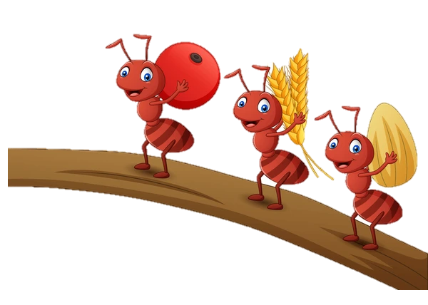
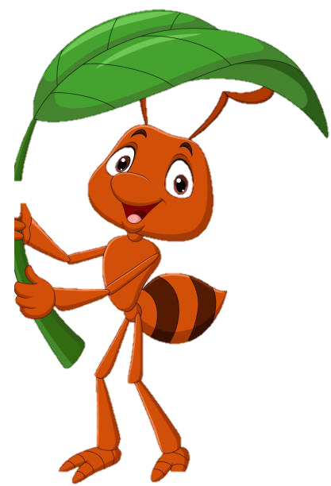
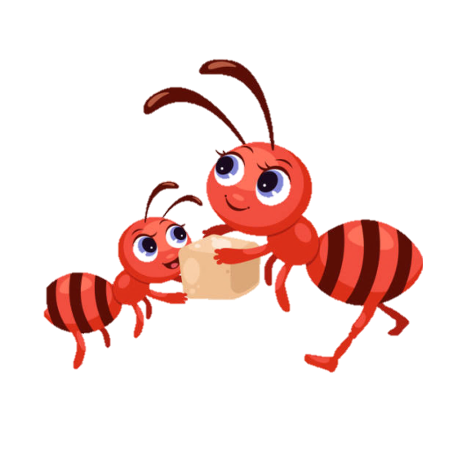
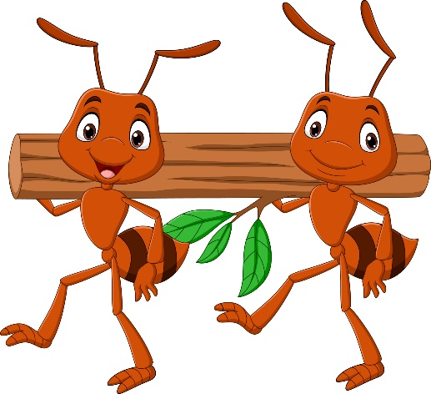
Game: “Slow motion”
quiz
Notes:
Click the ant to see the picture
Click the picture to see the word
Click the word to hear the sound

Slide 26

Game: “Slow motion”
square
Notes:
Click the ant to see the picture
Click the picture to see the word
Click the word to hear the sound

Slide 27

Game: “Slow motion”
question
Notes:
Click the ant to see the picture
Click the picture to see the word
Click the word to hear the sound

Slide 28

Game: “Whispers”

Slide 29

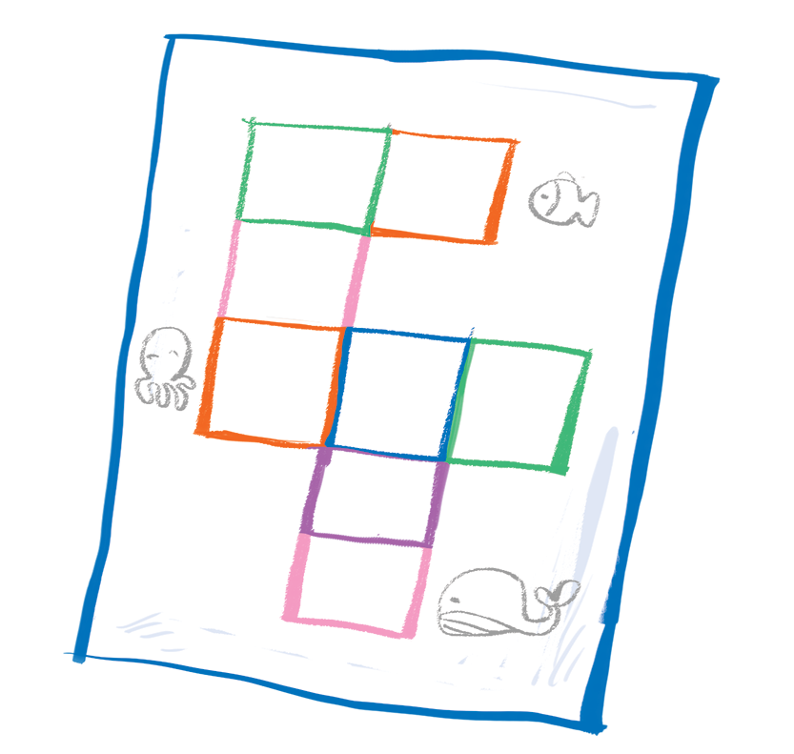
Time to say goodbye!
q

Slide 30


