Slide 2

Unit 4: In the countryside
Lesson 3

Slide 3
I. OBJECTIVES.
By the end of this lesson, pupils will be able to.
1. Knowledge and skills.
- Use the sentence structures “What can you see?” and “I can see a _____.” to describe features of a scene.
Sing a song with the sentence structures “What can you see?” and “I can see a _____.”.
- Write the letter R/r and complete the words river, rainbow and road.
2. Competences.
- Critical thinking and creativity: learn how to describe features of a scene correctly and fluently.
- Communication and collaboration: work in pairs or groups to complete the learning tasks.
- Self-control & independent learning: perform speaking task.
3. Attributes.
- Show their love for the beauty of the nature and responsibility to protect it.
- Study hard.
II. MATERIALS.
- Pupil’s book: Page 19
- Audio Tracks 20, 21
- Teacher’s guide: Pages 32, 33
- Website hoclieu.vn
- Flashcards/ pictures and posters (Unit 4)
- Computer, projector, …

Slide 4

Warm-up
and review

Slide 5
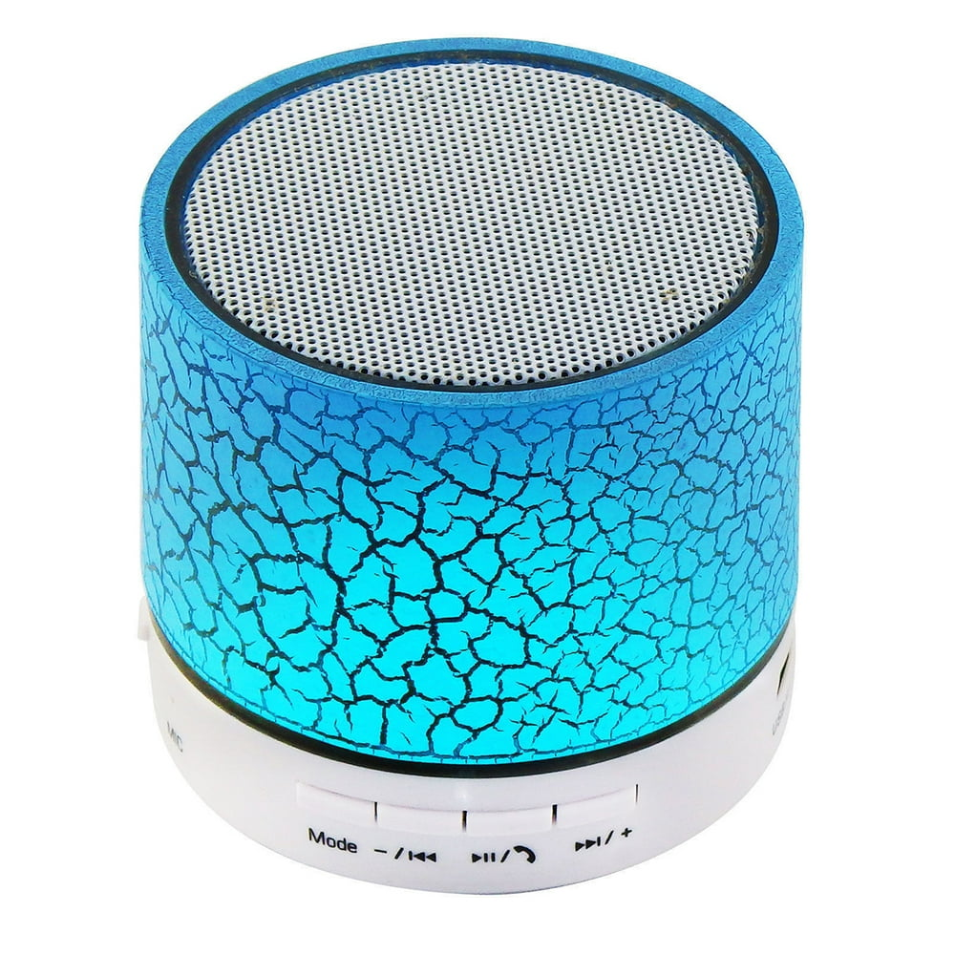













Slide 6


5. Look and write.

Slide 7







Look and write.

Slide 8
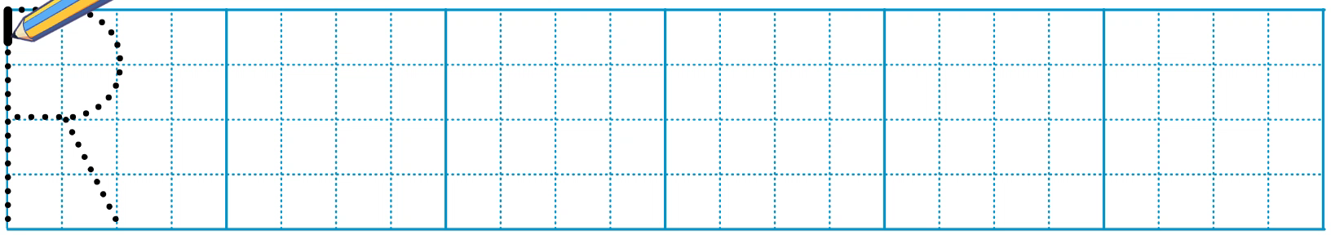
Look and write.

Slide 9
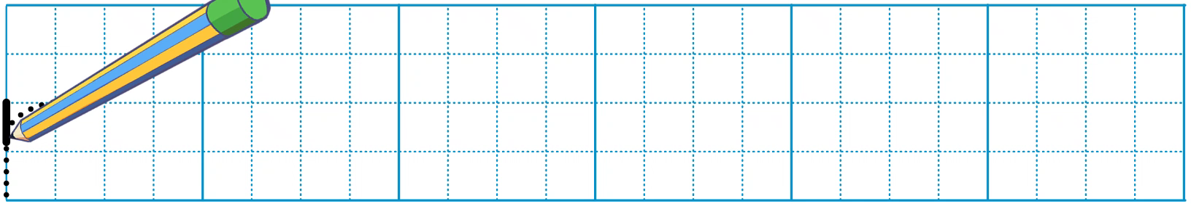
Look and write.

Slide 10
Look and write.
_oad
r

Slide 11
Look and write.
r
_iver

Slide 12
Look and write.
r
_ainbow

Slide 13
6. Listen and repeat.

Slide 14



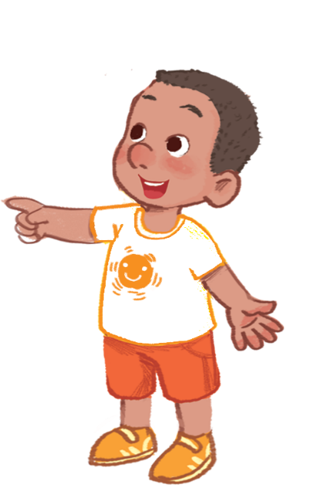

Listen and repeat.

Slide 15


Listen and repeat.
What can you see?
What can you see?
What can you see?
What can you see?
I can see a rainbow.
I can see a rainbow.
I can see a rainbow.
I can see a rainbow.

Slide 16
7. Let’s talk.

Slide 17






Let’s talk.
What can you see?
I .
a
b
c

Slide 18

Let’s talk.
What can you see?
I _______.
a
Notes:
Click the bubble to see the answer

Slide 19


Let’s talk.
What can you see?
I _______.
b

Slide 20


Let’s talk.
What can you see?
I _______.
c

Slide 21
8. Let’s sing.

Slide 22


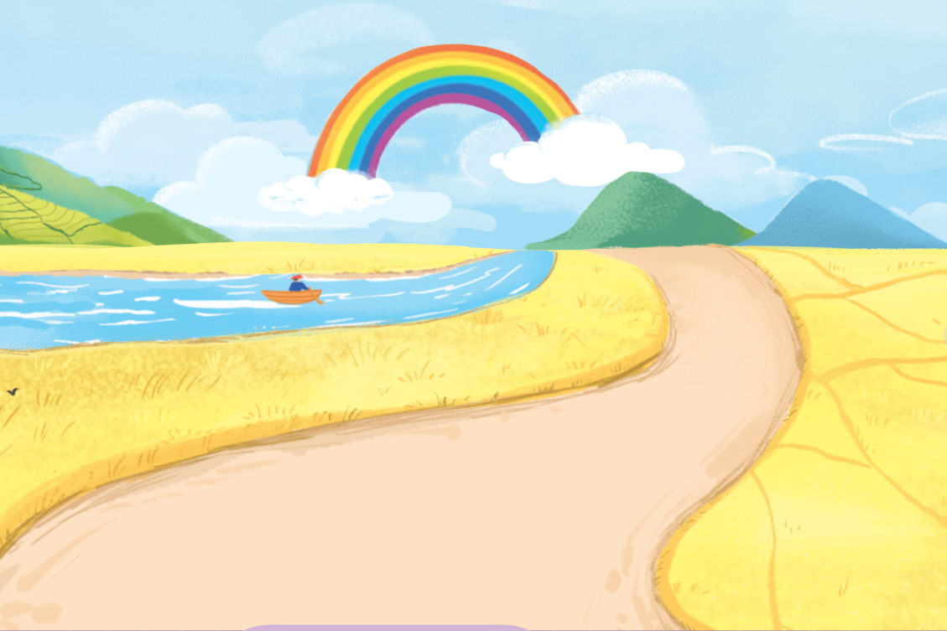
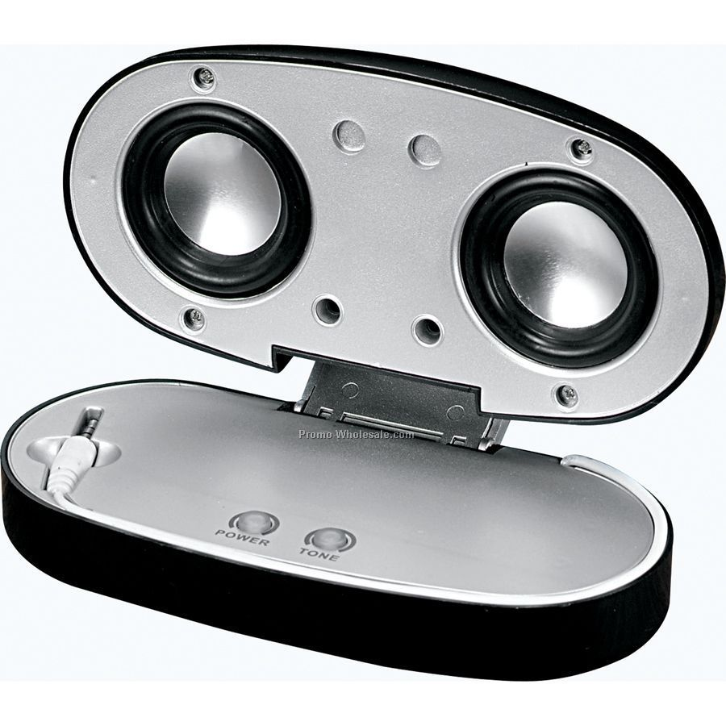
Let’s sing!
What can you see?
I can see a rainbow.
A rainbow in the sky.
What can you see?
I can see a river.
A river near the road.
Turn 1
Turn 2
Turn 3
Next
Notes:
Click Turn 1/2/3 to move to the Group Choosing slide.

Slide 23
Fun corner
and wrap-up

Slide 24
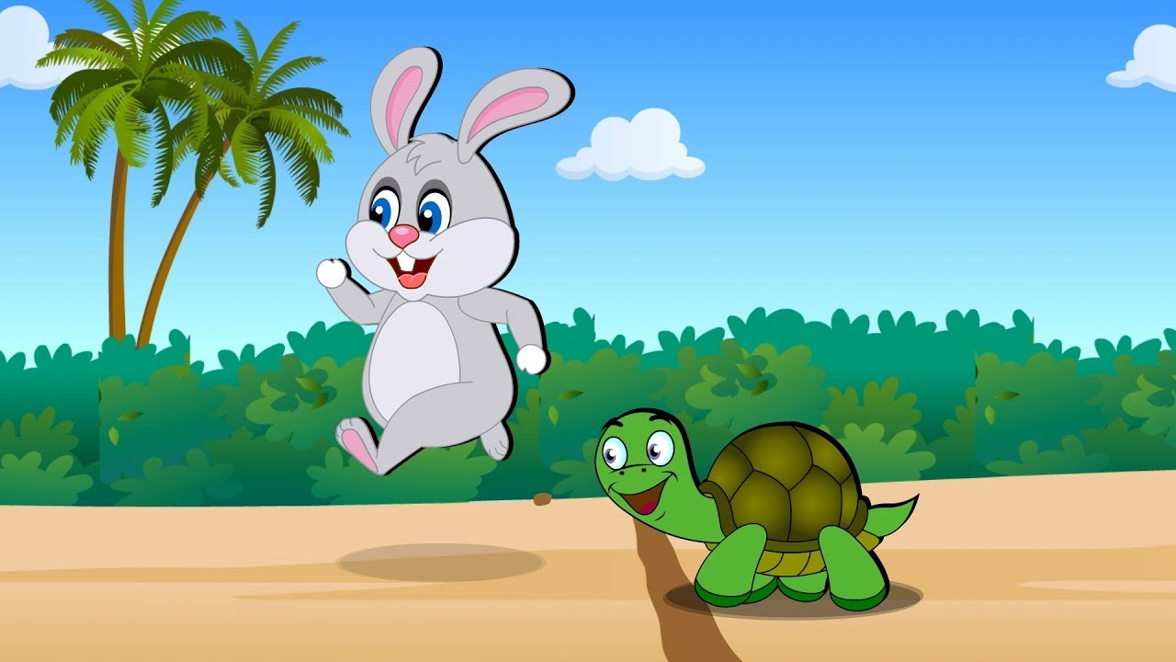
Game
NOUGHTS AND CROSSES
Let’s play!

Slide 25




2
X
X
O
O
O
X
1
3
X
O
O
X
X
6
O
4
5
7
8
9
O
O
O
X
X
X
Winner
Notes:
Click the number to move to the slides of the questions
Click on the right of the square to add the cross remove it
Click on the left to add the nought or remove it

Slide 26


What can you see?
I can see a ______.
rainbow
Notes:
click to see the answers

Slide 27
What can you see?
I can see a ____.
river

Slide 28

What can you see?
I can see a ____.
road

Slide 29

What can you see?
I can see a ____.
ruler

Slide 30

What can you see?
I can see a _______.
red apple

Slide 31

What can you see?
I can see a _____.
rabbit

Slide 32

What can you see?
I can see a ___.
sail

Slide 33

What can you see?
I can see a ___.
kite

Slide 34

What can you see?
I can see a _____.
kitten

