Slide 2


Unit 3
At the seaside
Lesson 3 + Lesson 3

Slide 3


I. OBJECTIVES.
By the end of this lesson, pupils will be able to:
1. Knowledge and skills.
- write the letter S/s and complete the words sand, sail and sea.
- use the sentence structure “Let’s look at the _____!” to suggest doing something.
- sing a song with the sentence structure “Let’s look at the _____!”.
2. Competences.
- Critical thinking and creativity: learn how to suggest doing something correctly and fluently.
- Communication and collaboration: work in pairs or groups to complete the learning tasks.
- Self-control & independent learning: perform speaking task.
3. Attributes.
- Show their love for the beauty of nature and responsibility to protect it.
- Study hard.

Slide 4

WARM-UP & REVIEW
Game: “A magic apple”

Slide 5








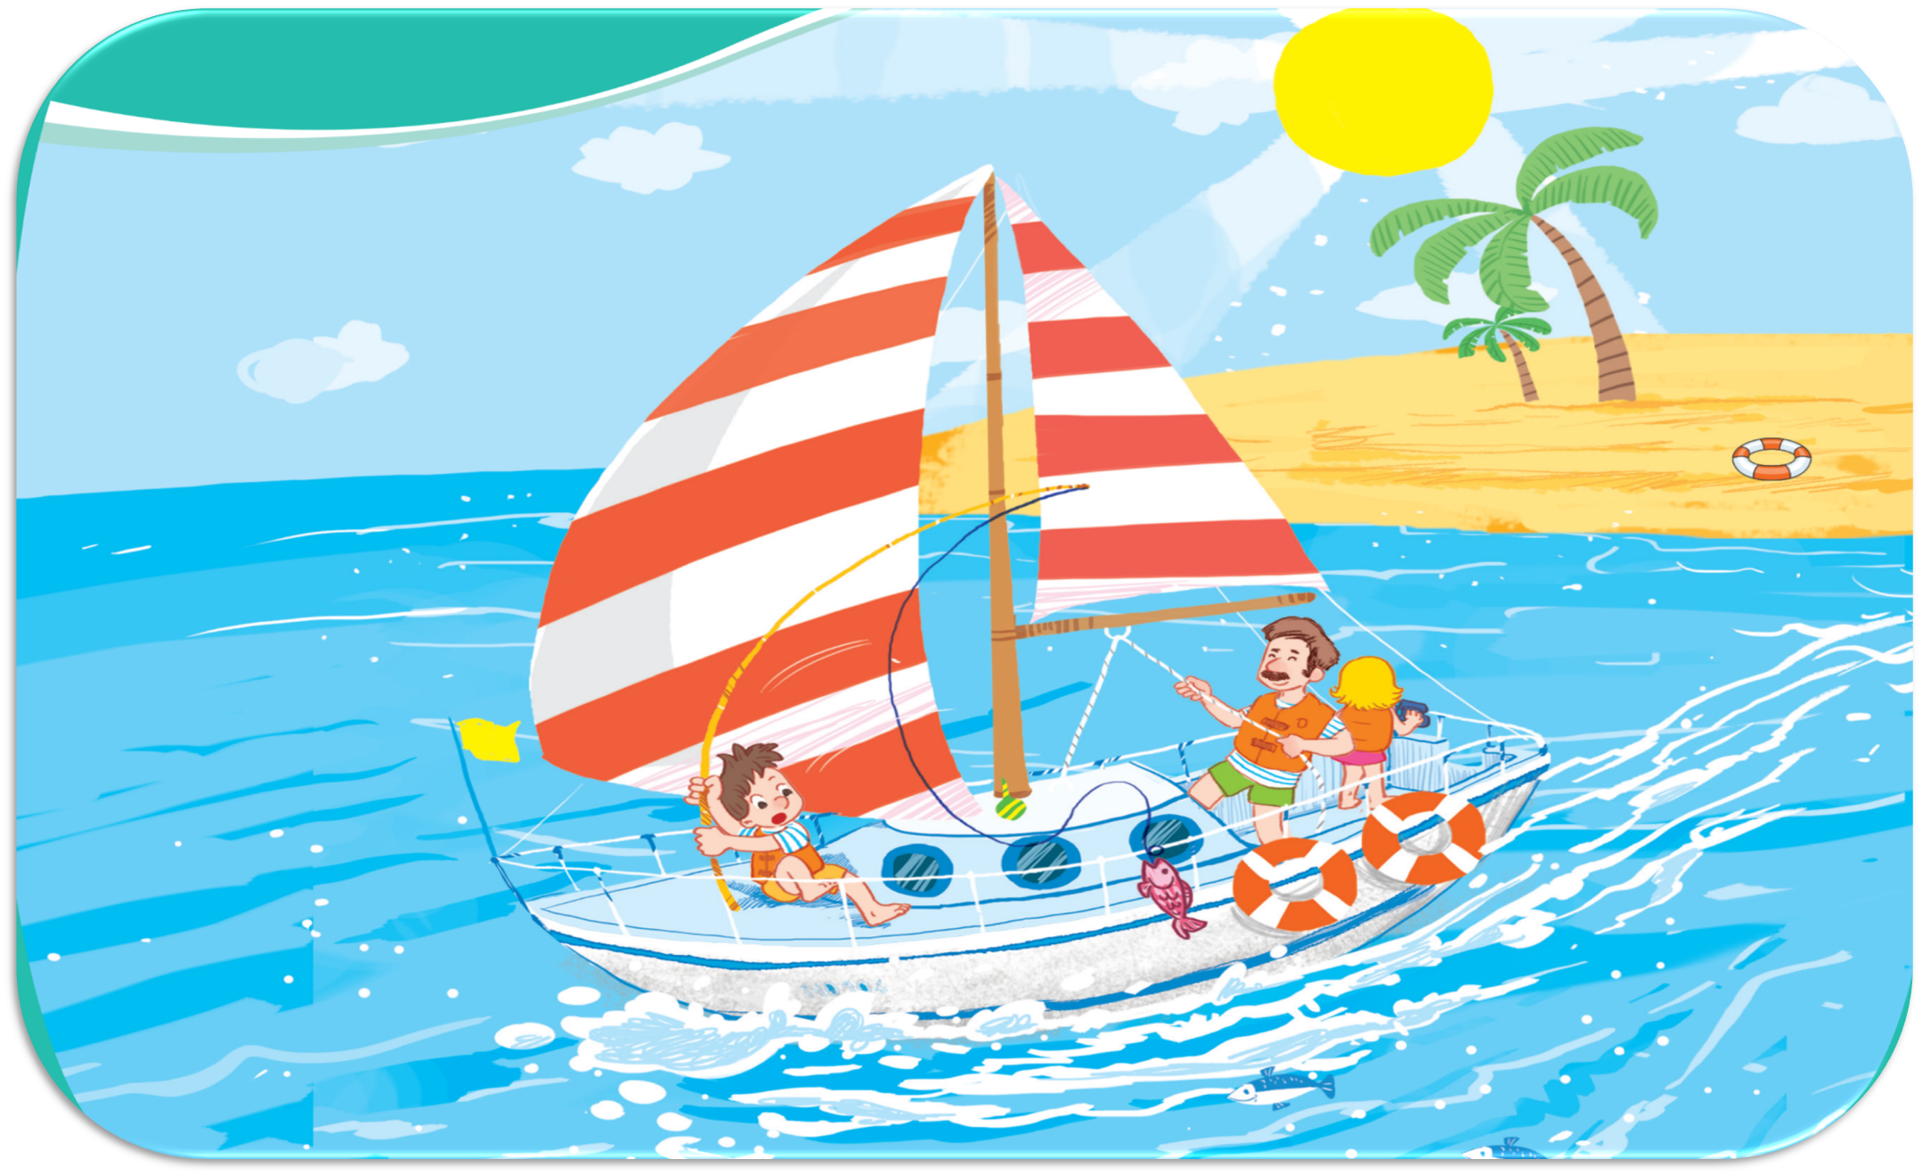
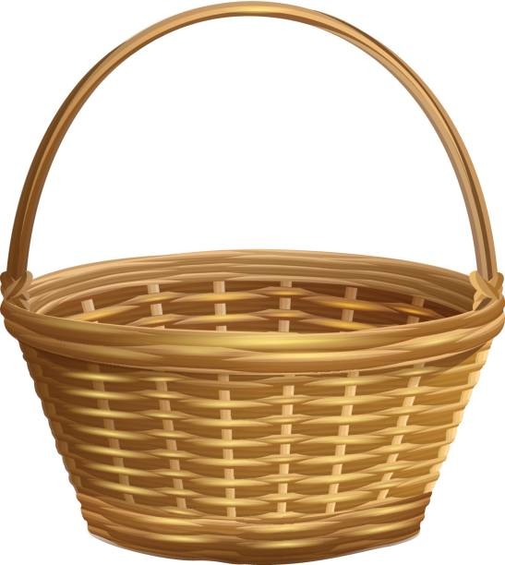


Game: “A magic apple”
Oops, Try again!
3
2
5
4
6
1
Let’s look at the sail!
Let’s look at the seaside!
Let’s look at the sun!
7
Let’s look at the sand!
Let’s look at the sea!
TEAM 1
TEAM 2
Notes:
Click the apple to see the picture then say the sentences
Click the pictures to see the right sentences
Click the pictures again to clear them
Click the Team 1/ 2 to get points/ presents

Slide 6
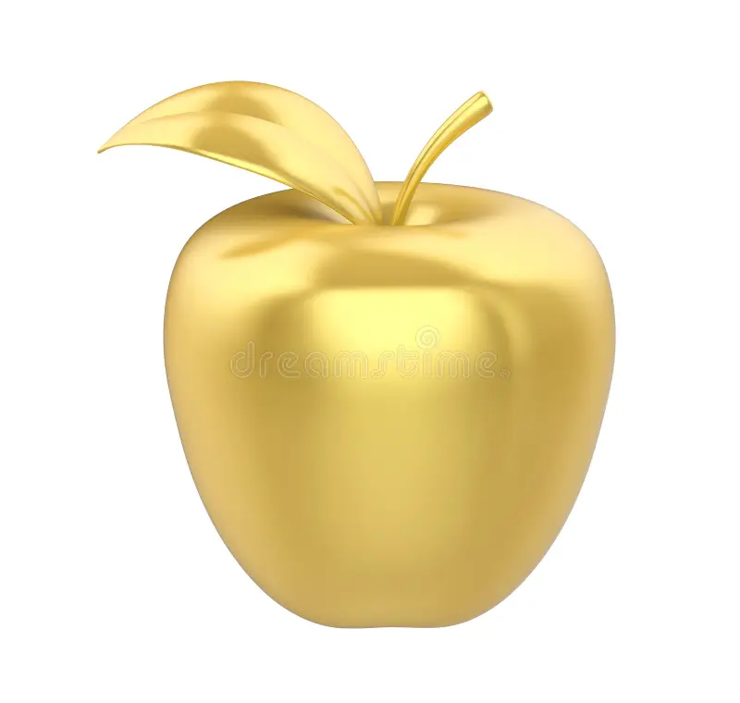
Team 1
3
2
5
4
6
1
7
Back

Slide 7
Team 2
3
2
5
4
6
1
7
Back

Slide 8


Team …

Slide 9
5.Look and write

Slide 10


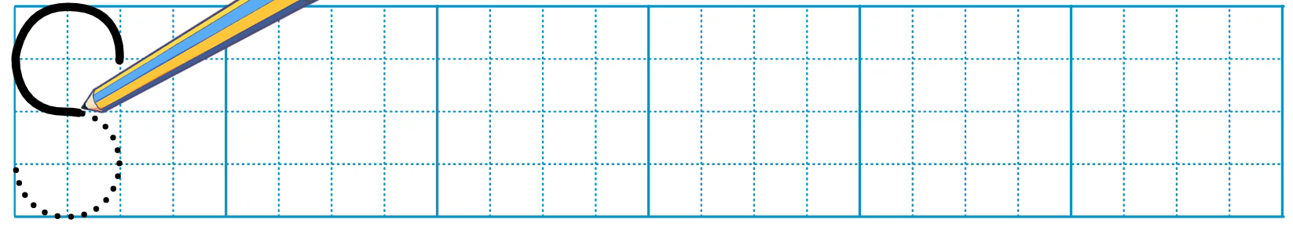
Look and write.

Slide 11
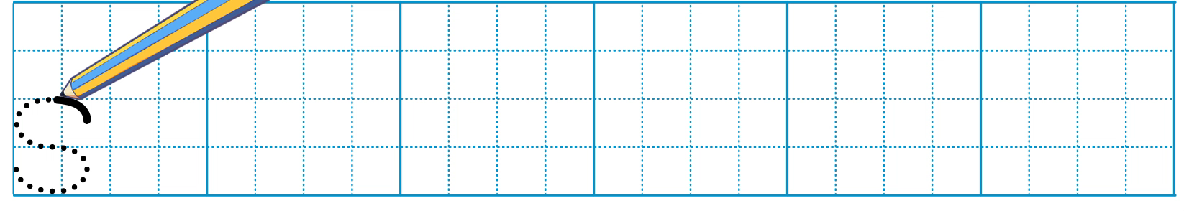
Look and write.

Slide 12
6. Listen and repeat

Slide 13

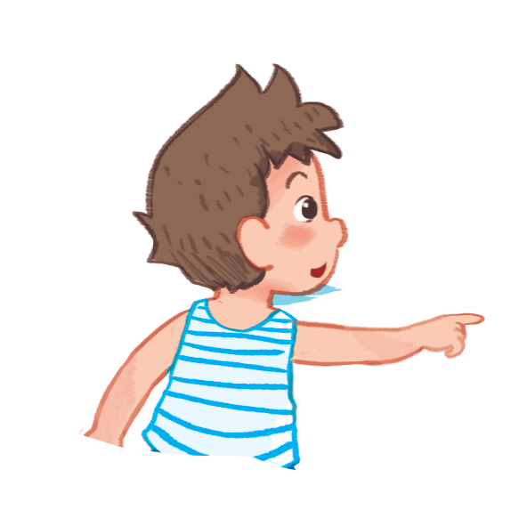
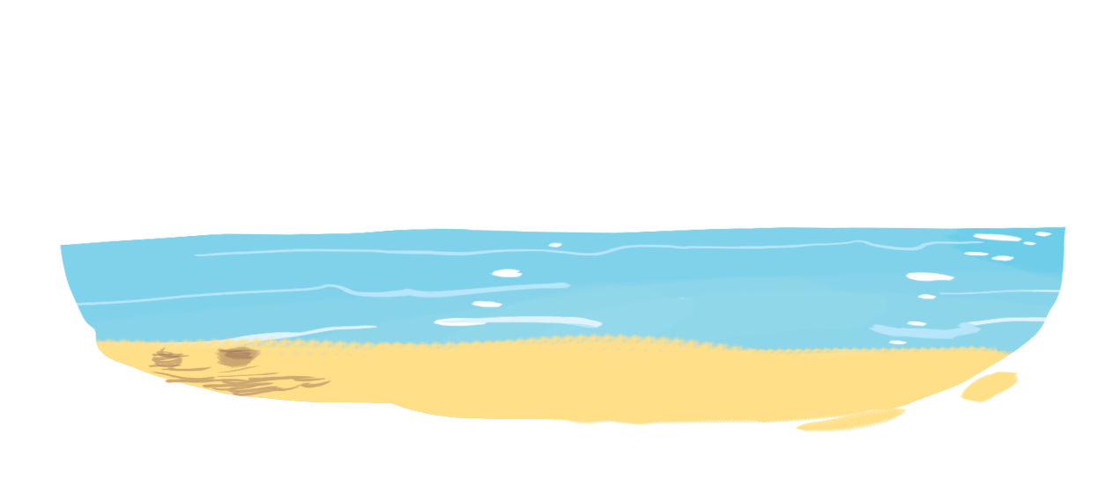
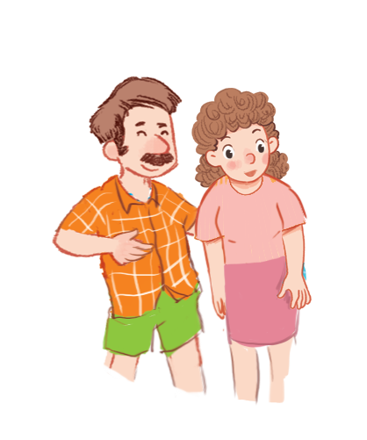

Let’s look at the sea!

Slide 14
7.Let’s talk

Slide 15





Let’s ____ !
a
b
c

Slide 16

Let’s ____ !
a

Slide 17

Let’s ____ !
b

Slide 18

Let’s ____ !
c

Slide 19
8.Let’s sing

Slide 20





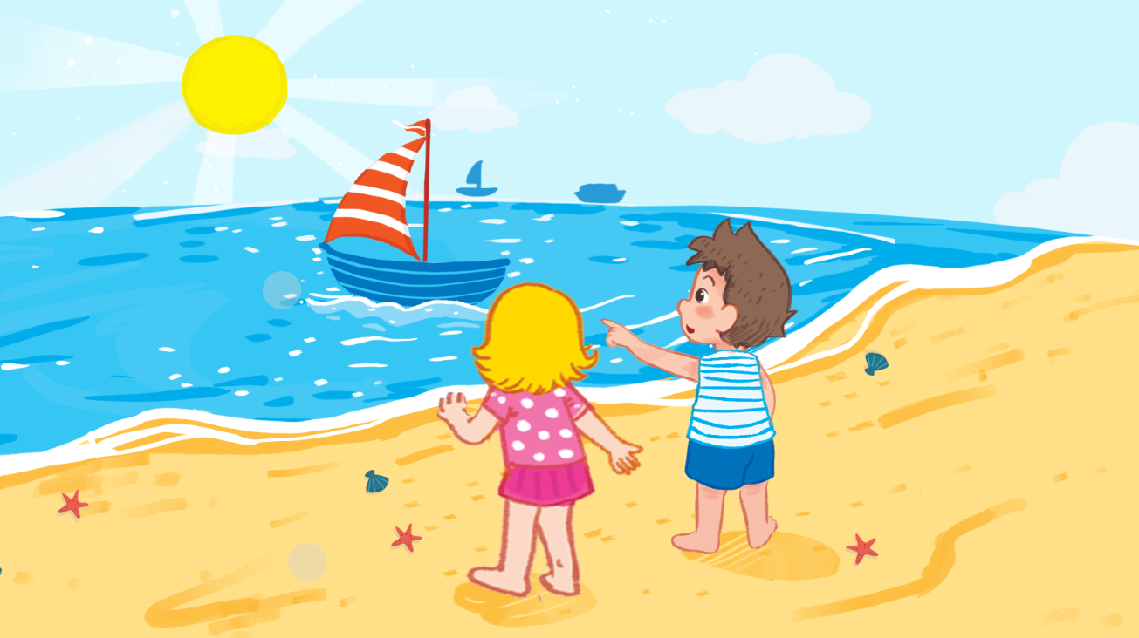

Unit
Let’s sing!
It’s Saturday.
It’s a sunny day.
We’re at the seaside.
Let’s look at the sail!
It’s Sunday.
It’s a sunny day.
We’re at the seaside.
Let’s look at the sand!

Slide 21



Slide 22


Watch and sing along

Slide 23
Fun corner & Wrap-up
Game: “Lucky numbers”

Slide 24
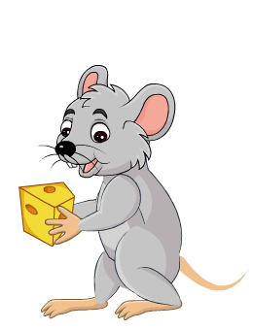




Game: “Lucky numbers”
1
2
3
4
You get points
5
6
7
8

Slide 25

Game: “Lucky numbers”
Let’s ____________!
look at the sea

Slide 26

Game: “Lucky numbers”
see the sail
I can __________.

Slide 27
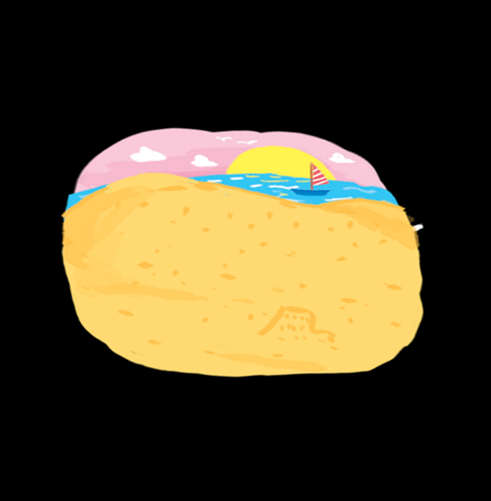
Game: “Lucky numbers”
I can __________.
see the sand

Slide 28

Game: “Lucky numbers”
sunny
It’s a ____ day.

Slide 29


Slide 30


