Slide 2
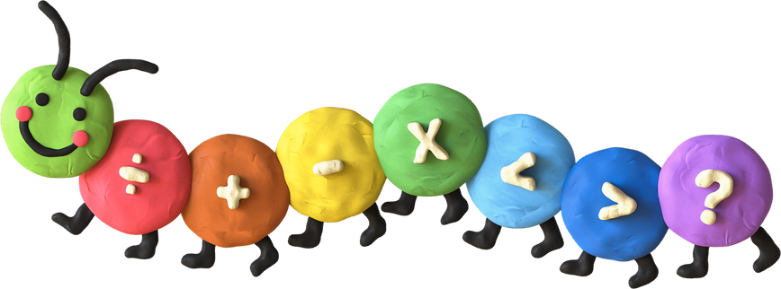

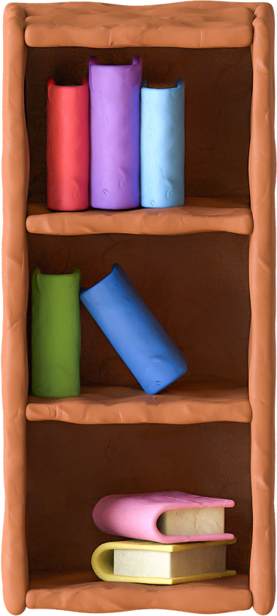
Unit 2:In the backyard
Lesson 1+Lesson 2

Slide 3
I. OBJECTIVES
By the end of this lesson, pupils will be able to:
1. Knowledge and skills
- correctly pronounce the name of the letter K/k (/keɪ/).
correctly pronounce the sound of the letter K/k (/k/) in isolation and in the words kite, bike and kitten.
- say a chant with the sound of the letter K/k (/k/), the words kite, bike and kitten and the sentence structure “He’s/She’s _____ (verb + -ing).”.
2. Competences
- Communication and collaboration: work in pairs or groups to complete the learning tasks.
- Self-control and independent learning: perform pronunciation tasks.
3. Attributes
- Show their love and interest in outdoor activities.
- Participate in common tasks actively.

Slide 4
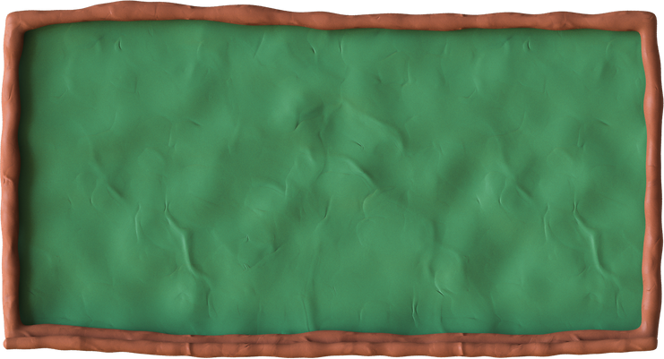
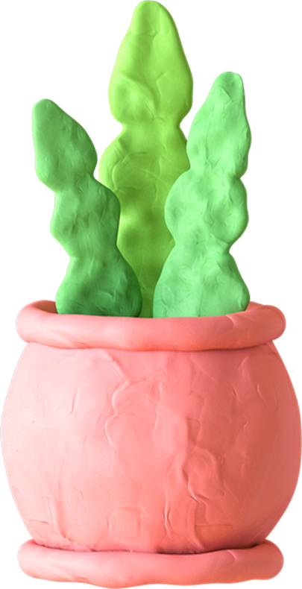
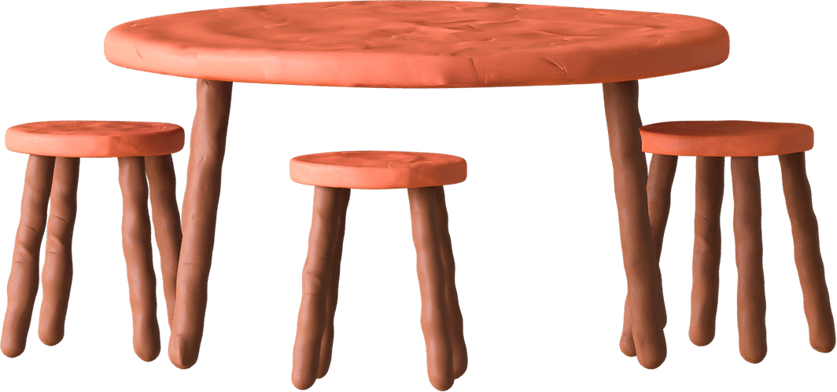
Game
LUCKY FLOWERS

Slide 5





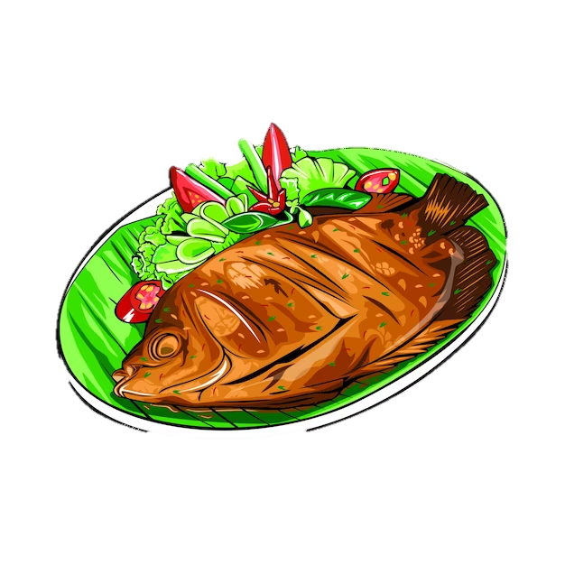


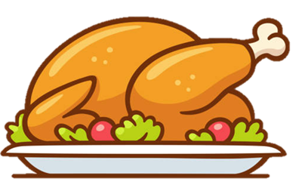





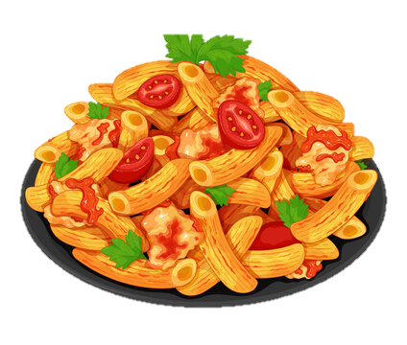
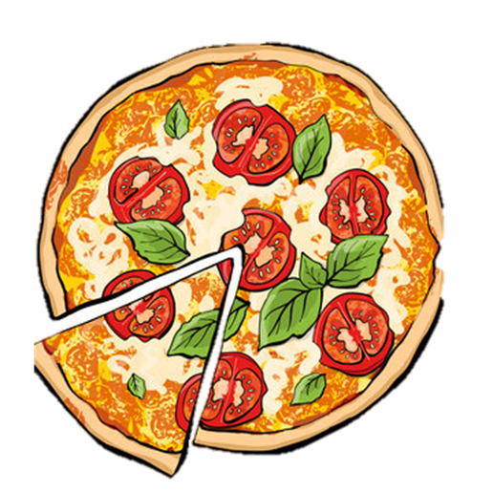


Game
LUCKY FLOWERS
You get
3 points

Slide 6
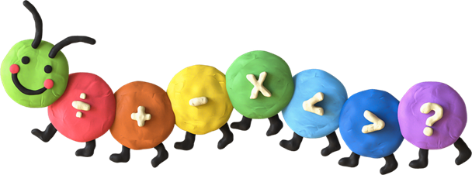

Look and say

Slide 7
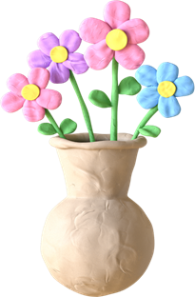
01
Listen and repeat

Slide 8

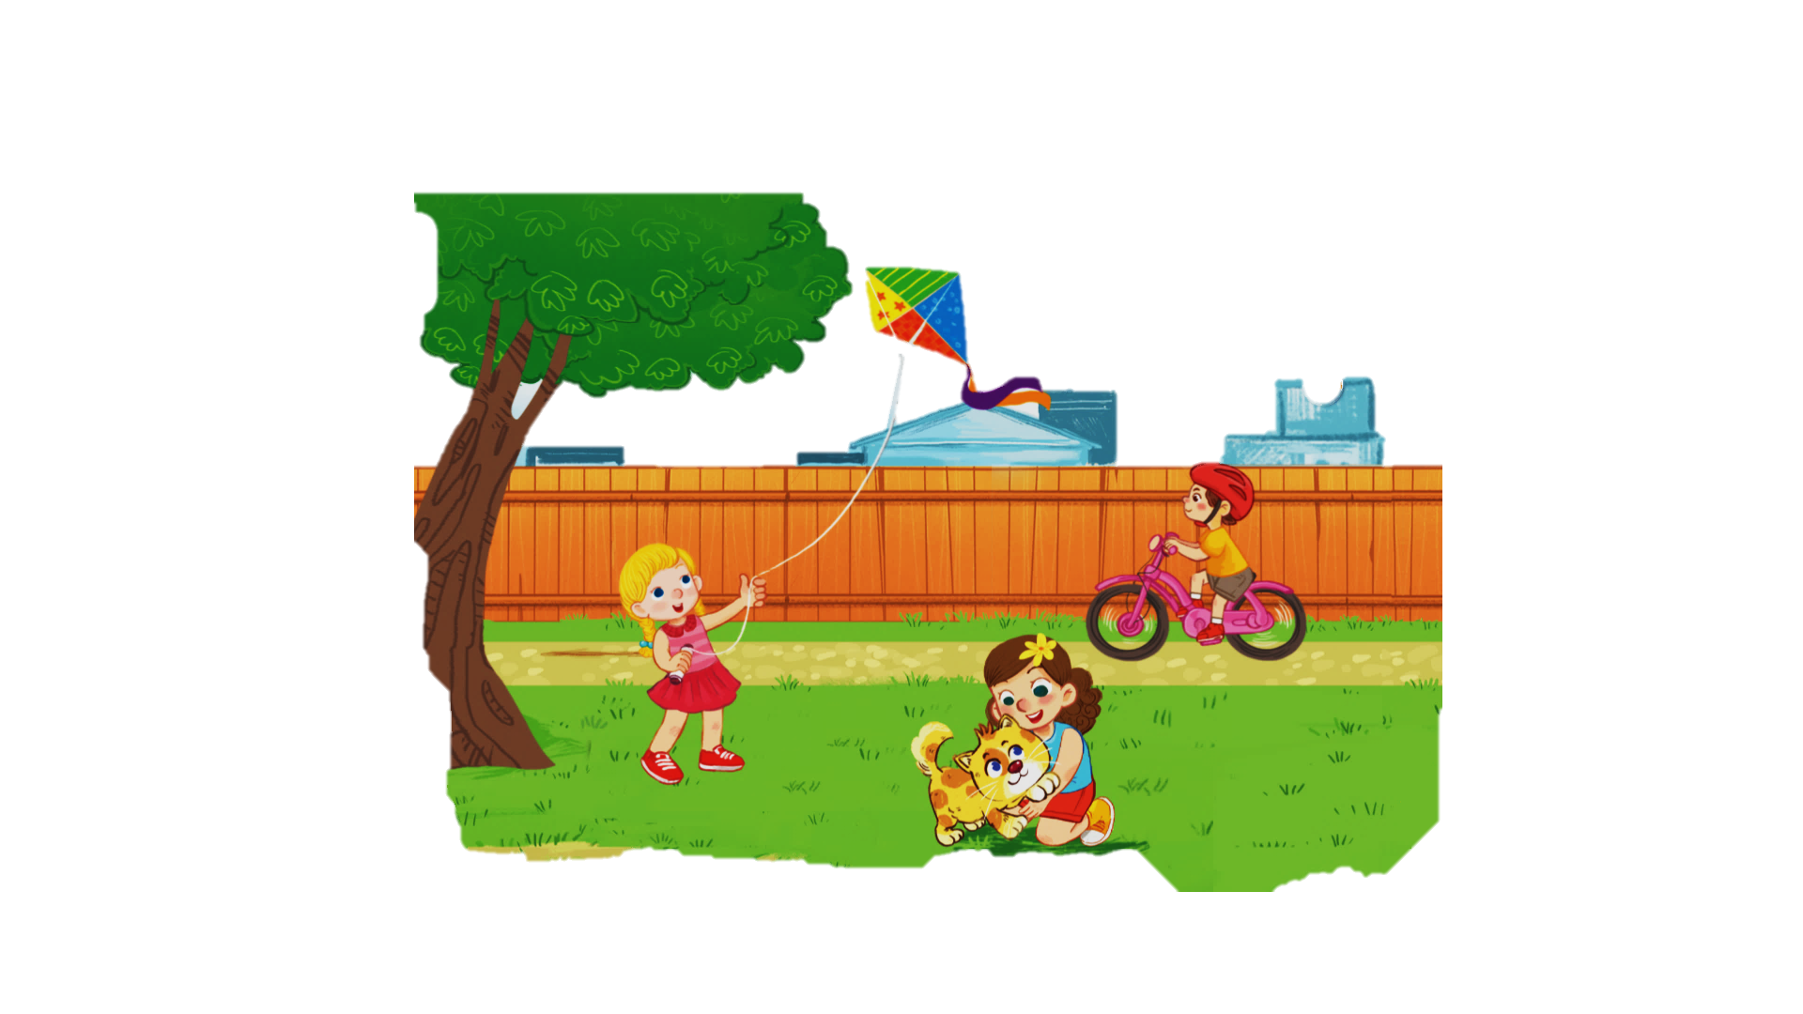


Slide 9

backyard →

Slide 10

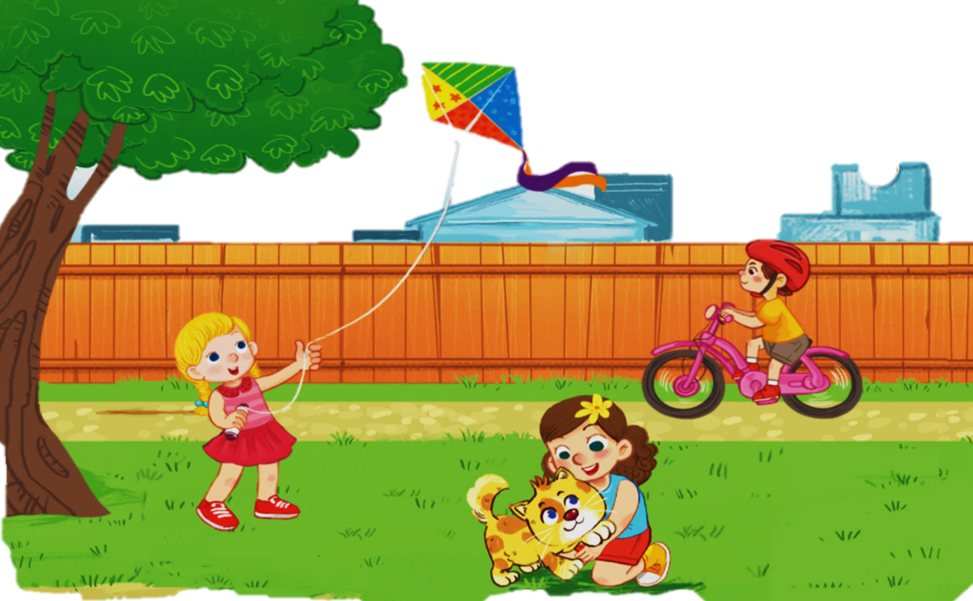

Kk
kite
bike
kitten

Slide 11
k
ite
k
bi e
k
itten

Slide 12
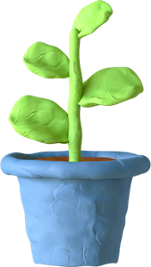
2
Point and say

Slide 13

Kk
kite
bike
kitten

Slide 14
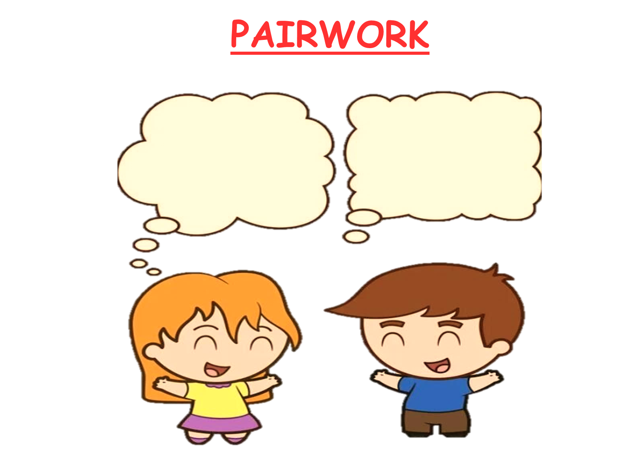
WORK IN PAIRS
k
kite

Slide 15
WORK IN PAIRS
kitten
k

Slide 16







  3
  Listen and chant

Slide 17




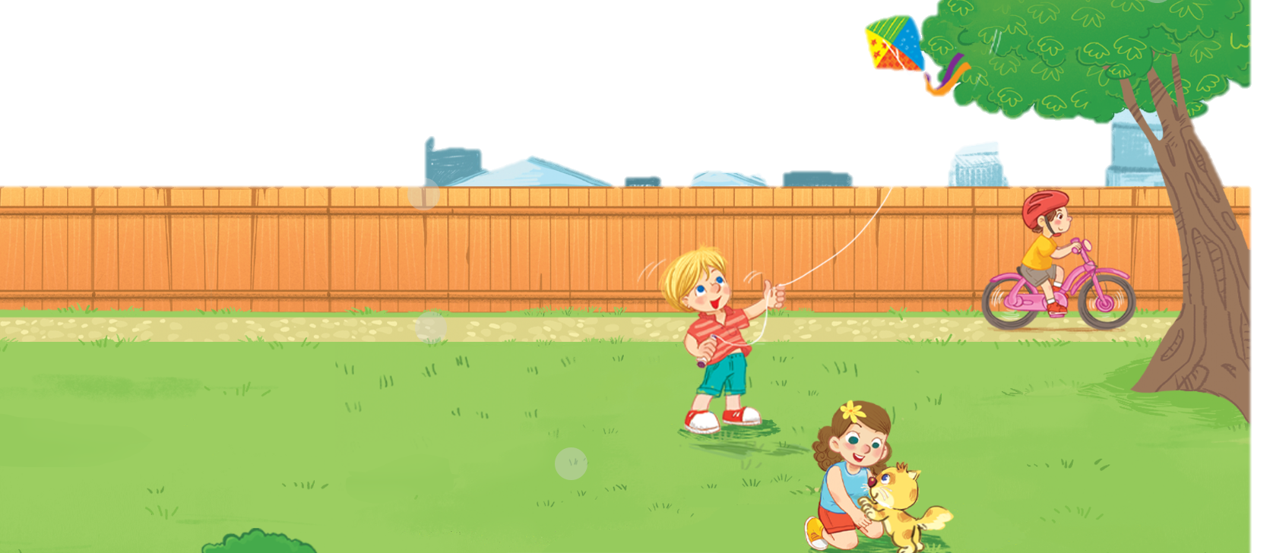
Unit
3. Listen and chant.

Slide 18

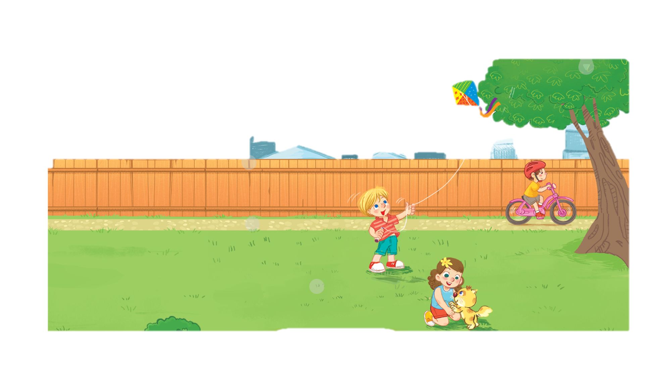
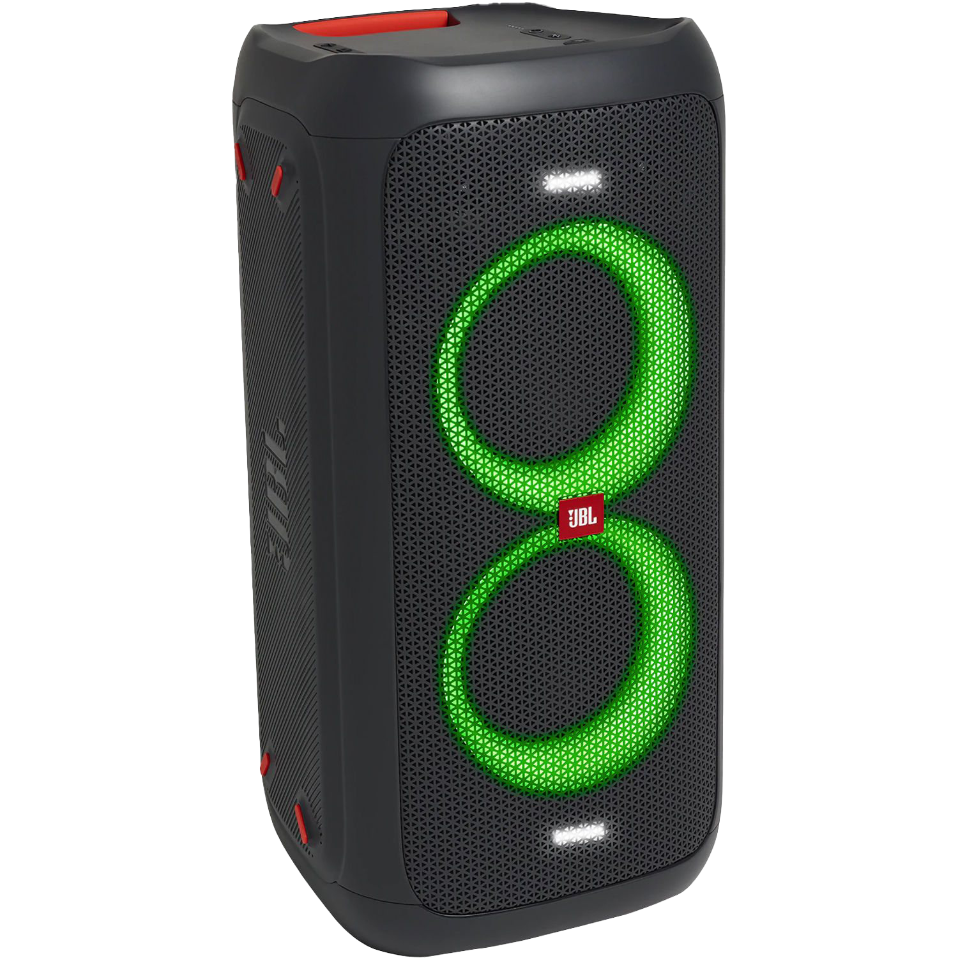
Unit
3. Listen and chant.
K, k, kite.
He’s flying a kite.
K, k, bike.
He’s riding a bike.
K, k, kitten.
She’s playing with a kitten.
This Photo by Unknown Author is licensed under CC BY-NC

Slide 19
  4
  Listen and circle

Slide 20
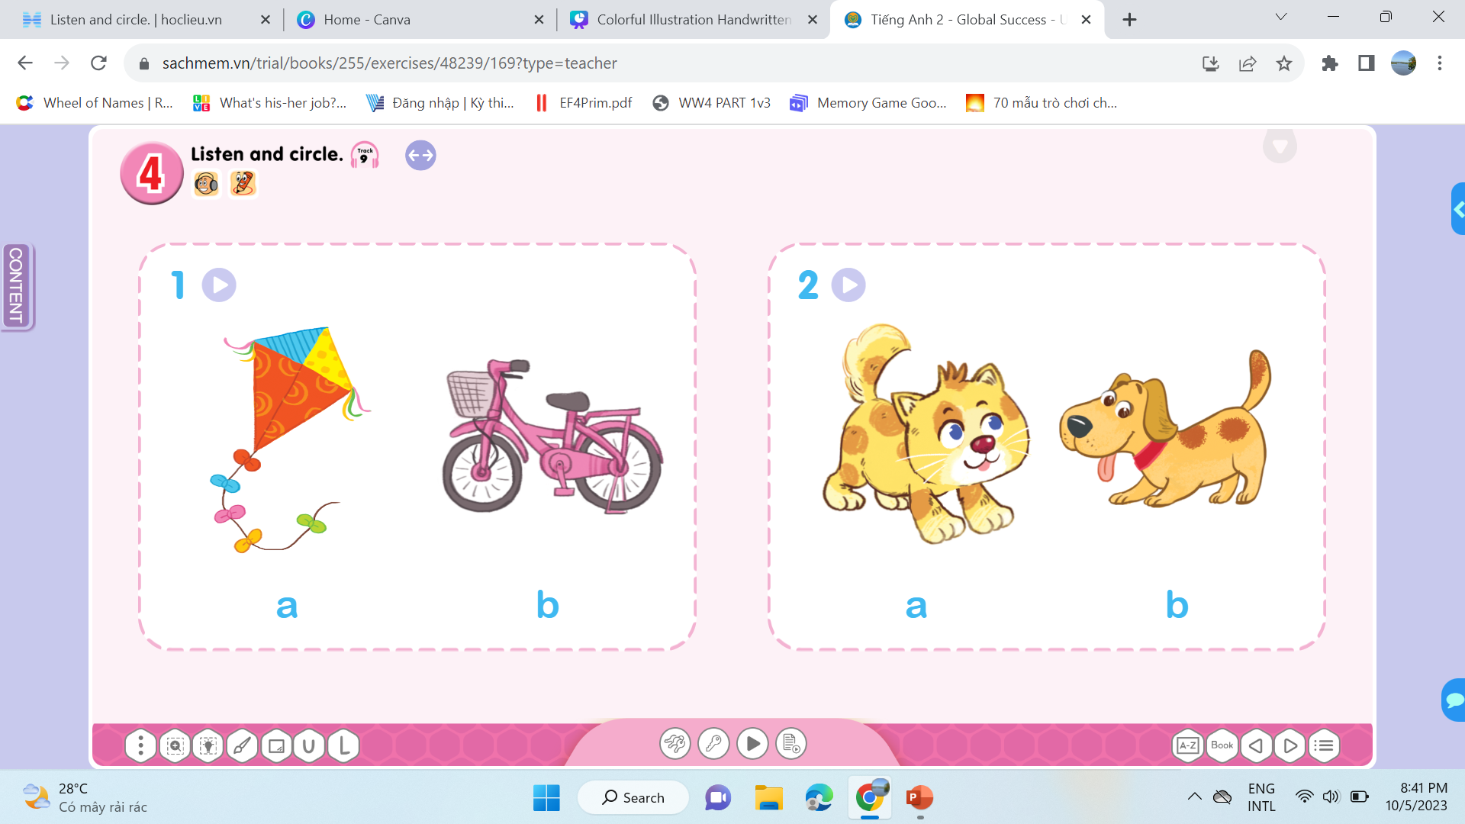
Unit
a
b
a
b

Slide 21
Unit
I have a ….

Slide 22
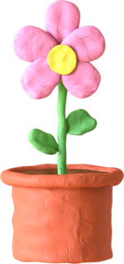
FUN CORNER
“Word Game”

Slide 23



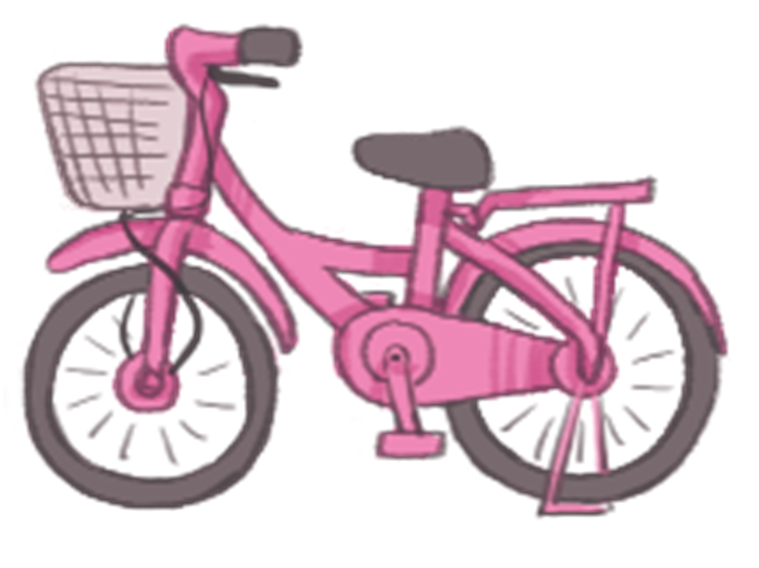
FUN CORNER
“Word Game”
Next
1
3
2
bike

Slide 24


FUN CORNER
“Word Game”
Next
1
3
2
kite

Slide 25

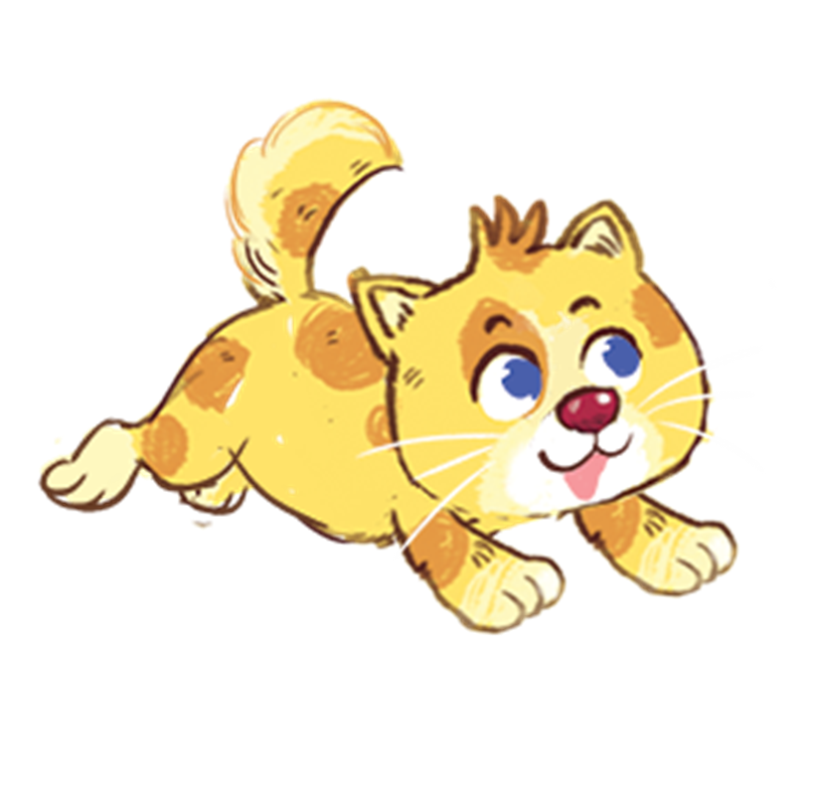
FUN CORNER
“Word Game”
Next
1
3
2
popcorn

Slide 26


FUN CORNER
“Word Game”
Next
1
3
2
pasta

Slide 27

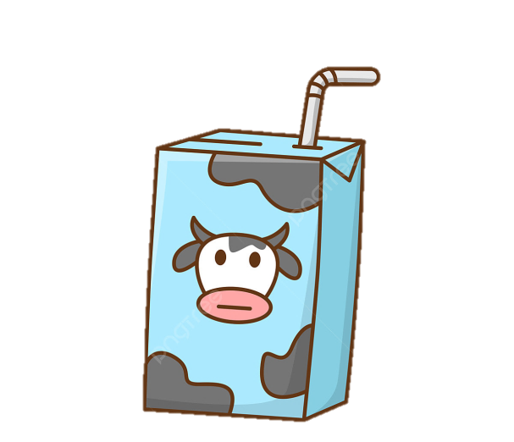
FUN CORNER
“Word Game”
Next
1
3
2
duck
milk

Slide 28




Slide 29

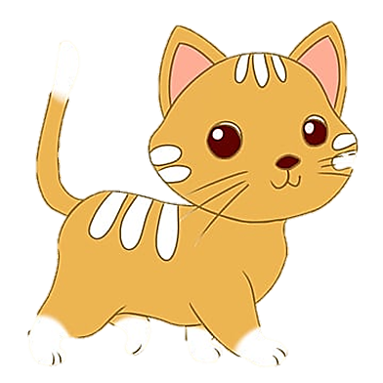

Say goodbye

Slide 30
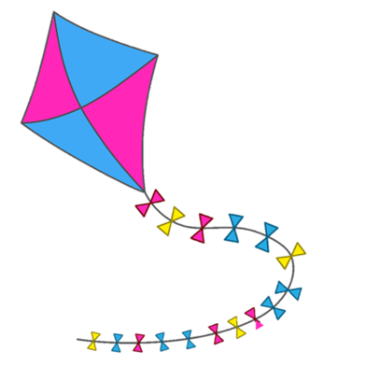
Say goodbye

Slide 31
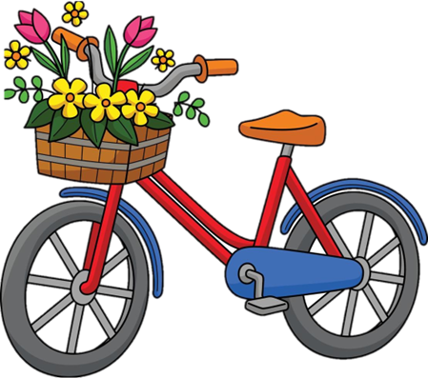
Say goodbye

Slide 32
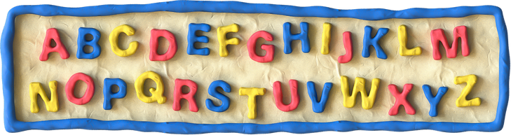
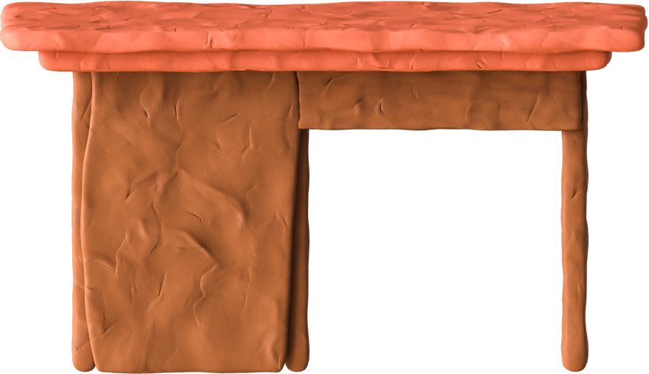
Goodbye
See you later

