Slide 1



























Unit 1:
At my birthday party
Lesson 3

Slide 2
I. OBJECTIVES
By the end of this lesson, pupils will be able to:
1. Knowledge and skills
- use the sentence structure “The _____ is yummy.” to express this feeling about a particular food.
- sing a song with the sentence structures “I like _____.” and “The _____ is yummy.”.
2. Competences
- Critical thinking and creativity: learn how to express their feelings about food correctly and fluently.
- Communication and collaboration: work in pairs or groups to complete the learning tasks.
- Self-control & independent learning: perform speaking tasks.
3. Attributes
- Show their love and interest in food.
- Show their knowledge about choosing healthy food.
- Willing to help friends.

Slide 3








  Warm-up and Review

Slide 4


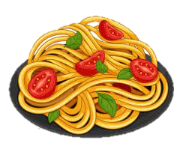
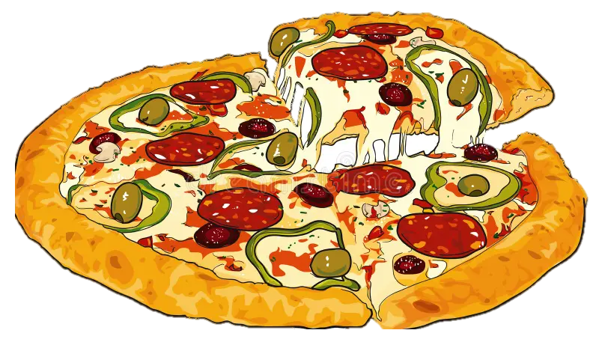

GAME
“What’s missing?”

Slide 5
GAME
“What’s missing?”

Slide 6
GAME
“What’s missing?”

Slide 7
6. Listen and repeat.

Slide 8
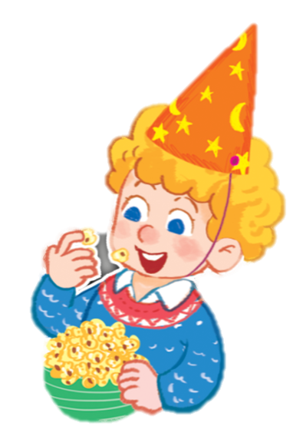

Slide 9
The popcorn is yummy.

Slide 10
7. Let’s talk

Slide 11

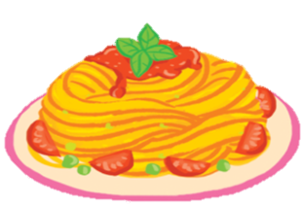
a. The pasta is yummy.

Slide 12
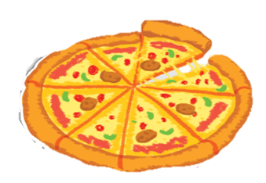
b. The pizza is yummy.

Slide 13

c. The popcorn is yummy.

Slide 14
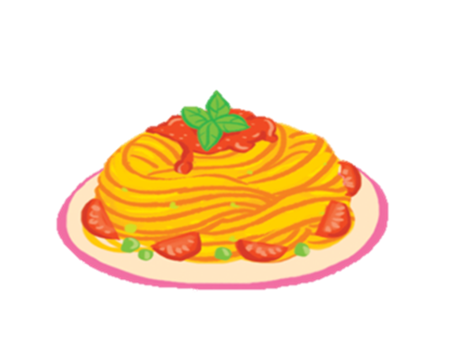

GROUPWORK
The _______ is yummy.

Slide 15

8. Let’s sing

Slide 16

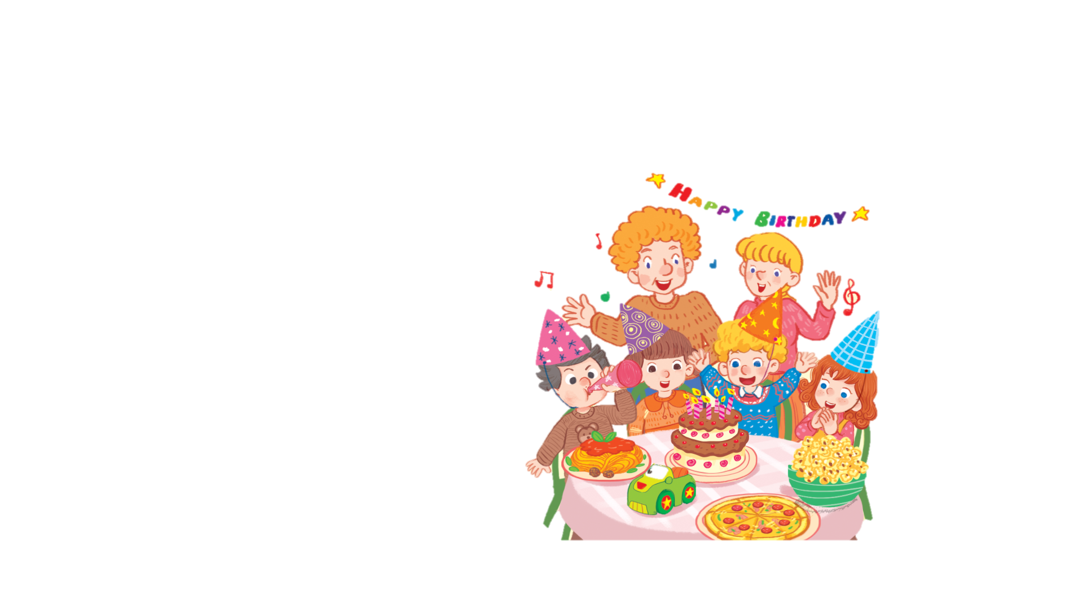

It’s my birthday party.
I like pasta.
The pasta is yummy.
I like pizza.
The pizza is yummy.
I like popcorn.
The popcorn is yummy.

Slide 17
WORK IN GROUPS

Slide 18


Slide 19
  Fun corner & wrap-up

Slide 20
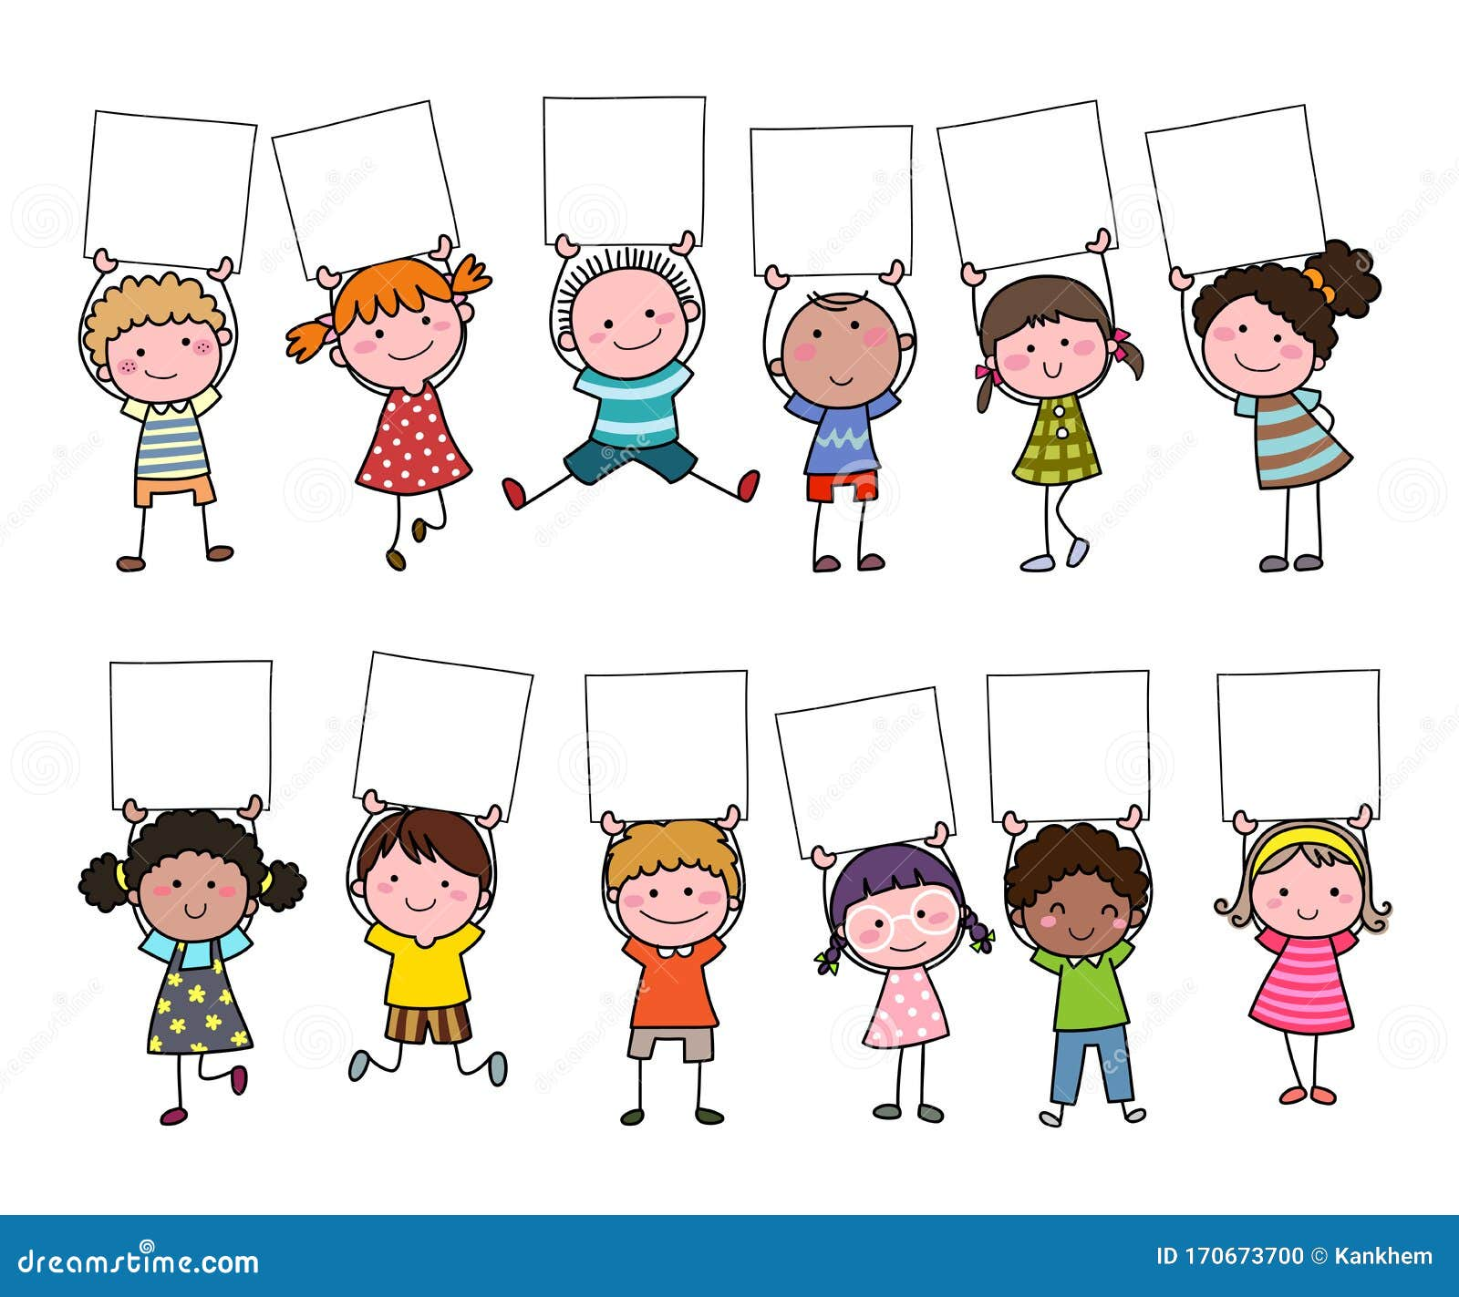
GAME
“Pass the card”
The …… is yummy.

Slide 21
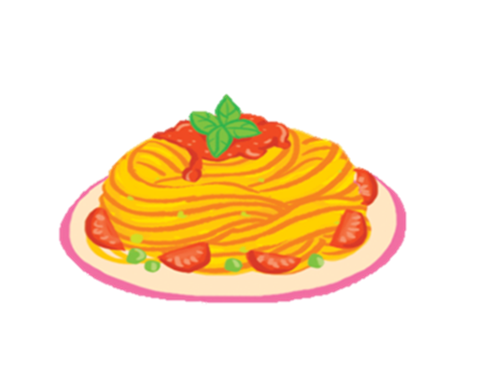


GAME
“Pass the card”

Slide 22

GAME
“Pass the card”
The popcorn is yummy.

Slide 23
GAME
“Pass the card”

Slide 24
GAME
“Pass the card”
The pasta is yummy.

Slide 25
GAME
“Pass the card”

Slide 26
GAME
“Pass the card”
The pizza is yummy.

Slide 27




Slide 28

MOVING TIME
Let’s sing and dance

Slide 29


