Slide 1


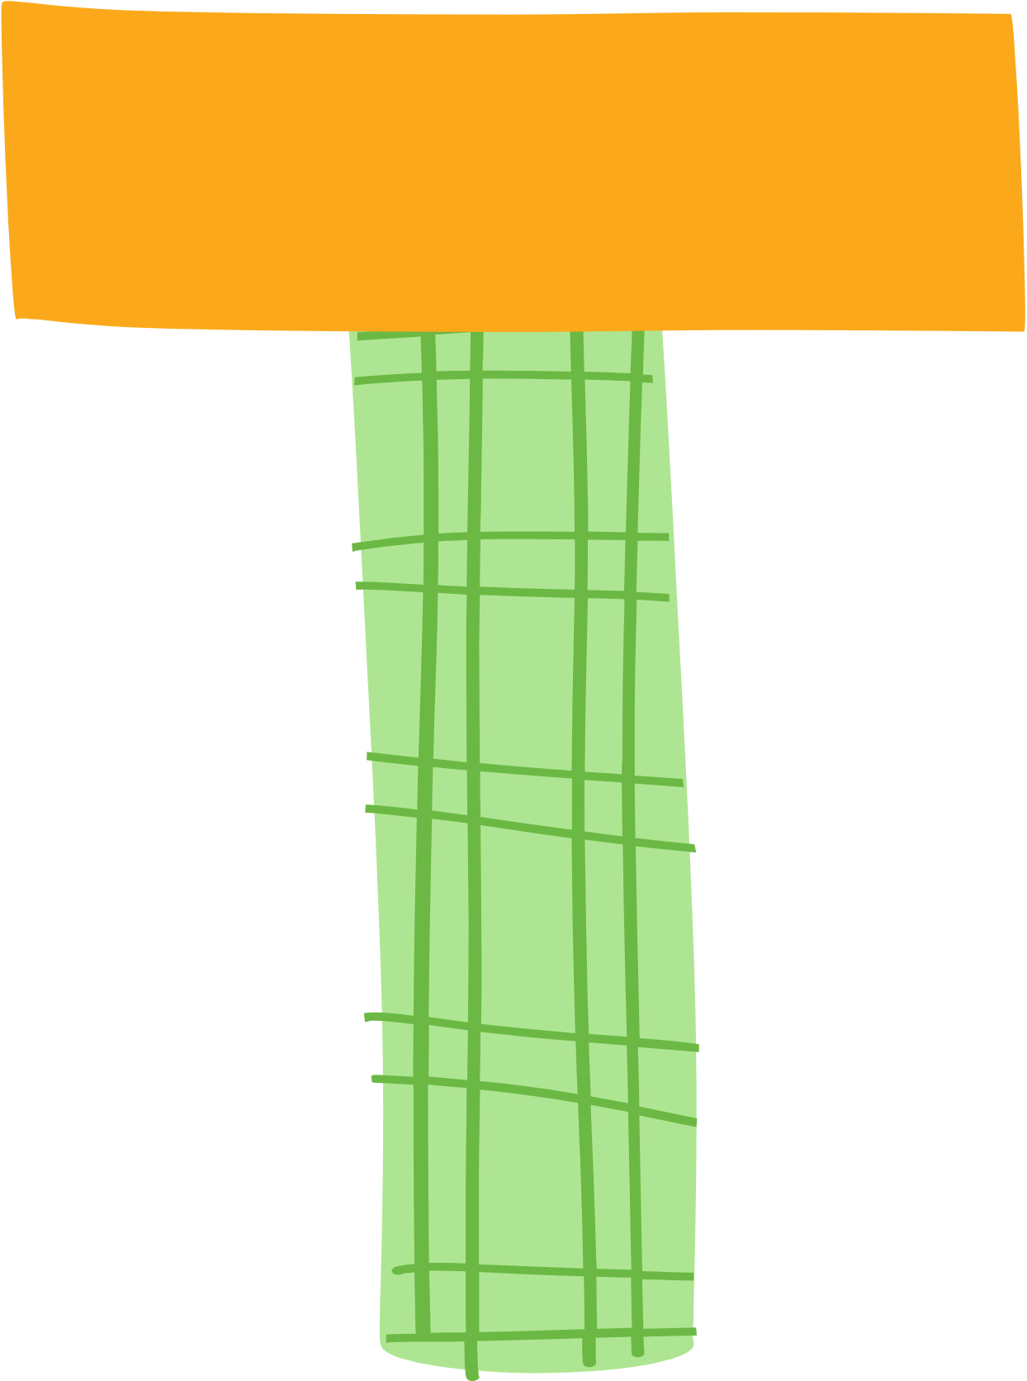
























Unit 1:
At my birthday party
Lesson 2

Slide 2
I. OBJECTIVES
By the end of this lesson, pupils will be able to:
1. Knowledge and skills
- say a chant with the sound of the letter P/p (/p/), the words pasta, pizza and popcorn and the sentence structure “I like _____.”.
- recognise target words and the sentence structure while listening.
- write the letter P/p and complete the words pasta, pizza and popcorn.
2. Competences
- Communication and collaboration: work in pairs or groups to complete the learning tasks.
- Self-control & independent learning: perform listening and writing tasks.
- Problem-solving and creativity: confidently answer appropriate questions.
3. Attributes
- Show their love and interest in food.
- Show their knowledge about choosing healthy food.

Slide 3
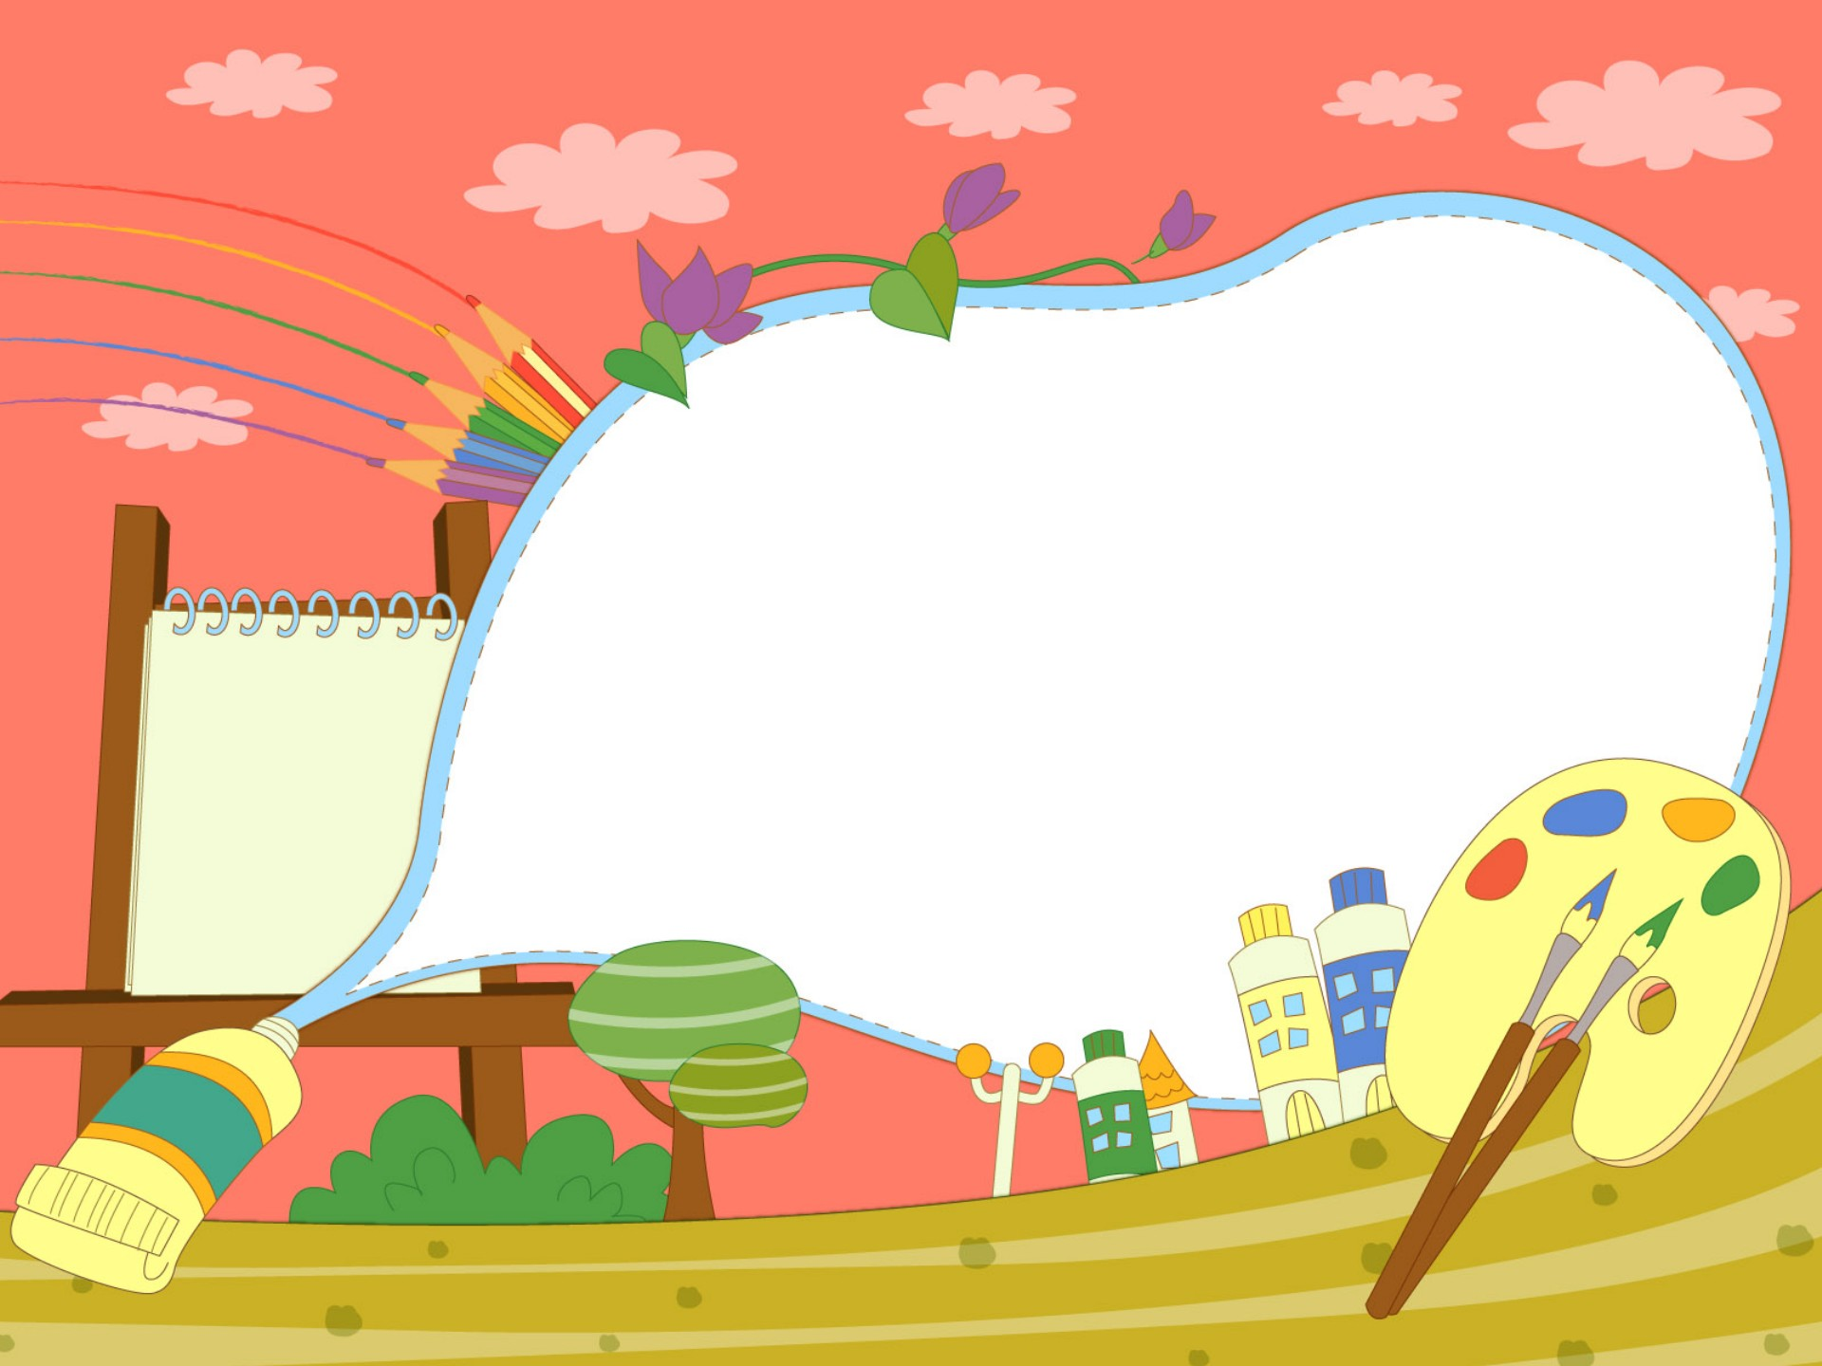

Warm-up and review

Slide 4



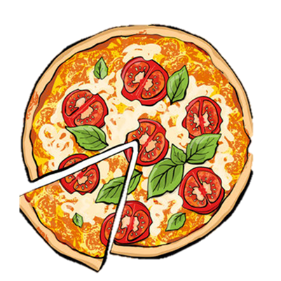

“Guess the picture”
  pizza

Slide 5

“Guess the picture”
  popcorn

Slide 6
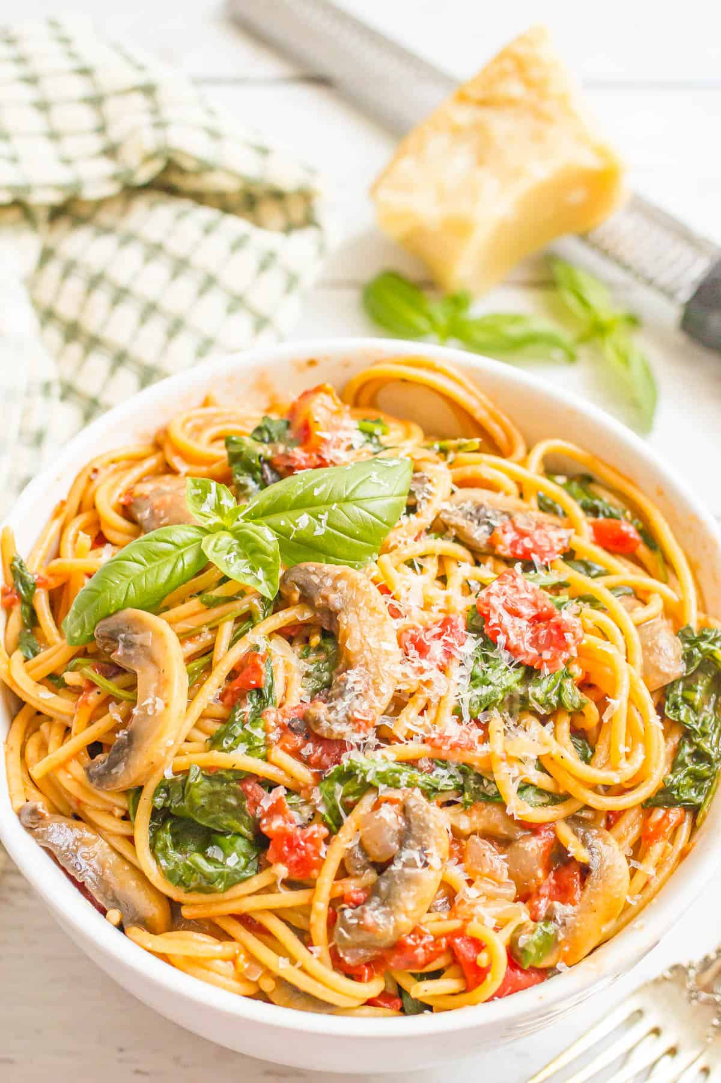
“Guess the picture”
  pasta

Slide 7

Listen and chant.

Slide 8
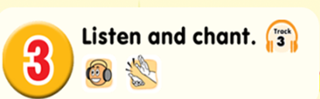
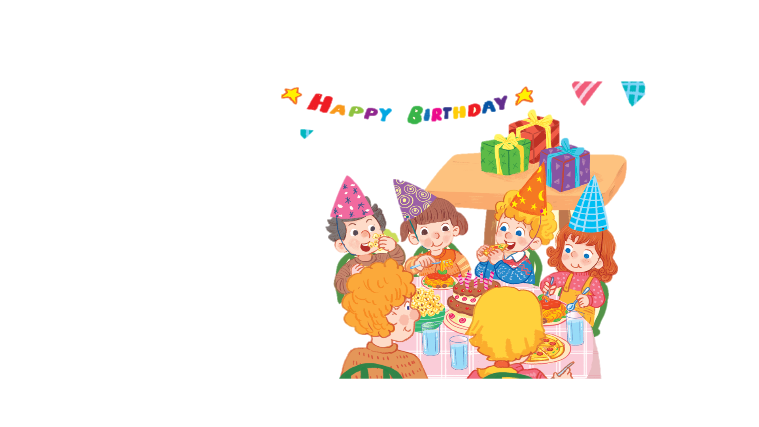

Slide 9

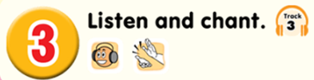
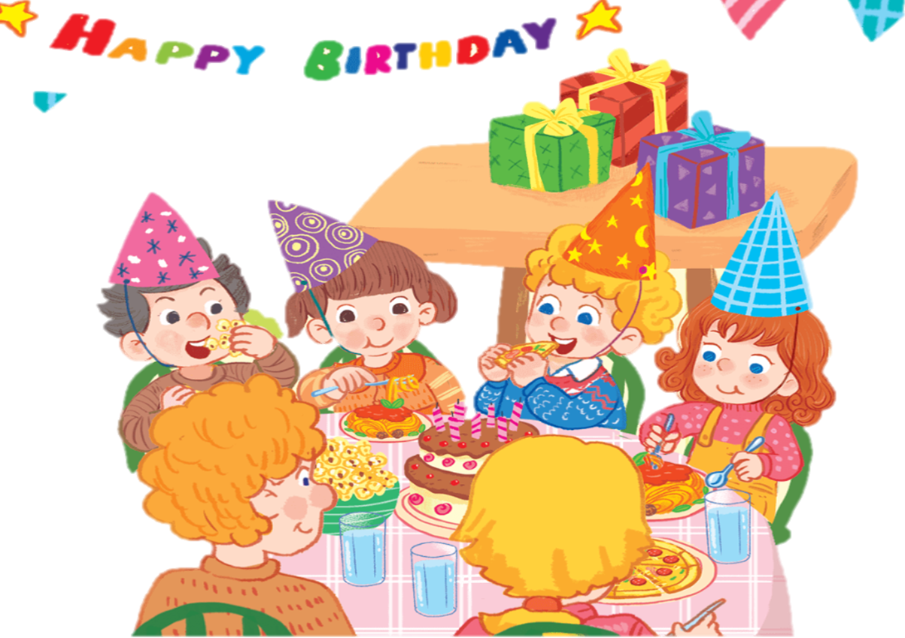
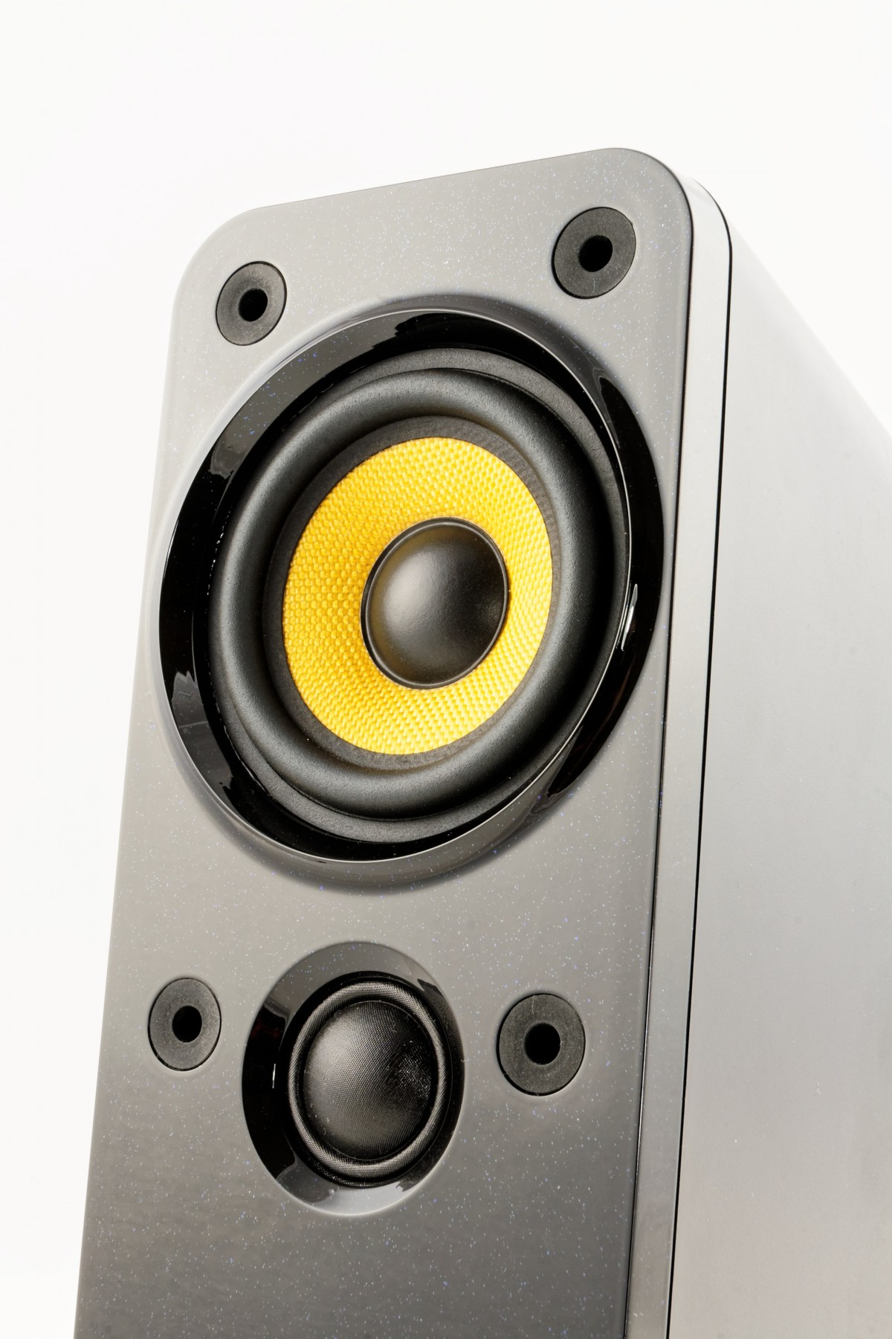
P, p, pasta.
P, p, pizza.
P, p, popcorn.
I like pasta.
I like pizza.
I like popcorn.
Yummy, yummy, yummy.
Notes:
Click to see each line
Click each line to hear the sound
Click the speaker to hear the whole chant

Slide 10


  WORK IN GROUPS

Slide 11


Slide 12






SPINNING WHEEL

Slide 13


Slide 14
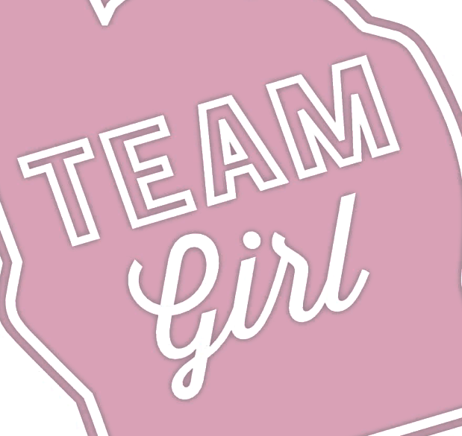

Slide 15

Let’s chant

Slide 16

Listen and tick

Slide 17
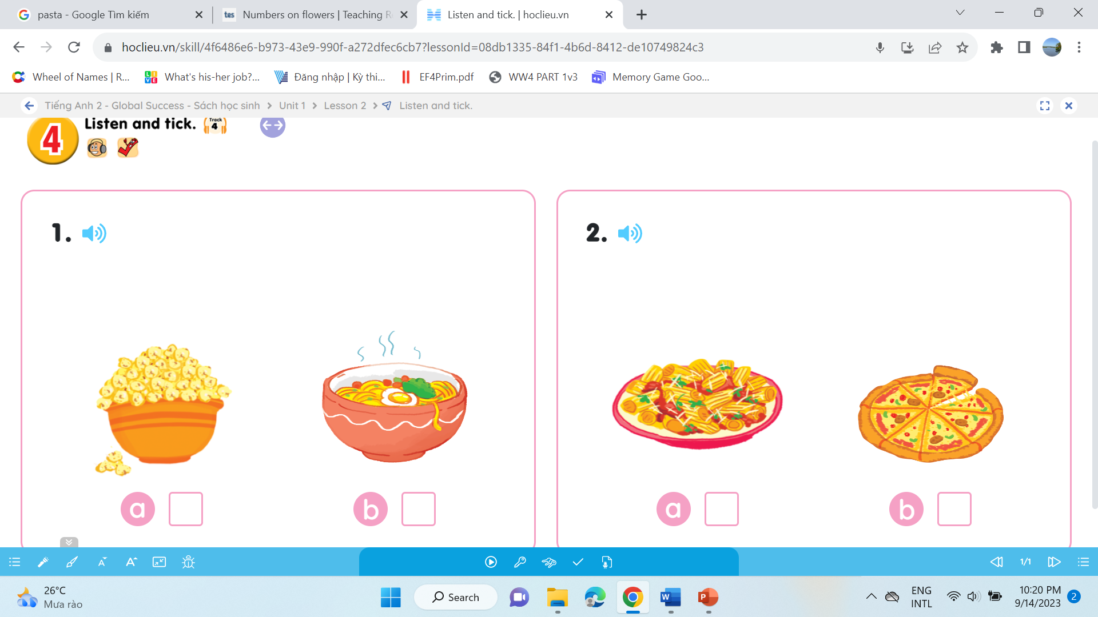
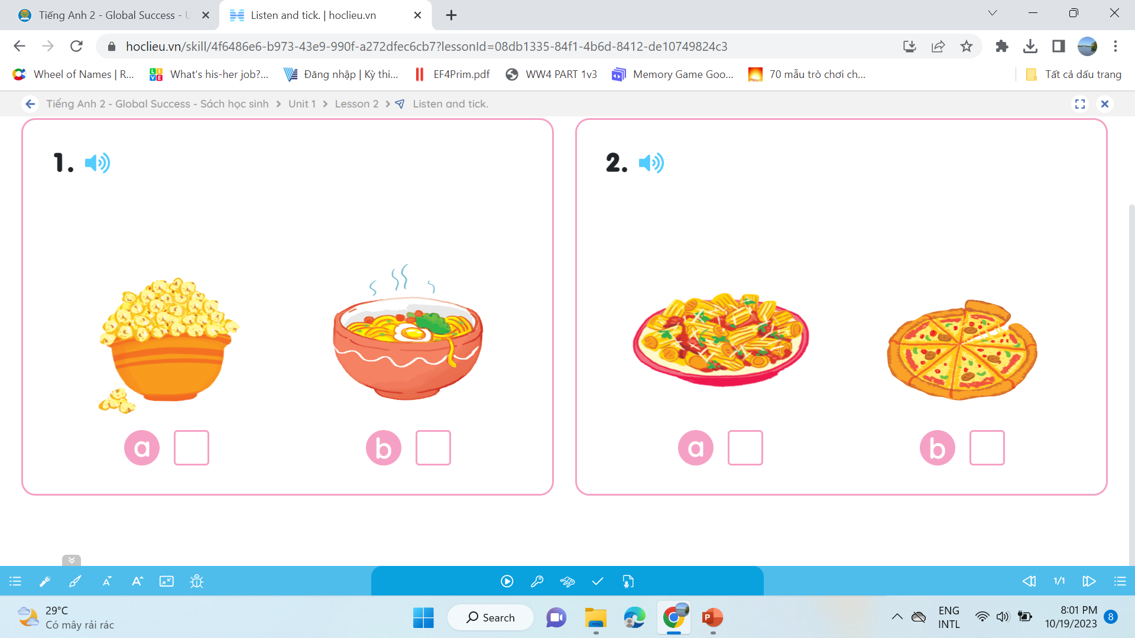
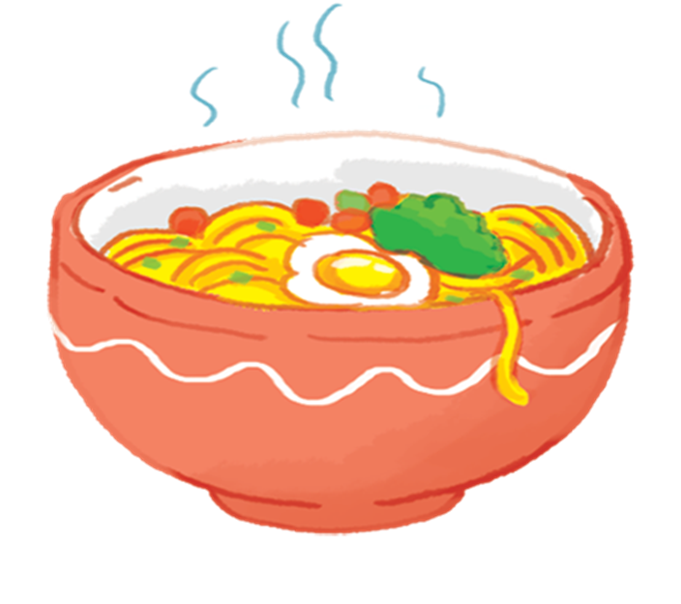
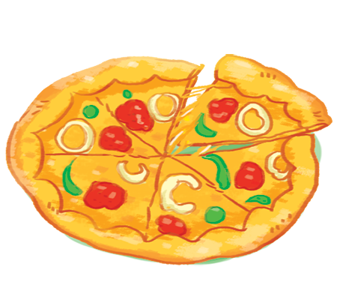



1.
2.
a
b
a
b

Slide 18

Look and write

Slide 19


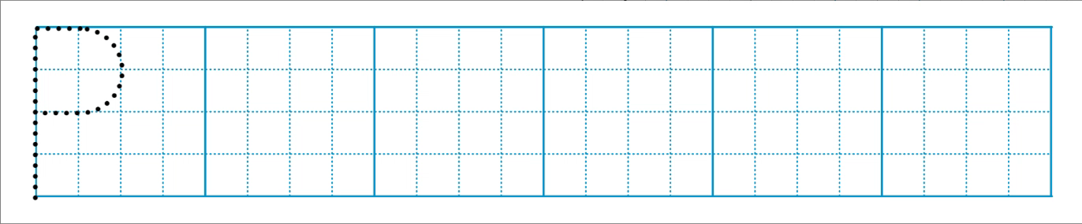

Slide 20
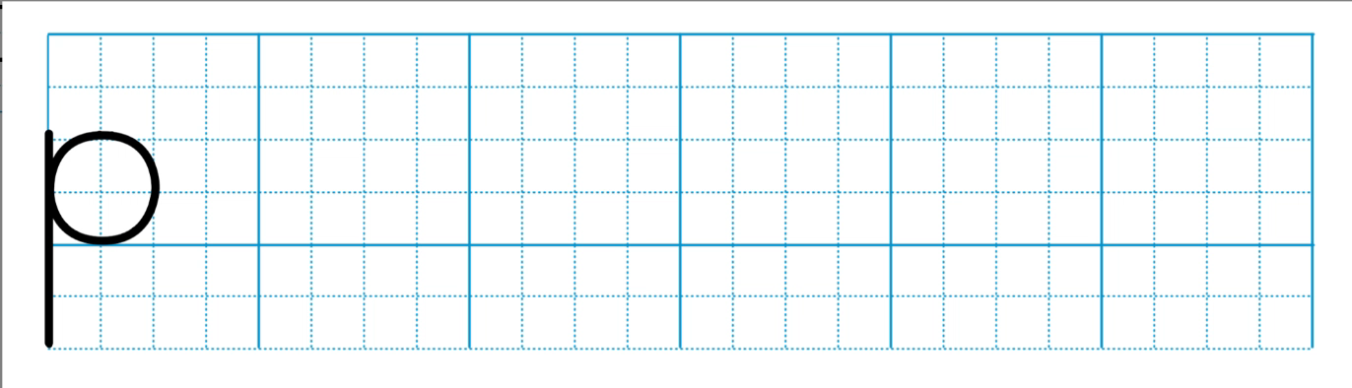

Slide 21
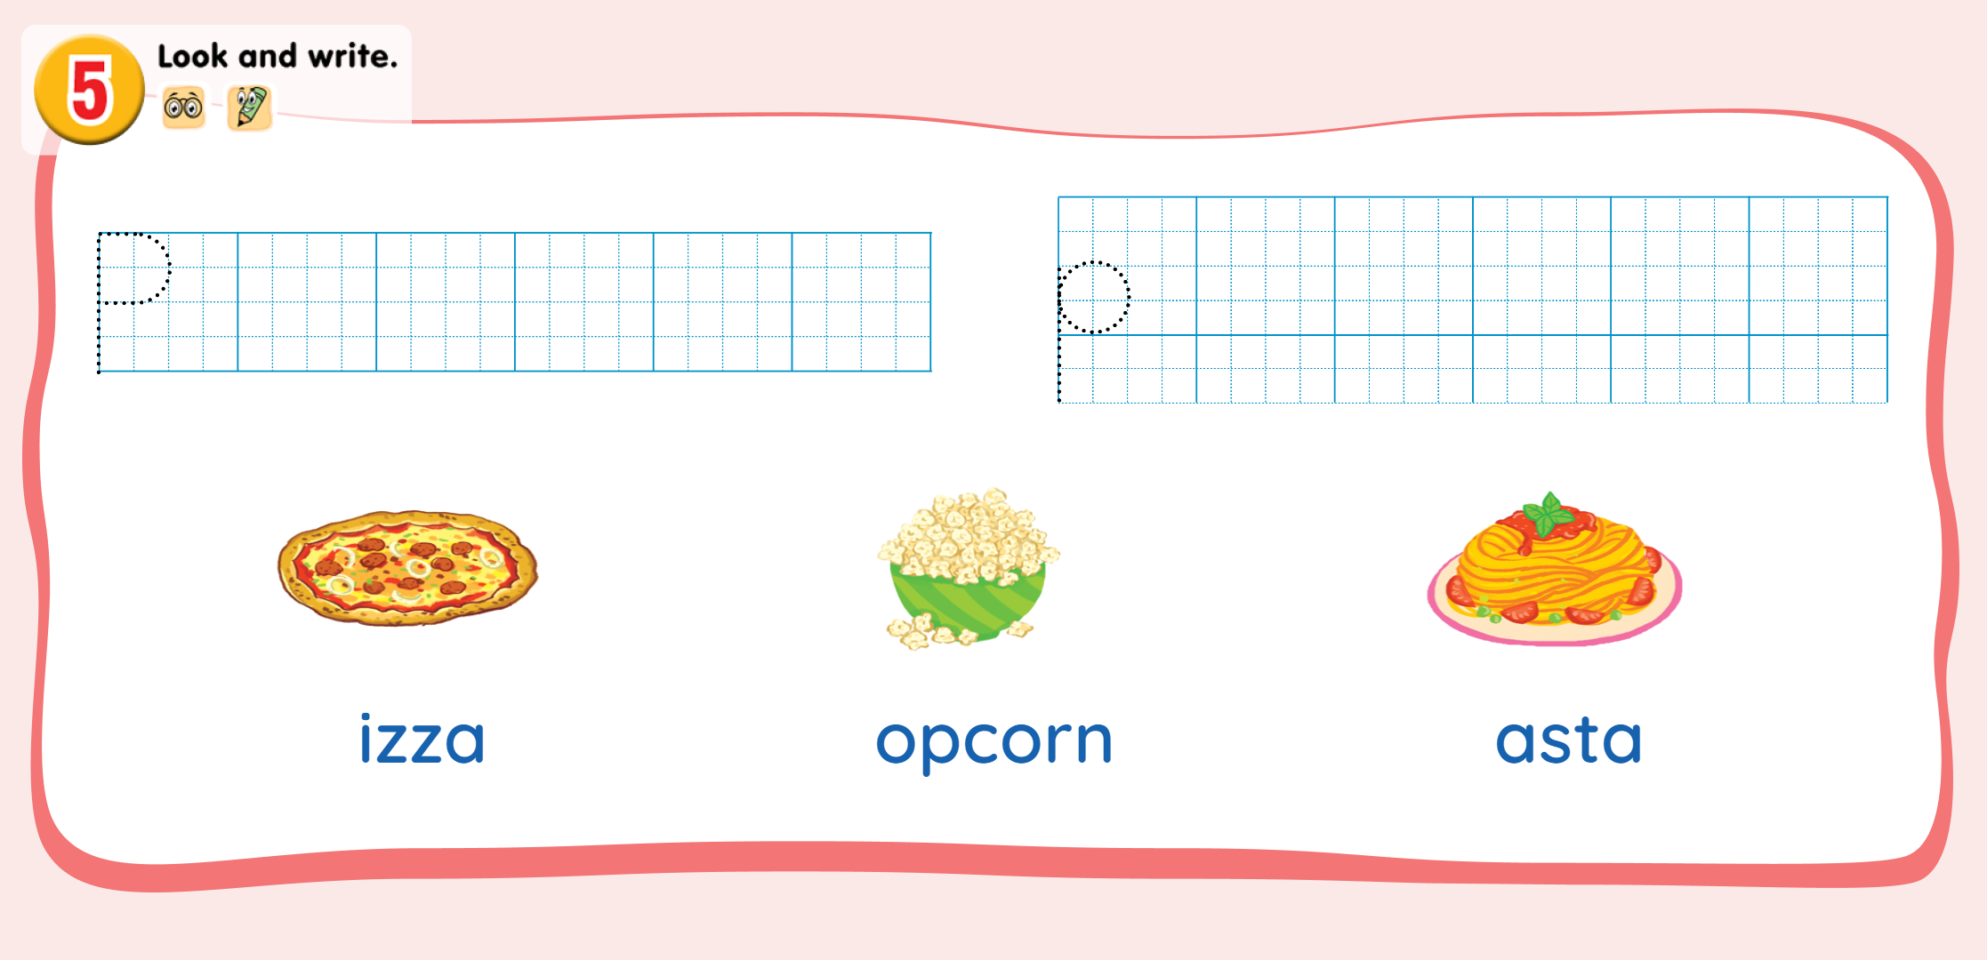
p
p
p

Slide 22

Fun corner
& Wrap-up

Slide 23


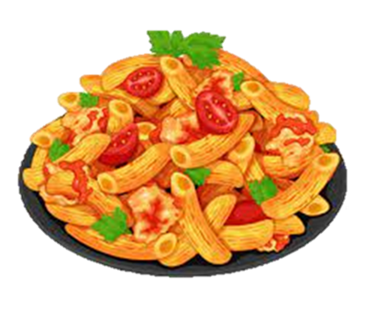

Game
“Slap the board”
Notes:
Listen to the audio first then click the pictures

Slide 24

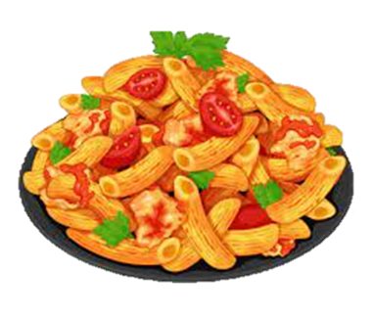

Game
“Slap the board”

Slide 25



Game
“Slap the board”

Slide 26


Game
“Slap the board”

Slide 27


Game
“Slap the board”

Slide 28


