Slide 1


Slide 2
I. OBJECTIVES.
By the end of the lesson, pupils will be able to:
- Repeat and understand a short story
- Identify and say the words they have learnt
1. Language.
Vocabulary: pasta, pizza, kite, bike, kitten, sail, sea, rainbow, road
Structures: Is he/she _____ (verb + –ing)?
Yes, he/she is. / No, he/she isn’t. to ask and answer questions about actions in progress. Let’s look at the _____! to suggest doing something. What can you see?
I can see a _____. to describe features of a scene.

Slide 3







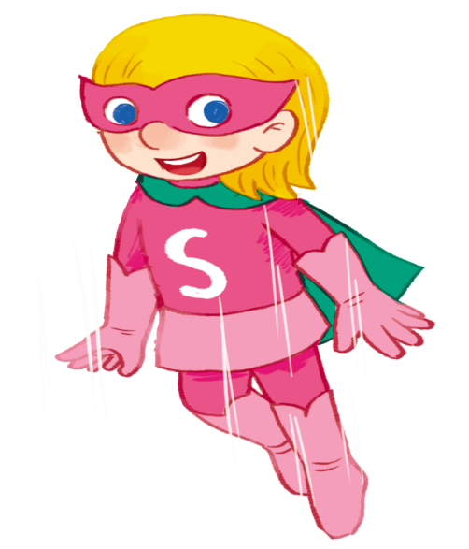
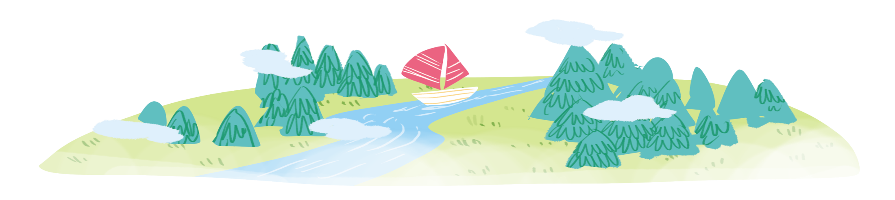
Listen and read.
… and I’m Super Sue!
Hi! I’m Phonic Phil!
… and I’m
Super Sue!
Hi! I’m
Phonic Phil!

Slide 4

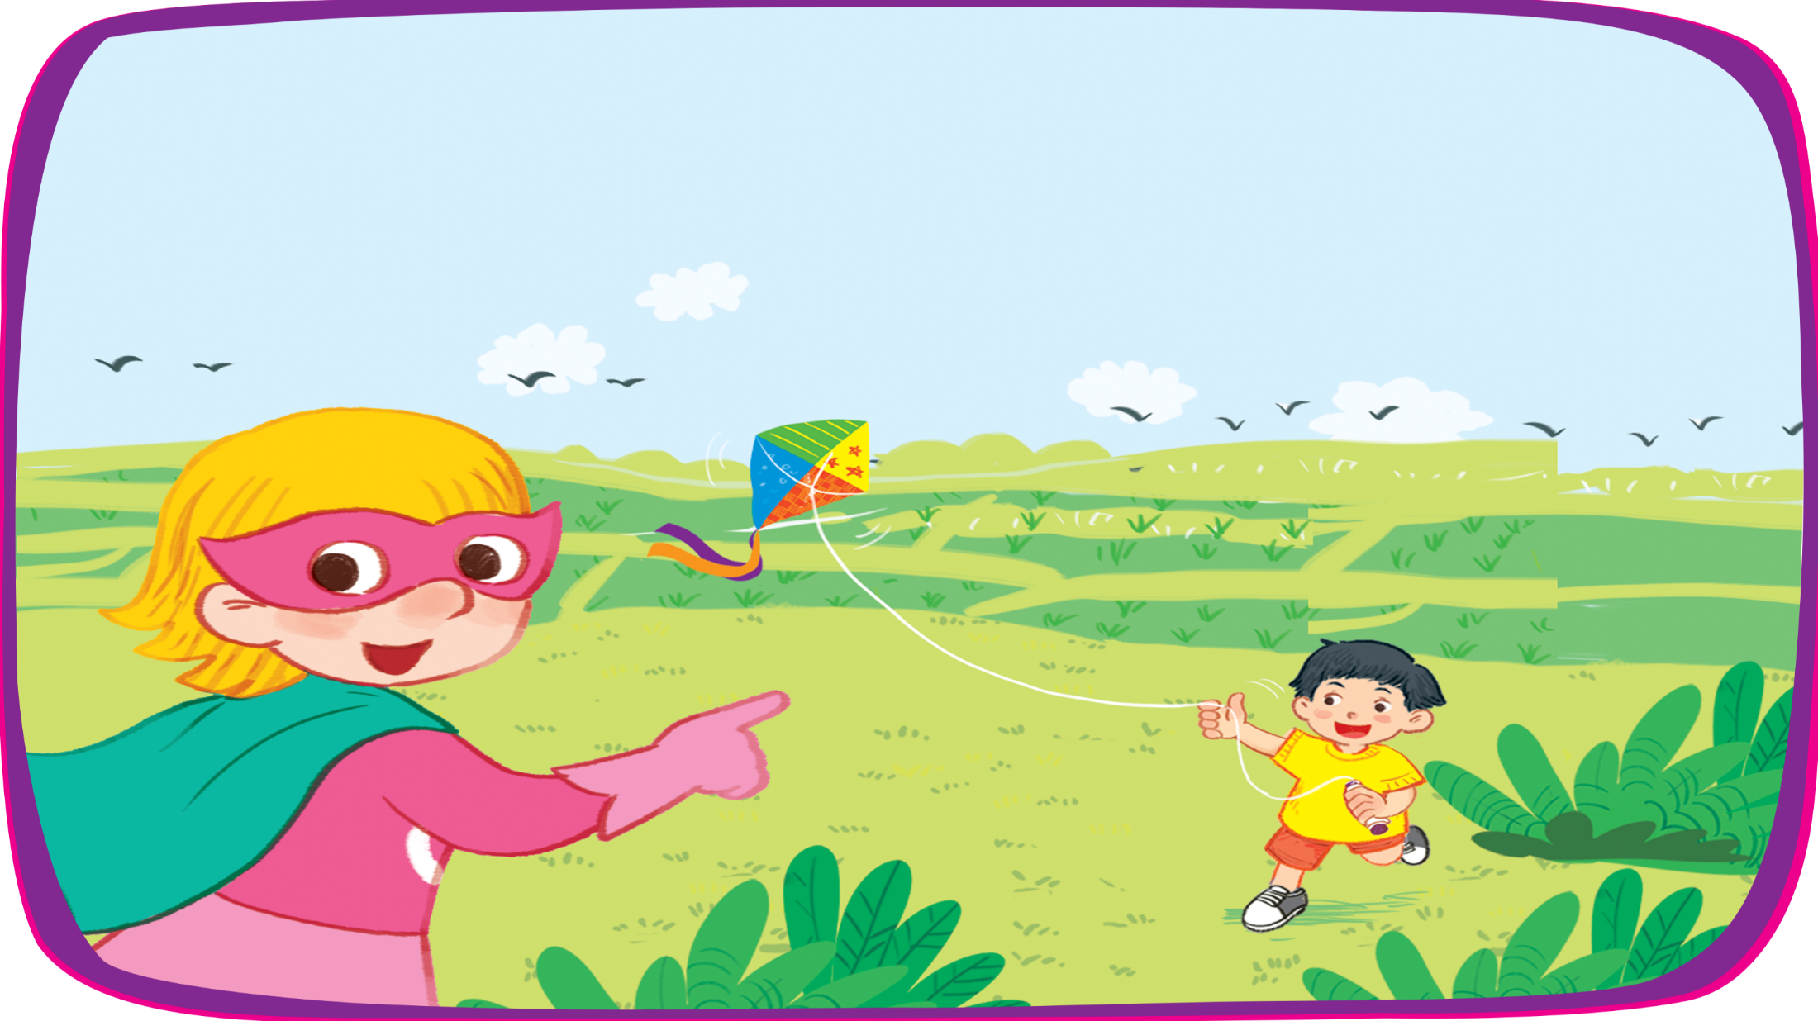

Look! Ba’s flying a kite!
Look! Ba’s flying
a kite!

Slide 5

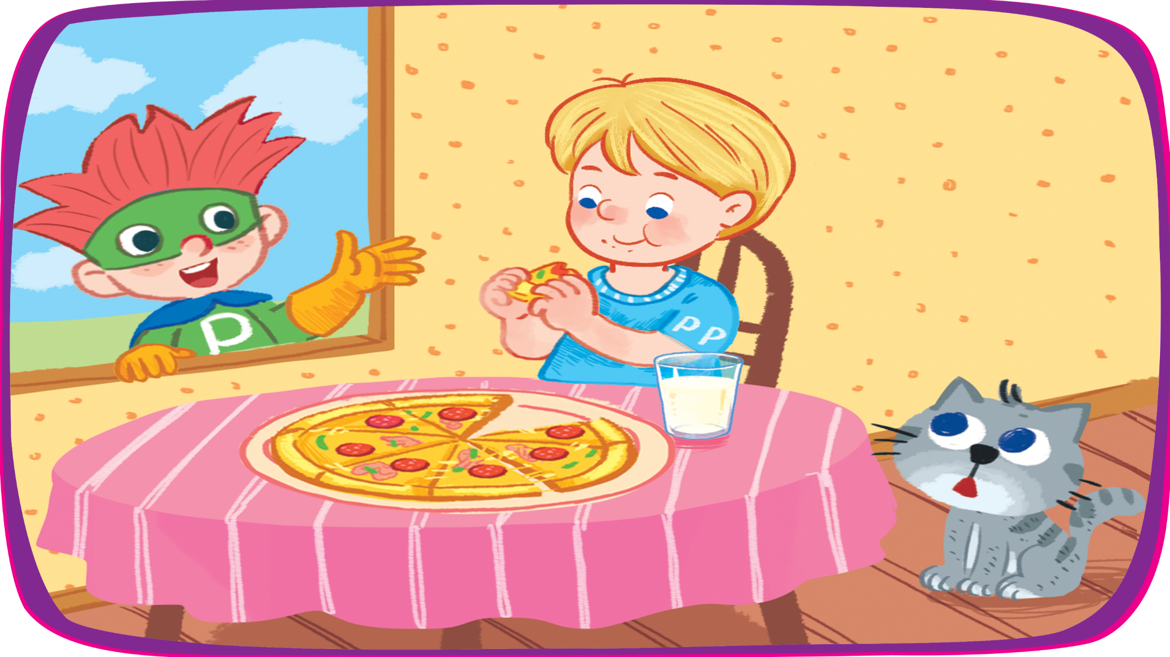
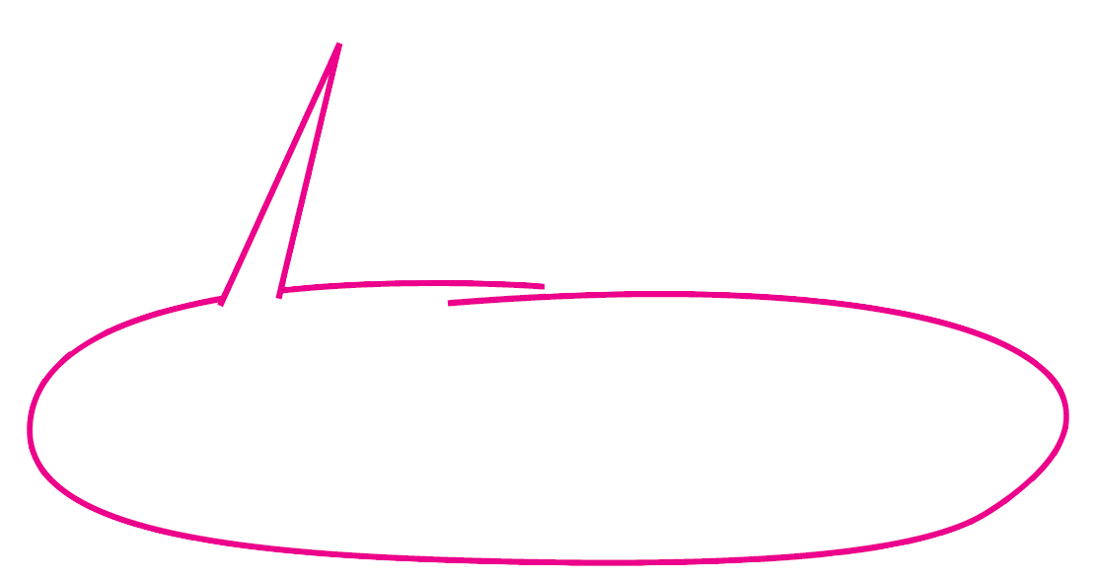
Look! Ken’s having a big pizza!
Look! Ken’s having a big pizza!

Slide 6

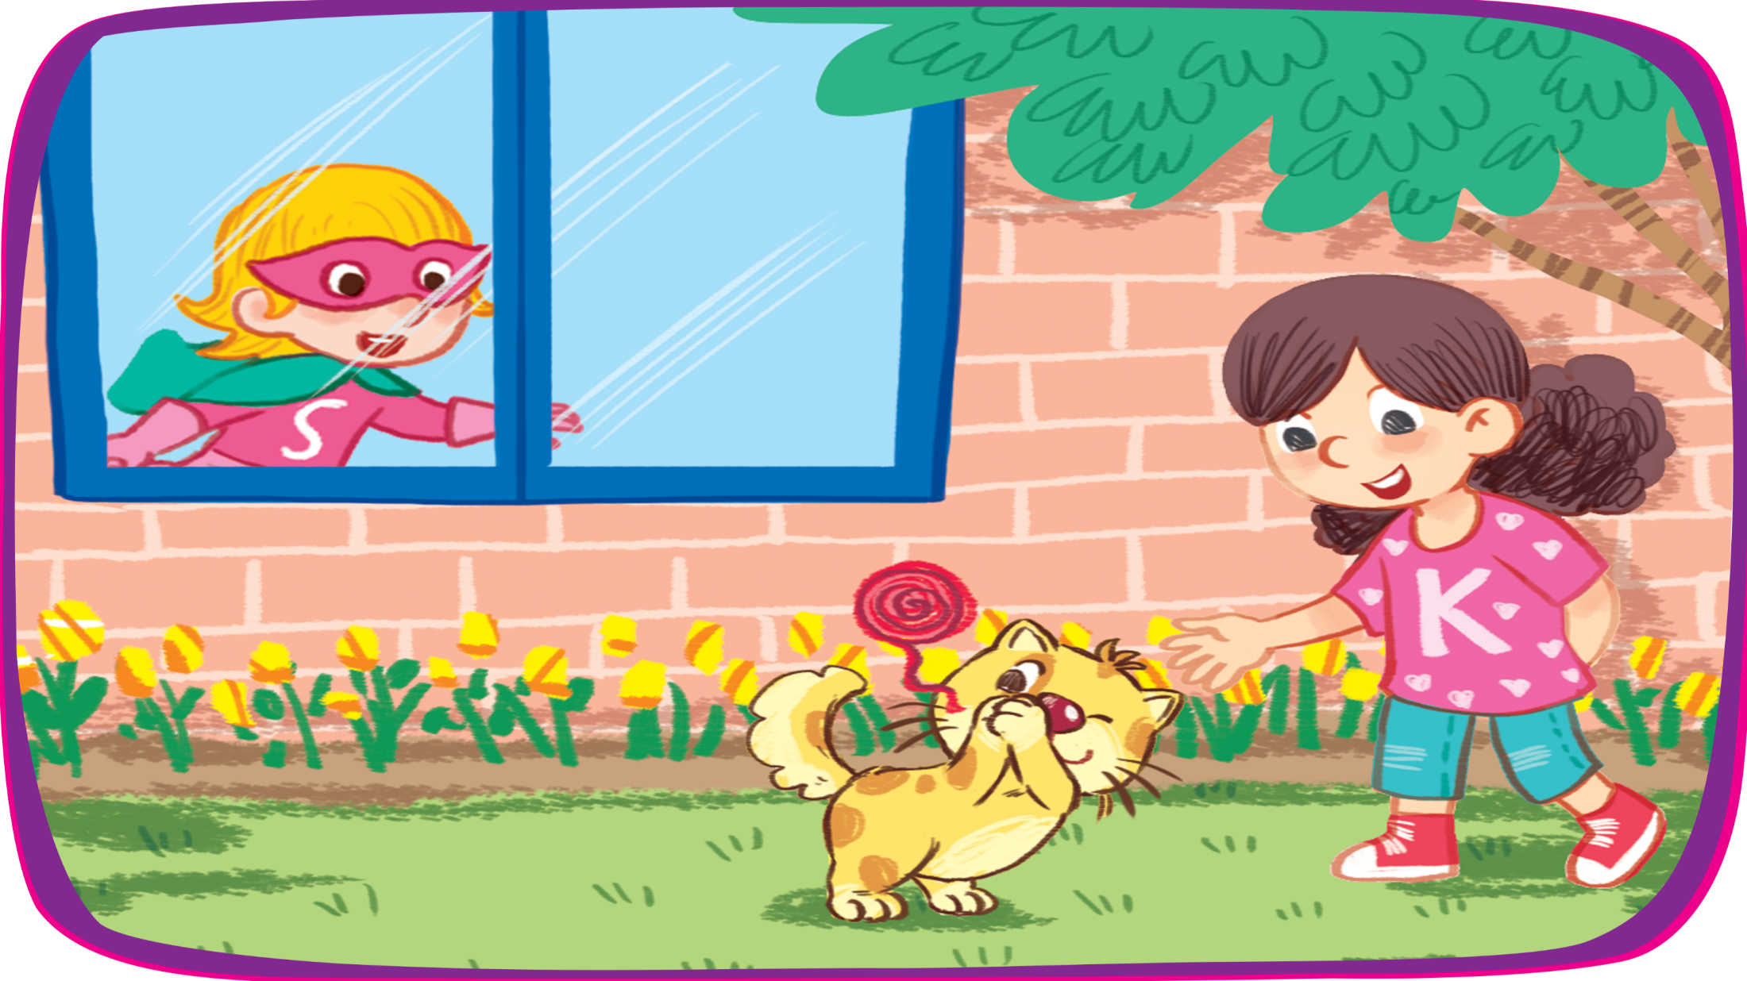

Look! Kate’s playing with a kitten!
Look! Kate’s playing with a kitten!

Slide 7

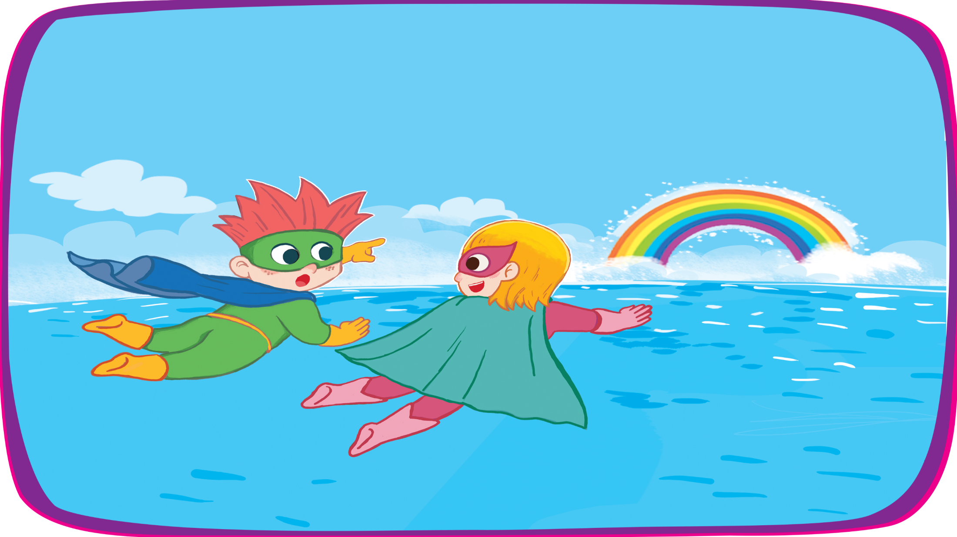



Let’s look at the sea!
Let’s look at the sea!
What can you see?
I can see a rainbow.
What can you see?
I can see a rainbow.

Slide 8



Look again and circle.
bike
pasta
pizza
sail
sea
rainbow
road
kitten

Slide 9




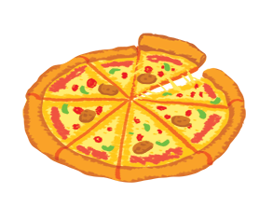
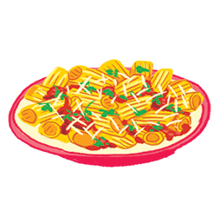



3. Listen and tick.
1
2
3

Slide 10


1


Slide 11
2


Slide 12
3


Slide 13

4. Listen and circle.
1
s
r
2
r
p
3
p
k
4
s
k

Slide 14



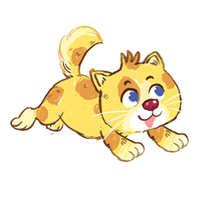

5. Write and say.
1
p
opcorn
2
k
itten
3
s
and
4
r
ainbow

Slide 15


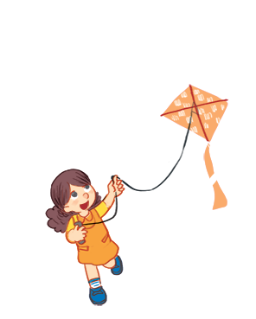

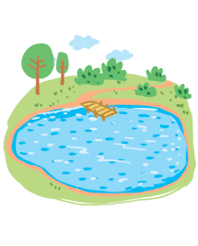
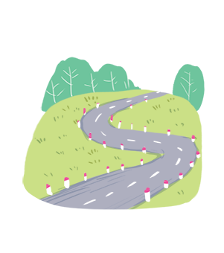
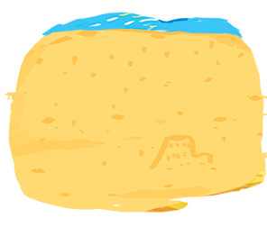
6. Read and tick.
1
Let’s look at the river!
2
A: Is she flying a kite?
B: Yes, she is.
3
A: What can you see?
B: I can see a road.

Slide 16
1
Let’s look at the river!


Slide 17
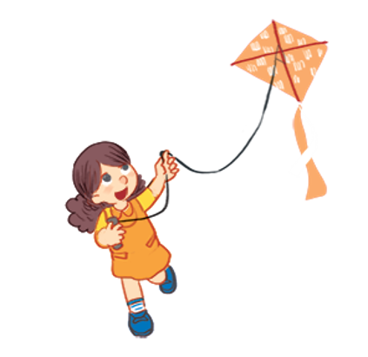
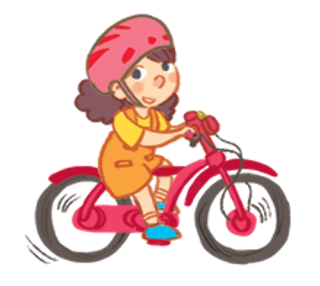
Let’s look at the river!
2
A: Is she flying a kite?
B: Yes, she is.


Slide 18
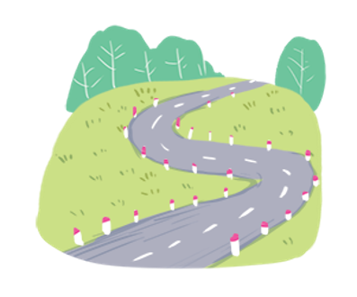
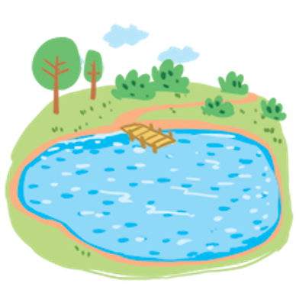
3
A: What can you see?
B: I can see a road.


Slide 19


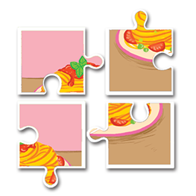

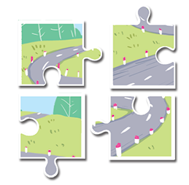
7. Guess, read and circle. Then say.
1
2
3

Slide 20

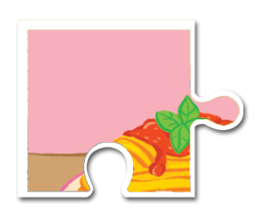
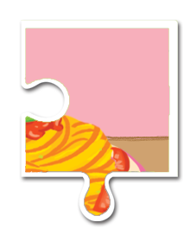
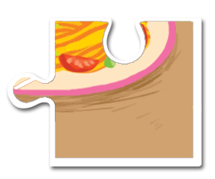
1
a.
The pasta is yummy.
b.
The pizza is yummy.

Slide 21




2
a.
I can see a sail.
b.
I can see a rainbow.

Slide 22



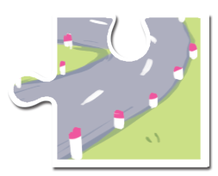
3
a.
Let’s look at the sea!
b.
Let’s look at the road!

Slide 23
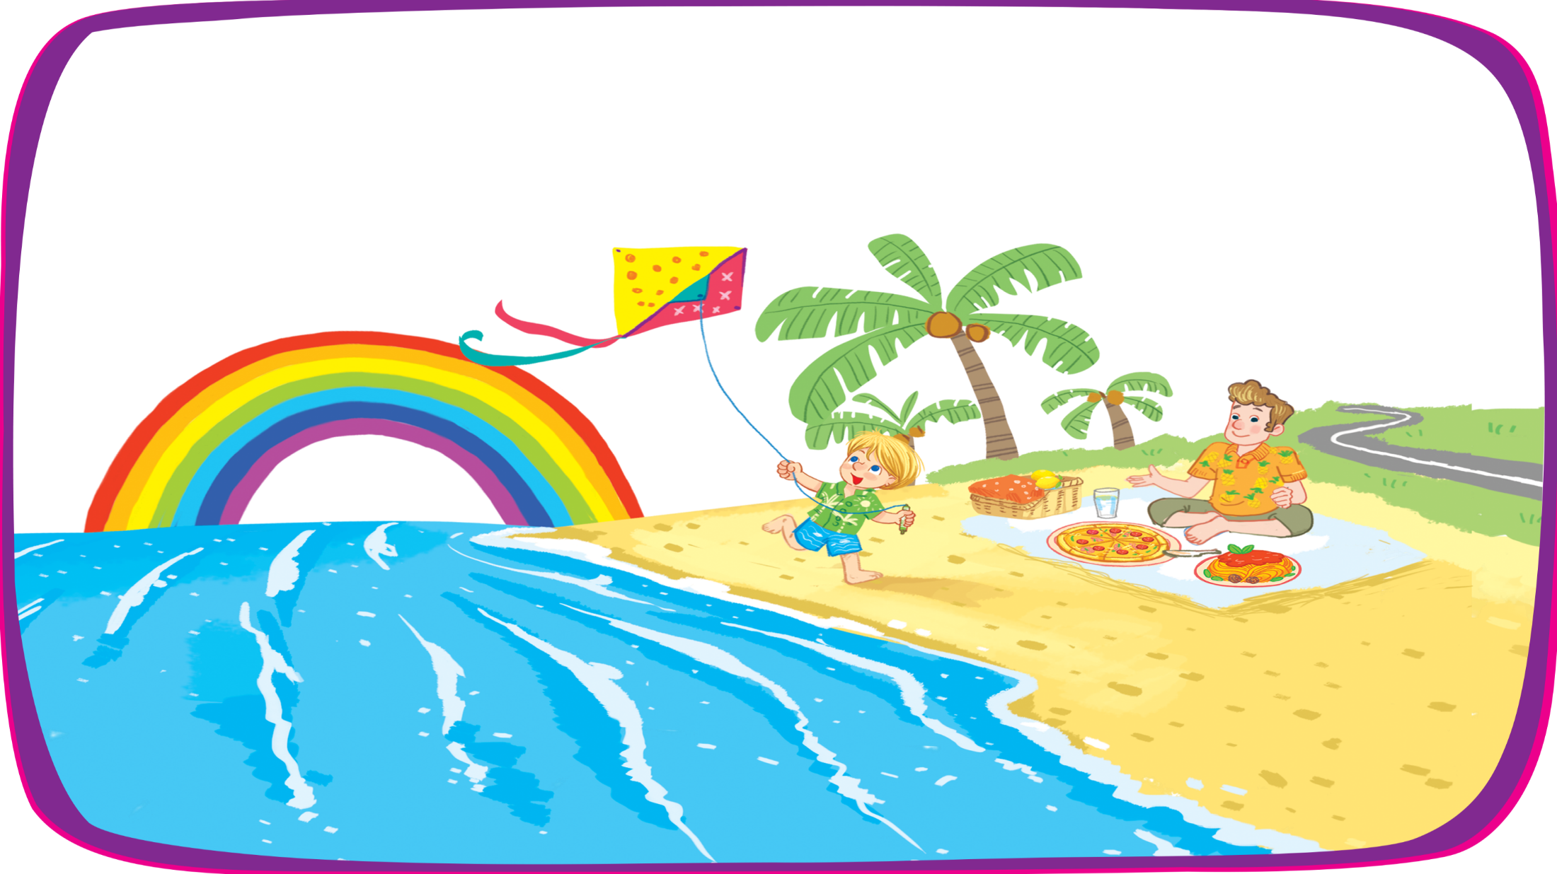
8.Write the words.
k
t
e
i
ainbow
r
r
o
a
d
p
a
s
t
a
i
p
z
z
a
s
e
a

