Slide 2

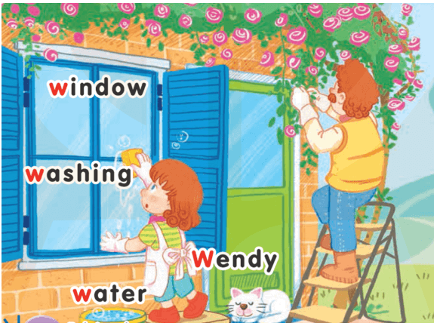
1-Listen and repeat
UNIT 16:
AT HOME
LESSON 1
Ww
Washing: rửa
Water: nước
Window: cửa sổ
Wendy

Slide 3
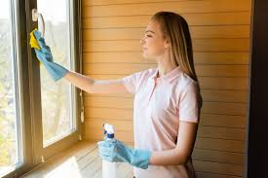
2-Point and say
UNIT 16:
AT HOME
LESSON 1
washing

Slide 4

2-Point and say
UNIT 16:
AT HOME
LESSON 1
water

Slide 5

2-Point and say
UNIT 16:
AT HOME
LESSON 1
window

Slide 6

2-Point and say
UNIT 16:
AT HOME
LESSON 1
Wendy

Slide 7
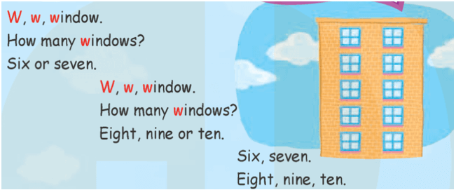
LESSON 2
3-Listen and chant

Slide 8
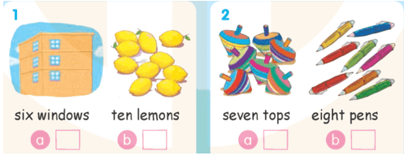
4-Listen and tick
√
√

Slide 9
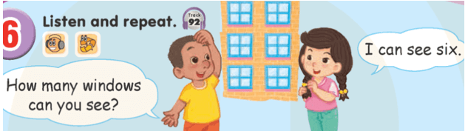
LESSON 3
6-Listen and repeat

Slide 10
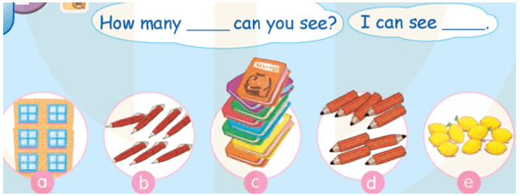
7-Let’s talk

Slide 11


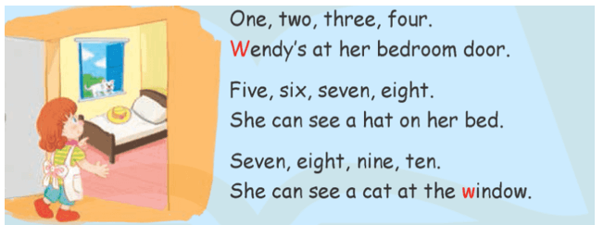
8-Let’s sing!

Slide 12
Goodbye
!
Goodbye!
washing

Slide 13
Goodbye
!
Goodbye!
water

Slide 14
Goodbye
!
Goodbye!
window

Slide 15
Goodbye
!
Goodbye!
Wendy

