Slide 2

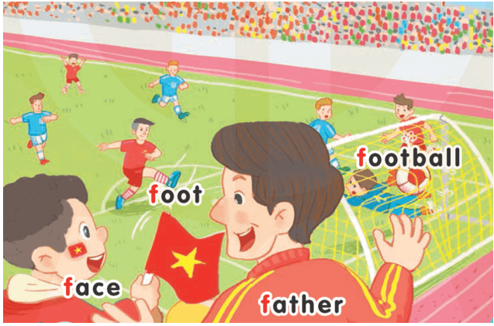
1-Listen and repeat
UNIT 15:
AT THE FOOTBALL MATCH
Ff
LESSON 1
Face: mặt
Foot: chân
Father: bố
Football: bóng đá

Slide 3
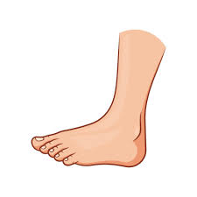
2-Point and say
UNIT 15:
AT THE FOOTBALL MATCH
LESSON 1
foot

Slide 4
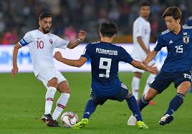
2-Point and say
UNIT 15:
AT THE FOOTBALL MATCH
LESSON 1
football

Slide 5

2-Point and say
UNIT 15:
AT THE FOOTBALL MATCH
LESSON 1
father

Slide 6

2-Point and say
UNIT 15:
AT THE FOOTBALL MATCH
LESSON 1
face

Slide 7

LESSON 2
3-Listen and chant

Slide 8
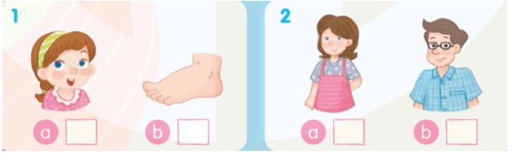
4-Listen and tick
√
√

Slide 9
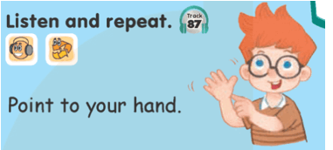
LESSON 3
6-Listen and repeat

Slide 10
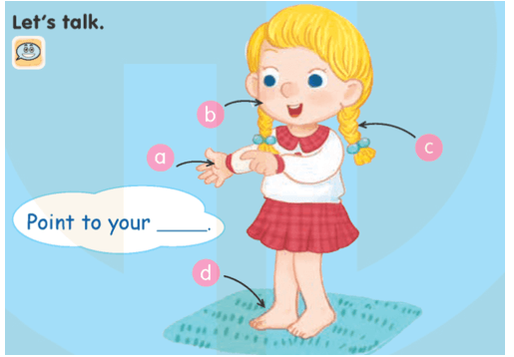
7-Let’s talk

Slide 11


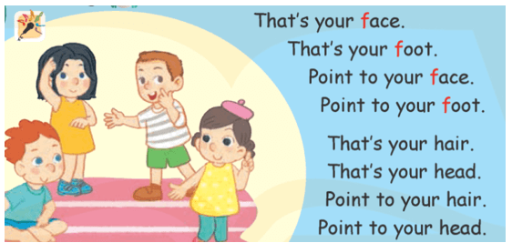
8-Let’s sing!

Slide 12
Goodbye
!
Goodbye!
foot

Slide 13
Goodbye
!
Goodbye!
football

Slide 14
Goodbye
!
Goodbye!
father

Slide 15
Goodbye
!
Goodbye!
face

