Slide 2
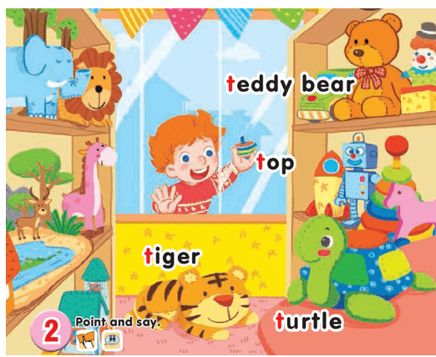

1-Listen and repeat
UNIT 14:
IN THE TOY SHOP
LESSON 1
Tt
Tiger: con hổ
Teddy bear: gấu bông
Top: con quay
Turtle: con rùa

Slide 3
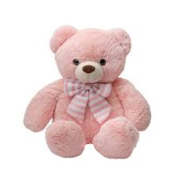
UNIT 12:
IN THE TOY SHOP
LESSON 1
Teddy bear

Slide 4
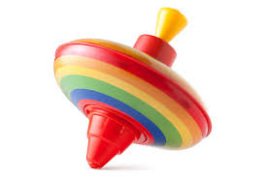
UNIT 12:
IN THE TOY SHOP
LESSON 1
top

Slide 5
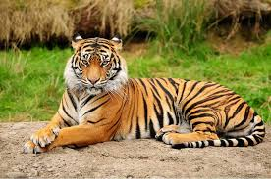
UNIT 12:
IN THE TOY SHOP
LESSON 1
tiger

Slide 6

UNIT 12:
IN THE TOY SHOP
LESSON 1
Turtle

Slide 7
UNIT 12:
IN THE TOY SHOP
LESSON 1
Teddy bear: gấu bông
Top: con quay
Tiger: con hổ
Turtle: con rùa

Slide 8
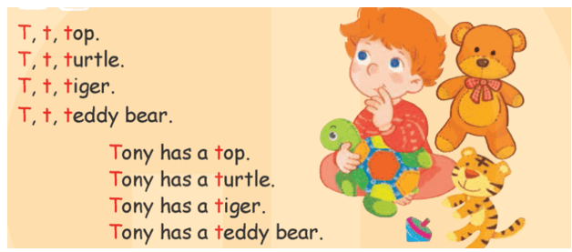
LESSON 2
3-Listen and chant

Slide 9
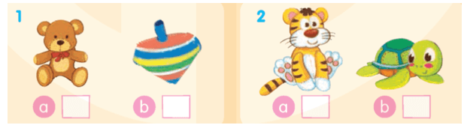
4-Listen and tick
√
√

Slide 10
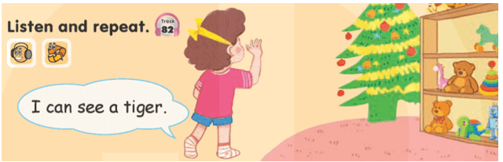
LESSON 3
6-Listen and repeat

Slide 11
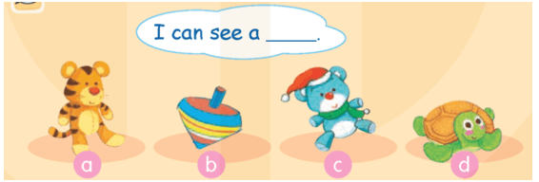
7-Let’s talk

Slide 12


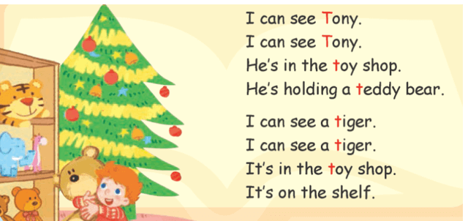
8-Let’s sing!

Slide 13
Goodbye
!
Goodbye!
Teddy bear

Slide 14
Goodbye
!
Goodbye!
top

Slide 15
Goodbye
!
Goodbye!
tiger

Slide 16
Goodbye
!
Goodbye!
Turtle

