Slide 2

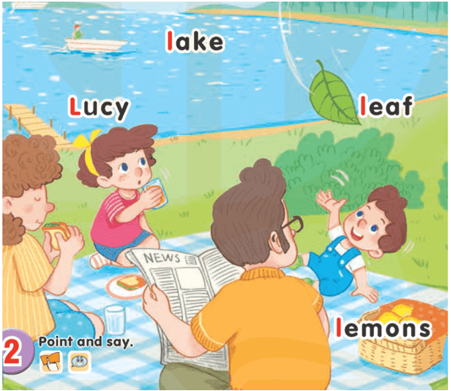
UNIT 12:
AT THE LAKE
LESSON 1
Ll
Lucy
Lake: hồ
Lemons: những quả chanh
Leaf: chiếc lá

Slide 3
2-Point and say

Slide 4
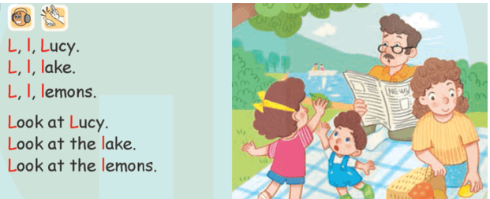
LESSON 2
3-Listen and chant

Slide 5
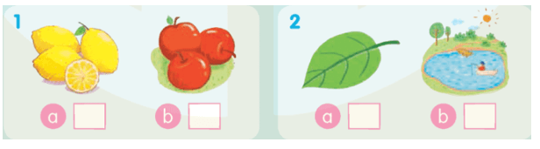
4-Listen and tick
√
√

Slide 6
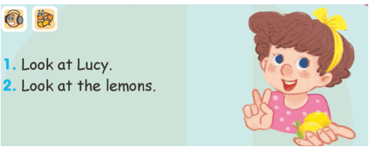
LESSON 3
6-Listen and repeat

Slide 7
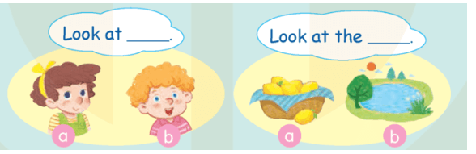
7-Let’s talk

Slide 8

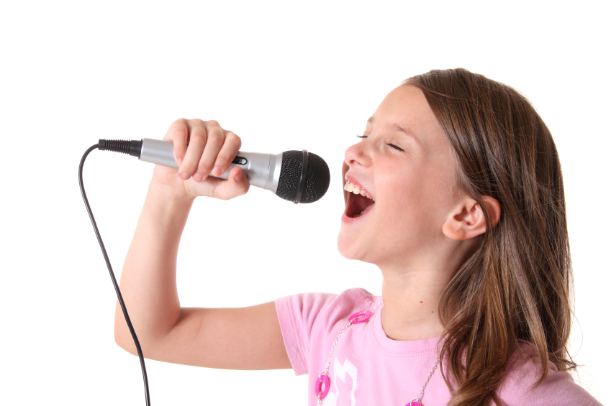
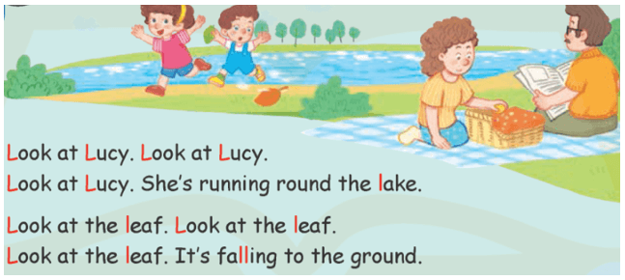
8-Let’s sing!

Slide 9

Goodbye
!
Goodbye!
lake

Slide 10

Goodbye
!
Goodbye!
leaf

Slide 11
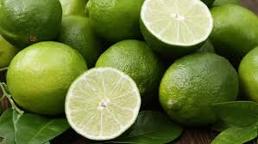
Goodbye
!
Goodbye!
lemons

