Slide 2

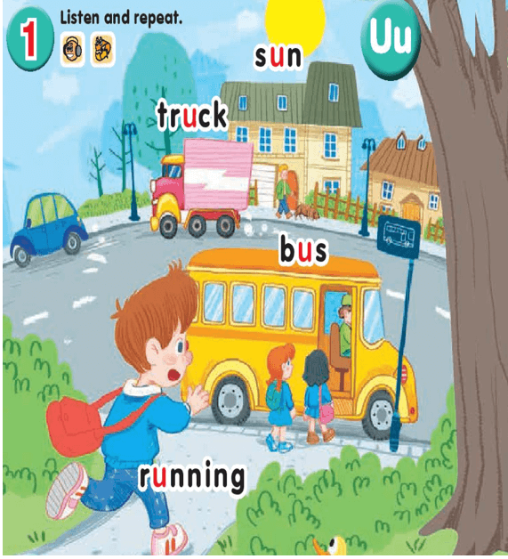
UNIT 11:
AT THE BUS STOP
LESSON 1
Uu
Running: chạy
Truck: xe tải
Sun: mặt trời
Bus: xe buýt

Slide 3
2-Point and say

Slide 4
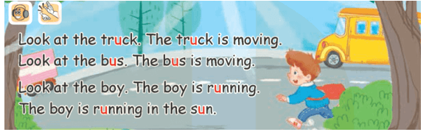
LESSON 2
3-Listen and chant

Slide 5
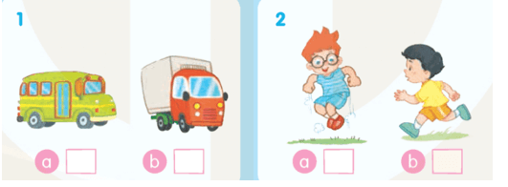
4-Listen and tick
√
√

Slide 6
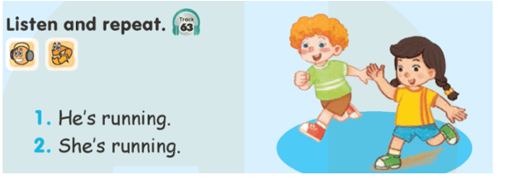
LESSON 3
6-Listen and repeat

Slide 7
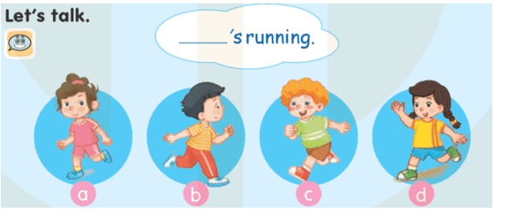
7-Let’s talk

Slide 8

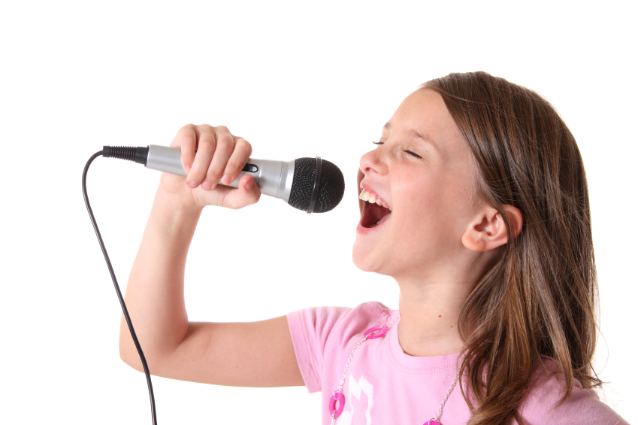
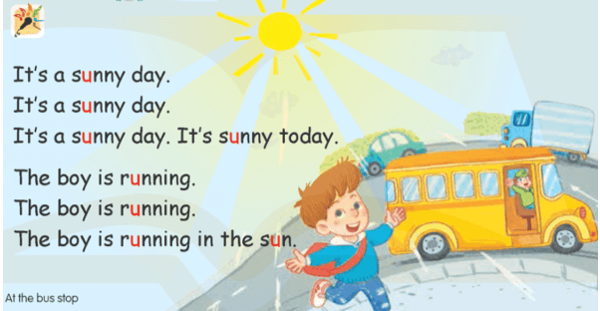
8-Let’s sing!

Slide 9

Goodbye
!
Goodbye!
sun

Slide 10
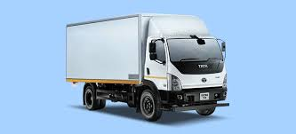
Goodbye
!
Goodbye!
truck

Slide 11
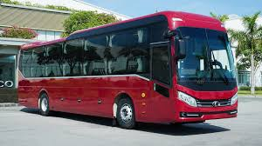
Goodbye
!
Goodbye!
bus

Slide 12
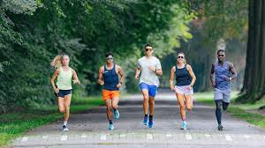
Goodbye
!
Goodbye!
running

