Slide 2
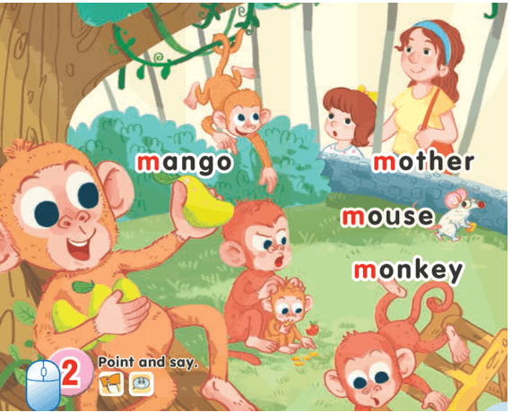
UNIT 10:
AT THE ZOO

Slide 3

1-Listen and repeat
Mm
Mango: quả xoài
Monkey: khỉ
Mouse: chuột
Mother: mẹ

Slide 4
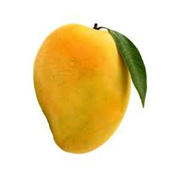
1-Listen and repeat
mango

Slide 5
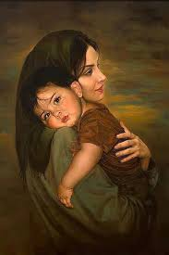
1-Listen and repeat
mother

Slide 6
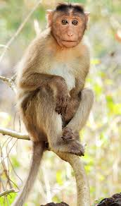
1-Listen and repeat
monkey

Slide 7
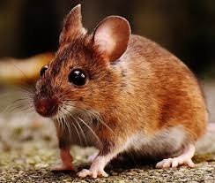
1-Listen and repeat
mouse

Slide 8
2-Point and say

Slide 9
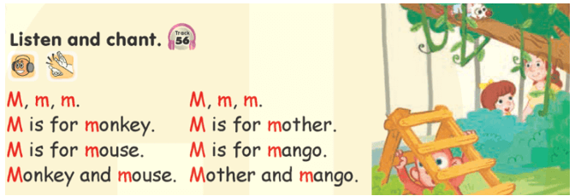
LESSON 2

Slide 10
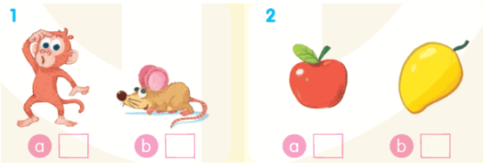
4-Listen and tick
√
√

Slide 11
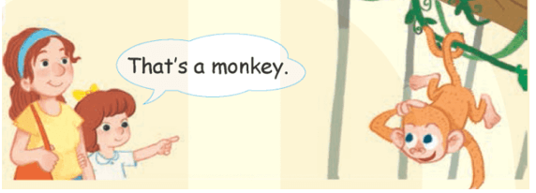
6-Listen and repeat

Slide 12
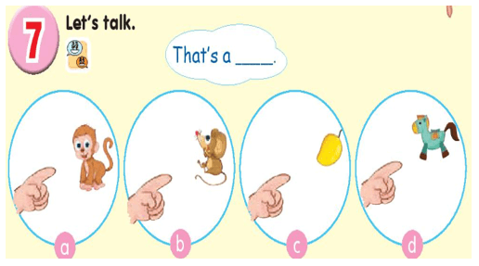
7-Let’s talk

Slide 13

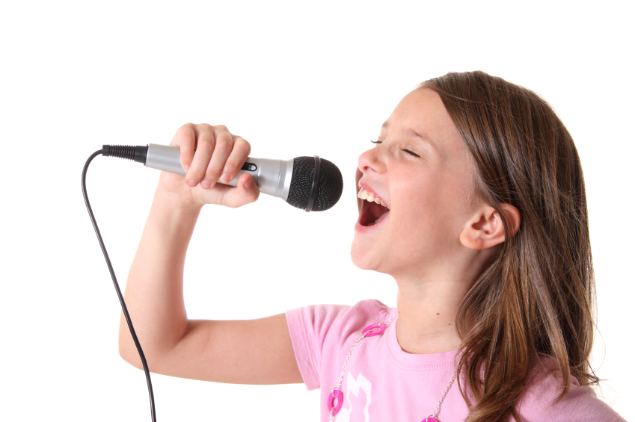
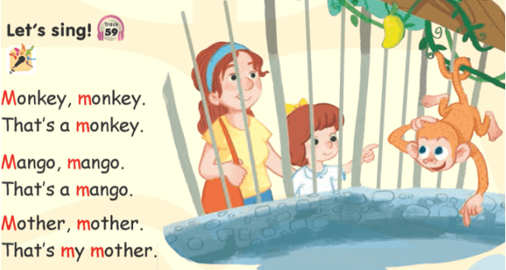
8-Let’s sing!

Slide 14
Goodbye
!
Goodbye!
mango

Slide 15
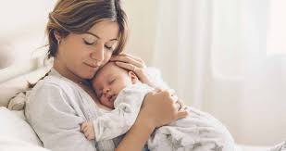
Goodbye
!
Goodbye!
mother

Slide 16
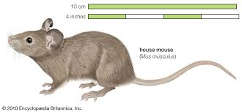
Goodbye
!
Goodbye!
mouse

Slide 17
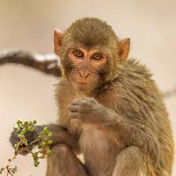
Goodbye
!
Goodbye!
monkey

