Slide 2
I. OBJECTIVES.
By the end of the unit, pupils will be able to:
- pronounce the sound of the letter O/o in isolation and in the words clocks,
locks, mops and pots correctly.
- say the sound of the letter O/o and the words clocks, locks, mops and pots
in a chant.
- recognize the words in different situations when listening.
- use the exchange “How many _____?” - “_____.” to ask and answer
questions about the quantity of things (from two to five).
- trace the letter O/o and complete the words m__ps, p__ts, l__cks, cl__cks.
- sing a song focusing on the structure “There are _____.”

Slide 3
Unit 9: In the shop lesson 1
I. OBJECTIVES.
By the end of the lesson, pupils will be able to:
- pronounce the sound of the letter O/o in isolation and in the words clocks, locks, mops and pots correctly.
- point to the letter O/o and the things (clocks, locks, mops and pots) in the picture and say the sound of the letter O/o and the words clocks, locks, mops and pots correctly.
- revise the words (clocks, locks, mops and pots) through the game Slap the board.

Slide 4
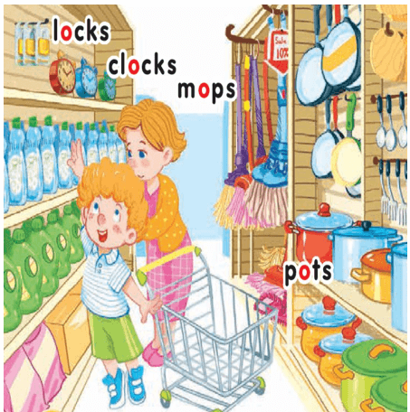
Unit 9: In the shop Lesson 1 lesson 1 In the playground

Slide 5




O
O
LOCKS: khoá
CLOCKS: đồng hồ
MOPS: cây lau nhà
POTS: nồi

Slide 6

2-Point and say
locks

Slide 7
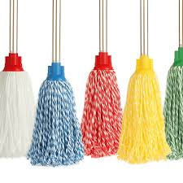
2-Point and say
mops

Slide 8
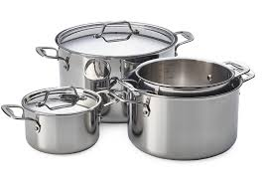
2-Point and say
pots

Slide 9

2-Point and say
clocks

Slide 10
Unit 9: In the shop lesson 2
OBJECTIVES. By the end of the lesson, pupils will be able to:
- say the sound of the letter O/o, the words locks, clocks, mops, pots in a chant.
- listen, recognize the words and tick the correct boxes.
trace the letter O/o and write the missing letters in the given words.

Slide 11
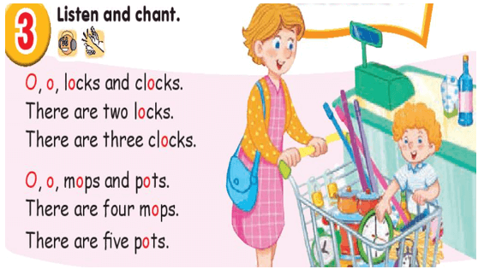
Unit 9: In the shop
:Lesson 2 In the playground

Slide 12
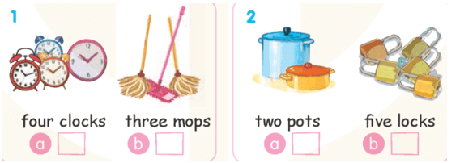
4-Listen and tick

Slide 13
Unit 9: In the shop lesson 3
OBJECTIVES. By the end of the lesson, pupils will be able to:
- listen and repeat the exchange: ”How many clocks?” – ”Two.”
- ask and answer questions about the numbers of things, using ”How many _____?” – ” _____.”
- sing a song with numbers from one to five using the structure ”There are _____.”

Slide 14
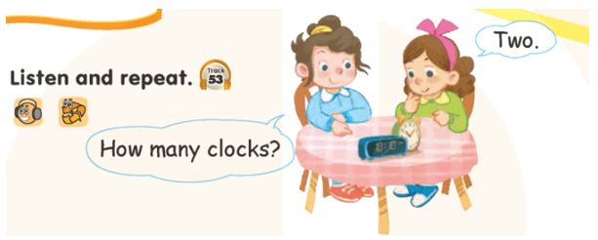
Unit 9: In the shop
:Lesson 3 In the playground

Slide 15
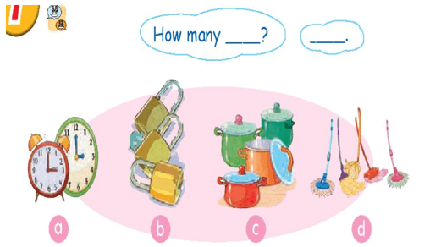
Unit 9: In the shop
:Lesson 3 In the playground
7-LET’S TALK

Slide 16
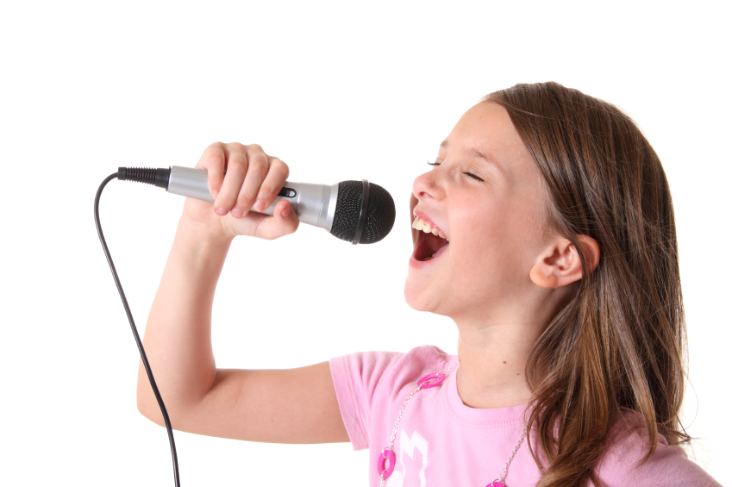

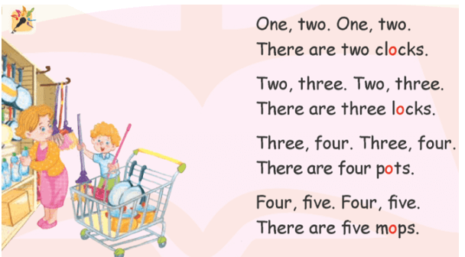
Unit 9: In the shop
:Lesson 3 In the playground
8-Let’s sing

Slide 17
Goodbye
!
Goodbye!
locks

Slide 18
Goodbye
!
Goodbye!
mops

Slide 19
Goodbye
!
Goodbye!
pots

Slide 20
Goodbye
!
Goodbye!
clocks

