Slide 2
Unit 8
In the park
Lesson 1
Notes:
By the end of the unit, pupils will be able to:
- pronounce the sound of the letter H/h in isolation and in the words hair, hand, head and horse correctly.
- say the sound of the letter H/h and the words hair, hands, head in a chant.
- recognize the words in different situations when listening.
- use Touch your_______ to express a command.
- trace the letter H/h.
- sing a song with the structure Touch your_______.
Lesson 1
By the end of the lesson, pupils will be able to:
pronounce the sound of the letter H/h in isolation and in the words hair, hand, head and horse correctly.
point to the letter H/h, the animal and parts of the body in the picture and say the sound of the letter H/h and the words hair, hand, head, horse.

Slide 3
I. OBJECTIVES.
By the end of the lesson, pupils will be able to:
- Pronounce the sound of the letter H/h in isolation.
- Say the words hair, hand, head, horse.
- Say the letter H/h, the words hand, head, hat, hair and the phrases - -
- Containing /h/ and hand, head, hat, hair in a chant.
II. INPUT.
1. Language.
- Sound /h/
- Vocabulary: hair, hand, head, horse
2. Resources/Material.
- Student’s book p. 34, 35
- Teacher’s guide pp. 80-82-84-85
- Workbook p. 24, 25, 26
- Computer, projector

Slide 4

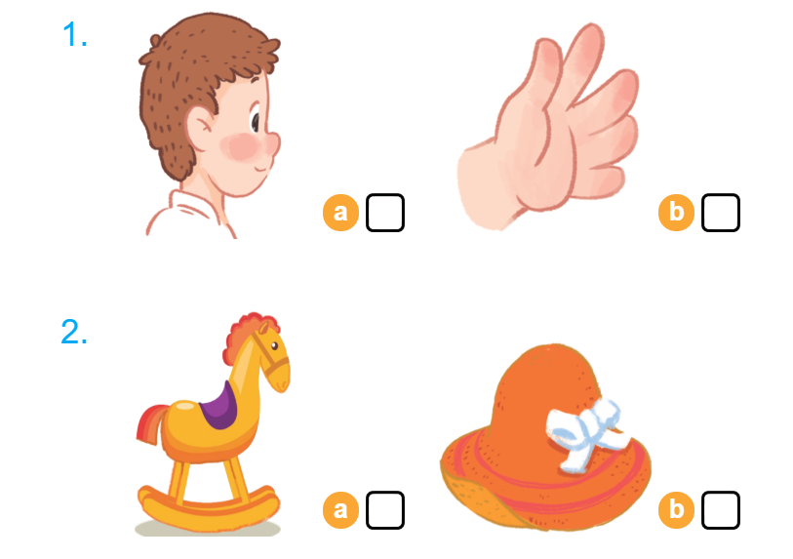

Listen and tick

Slide 5

Warm-up
Notes:
Game: Quick spelling
Goals:
- Help pupils feel happy at the beginning of the lesson.
- Review vocabulary of previous lesson (Unit 7)
Time limit: 5 mins
- Teacher sticks flashcards on the board. Pupils read the words again.
- Teacher spells a word, pupils touch the matching picture.

Slide 6


1. Listen and repeat.
Notes:
Goal:
- Pupils will be able to pronounce the sound of the letter H/h in isolation and in the words hair, hand, head and horse correctly.
Step 1: Lead-in
Time limit: 3 mins
Objective: Pupils are able to identify and pronounce sound /h/
- Teacher shows letter “h” on slide and asks pupils What letter is this? and What sound does this make?
- Teacher pronounces sound /h/. Pupils listen and repeat. (as a class/ teams)
- Teacher says Today we are going to learn 4 words that have the sound /h/.

Slide 7
h

Slide 8
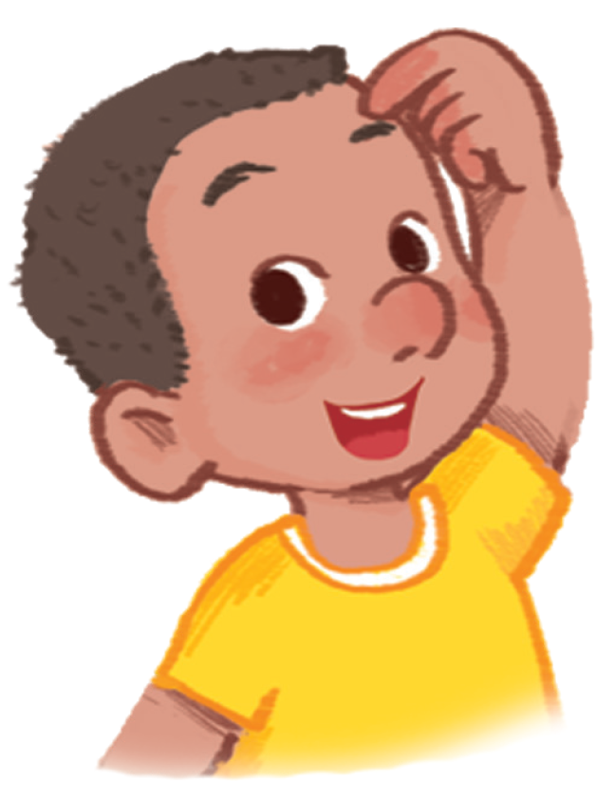
head
Notes:
Step 2: Listen and repeat vocabulary
Time limit: 5 mins
Objectives: Pupils are able to identify and pronounce 4 words: hair, hand, head and horse
- Teacher shows pictures on slide and says the words. (Teacher may pronounce each sound of the word separately, for example h – h – head).
- Pupils listen to teacher and repeat.

Slide 9
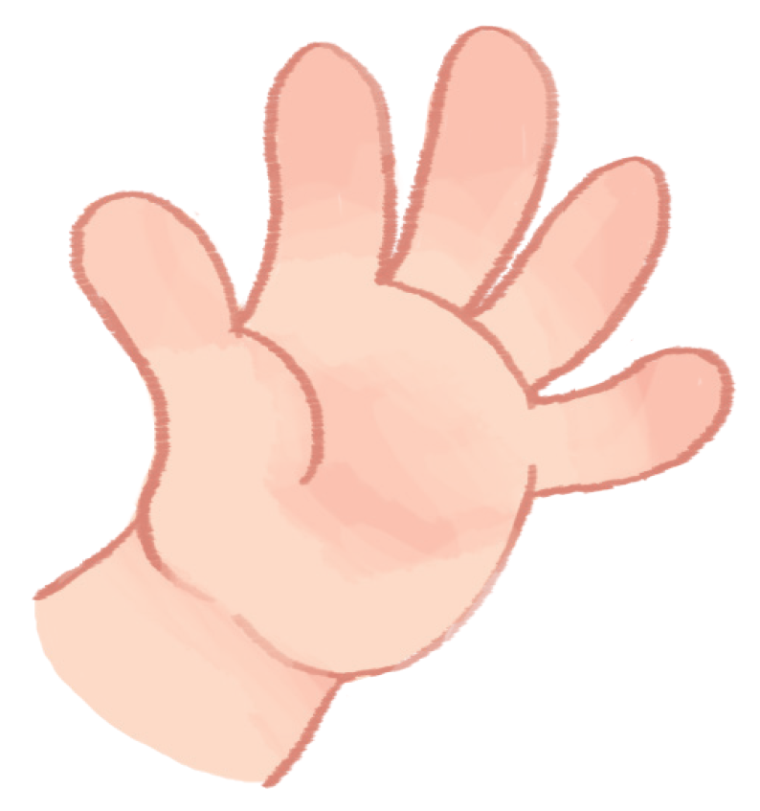
hand

Slide 10
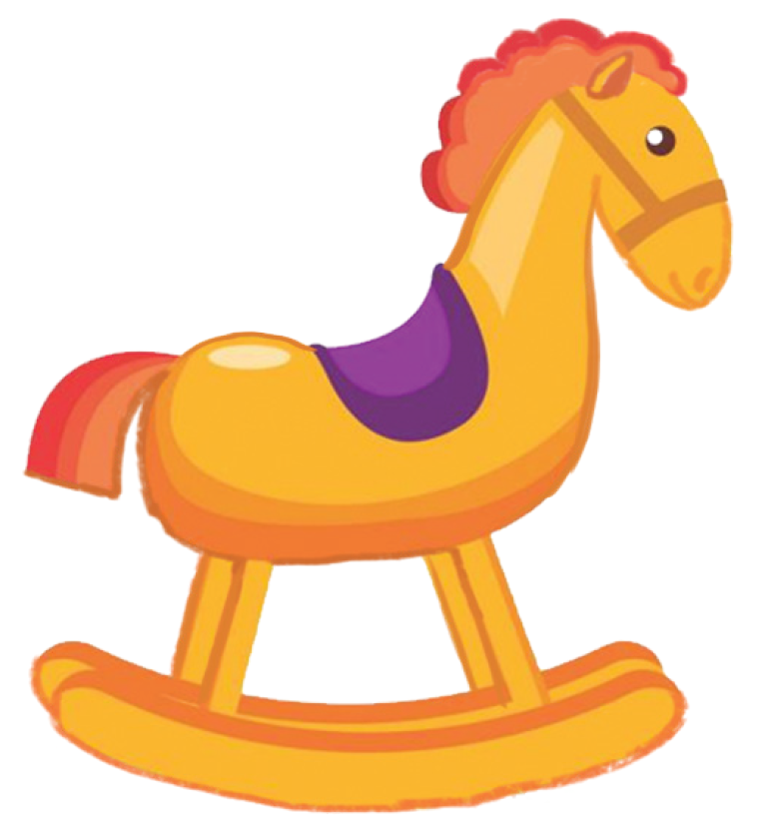
horse

Slide 11
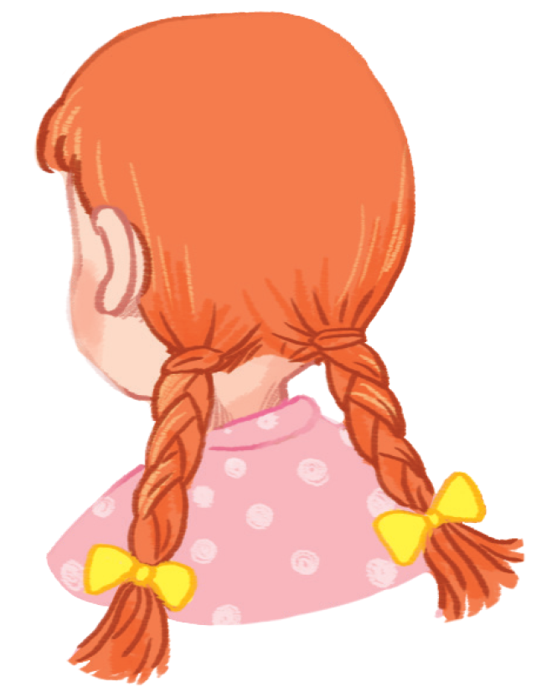
hair
Notes:
Step 3: Quick check
Time limit: 4 mins
- Teacher checks pronunciation (as teams).
- Teacher sticks flashcards and word cards on the board randomly. Teacher has Pupils go to the board and put word cards under the matching flashcards.
- Teacher checks pronunciation individually. Teacher points to a picture and has a pupil say the word.

Slide 12


2. Point and say.
Notes:
Goal:
- Pupils will be able to point to the letter H/h, the animal and parts of the body in the picture and say the sound of the letter H/h and the words hair, hand, head, horse.
Step 1: Listen, point and say
Objective: Pupils are able to point to the correct picture and pronounce the words.
Time limit: 3 mins
- Teacher plays the audio, pupils listen and point only.
- Then pupils point and say the words.
- Pupils repeat the words as a class and teams.
Step 2: Point and say (in pairs)
Time limit: 3 mins
Pupils work in pairs: 1 pupil points, 1 pupil say the words.
Teacher goes around the class and gives feedback on pupils’ pronunciation
Step 3: Quick check
Time limit: 5 mins
- Teacher gives each team a set of 4 word cards: hair, hand, head, horse
- Teacher says a word, pupils choose the matching word card and stick it under the picture on the board.
- Pupils take turn to play. (When pupils in the first table row finish their turn, they pass the word cards to the next table.)

Slide 13
head

Slide 14
hand

Slide 15
head

Slide 16
hand

Slide 17
horse

Slide 18
hair

Slide 19
hair

Slide 20
horse

Slide 21

3.Listen and chant.
Notes:
Goal:
- Pupils will be able to say the sound of the letter H/h and the words hair, hand, head and hat in a chant.
Step 1: Read. Listen and repeat the chant.
Time limit: 4 mins
- Teacher shows the chant on slide. Whole class read together.
- Teacher plays the audio. Pupils listen through, then listen and repeat.
Pupils then chant and clap along.
Pupils chant in teams.
Step 2: Pupils chant and do actions.
Time limit: 4 mins
- Teacher shows pupils how to do actions to describe the vocabulary.
- Pupils do the actions as teams. Then pupils chant and do the actions along.
Example:
H (clap), h (clap), h (clap)
Head (touch the head) and hair (touch the hair)
Hoa’s head (touch the head)
Hoa’s hair (touch the hair)
Step 3: Quick check
Time limit: 4 mins
Pupils chant as teams and individually.

Slide 22
Listen and chant
h, h, h.
Head and hair.
Hoa’s head.
Hoa’s hair.
h, h, h.
Hat and hands.
Hoa’s hat.
Hoa’s hands.

Slide 23

4.Listen and tick.
Notes:
Goal:
- Pupils will be able to listen, recognize the words and tick the correct boxes.
Step 1: Listen and tick the correct picture.
Time limit: 5 mins
- Teacher says Listen and tick and writes words on the board.
- Teacher says and does actions: Listen (put hands on one ear) and tick (write a tick in the air). Pupils follow.
- Teacher plays audio. Pupils do the tasks.
When Pupils finish, teacher plays the audio again, pause at each question and checks answer.
Step 2: Quick check
Time limit: 3 mins
- Teacher says a word, pupils go to the board and touch the correct picture.

Slide 24
Listen and tick

Slide 25
Goodbye
Notes:
- Teacher shows the vocabulary of the lesson on slide.
- Pupils say goodbye.

Slide 26
Goodbye

Slide 27

Goodbye

Slide 28

Goodbye

