Slide 2
Unit 7 : In the garden Lesson 1 + Lesson 2
Notes:
By the end of the unit, pupils will be able to:
- pronounce the sound of the letter G/g in isolation and in the words garden, girl, goat and gate correctly.
- say the sound of the letter G/g and the words garden, girl, goat and gate in a chant.
- recognize the words in different situations when listening.
- use There’s a ______. to introduce something.
- trace the letter G/g.
- sing a song with the structure There’s a ______ in the garden.
Lesson 1
By the end of the lesson 1, pupils will be able to:
pronounce the sound of the letter G/g in isolation and in the words garden, gate, girl and goat correctly.
point to the letter G/g and the girl/things/animal (garden, gate, girl, goat) in the picture and say the sound of the letter G/g and the words garden, gate, girl and goat.

Slide 3
I. OBJECTIVES.
By the end of the lesson, pupils will be able to:
pronounce the sound of the letter G/g.
say the words girl, goat, gate, garden.
say the letter G/g and the words garden, girl, goat, gate and the phrases a goat and a gate, a girl and a garden in a chant.
II. INPUT.
1. Language:
Sound /g/
Vocabulary: girl, goat, gate, garden
2. Resources/Material:
Student’s book p.31
Flashcards for Unit 7
Poster for Unit 7
Teacher’s guide pp. 72-74
Computer, projector

Slide 4

Warm-up
Notes:
Game: Slap the board
Goals:
- Help pupils feel happy at the beginning of the lesson.
- Review vocabulary of the previous lesson.
Time limit: 5 mins
- Teacher sticks flashcards and word cards on the board.
- Teacher draws a circle under each picture.
- Teacher says a word, pupils slap the corresponding circle.
- Teacher may have pupils say the words.

Slide 5


1. Listen and repeat.
Notes:
Goal:
- Pupils will be able to pronounce the sound of the letter G/g in isolation and in the words garden, gate, girl and goat correctly.
Step 1: Lead-in
Time limit: 3 mins
Objective: pupils are able to identify and pronounce sound /g/.
- Teacher shows letter “g” on slide and asks pupils What letter is this? and What sound does this make?
- Teacher pronounces sound /g/. Pupils listen and repeat. (as a class/ teams)
- Teacher says Today we are going to learn 4 words that have the sound /g/.
Step 2: Listen and repeat vocabulary
Time limit: 5 mins
Objectives: Pupils are able to identify and pronounce 4 words: garden, goat, girl, gate
- Teacher shows pictures on slide and says the words. (Teacher may pronounce each sound of the word separately, for example g – g – garden).
- Pupils listen to teacher and repeat.
Step 3: Quick check
Time limit: 4 mins
- Teacher checks pronunciation (as teams).
- Teacher sticks flashcards and word cards on the board randomly. Teacher has pupils go to the board and put word cards under the matching flashcards.
- Teacher checks pronunciation individually. Teacher points to a picture and has a pupil say the word.

Slide 6

g

Slide 7
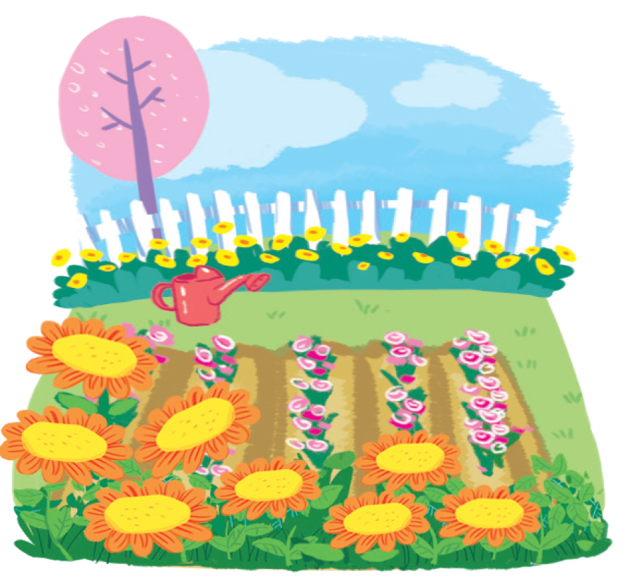
garden

Slide 8
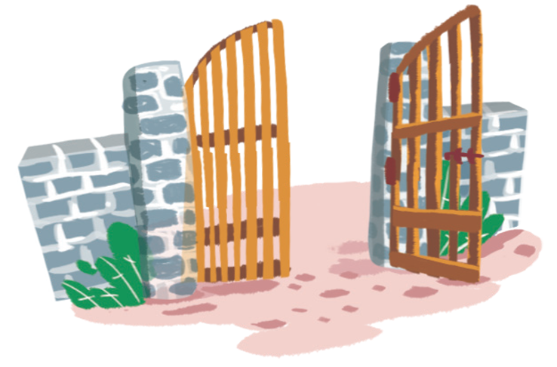
gate

Slide 9
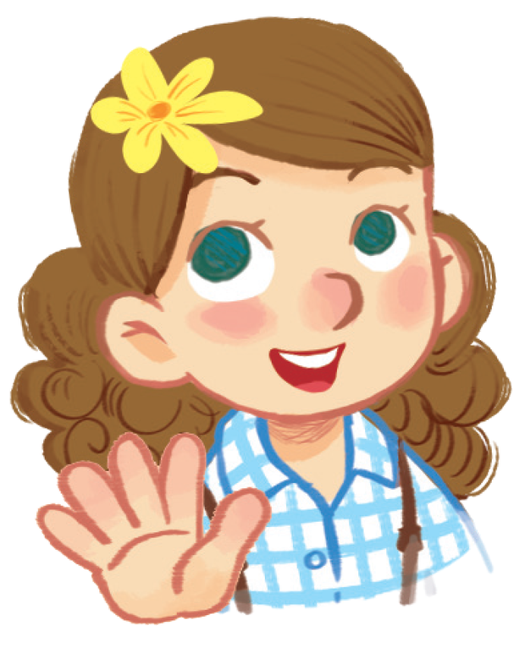
girl

Slide 10
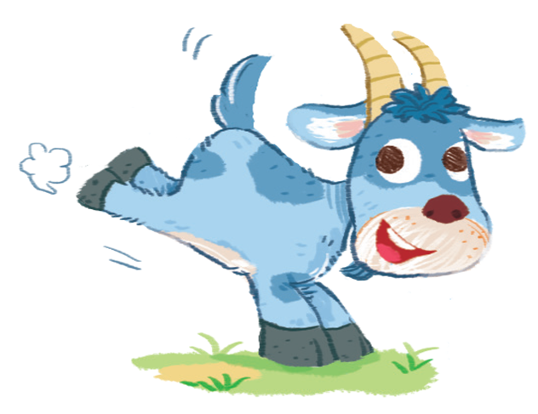
goat

Slide 11


2. Listen point and say.
Notes:
Goal:
- Pupils will be able to point to the letter G/g and the girl/things/animal (garden, gate, girl, goat) in the picture and say the sound of the letter G/g and the words garden, gate, girl and goat.
Step 1: Listen, point and say
Objective: Pupils are able to point to the correct picture and pronounce the words.
Time limit: 3 mins
- Teacher plays the audio, pupils listen and point only.
- Then pupils point and say the words.
Pupils repeat the words as a class and teams.
Step 2: Point and say (in pairs)
Time limit: 3 mins
Pupils work in pairs: 1 pupil points, 1 pupils says the words.
Teacher goes around the class and gives feedback on pupils’ pronunciation.
Step 3: Quick check
Game: What’s missing?
- Teacher sticks 4 flashcards: girl, gate, goat and garden on the board.
- Teacher says Go to sleep, whole class close their eyes.
- Teacher takes one flashcard away, then says Wake up, pupils open their eyes and says the missing picture.

Slide 12
GAME
Notes:
Game: Hungry Bobby
Time limit: 5 mins
- Teacher shows a picture covered partly by a wheel turning 360* clockwise.
Teacher has 1 pupil from each team in a turn. Pupils look and say the word. Faster team gets 2 stars, the others get 1 star.
Teacher has whole class read the word out loud at the end of a turn.

Slide 13
garden

Slide 14
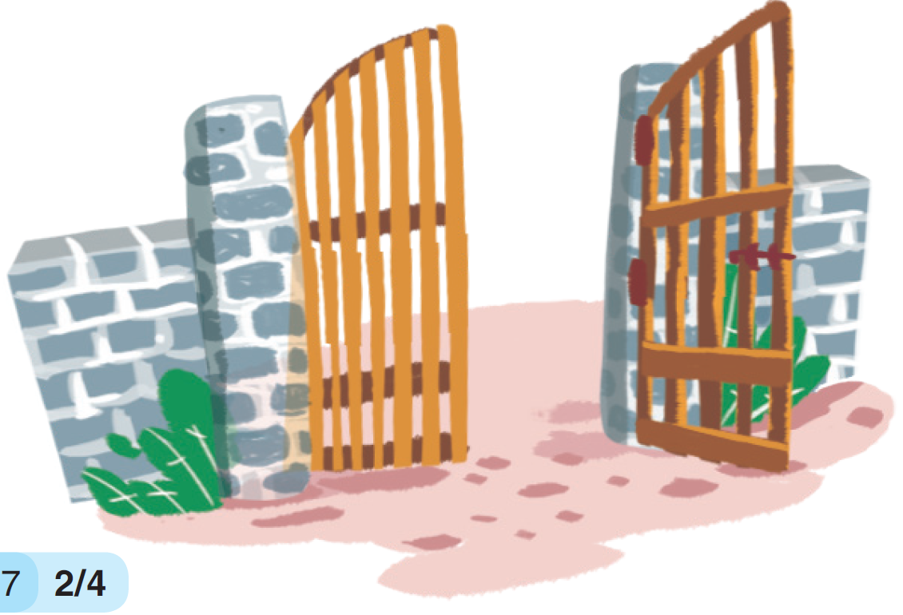
gate

Slide 15
girl

Slide 16
goat

Slide 17

3. Listen and chant
Notes:
Goal:
- Pupils will be able to say the sound of the letter G/g and the words garden, gate, girl, and goat in a chant.

Slide 18
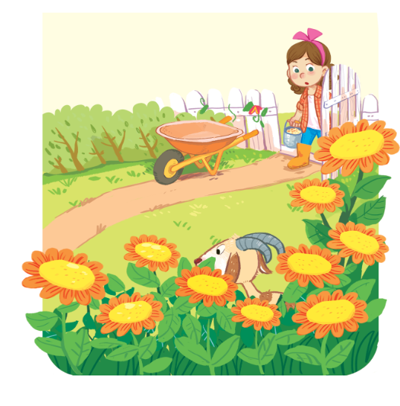
Listen and chant
G, g, goat.
G, g, gate.
A goat and a gate.
G, g, girl.
G, g, garden.
A girl and a garden.
Notes:
Step 1: Read. Listen and repeat the chant.
Time limit: 4 mins
- Teacher shows the chant on slide. Whole class read together.
- Teacher plays the audio. pupils listen through, then listen and repeat.
- Pupils then chant and clap along.
- Pupils chant in teams.
Step 2: Pupils chant and do actions.
Time limit: 4 mins
- Teacher shows pupils how to do actions to describe the vocabulary.
- Pupils do the actions as teams. Then pupils chant and do the actions along.
Example:
g (clap), g(clap), goat (action)
g (clap), g (clap), gate (action)
A goat (action) and a gate (action)
Step 3: Quick check
Time limit: 4 mins
Pupils chant as teams and individually.

Slide 19

Listen and tick
Notes:
Goal:
- Pupils will be able to listen, recognize the words and tick the correct boxes.
Step 1: Listen and tick the correct picture.
Time limit: 5 mins
- Teacher says Listen and tick and writes words on the board.
- Teacher says and does actions: Listen (put hands on one ear) and tick (write a tick in the air). Pupils follow.
- Teacher plays audio. Pupils do the tasks.
- When pupils finish, teacher plays the audio again, pause at each question and checks answer.
Step 2: Quick check
Time limit: 3 mins
- Teacher says a word, pupils go to the board and touch the correct picture.

Slide 20
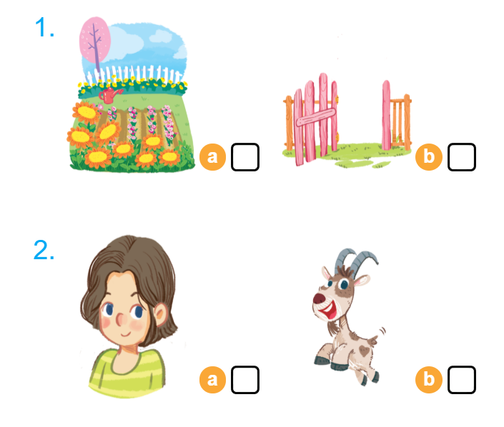

4. Listen and tick

Slide 22
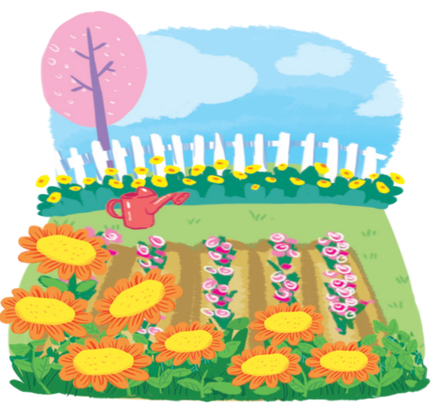
Goodbye
Notes:
- Teacher shows the vocabulary of the lesson on slide.
- Pupils say goodbye.

Slide 23
Goodbye

Slide 24
Goodbye

Slide 25
Goodbye

