Slide 2
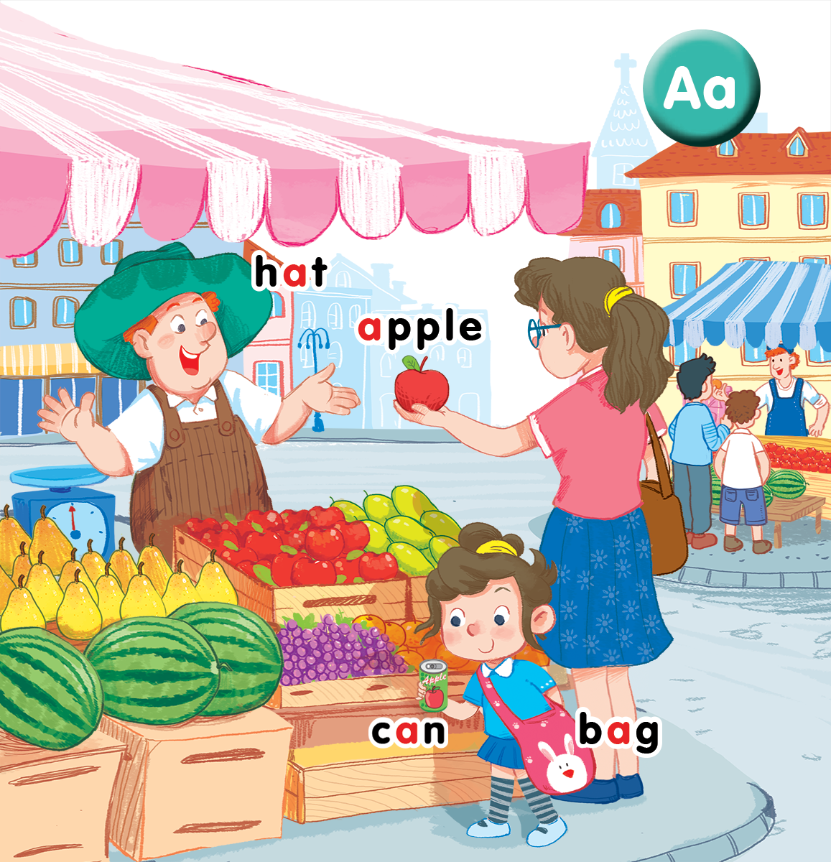
Unit 3
Lesson 2 + Lesson 3
At the street market
Notes:
Goals:
By the end of the lesson, pupils will be able to:
- introduce something using the structure This is my…
- sing along the unit song.

Slide 3
OBJECTIVES.
By the end of the lesson, pupils will be able to:
- use I have a _____ to introduce things.
- sing a song with the structures Hi, I’m + name and This is my _____.
Language:
- Sentence pattern: This is my _____.

Slide 4

Warm-up
Notes:
Goal: Warm up and revise the unit keywords.
Time: 3 minutes
Find the pair of cards.
Have pupils choose 2 numbers and find the picture hidden under the number. If they are the same, you can open then. If not, close the numbers and have pupils guess again.
After opening all the numbers, have pupils chant the verse relating to the pictures.
Have pupils chant the words.

Slide 5


1
2
3
4

Slide 6
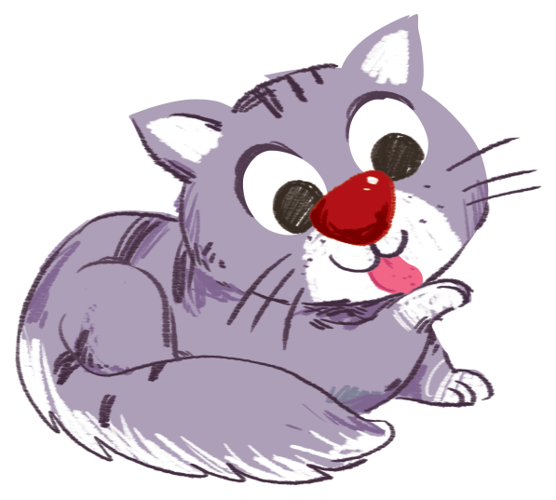
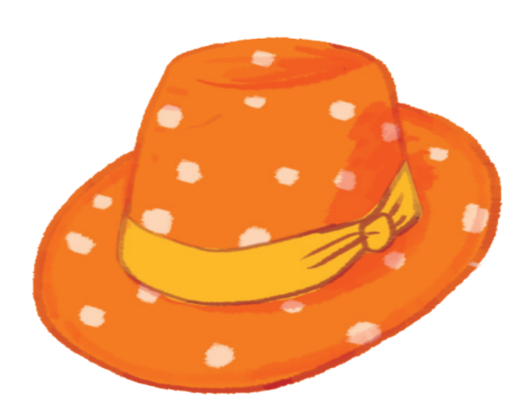

1
2
3
4

Slide 7
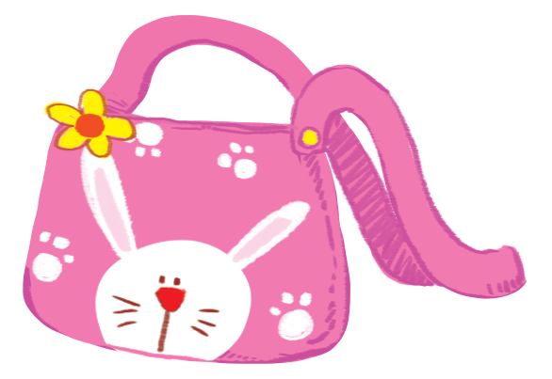




Slide 8

A, a, apple.
A, a, bag.
There’s an apple.
In the bag.
A, a, cat.
A, a, hat.
There’s a cat.
On the hat.
Notes:
Step 2
Goal: Pupils will be able to chant and clap along.
Time: 3 minutes
Play the recording, have pupils listen and clap along.
Play the recording, have pupils listen, clap and chant along
+ Round 1. Have pupils listen and clap along.
+ Round 2. Have pupils listen and do TPR actions with teacher.
+ Round 3. Have pupils listen and do the actions and chant along.
Repeat round 3 several times.
Revise the letter a by writing in the air.
Suggested TPR actions
A (clap), a (clap), apple (roll your hands to make an apple)
A (clap), a (clap), bag (use your hands to draw a bag in the air)
There’s (clap) an apple (roll your hands to make an apple).
In (clap) the bag (spread your hands forward)
A (clap), a (clap), cat (use your hands to draw cat whiskers)
A (clap), a (clap), hat (use your hands to make a hat over your head)
There’s (clap) a cat (use your hands to draw cat whiskers)
on (clap) the hat (spread your hands forward).
Step 3
Goal: Pupils will be able to chant and clap along in pairs.
Time: 3 minutes
Have pupils chant along in pairs.

Slide 9


6. Listen and repeat
Notes:
Listen and repeat is divided in to 2 steps.
Step 1
Goal: Pupils will be able to listen to the structure This is my … and understand the meaning.
Time: 7 minutes.
Introduce the structure and have pupils listen and repeat.
Hold up a flashcard for bag and say This is my bag.
Stick the flashcard for bag on the board.
Do the same with other words.
Play the recording, and have pupils listen and repeat.
Step 2
Goal: Pupils will be able to recognize and repeat the structure This is my …
Time: 3 minutes.
Have pupils open the book, listen and repeat.

Slide 10

hat

Slide 11

apple

Slide 12
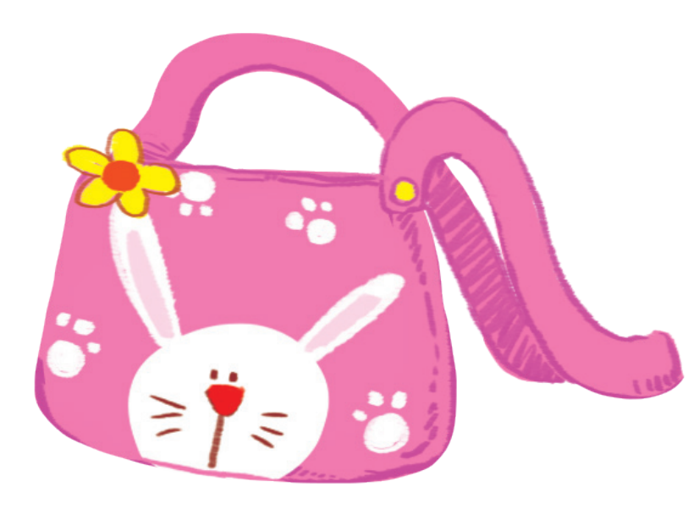
bag

Slide 13
can
Notes:
Tranh trong sách mềm chưa cập nhật

Slide 14
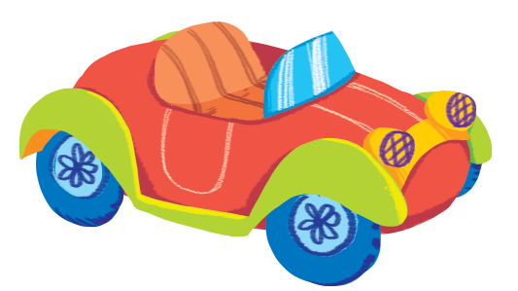

Slide 15


Slide 16
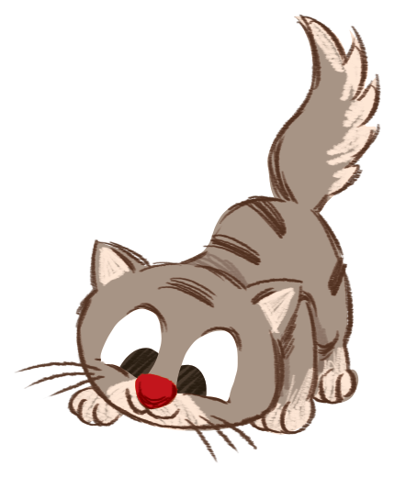

Slide 17


7. Let’s talk
Notes:
Let’s talk is divided into 2 steps.

Slide 18
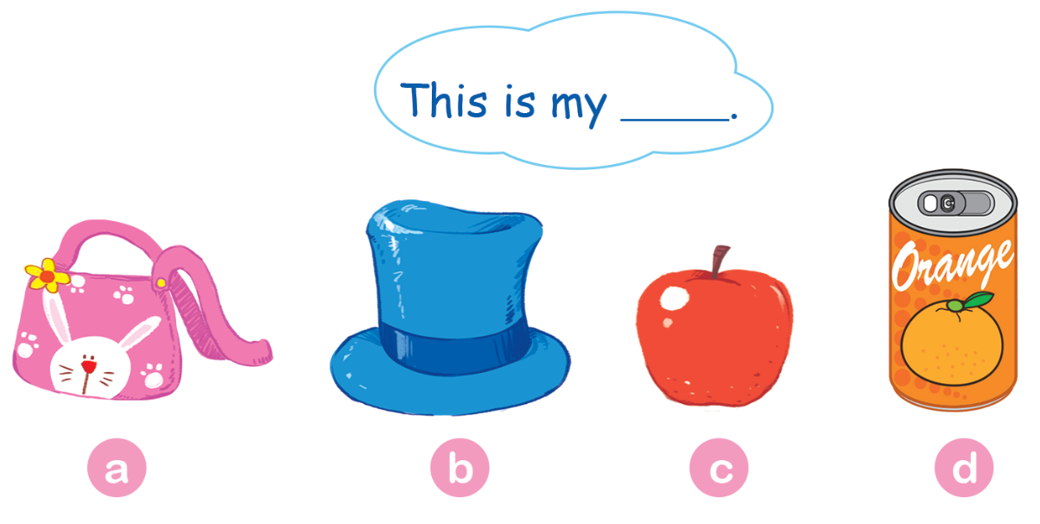
Notes:
Step 1
Goal: Pupils will be able to say a sentence with This is my ….
Time: 3 minutes
Have pupils do the task in the textbook in chorus, pairs then individuals.

Slide 19

Notes:
Step 2.
Goal: Pupils will be able to practice more, using the new structure.
Time: 3 minutes
One pupil hides a flashcard (or real object) behind and say: This is my… for others to guess its true or not.
Pupils repeat the sentence when seeing the real objects.

Slide 20
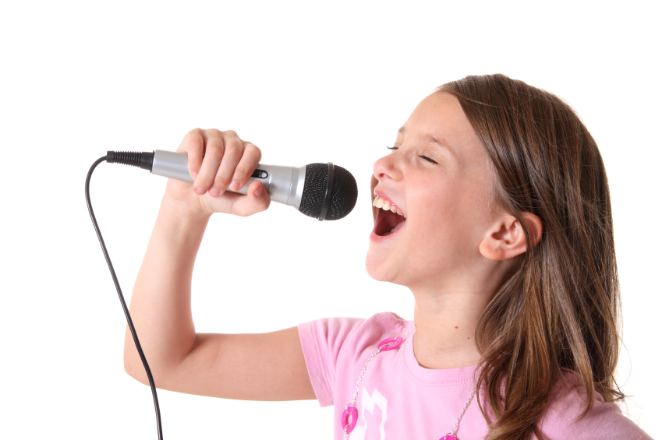

8. Let’s sing
Notes:
Let’s sing is divided into 2 steps.
Step 1
Goal: Pupils will be able to read the lyrics of the song.
Time: 3 minutes
Have pupils read the lyrics of the song, sentence by sentence.
Then say with TPR.
Step 2
Goal: Pupils will be able to listen and sing the song
Time: 5 minutes
Have pupils listen to the song and sing with TPR in chorus then in groups.

Slide 21
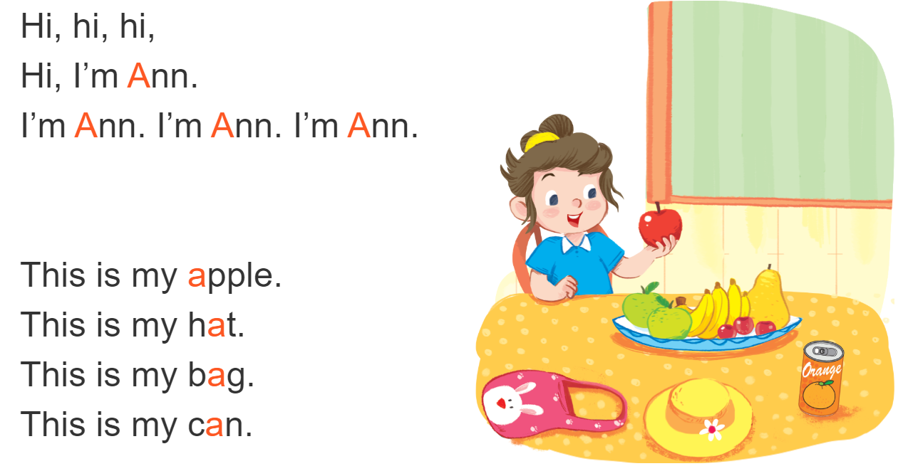
Let’s sing!

Slide 22
Game
Notes:
Goal: Review the unit keywords, the song and the chant.
Time: 5 minutes
Spinning wheel
Revise the words and play the game.

Slide 23
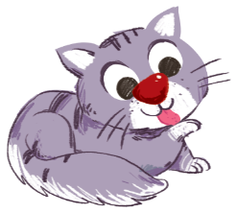




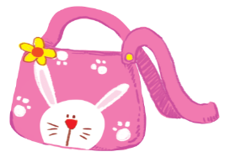
START/STOP
Notes:
Press START/STOP to start or stop the wheel

Slide 24

It’s time to say goodbye
Notes:
Goodbye
Time: 2 minutes
Teacher and pupils say goodbye to the words.

Slide 25

Goodbye
hat

Slide 26
Goodbye
apple

Slide 27

Goodbye
bag

Slide 28

Goodbye
can

