Slide 2
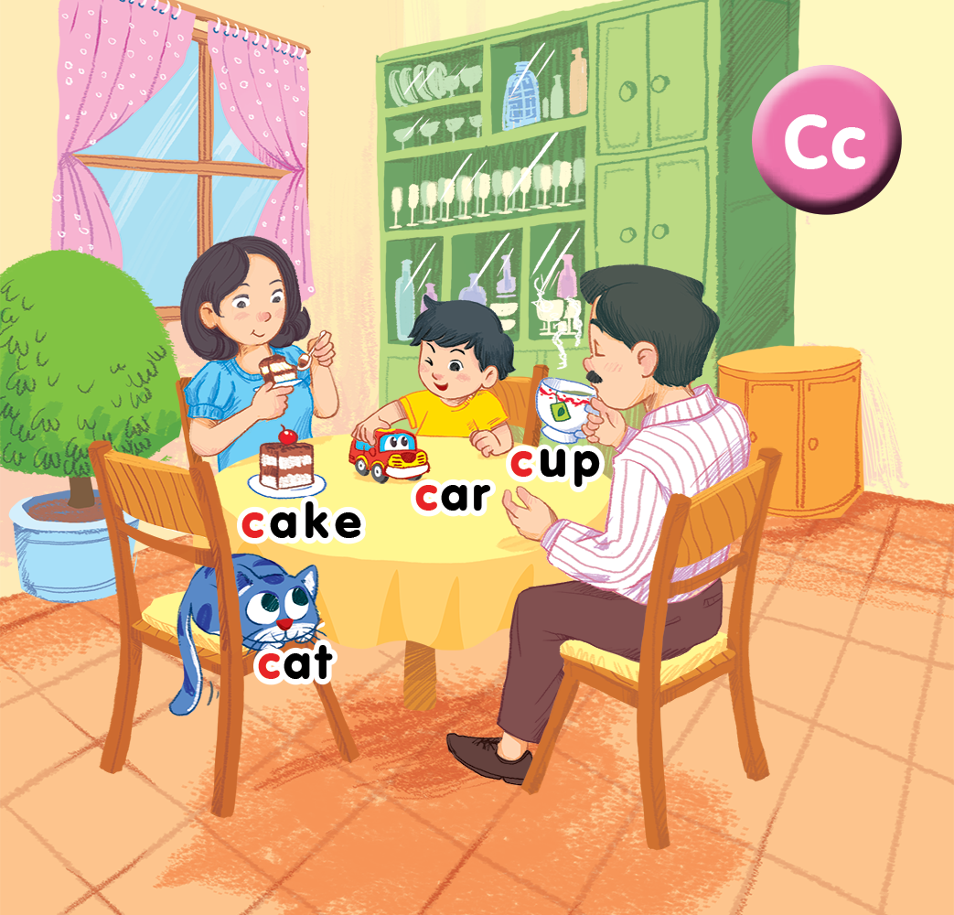
Unit 2 Lesson 2 +Lesson 3 In the dining room
Notes:
Goals:
By the end of the lesson, pupils will be able to:
- introduce what they have using the structure I have a…
- sing along the unit song.

Slide 3
I. OBJECTIVES.
By the end of the lesson, pupils will be able to:
- trace the letter C/c.
- use I have a _____ to talk about possession.
sing a song with the structures:
I have a _____.
I have a _____
I have a _____.
1. Language:
Sentence pattern: I have a _____.
Notes:
Goals:
By the end of the lesson, pupils will be able to:
- introduce what they have using the structure I have a…
- sing along the unit song.

Slide 4

Warm-up
Notes:
Goal: Warm up and revise the unit keywords.
Time: 3 minutes
Find the pair of cards.
Have pupils choose 2 numbers and find the picture hidden under the number. If they are the same, you can open then. If not, close the numbers and have pupils guess again.
After opening all the numbers, have pupils chant the verse relating to the pictures.

Slide 5


1
2
3
4

Slide 6


1
2
3
4

Slide 7


5. Look and trace
Notes:
Goal: Pupils will be able to trace the letter.
Time: 5 minutes
Have pupils say the word.
Demonstrate how to trace the word in the air.
Have pupils write the word by air tracing.
Have pupils do the task in the book with pencils .

Slide 8

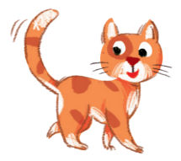





START/STOP

Slide 9


6.Listen and repeat
Notes:
Listen and repeat is divided in to 2 steps.
Step 1
Goal: Pupils will be able to listen to the structure I have a…. and understand the meaning.
Time: 7 minutes.
Introduce the structure and have pupils listen and repeat.
Hold up a flashcard for car and say I have a car.
Stick the flashcard for car on the board.
Do the same with other words.
Play the recording, and have pupils listen and repeat.
Step 2
Goal: Pupils will be able to recognize and repeat the structure I have a….
Time: 3 minutes.
Have pupils open the book, listen and repeat.

Slide 10
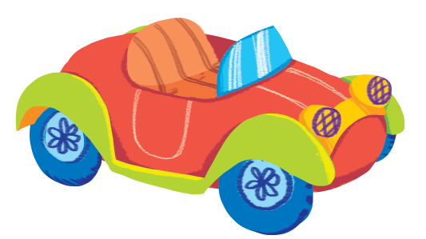

Slide 11


Slide 12


Slide 13
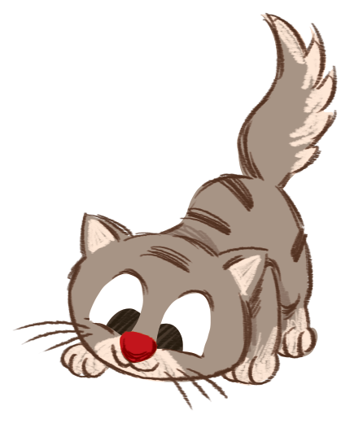

Slide 14


7. Let’s talk
Notes:
Let’s talk is divided into 2 steps.

Slide 15
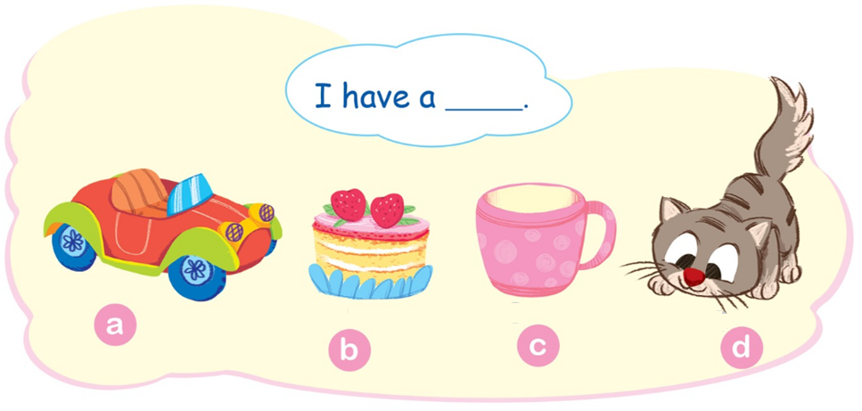
Notes:
Step 1
Goal: Pupils will be able to understand and say a sentence with I have a ….
Time: 3 minutes
Introduce the sentence and its meaning.
Have pupils say the sentences in chorus, then in pairs.

Slide 16
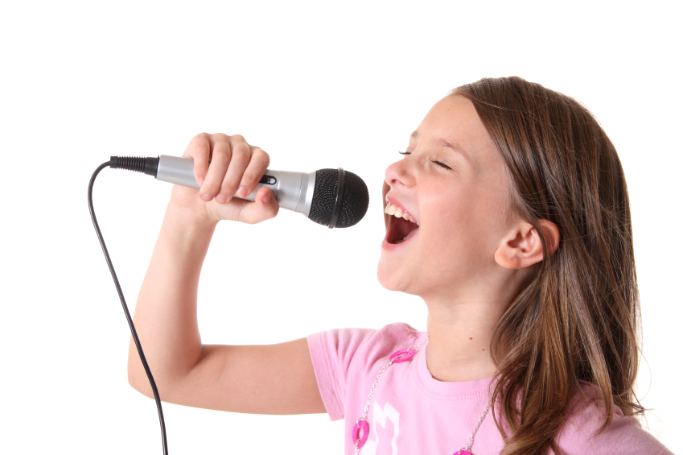

8. Let’s sing
Notes:
Let’s sing is divided into 2 steps.

Slide 17

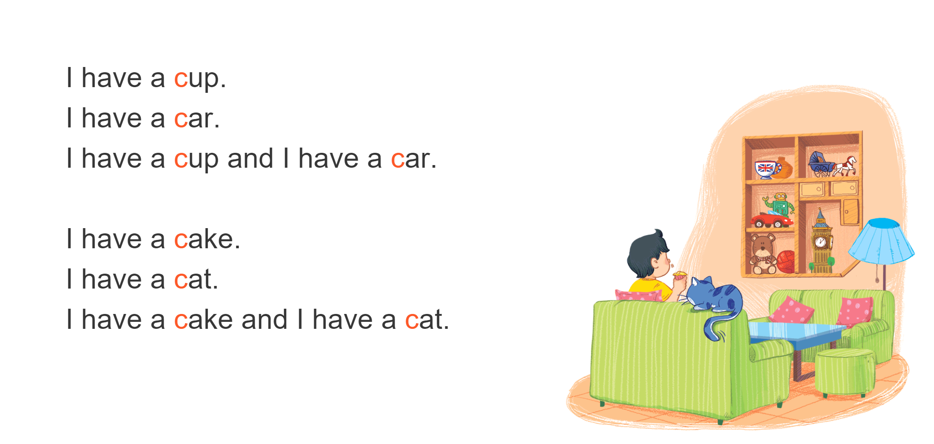
Notes:
Step 1
Goal: Pupils will be able to read the lyrics of the song.
Time: 3 minutes
Have pupils listen to the song one time.
Then pupils read the lyrics, sentence by sentence with TPR actions.
(Each group reads one sentence to the end of the song. Then each table reads one sentence to the last table.)
Suggested TPR actions.
I have a cup. (Tea drinking action)
I have a car. (Driving action)
I have a cup (clap) and I have a car (clap).
I have a cake. (cake eating action)
I have a cat. (cat action)
I have a cake (clap) and I have a cat (clap).
Finish the lyrics with the TRP for High five and fist bump.
Step 2
Goal: Pupils will be able to sing the song.
Time: 5 minutes
1st time: Have pupils listen to the song.
2nd time: Pause at each sentence for pupils to sing follow.
3rd: Pause at each paragraph for pupils to sing follow.
Then pupils sing the whole song in class first, then in groups.

Slide 18
Game
Notes:
Goal: Review the unit keywords, the song and the chant.
Time: 5 minutes
Racing game
Revise the words and play the game.
Play the game in groups.
Group 1, 2, 3 4.
Choose the card one by one in each group and say I have a _____. 10 points for each correct sentence.
The team with the highest points is the winner.

Slide 19


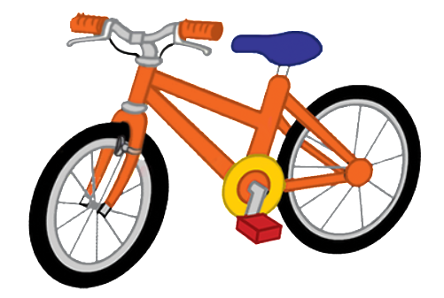

Slide 20


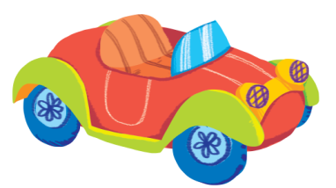

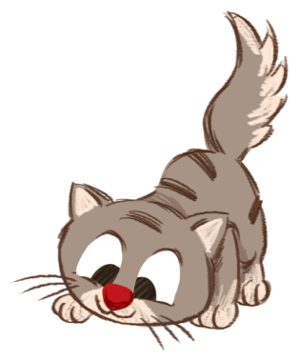




1
2
3
4

Slide 21

Goodbye

Slide 22

Goodbye

Slide 23

Goodbye

Slide 24

Goodbye
cup

