Slide 2
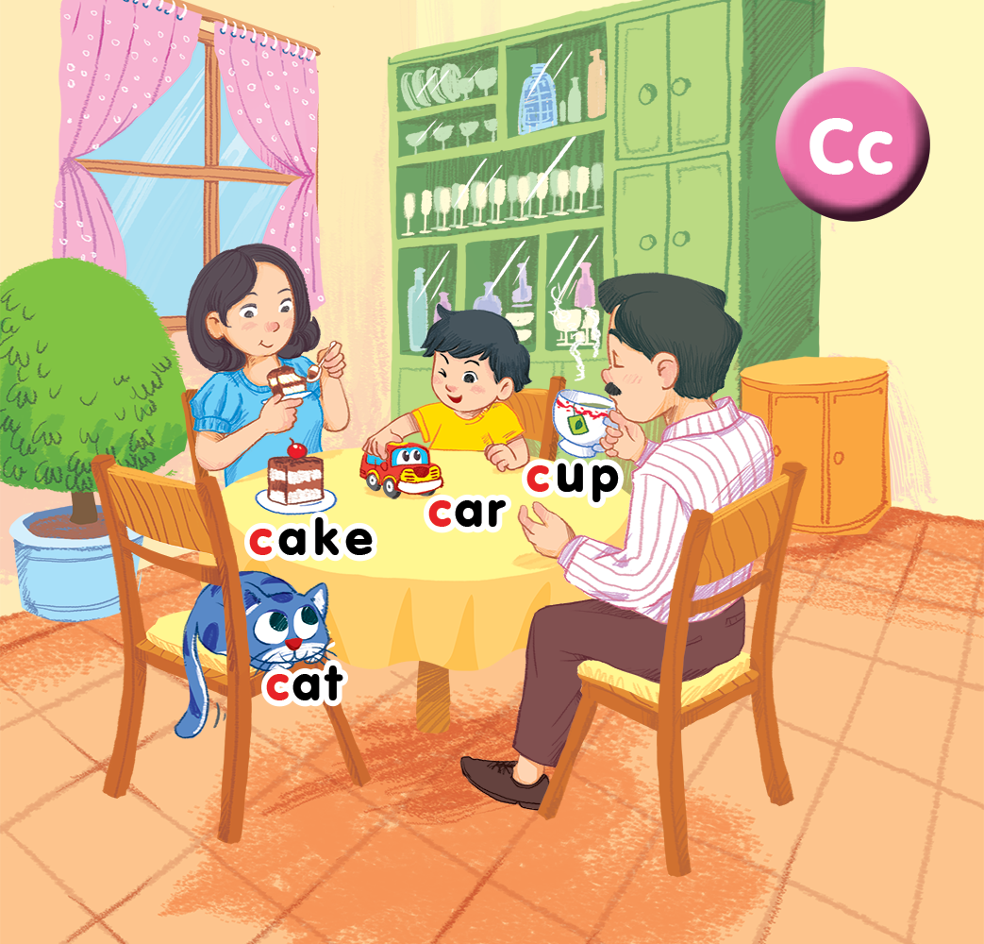
Unit 2
In the dining room lesson 1
Notes:
By the end of the unit, pupils will be able to:
- pronounce the sound of the letter C/c in isolation and in the words cake, car, cat and cup correctly.
- understand the words cake, car, cat and cup.
- say the sound of the letter C/c and the words cake, car, cat, cup in a chant.
- recognize the words in different situations when listening.
- use I have a _____ to talk about possession.
- trace the letter C/c.
- sing a song with the structure I have a _____.
Lesson 1
By the end of the lesson, pupils will be able to:
- pronounce the sound of the letter C/c in isolation and in the words cat, cake, car and cup correctly.
- point to the letter C/c and the things in the picture; say the sound of the letter C/c; understand and say the sound of the words cat, cake, car and cup.

Slide 3
OBJECTIVES.
By the end of the lesson, pupils will be able to
pronounce the sound of the letter C/c.
say the words cake, car, cat, cup.
say the letter C/c and the words cup, cake, cat, car and the phrases a cup and a cake, a cat and a car in a chant.
Language.
- Sound /c/
- Vocabulary: cake, car, cat, cup
Notes:
Point and say is divided into 3 main steps.
Step 1
Goal: Pupils will be able to listen and repeat the words.
Time: 3 minutes
Choose a picture on the digital book, click on the picture and have pupils listen and repeat.
Have pupils repeat the word softly, loudly in groups to motivate them.
Step 2.
Goal: Pupils will be able to point and say the pictures.
Time: 5 minutes
Hold up your index finger, demonstrate the action for Point.
Say Point and say with TRP actions.
Point to the car and say car. Have pupil point and say.
Repeat the procedure.
Vary the speed to make the activity fun.
Do the activity in groups.
Ask one or two students to point to the picture and have other pupils say the word.
Step 3
Goal: Pupils will be able to point and say the pictures in pairs.
Time: 5 minutes
Have pupils work in pairs and do the activity.

Slide 4




Class rules
Sit nicely!
Listen!
Be happy!
Notes:
Set up the class rules.
Hold up or point to the picture and say Sit nicely! and do the TPR action. Have pupils do the TPR action.
Do the same with Listen! and Be happy!

Slide 5

Warm-up
Notes:
Goal: Warm up the class and have pupils guess the key words. Create the curiosity in learning.
Time: 5 minutes
Have pupils listen to the sounds, and guess what it is.
Play the sound hidden in each slide, Ask What is it? and turn on the sound. Students can answer in English or in Vietnamese. After guessing, teacher says the word in English. Have pupils repeat the word.
Have pupils look at the picture parts and guess the words.

Slide 6


Notes:
https://freesound.org/people/shakaharu/sounds/88498/
Sound of the ball hitting

Slide 7


Slide 8
Notes:
https://freesound.org/people/mboscolo/sounds/212663/
The sound of bicycle bell

Slide 9


Slide 10
Notes:
https://www.freesoundeffects.com/free-sounds/cars-10069/
The sound of car

Slide 11

Notes:
Stick the flashcard for car on the board

Slide 12

Notes:
https://www.freesoundeffects.com/free-sounds/cars-10069/
The sound of cat

Slide 13

Notes:
Stick the flashcard for cat on the board

Slide 14


Notes:
Cat or car?
Use flashcard or slide to show a part of the picture.
Have pupil guess whether it’s cat or car.

Slide 15



1
Notes:
Listen and Repeat is divided into 3 steps.
Step 1
Goal: Set up the context; Predict what pupils will learn.
Time: 3 minutes
Say Open your book! with a TPR action. Have pupils open the book, Unit 2, In the dinning room. Teacher opens the digital book.
Teacher points to Ba and prompt pupils to answer Ba.
Continue with Mum and Dad and say Ba, Mum and Dad are in the dinning room. Have students describe the picture and name some things in the picture (pupils can use Vietnamese if they are not ready to speak English).
Play the recording and have pupils listen and repeat.

Slide 16

Notes:
Step 2
Goal: Pupils will be able to listen and repeat the unit key words cat and car.
Recognize and say the words with flashcards.
Time: 3-4 minutes
Introduce the unit keywords cat and car with flashcards.
On the board, there are two flashcards for car and cat. The flashcard for car is above the flashcard for cat.
Teacher points to the car, say the word and have pupils repeat the word. Do the TPR action which saying the word.
Do the same with cat.
Have pupils guess the word and repeat by pointing to car or cat. Hold your hand up or down to the position of the flashcard.
Turn over the cards, have pupils guess the card and shout out the word.
Swap the cards and have pupils guess.

Slide 17


Notes:
Step 3
Listen and repeat
Goal:
- Pupils will be able to listen and repeat the unit keywords cake and cup; listen and repeat the sound c.
- Recognize and say the words with flashcards.
Time: 3-4 minutes.
Introduce the unit keywords cake and cup with flashcards.
Hold up the flashcard for cup and have pupils shout out the word. Stick the flashcard on the board.
Continue with the flashcard for cake.
On the board, there are two flashcards for cup and cake. The flashcard for cup is above the flashcard for cake.
Teacher points to the cup, say the word and have pupils repeat the word. Do the TPR action which saying the word.
Do the same with cake.
Have pupils guess the word and repeat by pointing to cup or cake. Hold your hand up or down to the position of the flashcard.
Turn over the cards, have pupils guess the card and shout out the word.
Swap the cards and have pupils guess.
Play the game with all four 4 flashcards for car, cat, cup, cake.
Ask pupils what is similar at the beginning of each word.
Introduce the sound c, point to the first letter of each word and say. Have pupils listen and repeat.

Slide 18



2
Notes:
Point and say is divided into 3 main steps.
Step 1
Goal: Pupils will be able to listen and repeat the words.
Time: 3 minutes
Choose a picture on the digital book, click on the picture and have pupils listen and repeat.
Have pupils repeat the word softly, loudly in groups to motivate them.
Step 2.
Goal: Pupils will be able to point and say the pictures.
Time: 5 minutes
Hold up your index finger, demonstrate the action for Point.
Say Point and say with TRP actions.
Point to the car and say car. Have pupil point and say.
Repeat the procedure.
Vary the speed to make the activity fun.
Do the activity in groups.
Ask one or two students to point to the picture and have other pupils say the word.
Step 3
Goal: Pupils will be able to point and say the pictures in pairs.
Time: 5 minutes
Have pupils work in pairs and do the activity.

Slide 19
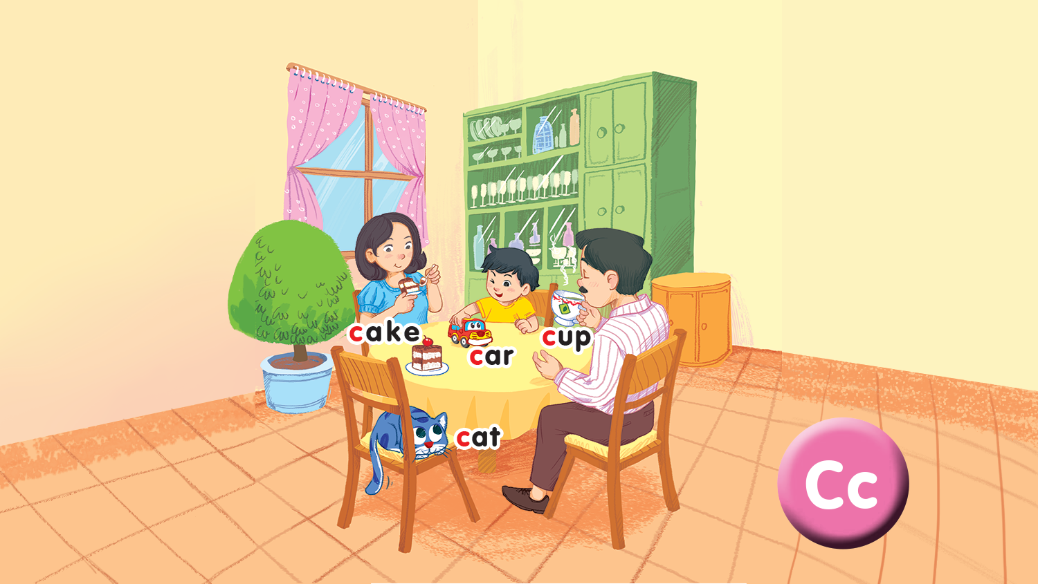

Slide 20

3
Listen and chant
Notes:
Point and say is divided into 3 main steps.
Step 1
Goal: Pupils will be able to listen and repeat the words.
Time: 3 minutes
Choose a picture on the digital book, click on the picture and have pupils listen and repeat.
Have pupils repeat the word softly, loudly in groups to motivate them.
Step 2.
Goal: Pupils will be able to point and say the pictures.
Time: 5 minutes
Hold up your index finger, demonstrate the action for Point.
Say Point and say with TRP actions.
Point to the car and say car. Have pupil point and say.
Repeat the procedure.
Vary the speed to make the activity fun.
Do the activity in groups.
Ask one or two students to point to the picture and have other pupils say the word.
Step 3
Goal: Pupils will be able to point and say the pictures in pairs.
Time: 5 minutes
Have pupils work in pairs and do the activity.

Slide 21



Slide 22
C, c, a cup.
C, c, a cake.
A cup and a cake.
C, c, a cat.
C, c, a car.
A cat and a car.
Notes:
Step 2
Goal: Pupils will be able to chant and clap along.
Time: 3 minutes
Play the recording, have pupils listen and clap along.
Play the recording, have pupils listen, clap and chant along
+ Round 1. Have pupils listen and clap along.
+ Round 2. Have pupils listen and do the TPR actions with teacher.
+ Round 3. Have pupils listen and do the actions and chant along.
+ Repeat round 3 several times.
+ Revise the letter C/c by writing in the air.
Step 3
Goal: Pupils will be able to chant and clap along in pairs.
Time: 3 minutes
Have pupils chant along in pairs.

Slide 23

4
Listen and tick
Notes:
Point and say is divided into 3 main steps.
Step 1
Goal: Pupils will be able to listen and repeat the words.
Time: 3 minutes
Choose a picture on the digital book, click on the picture and have pupils listen and repeat.
Have pupils repeat the word softly, loudly in groups to motivate them.
Step 2.
Goal: Pupils will be able to point and say the pictures.
Time: 5 minutes
Hold up your index finger, demonstrate the action for Point.
Say Point and say with TRP actions.
Point to the car and say car. Have pupil point and say.
Repeat the procedure.
Vary the speed to make the activity fun.
Do the activity in groups.
Ask one or two students to point to the picture and have other pupils say the word.
Step 3
Goal: Pupils will be able to point and say the pictures in pairs.
Time: 5 minutes
Have pupils work in pairs and do the activity.

Slide 24
Game
Notes:
Miming
Goal: Pupils will be able to recognize the unit keywords through pictures, sounds, and meaning.
Time: 5 minutes
Show the flashcard for car to a pupil.
The pupil does the TPR action for the word. Have other pupils guess the word.
After guessing the word, have the whole class repeat the word in chorus.

Slide 25

Goodbye
Notes:
Goodbye
Time: 2 minutes
Teacher and pupils say goodbye to the words.

Slide 26

Goodbye

Slide 27

Goodbye

Slide 28

Goodbye
cup

