Slide 2
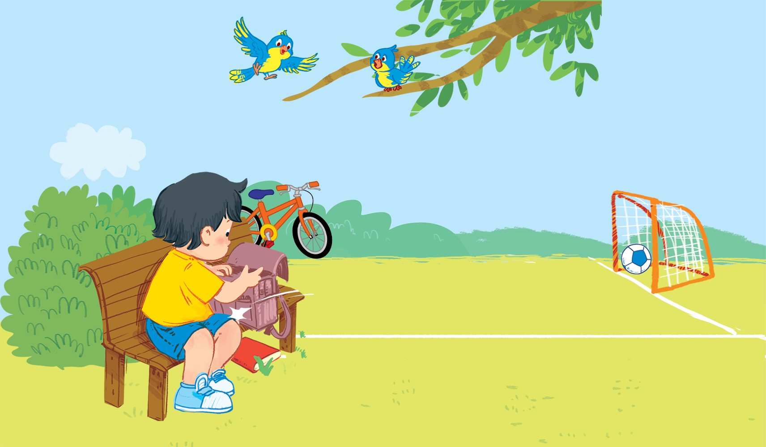
Unit 1
In the school playground
Lesson 3
Notes:
Goals:
By the end of the lesson, pupils will be able to:
- introduce themselves with the structure Hi, I’m ____ and say goodbye to each other, using Bye, ____.
- sing along the unit song.

Slide 3
By the end of the unit, pupils will be able to:
- recognize the words in different situations when listening.
- use “Hi, I’m _____.” to greet and introduce someone’s name and “Bye, _____.” to say goodbye to someone.
- trace the letter B/b.
- sing a song with the structures “Hi, I’m _____.” and “Hi, _____. I’m _____.”

Slide 4

Warm-up
Notes:
Goal: Warm up and revise the unit keywords.
Time: 3 minutes
Have the class sing the chant or play the game Slap the board with the unit keywords.

Slide 5


Listen and repeat
Notes:
Listen and repeat is divided in to 2 steps.
Step 1
Goal: Pupils will be able to listen to the structure Hi, I’m … and understand the meaning.
Time: 7 minutes.
Introduce the structure and have pupils listen and repeat.
Hold up the book and introduce the picture. Have pupils point to Bill and Ba.
Hold up the flashcard for Bill, say I’m Bill.
Do the same with Ba.
Play the recording, and have pupils listen and repeat.

Slide 6

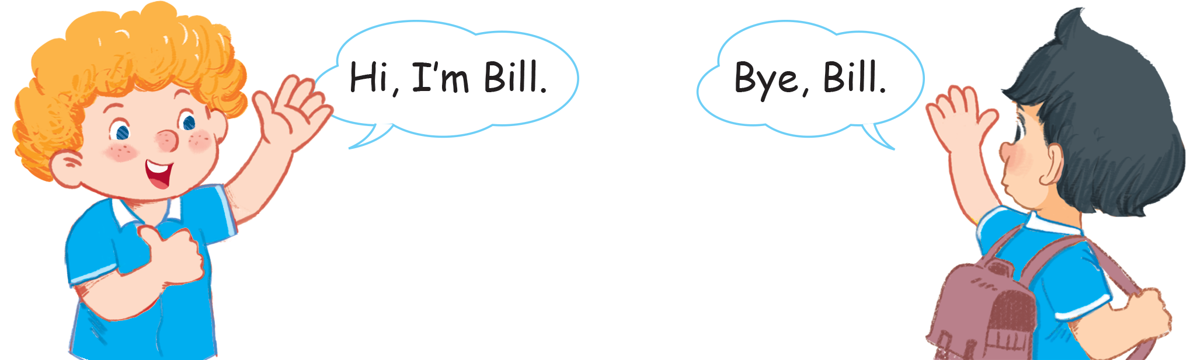
Listen and repeat
Notes:
Step 2
Goal: Pupils will be able to recognize and repeat the structures Hi, I’m Bill; Bye, Bill.
Time: 3 minutes.
Have pupils open the book, listen and repeat.

Slide 7


Let’s talk
Notes:
Let’s talk is divided into 2 steps.
Step 1
Goal: Pupils will be able to say the sentences with Hi, I’m Bill; Bye, Bill.
Time: 3 minutes
Have pupils say the sentences in chorus.
Half of the class is Bill, the other is Ba. For example, groups 1 and 2 pretend to be Bill, and groups 3 and 4 pretend to be Ba. Practice the sentences.
Step 2
Goal: Pupils use the structures to greet and say goodbye to each other
Have two pupils practice in front of the class.
P1: Hi, I’m (name that he likes)
P2: Hi, I’m (name that he likes)
P1: Bye, (his friend’s name)
P2: Bye, (his friend’s name).
Then they do high five or fist bump.
Have pupils practice in pairs.

Slide 8
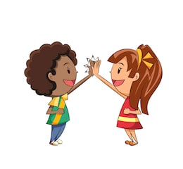
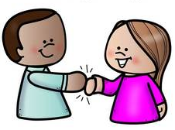
High five
Fist bump

Slide 9

Hi, I’m __________.
Hi, ________.
I’m _________.

Slide 10
Hi, I’m __________.
Hi, ________.
I’m _________.

Slide 11
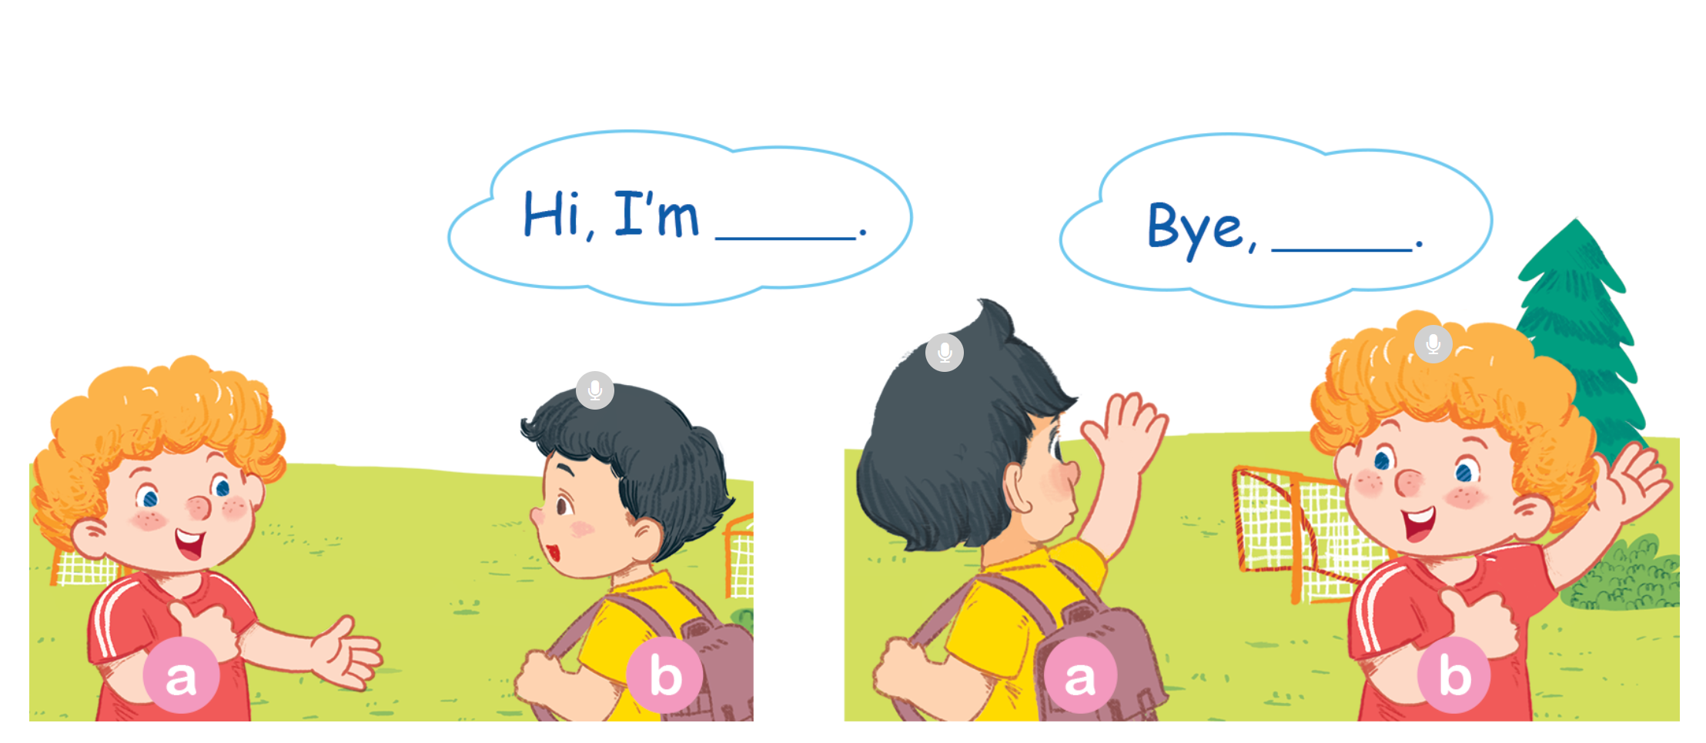
Let’s talk

Slide 12
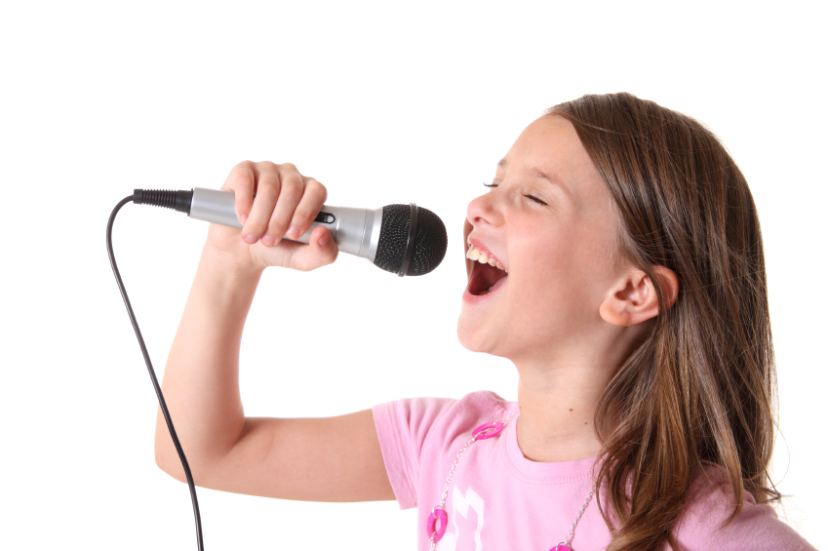

Let’s sing
Notes:
Let’s sing is divided into 2 steps.
Step 1
Goal: Pupils will be able to read the lyrics of the song.
Time: 3 minutes
Have pupils read the lyric of the song, sentence by sentence.
Then say with TPR actions.
Suggested TPR actions.
Hi (wave hand), I’m Ba. (point to yourself)
Hi (wave hand), I’m Bill. (point to yourself)
Finish the song with the TRP for High five and fist bump.
Step 2
Goal: Pupils will be able to listen and sing the song.
Time: 5 minutes
Have pupils listen to the song and sing with TPR in chorus then groups.

Slide 13

Let’s sing!
Hi, I’m Ba.
Hi, I’m Bill.
Hi, Bill. I’m Ba.
Hi, Ba. I’m Bill.

Slide 14
Game
Notes:
Goal: Review the unit keywords, the song and the chant.
Time: 5 minutes
Memory
Stick flashcards for Bill, ball, bike, book on the board.
Turn over the flashcards, change their places.
Point to a flashcard and have pupils guess.
If a pupil give correct answer, the class will sing or chant the paragraph that has this word.
Example:
If flashcard is book, the whole class will chant b, b, book.
If flashcard is Bill, the whole class will sing Hi, I’m Ba. Hi, I’m Bill

Slide 15



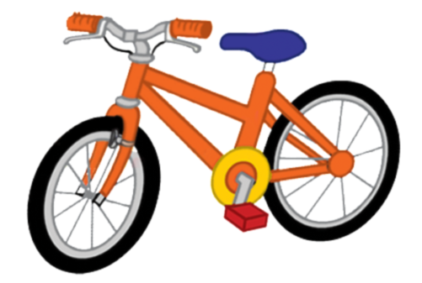
bike

Slide 16
Goodbye
bike
Notes:
Goodbye
Time: 2 minutes
Say goodbye to the words.

Slide 17
Goodbye

Slide 18

Goodbye

Slide 19
Goodbye

