Slide 2
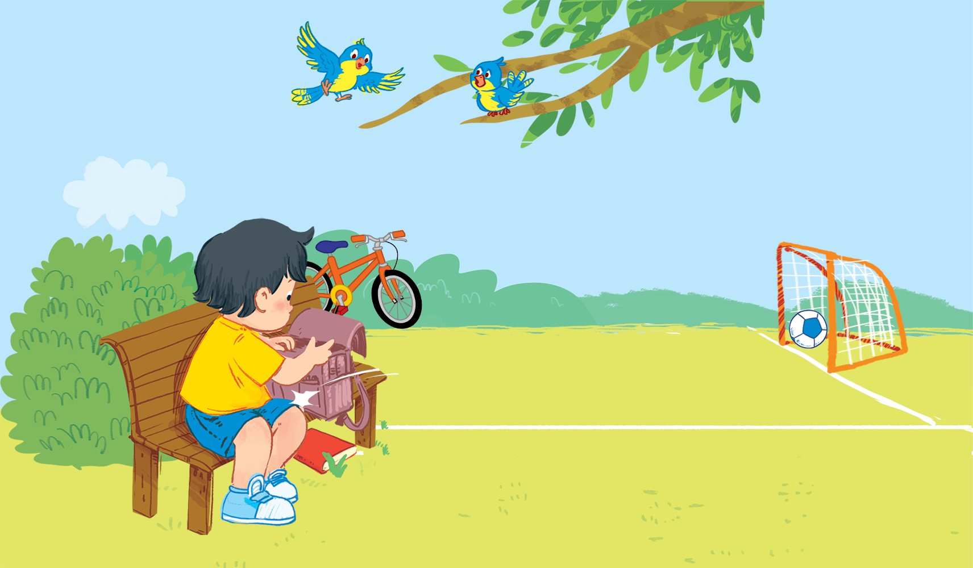
Unit 1 – Lesson 2
In the school playground
Notes:
Goals:
By the end of the lesson, pupils will be able to:
say the sound of the letter B/b and the words ball, book and bike in a chant.
listen, recognize the words and tick the correct boxes.
trace the letter B/b (upper case and lower case).

Slide 3

Warm-up
Notes:
Goal: Warm up and revise the Unit keywords.
Time: 3 minutes
Write the keywords ball, bike, book, and Bill on the board.
Hold up one flashcard and do not show it to pupils.
Do the TPR action for the flashcard and have pupils guess.

Slide 4





Slide 5


Listen and chant
Notes:
Listen and chant is divided into 3 steps.
Step 1
Goal: Pupils will be able to say the sound of the letter B/b and the words in the chant
Time: 5 minutes.
Have pupils listen and repeat the sound and the words of the chant, sentence by sentence.

Slide 6


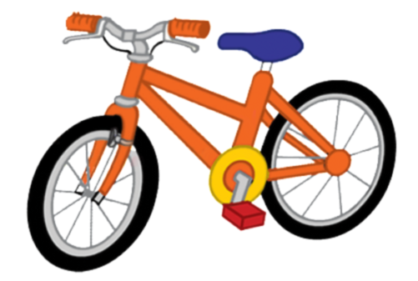





Slide 7
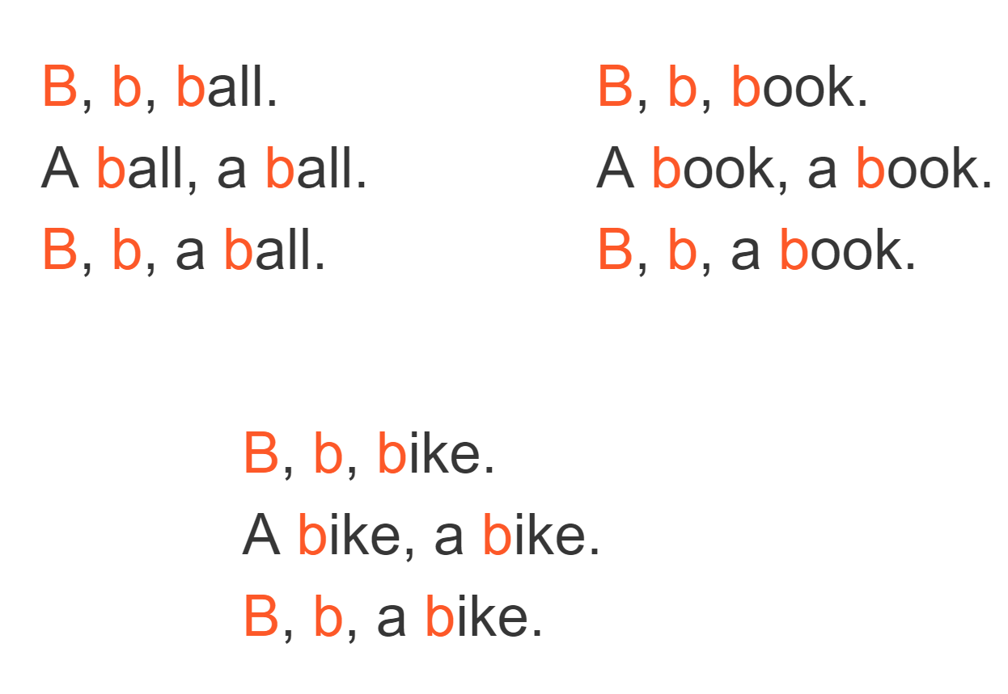
Listen and chant
Notes:
Step 2
Goal: Pupils will be able to chant and clap along.
Time: 3 minutes
Play the recording, have pupils listen and clap along.
Play the recording, have pupils listen, clap and chant along.
+ Round 1. Have pupils listen and clap along.
+ Round 2. Have pupils listen and do the TPR actions with teacher.
+ Suggested TPR actions
B (clap) b (clap) ball (roll hands to make a ball)
B (clap) b (clap) book (open hands to make a book)
B (clap) b (clap) bike (spin hands to make cycling activity)
+ Round 3. Have pupils listen and do the actions and chant along.
+ Repeat round 3 several times.
Step 3
Goal: Pupils will be able to chant and clap along in pairs.
Time: 3 minutes
Have pupils chant along in pairs.

Slide 8

Listen and tick
Notes:
Listen and tick is divided into 2 steps.
Step 1
Goal: Pupils will be able to listen and choose the correct pictures.
Time: 5 minutes
Do the TPR actions to help pupils understand the meaning of Listen and tick activity.
Play the recording and have pupils listen and choose the correct picture. Demonstrate an example.
Play the recording and have pupils listen and repeat.
Play the recording and have pupils do the task.

Slide 9
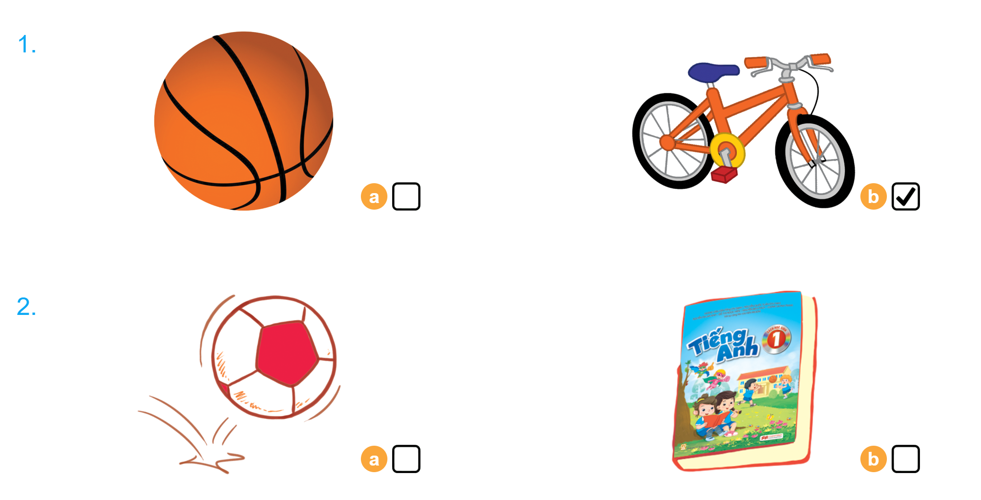

Listen and tick
Notes:
Step 2
Goal: Quick check
Time: 4 minutes
Stick the flashcards on the board.
Have pupils listen again and check the answer.
Ask pupils to repeat the answer.

Slide 10


Look and trace
Notes:
Listen and tick is divided into 2 steps.
Step 1
Goal: Pupils will be able to listen and choose the correct pictures.
Time: 5 minutes
Do the TPR actions to help pupils understand the meaning of Listen and tick activity.
Play the recording and have pupils listen and choose the correct picture. Demonstrate an example.
Play the recording and have pupils listen and repeat.
Play the recording and have pupils do the task.

Slide 11

Game
Notes:
Goal: Revise the words and chant.
Time: 5 minutes
What’s in the picture?
Play the game in groups.
Say the name of the box to open the box.
Answer the questions or do the action or say the words in the box.

Slide 12
Goodbye
bike
Notes:
Goodbye
Time: 2 minutes
Repeat the words with TPR actions. Goodbye to the words.

Slide 13

Goodbye

Slide 14

Goodbye

Slide 15

Goodbye

Slide 16
Website: hoclieu.vn
Fanpage: facebook.com/www.tienganhglobalsuccess.vn

