Slide 2
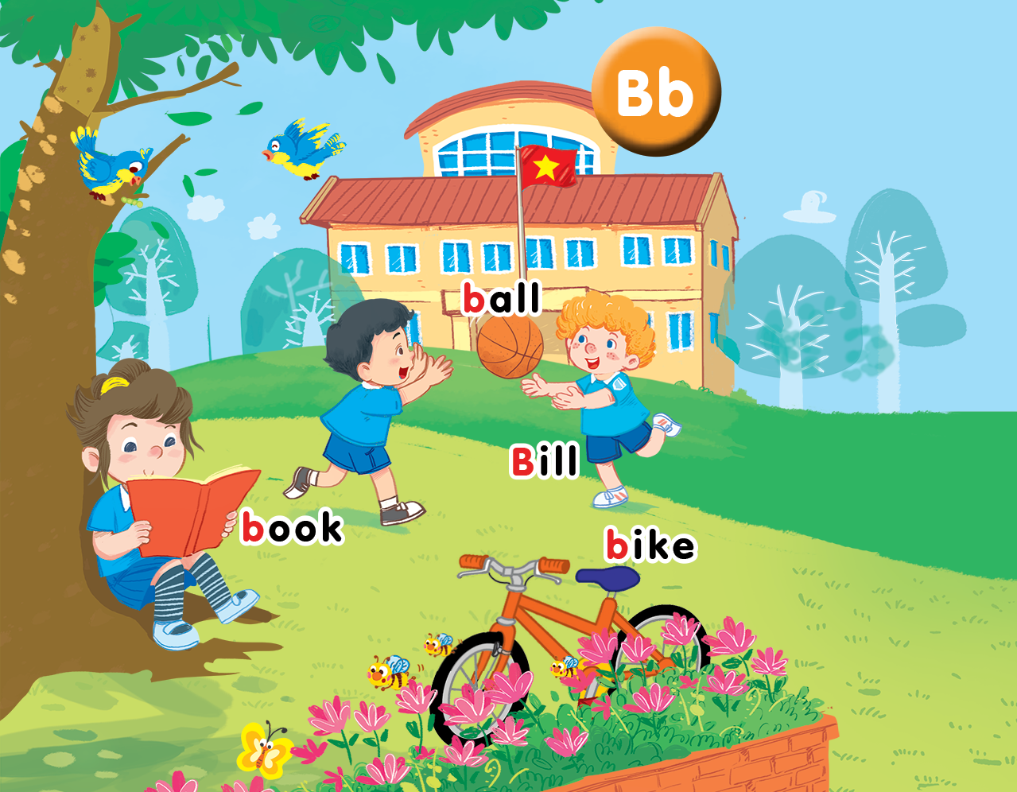
Unit 1
Lesson 1
In the playground
Notes:
By the end of the unit, pupils will be able to:
- pronounce the sound of the letter B/b in isolation and in the words Bill, ball, bike and book correctly.
- understand the words Bill, ball, bike and book.
- say the sound of the letter B/b and the words Bill, bike, ball, book in a chant.
- recognize the words in different situations when listening.
- use “Hi, I’m _____.” to greet and introduce someone’s name and “Bye, _____.” to say goodbye to someone.
- trace the letter B/b.
- sing a song with the structures “Hi, I’m _____.” and “Hi, _____. I’m _____.”
Lesson 1
By the end of the lesson, pupils will be able to:
- pronounce the sound of the letter B/b in isolation and in the words Bill, book, ball and bike correctly.
- point to the letter B/b and the things in the picture; say the sound of the letter B/b; understand and say the sound of the words Bill, book, ball and bike.

Slide 3
Sit in groups and try to get as many stars as possible!
Group 1 | Group 2 | Group 3 | Group 4
O | O | O | O
O | O | O | O
O | O | O | O
O | O | O | O
O | O | O | O
O | O | O | O
O | O | O | O
O | O | O | O
Notes:
Classroom management
Pupils sit in groups.
Each group will have a star if they do the task well.
At the end of the lesson, the group with the most stars will be the winners.

Slide 4




Class rules
Sit nicely!
Listen!
Be happy!
Notes:
Set up the class rules.
Hold up or point to the picture and say Sit nicely! and do the TPR action. Have pupils do the TPR action.
Do the same with Listen! and Be happy!

Slide 5

Warm-up
Notes:
Goal: Warm up and have pupils get to know the characters.
Time: 5 minutes
Write Ba and Bill on the board or use the slide.
Introduce the first flashcard for Ba and say, “This is Ba.”. Wave your hand and say Hi, Ba. Have the pupils repeat “Hi, Ba.”.
Stick the flashcard under the word “Ba” on the board.
To make it fun, ask the pupils where to stick the flashcard with the TPR actions for “Yes” or “No”.
Continue with Bill.
Point to Ba and wave your hand, say Ba.
Continue with Bill.
Have the pupils repeat the words.
Continue with the TPR actions for Left, Right, to prompt the pupils to say Ba or Bill.
Hold up the flashcard for Bill and say Bill, the pupils nod and say Yes or shake their heads and say No.
Do the same with Ba.

Slide 6



Slide 7
Notes:
Bill or Ba?
Show parts of a flashcard and have pupils guess if it is Bill or Ba.

Slide 8



Notes:
Listen and Repeat is divided into 3 steps.
Step 1
Goal: Set up the context; Predict what pupils have known.
Time: 3 minutes
Say Open your book! with a TPR action. Have pupils open the book. Teacher opens the digital book.
Teacher points to Ba and prompts pupils to answer Ba.
Continue with Bill.
Introduce the context (can speak Vietnamese).
Step 2
Goal:
- Pupils will be able to listen and repeat the unit keywords.
- Recognize and say the words with flashcards.
Time: 3 minutes
Hold up a book and say book. Do a TRP action to ask the pupil repeat book.
Open the book and say: Open your book (with a TPR action). Hold up high so pupils can choose the right page to open.
Repeat the action and words until everyone can open the book.
Stick the flashcard for book on the board. Have pupils repeat the word (with the TPR action).
Have pupils repeat the words with rhythm: Bill, book.
Turn over the flashcards and have pupils guess what the flashcard is.

Slide 9



Slide 10




Notes:
Step 3
Listen and repeat
Goal:
- Pupils will be able to listen and repeat the unit keywords ball and bike; listen and repeat the sound b.
- Recognize and say the words with flashcards.
Time: 3-4 minutes.
Introduce the unit keywords ball and bike with flashcards.
Hold up the flashcard for ball and have pupils say the word. Stick the flashcard on the board.
Continue with the flashcard for bike.
On the board, there are two flashcards for ball and bike. The flashcard for ball is above the flashcard for bike.
Point to the ball, say the word and have pupils repeat the word. Do the TPR action which saying the word.
Do the same with bike.
Have pupils guess the word and repeat by pointing to bike or ball. Hold your hand up or down to the position of the flashcard.
Turn over the cards, have pupils guess the card and say the word.
Swap the cards and have pupils guess.
Play the game with all four 4 flashcards for Bill, ball, bike, book.
Ask pupils what is similar at the beginning of each word.
Point to the sound B/b, point to the first letter of each word and say. Have pupils listen and repeat.

Slide 11



Notes:
Point and say is divided into 3 main steps.
Step 1
Goal: Pupils will be able to listen and repeat the words.
Time: 3 minutes
Choose a picture on the digital book, click on the picture and have pupils listen and repeat.
Have pupils repeat the word softly, loudly in groups to motivate them.
Step 2
Goal: Pupils will be able to point and say the pictures.
Time: 5 minutes
Hold up your index finger, demonstrate the action for Point.
Say Point and say with TRP actions.
Point to the book and say book. Have pupils point and say.
Repeat the procedure.
Vary the speed to make the activity fun.
Do the activity in groups.
Ask one or two students to point to the picture and have other pupils say the word.
Step 3
Goal: Pupils will be able to point and say the pictures in pairs.
Time: 5 minutes
Have pupils work in pairs and do the activity.

Slide 13
Game
Notes:
What’s missing?
Goal: Pupils will be able to recognize the unit words’ pictures, sounds and their meaning.
Time: 5 minutes
Show the flashcards for Bill, ball, book and bike.
Hide one flashcard and have the pupils guess what is missing.
Play with the whole class first then teams to get stars.

Slide 14








Notes:
What is missing?

Slide 15
Notes:
What is missing?

Slide 16
Notes:
What is missing?

Slide 17
Notes:
What is missing?

Slide 18
Notes:
What is missing?

Slide 19

It’s time to say goodbye
Notes:
Goodbye
Time: 2 minutes
Teacher and pupils say goodbye to the words.

Slide 20
Goodbye
bike
Notes:
Goodbye
Time: 2 minutes
Repeat the words and say goodbye to the words.

Slide 21

Goodbye

Slide 22

Goodbye

Slide 23
Goodbye

Slide 24
Website: hoclieu.vn
Fanpage: facebook.com/www.tienganhglobalsuccess.vn

